Slide 1
Natural Language Processing for Biobehavioral and Neuroscience Applications
Jamie Reilly, PhD^{1,2}
¹Eleanor M. Saffran Center for Cognitive Neuroscience
²Department of Communication Sciences & Disorders
Temple University, Philadelphia Pennsylvania

Slide 2
How to learn R coding and getting help
Many free resources
CodeAcademy, DataCamp, YouTube
Cannibalize code
Annotate code
Create and share tutorials
Ask on BlueSky or on StackOverflow
Judicious use of LLMs

Slide 3
Using LLMs for Coding
Claude, DeepSeek, ChatGPT
Ok to augment your R code but consider…..
Tiny errors have vast effects at scale
Errors often difficult to detect
Environmental, human costs
If using an LLM for this class, you must:
Annotate code yourself
Understand your code (be able to explain)
Acknowledge that you have used an LLM

Slide 4
Setting Up for NLP
NLP analyses often involve vast amounts of data
Processing pipelines and data proliferation
Sensible filenaming and file management conventions are essential

Slide 5
File naming best practices
Best practice overview <link Harvard biostats>
Include ‘readme’ when collaborating
Short, descriptive filenames
No spaces
Separate words with ‘_’, no other special characters
Camel case (each new word caps)
Use versioning

Slide 6
Paths and directories
Store files on a cloud drive (onedrive, google)
Organize folders hierarchically
Set this up now….
Reilly_RData
My_NewTextMiningProject
Data
Plots
Archive

Slide 7
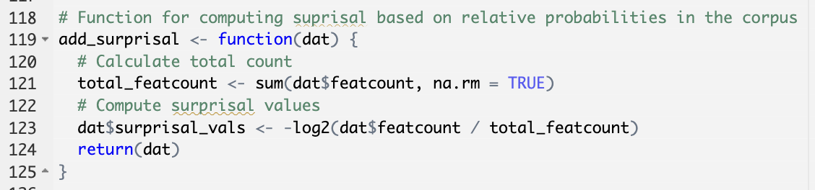
Annotation
In an Rmarkdown code block, anything following # is not executed and represents annotation
Explains what the code does
You cannot err on the side of annotating too much
I want you to annotate almost everything

Slide 8
RMarkdown
We will be using Rmarkdown
< link to Markdown cheatsheet >
< link to Markdown tutorial >

Slide 9
What is text mining?
Text mining: takes large amount of unstructured language, extracts novel insights
No requirement to read and/or manually tag the text you are analyzing
Typical steps in machine learning (text)
Gather historical data (corpus, pl. corpora)
Develop a predictive model (prediction)
Test the model on new data

Slide 10
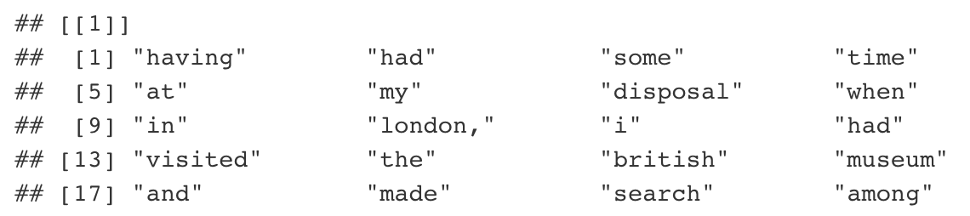
Types of Text Mining: Bag of Words
Having had some time at my disposal when in London, I had visited the British Museum and made search among the books and maps in the library regarding Transylvania. It had struck me that some foreknowledge of the country could hardly fail to have some importance in dealing with a nobleman of that country
Each word treated as an n-gram
Agnostic to word order or syntactic complexity

Slide 11
Bag of Words: Document Term Matrix
Not super complex or computationally intensiv
Document Term Matrix (DTM)
In DTM, rows are corpora and columns are words
Term Document Matrix (TDM)
 | Having | had | some | time
Dracula | 37 | 280 | 17 | 6
Pride & Prejudice | 6 | 521 | 230 | 23
 | Dracula | Pride & Prejudice
Having
had
some
time

Slide 12
Types of Text Mining: Syntactic Parsing
Cares about word order
Uses POS tagging
Hiearchical blocking and linking elements
Noun phrases linked to verbs
Much more sophisticated and resource intensive relative to bag of words

Slide 13
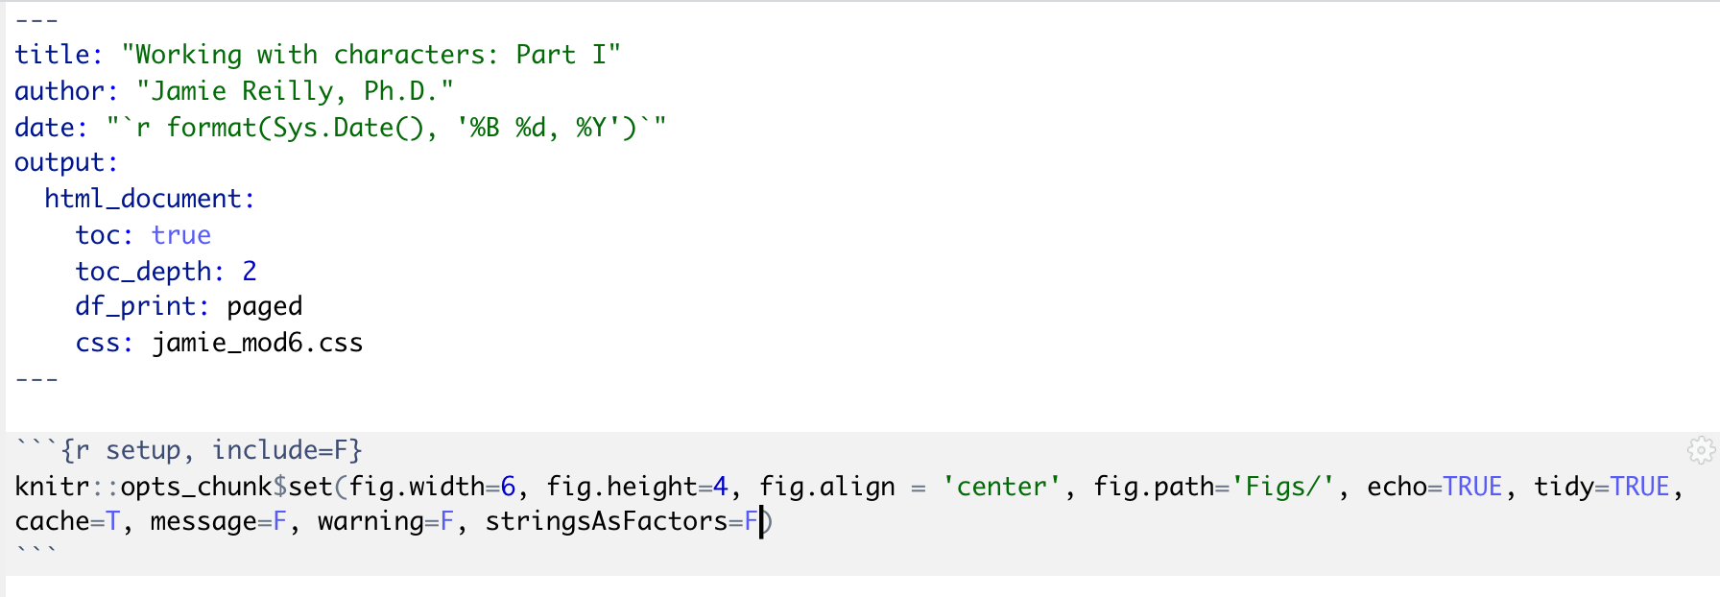
Prepping for text mining in Markdown
Make sure your header is descriptive
Turn off strings as factors!

