Slide 1





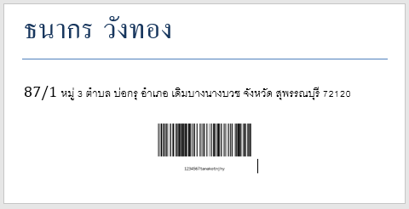
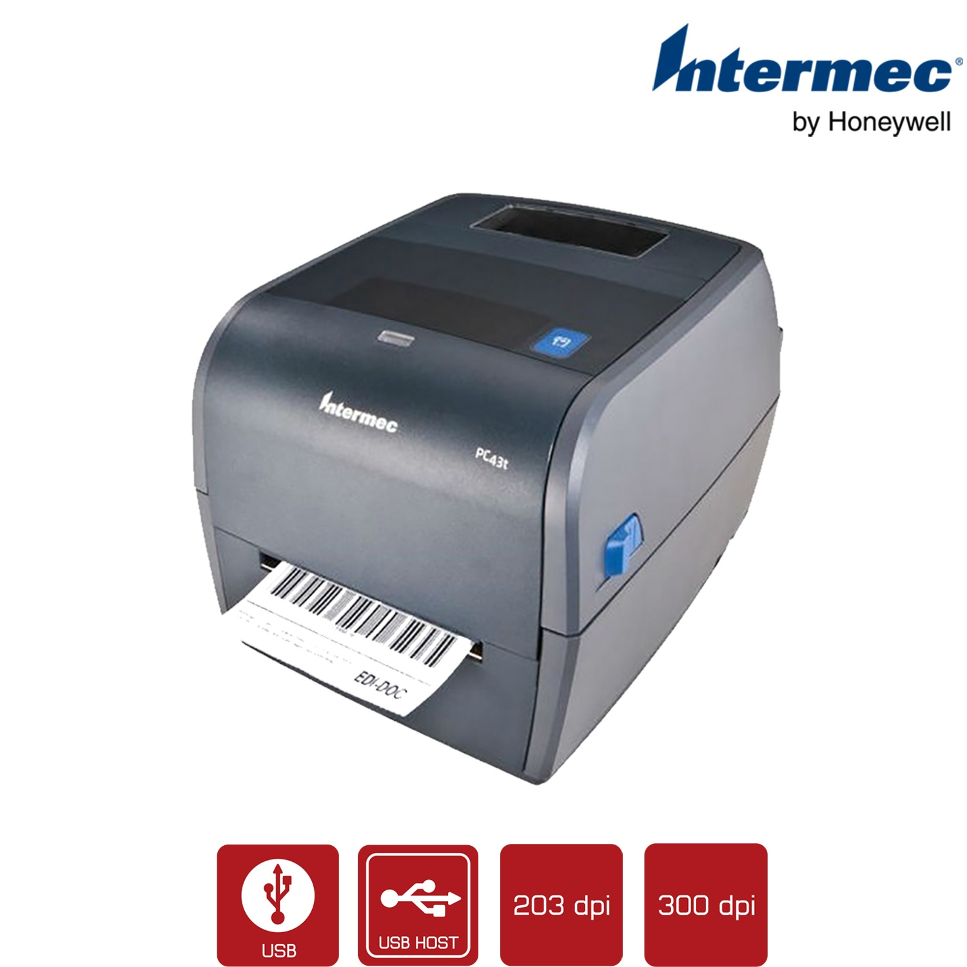

API
publisher
subscriber
.png
.docx

Slide 2


Packer A
UI
Channel 1
Select
Channel
With
User
Packer B
Channel 2
Packer C
Channel 3

