Slide 1

Understanding Employee Attrition
Tan Anni

Slide 2

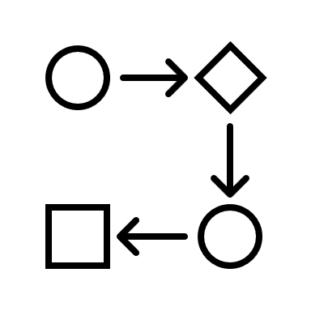

Content
Background
Problem Statement
Process
Data Preparation
Data Manipulation
Modelling
Insights

Slide 3

Background Topic
Workforce/People:
the most important (and expensive) asset of any organization

Slide 4
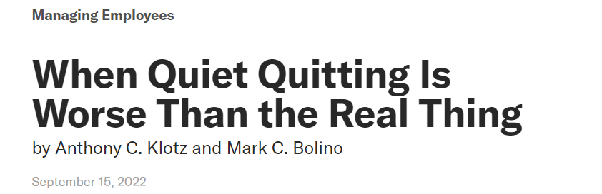
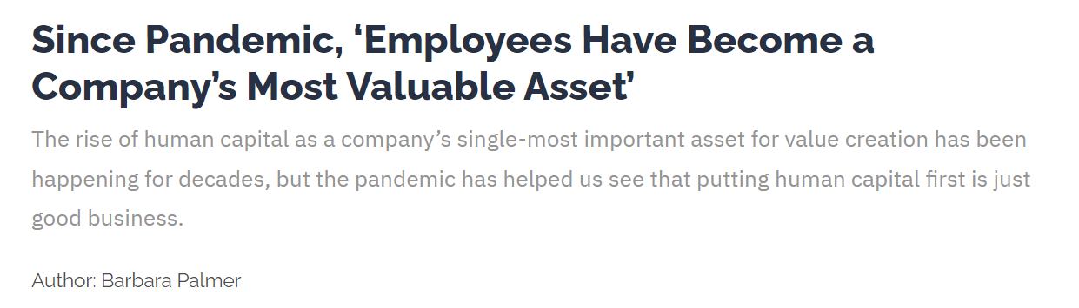
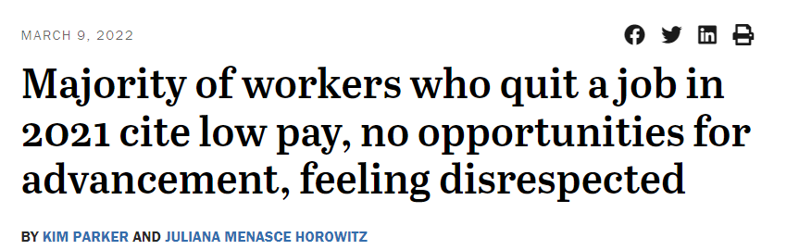
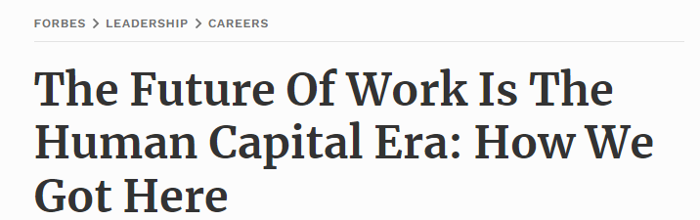
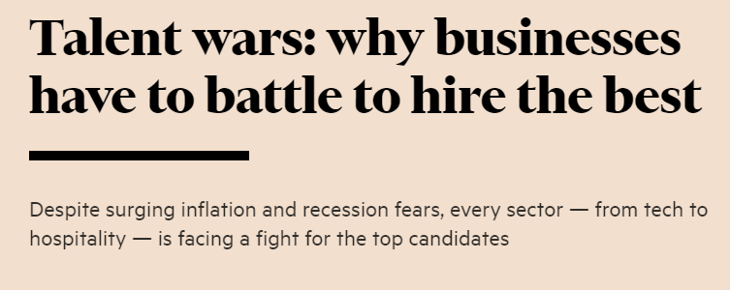
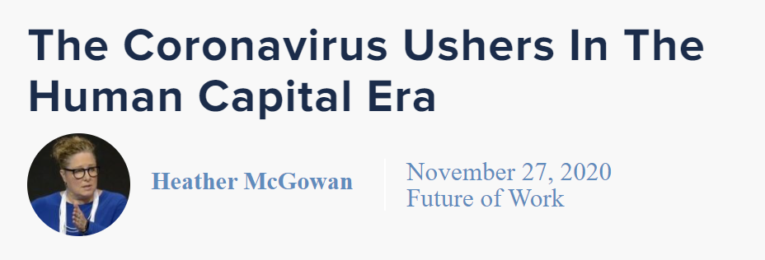
Background Concerns

Slide 5
Background Issues with Attrition
Increased Cost
Reduced Productivity
Loss of Knowledge
Reduced Engagement
Recruitment
Replacement
Training
Time needed to learn:
Jargons
Systems
Nuances
Reduced quality in work
More time needed to complete same set of work
Institutional Knowledge
Connections/ Network
Best Practices
Culture & Morale of employees
Reputation of organization

Slide 6
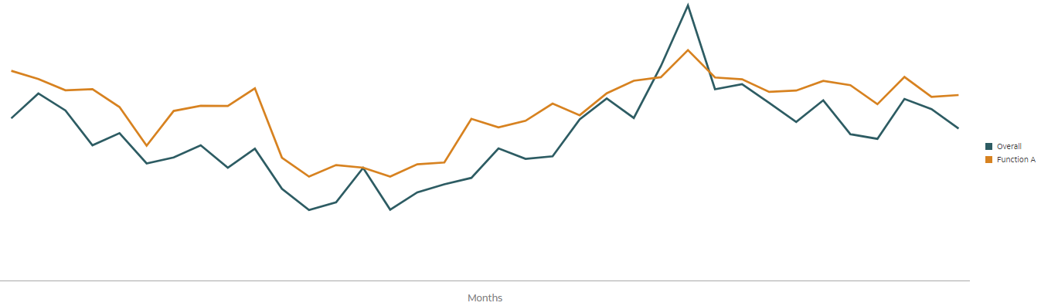
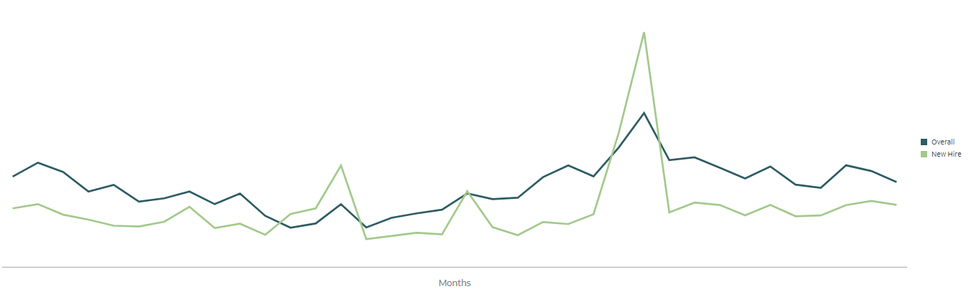
Background Where are we?
Rising Voluntary Attrition %, especially for Function A.
Rising Voluntary Attrition %, especially for New Hires.

Slide 7
Problem Statement
To identify the important features that make employees more likely to leave and use the insights to produce action plans to mitigate attrition.

Slide 8
Process
Data Preparation
Data Manipulation
Modelling
Insights
1. Data Extraction (7 sources, more than 54 CSV files)
2. Data Cleaning
(Remove Null, Impute missing data)
3. Data Merging
66,037 rows, 149 columns
4. Feature Engineering
Calculated Fields: Age Differences between Manager and Employee,
Binning of numerical data: Survey Scores, Tenure Bands, Attainment Values)
5. Data Preprocessing
Numerical: Mix Max Scaler
Categorical: One Hot Encoding
6. Models
Bernoulli
Logistic Regression
Random Forest
Extra Trees
Light GBM
Support Vector Machine
7. Performance of Models
8. Permutation Importance
9. Data Analysis
Important Features
Other Features
Focused Groups
Area of Focus
10. Suggestions

Slide 9
Process Data Preparation
Data Extraction, Data Cleaning, Data Merging
Source 1
Headcount Data
Remove Null Values, Impute missing data
Source 2
Termination Data
24 sets of month end Headcount Report (snapshot data)
Source 3
Indicators
Remove duplicates
(only capture the latest snapshot)
Source 4
Survey 1
Merge with multiple reports to capture all the data columns/features
Source 5
Survey 2
Include a column to identify if terminated or active
Source 6
Sales Attainment
Source 7
Assignment Details
Dataset: 66,037 rows and 149 columns

Slide 10
Process Data Preparation
Data Extraction, Data Cleaning, Data Merging
Types of Data
Dataset
Demographics
Gender, Age Group
Dataset that is used is both real and fictitious data.
2 years of data
Function A
Job Category A
Active Headcount and Voluntary Attrition
Job
Country, Region, Tenure, Line of Business, Cost Centers etc), Manager’s Details
Compensation
Salary Information (Compa-Ratio, Time since last salary increment, Number of Salary Increases)
Performance/
Talent
Talent Ratings, Appraisal Ratings, Sales Attainment
Employees’ Sentiments
Survey 1, Survey 2
Dataset: 2,240 rows and 149 columns
Attrition
Attrition Reasons/Type, Attrition Date

Slide 11
Process Data Manipulation
Feature Engineering,
Data Preprocessing
Numerical
Salary Range Penetration
Number of Organizational Changes*
Number of Career Level Changes*
Number of Supervisor Changes*
Number of Job Changes*
Number of Location Changes *
Number of Salary Changes *
Age Differences between Manager and Employee
Min Max Scaler:
to scale set of features to a specific range, typically between 0 and 1.
Categorical
Demographics
Job
Manager
One Hot Encoding:
Convert categorical data into a numerical representation that can be used as input to machine learning algorithms.
Converts each unique category value into a new categorical feature (also called a dummy feature) and assigning a binary value of 0 or 1 to represent the presence or absence of the category in each observation.
Gender
Age Band
Generations
Sub-Region
Country
Career Level
Tenure Bands - Continuous Service Date, Latest Hire Date, Job, Last Salary Incr Date, Career Level, Job Level, Job Function, Previous Career Level
Job Categories
Pillar
Product Specialty
Product Line
Product Association
Business Hierarchy
Cost Center Hierarchy
Company Code
Manager's Details – Hierarchy, Job Level Category, Country, Age Band, Gender, Generations, Tenure Bands (Continuous Service Date, Latest Hire Date, Job, Career Level, Job Level, Job Function), Location of Manager and Employee, Generations of Manager and Employee
Compa-Ratio Bands
Quartile
Talent Ratings
Survey 1 and Survey 2 Bands*
Attainment*
Dataset: 2,240 rows and 194 columns
*For Current and Previous Year

Slide 12
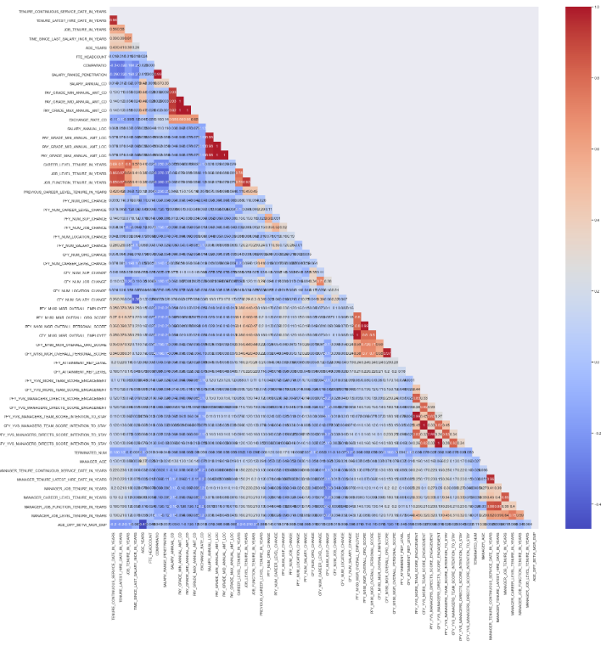
Process Data Manipulation
Feature Engineering,
Data Preprocessing
Correlation:
Columns with high collinearity should be dropped

Slide 13
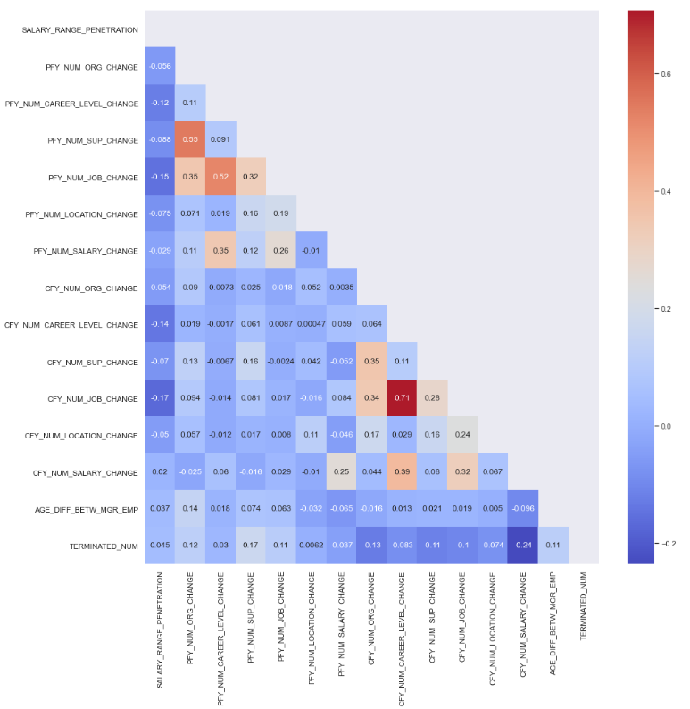
Process Data Manipulation
Feature Engineering,
Data Preprocessing
Dataset: 2,240 rows and 101 columns
Top 3 Positive Correlations
Supervisor and Org Change (PY)
Job Change and Career Level Change (PY and CY)
Top 3 Negative Correlations
Job Change (PY and CY) and Salary Penetration
Terminated Num and Salary Change (CY)
Top 3 Correlations with ‘TERMINATED_NUM’
Org Change (PY)
Supervisor Change (PY)
Age Difference Between Manager and Employee

Slide 14
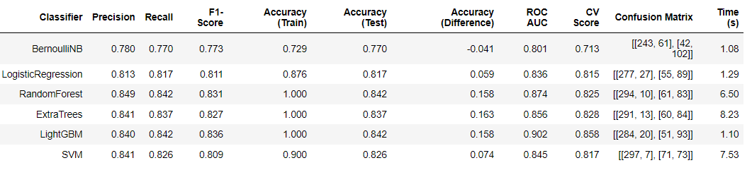
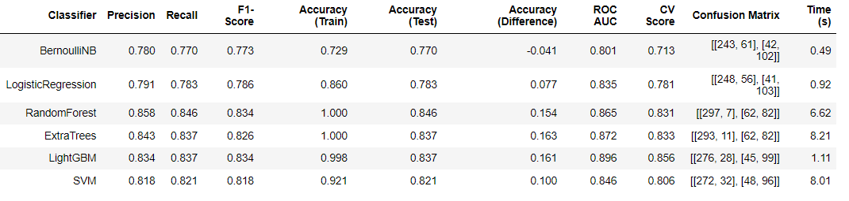
Process Modelling
Models
Original Dataset
(Imbalanced:
67% Active, 33% Terminated)
Problem with imbalanced dataset
Model might be biased towards the majority class
Train Test Split
Train: 80%
Test: 20%
Class Weights
(‘Balanced’)
Results of using class weights are mixed.
Accuracy Scores improved for some models and dropped for some models.
Hence, we will stick to the original dataset
With Class Weights
All models perform better than Bernoulli
Models are working better than chance
Suggests relationships exist between features

Slide 15
Process Modelling
Performance of Models
Selected Models
Light GBM
Support Vector Machine (SVM)
False Positive: predict an employee is likely to turnover when in fact s/he is not looking to leave the company
False Negative: predict an employee will not turnover when he/she is looking to leave (Recall reduces False Negative)
Accuracy: how well the model is able to correctly predict the outcome or class of new, unseen data based on the input features.
Accuracy (Difference): The difference in accuracy score between the train and test set can give you an indication of whether your model is overfitting or underfitting the data.
Uses ensemble method based on decision trees
SVM uses both linear and non-linear algorithm to try to separate the data into different classes
Criteria: High Recall & Low Accuracy (Difference)

Slide 16
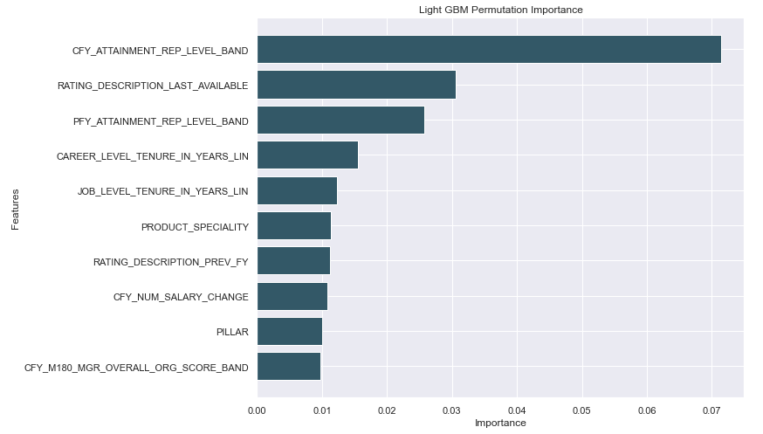
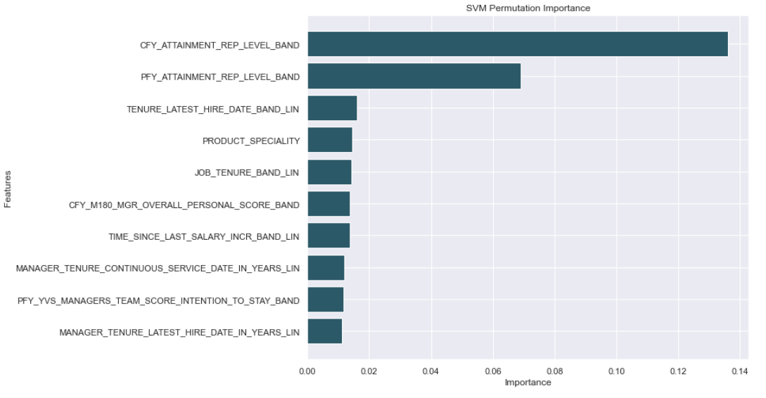
Process Modelling
Permutation Importance
Permutation Importance
Used to identify features in the that contributed most to the performance of the model
Values are shuffled, removed and added back into model to assess difference in model accuracy.
Features to Focus
Attainment (Current Year)
Attainment (Previous Year)
Tenure Bands
Ratings (Last Available)

Slide 17
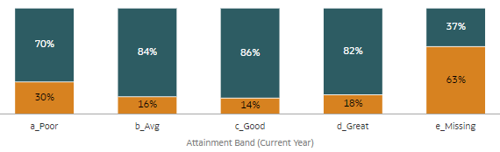
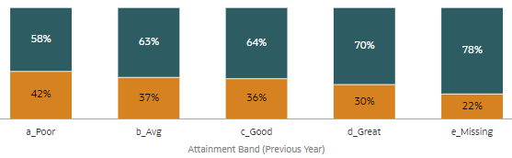
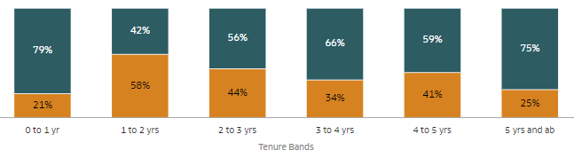
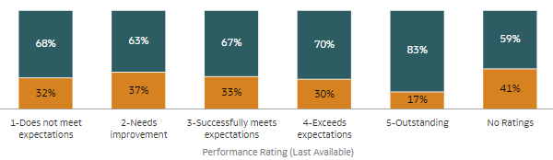

Insights Data Analysis – Important Features
Important Features
Attainment Band – Current Year
Attainment Band – Previous Year
Tenure Bands
Performance Ratings (Last Available)

Slide 18
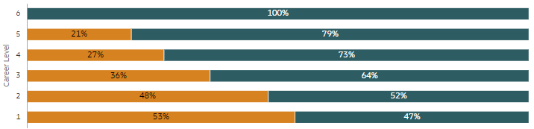
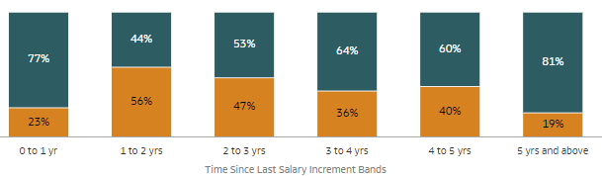
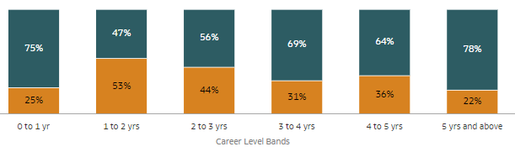
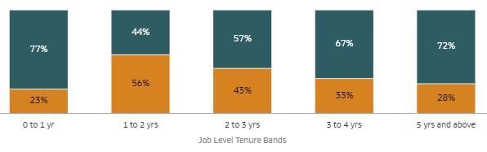
Insights Data Analysis – Other Features
Other Features
Career Level
Time Since Salary Increment Tenure Bands
Career Level Tenure Bands
Job Level Tenure Bands

Slide 19
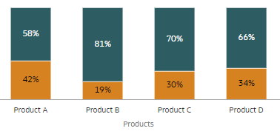
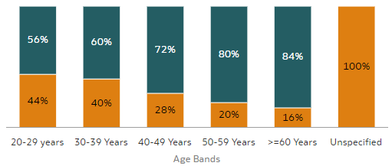
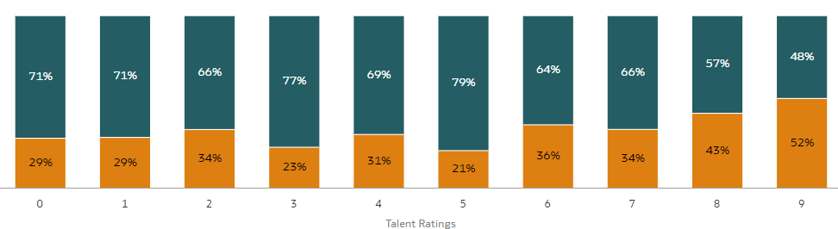
Insights Data Analysis – Other Features
Other Features
Age Bands
Products
Talent Ratings

Slide 20
Insights Data Analysis – Focused Groups
Focused Groups
New Hire vs Other Tenure Bands
Sustained Top, Sustained Poor, Others
(Excludes Tenure < 2 years)
New Hire: Tenure < 1 Yr
Others: Tenure >= 1 Yr
Sustained Top: Attainment = Great (Current and Previous Year)
Sustained Poor: Attainment = Poor (Current and Previous Year)
Others: All other bands

Slide 21
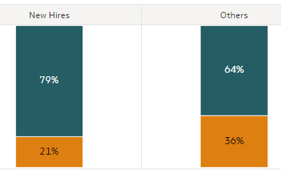
New Hire vs Other Tenure Bands
Focused Groups
Insights Data Analysis – Focused Groups (New Hires)
New Hires are less likely to leave.
This suggest that New Hires do stay around to try to succeed in the organization.
What can we do to retain them after 1 year?

Slide 22
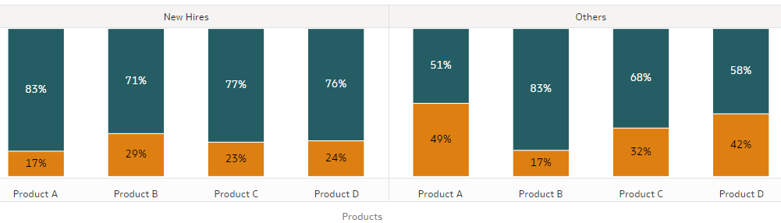
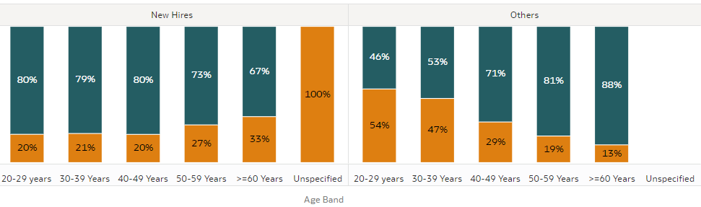
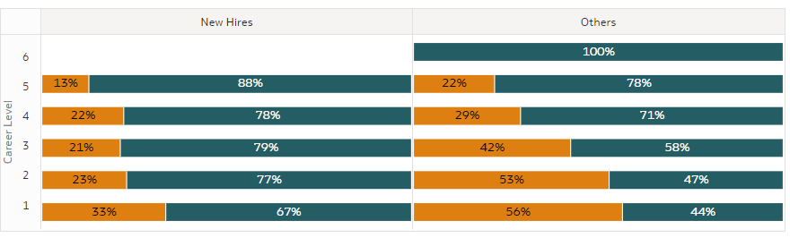
New Hire vs Other Tenure Bands
Focused Groups
Insights Data Analysis – Focused Groups (New Hires)
There is a huge gap in Attrition for Product A.
What are the struggles of employees after their first year? How can we support them better?
Younger employees are more willing to stick around, but also more mobile in leaving the organization after 1 year.
Older employees are more likely to leave in their 1st year. However, they stick around after that.
Are we offering enough opportunities or are we lacking in being attractive for younger employees?
Employees in lower career level are more likely to leave after their first year. Especially for level 1 and 2.
Is there a career progression issue?

Slide 23
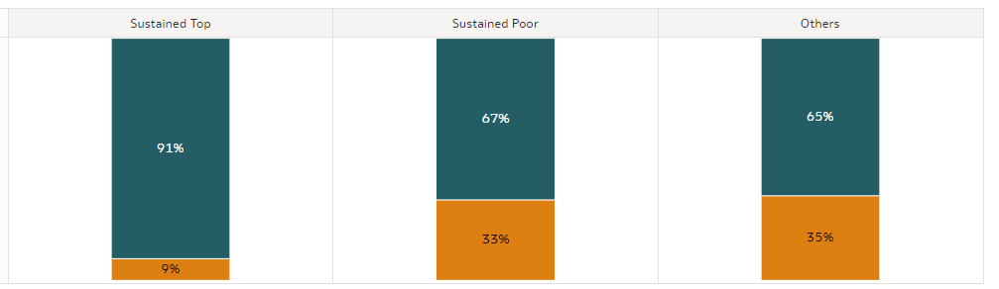
Sustained Top, Sustained Poor, Others
(Excludes Tenure < 2 years)
Focused Groups
Insights Data Analysis – Focused Groups (Attainment)
Sustained Top are less likely to leave.
Sustained Poor are just as likely to leave as Others.
Sustained Top: Attainment = Great (Current and Previous Year)
Sustained Poor: Attainment = Poor (Current and Previous Year)
Others: All other bands

Slide 24
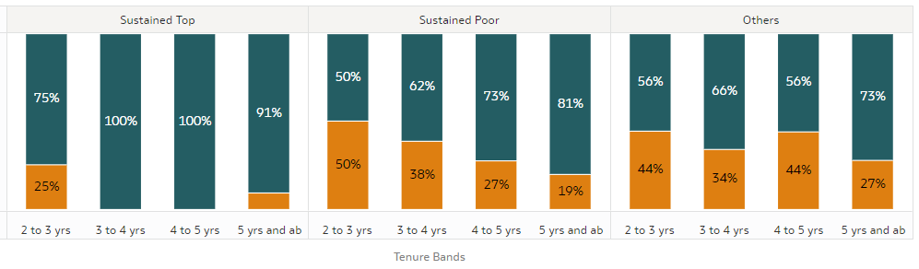
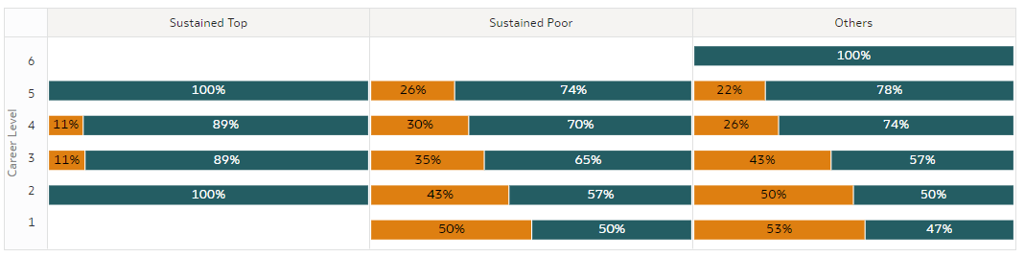
Sustained Top, Sustained Poor, Others
(Excludes Tenure < 2 years)
Focused Groups
Insights Data Analysis – Focused Groups (Attainment)
Across all Groups, Tenure Bands of 2 to 3 yrs are more are risk of leaving.
Is there a lack in confidence in the Organization’s ability to help improve employee’s performance?
Employees of lower career level are also more at risk as leaving.
(In fact, there are no Sustained Top for Career Level 1)
Are we doing enough to help lower career levels succeed?

Slide 25
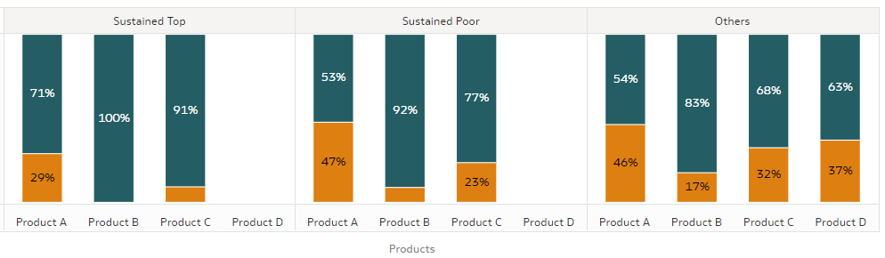
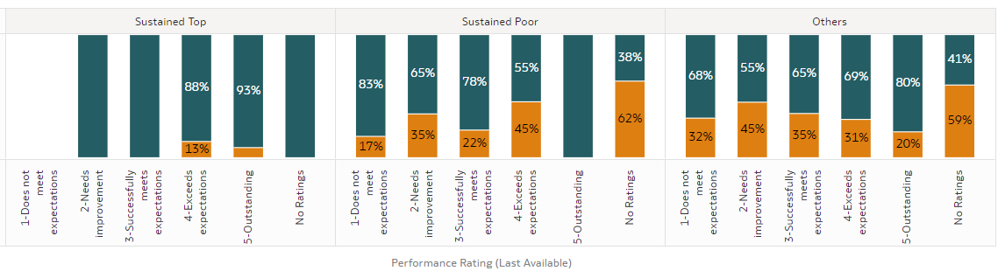
Sustained Top, Sustained Poor, Others
(Excludes Tenure < 2 years)
Focused Groups
Insights Data Analysis – Focused Groups (Attainment)
Product A has high attrition for Sustained Top.
What are the issues that Sustained Top are facing, that is specific for Product A?
Within Sustained Top and Sustained Poor, we are losing employees with better performing Performance Appraisal.
What are the struggles of Performers in Sustained Poor?

Slide 26
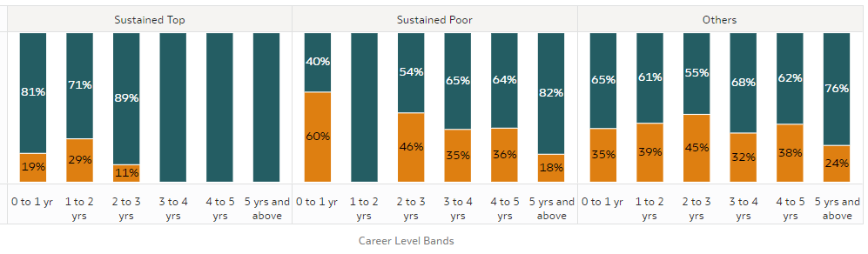
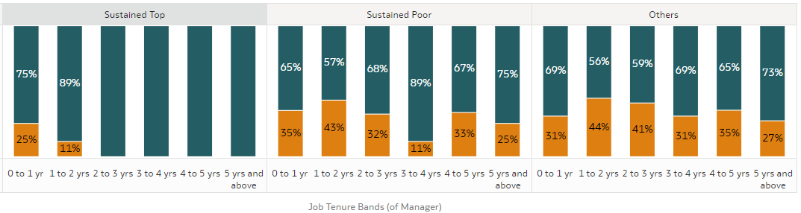
Sustained Top, Sustained Poor, Others
(Excludes Tenure < 2 years)
Focused Groups
Insights Data Analysis – Focused Groups (Attainment)
In Sustained Top, Employees with shorter Career Level Bands are more likely to leave.
This might suggest that promotion alone might not be useful in retaining our Top Performers.
What else can we do to retain our top performers?
In Sustained Top, Employees with Managers being New to the Job are more likely to leave.
Are the managers giving enough guidance for employees to succeed?
Are the Managers providing enough guidance for employees to further succeed?

Slide 27
Area of Focus
Insights Data Analysis – Area of Focus
New Hire vs Other Tenure Bands
Sustained Top, Sustained Poor, Others*
Employee Experience
Performance Guidance/Training
Look into the differences in experience (before and after 1 year) is across products.
Especially between Product A and Product B.
Look into the problems that Poor Performers face and introduce a program that help them get on track
Actively reach out and provide coaching to Poor Performers – let them know that the organization is committed to helping them
Programs and Benefits
How can we tweak it to be more attractive to younger employees?
Career Management
Other than promotion, what are the other needs of our Sustained Top?
Look into what is lacking from Manager’s support
To also provide training to help Managers who are new in job to succeed
Career Planning and Progression
How can we better support and retain employees of lower career level?
*Note: All groups excludes Tenure < 2 years

Slide 28
Suggestions
Insights Suggestions
Predict Proba
Include data of more years
Include ‘Predict Proba’ in the modelling
It allows us to identify employees who might be at high risk of attrition
Allows earlier engagement of employees
With a bigger dataset, it allows further analysis into focused groups.
After focusing on groups, each group becomes too small to do further analysis/modelling
Attrition % instead of Attrition Distribution
More Features
Using attrition % in our Data Exploratory allow better understanding of groups that has small employee counts
Collation of more data (For example, behavior data)
Create more features with existing data columns (For example, Indicators for employees with Job Change but no Career Level Changes)
Tackle the imbalanced dataset
Clustering
Try other methods to overcome imbalanced dataset (For example, oversampling)
Understanding features and characteristics are important to us. Hence, clustering might help us efficiently identify groups of employees with specific features/behaviors.

Slide 29
Thank you!

