Slide 1
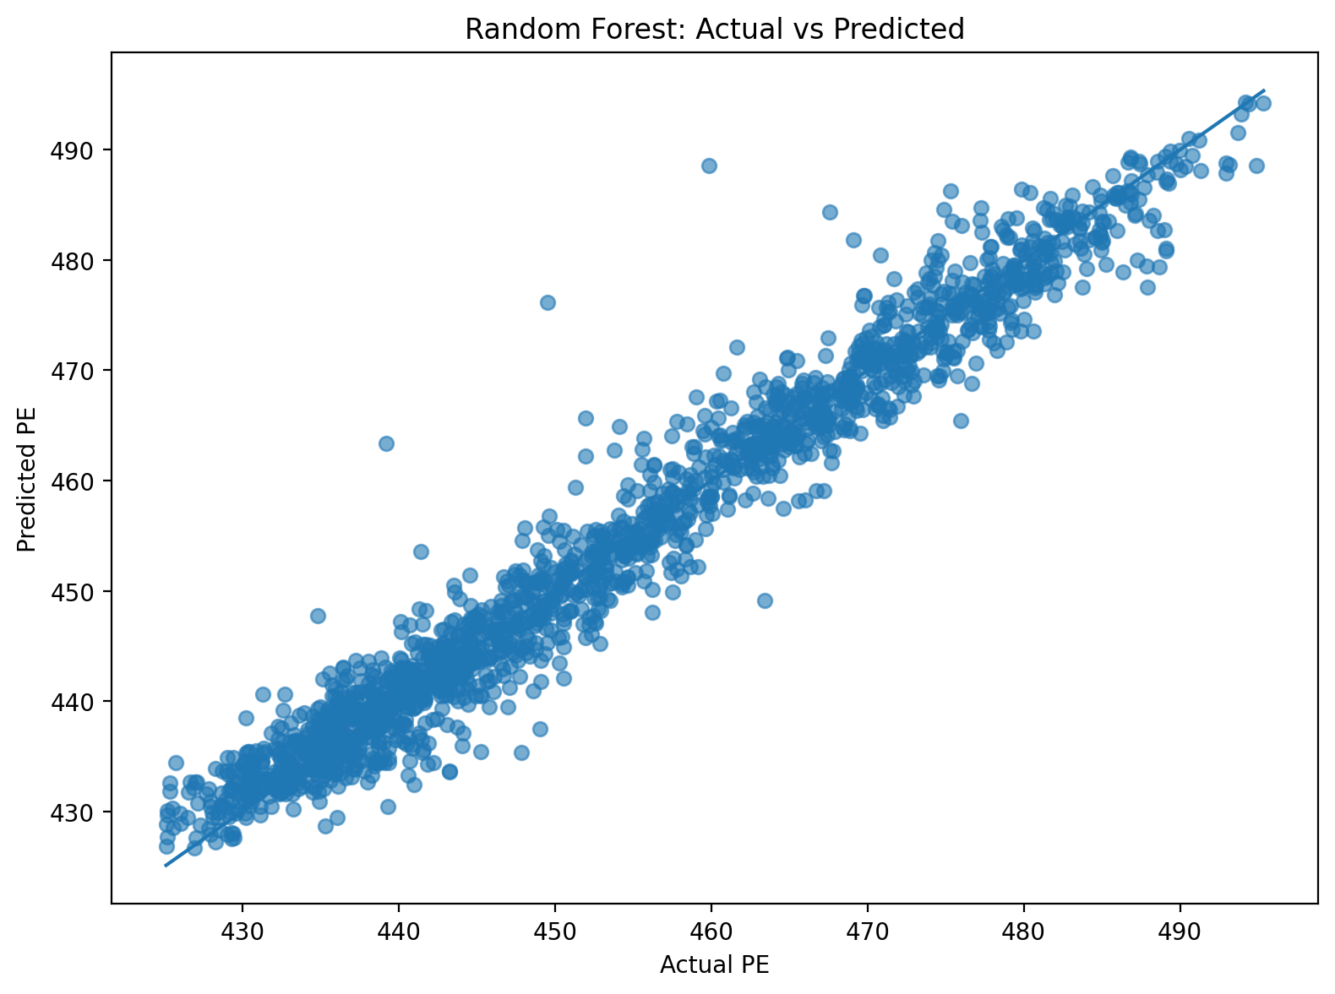
Predicting Power Output
Combined Cycle Power Plant Machine Learning Project
Using environmental sensor readings to predict net hourly electrical energy output (PE).
Supervised Regression
Random Forest Final Model
RMSE / MAE / R²
Final model snapshot
CCPP ML Project • 1
Notes:
Open by explaining that the goal is to use power plant sensor data to predict electrical energy output. Mention that the target is a continuous number measured in megawatts, so this is regression.

Slide 2
1. Problem & modeling approach
What kind of machine learning problem are we solving?
Goal
Model inputs → prediction
Predict net hourly electrical energy output from ambient power plant conditions.
AT + V + AP + RH
Approach
Ambient readings from plant sensors
Supervised regression, because the model predicts a continuous numeric target: PE in megawatts.
PE
RMSE
Primary metric
MAE
Support metric
R²
Fit quality
Predicted net electrical output
CCPP ML Project • 2
Notes:
State that this is supervised regression because the target PE is numeric. Explain that RMSE is the primary metric because it gives error in megawatts and penalizes larger misses.

Slide 3
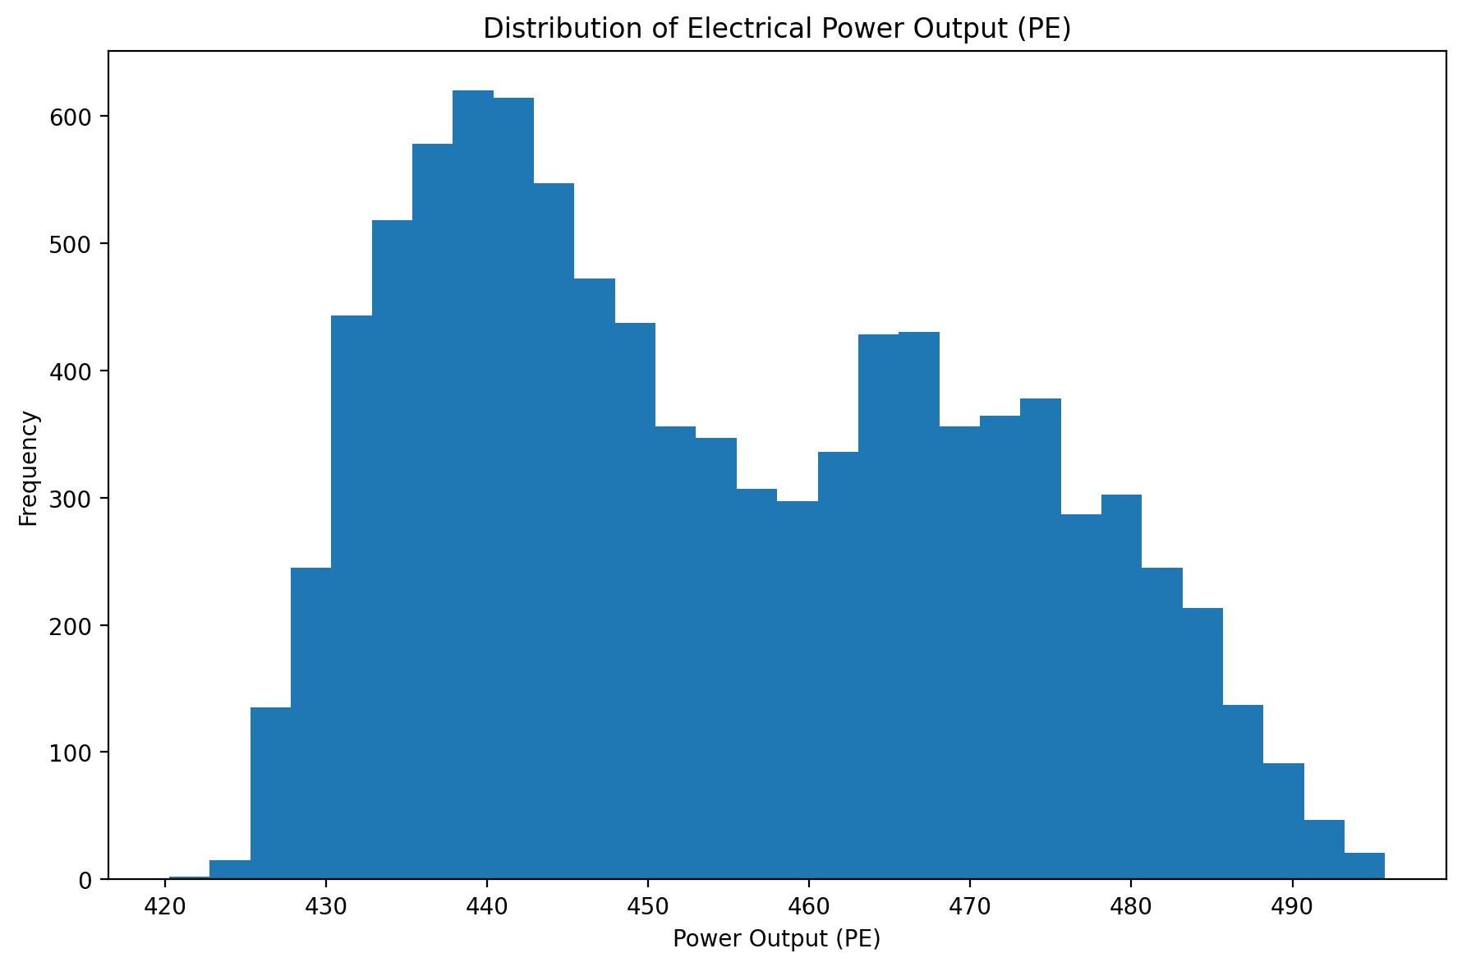
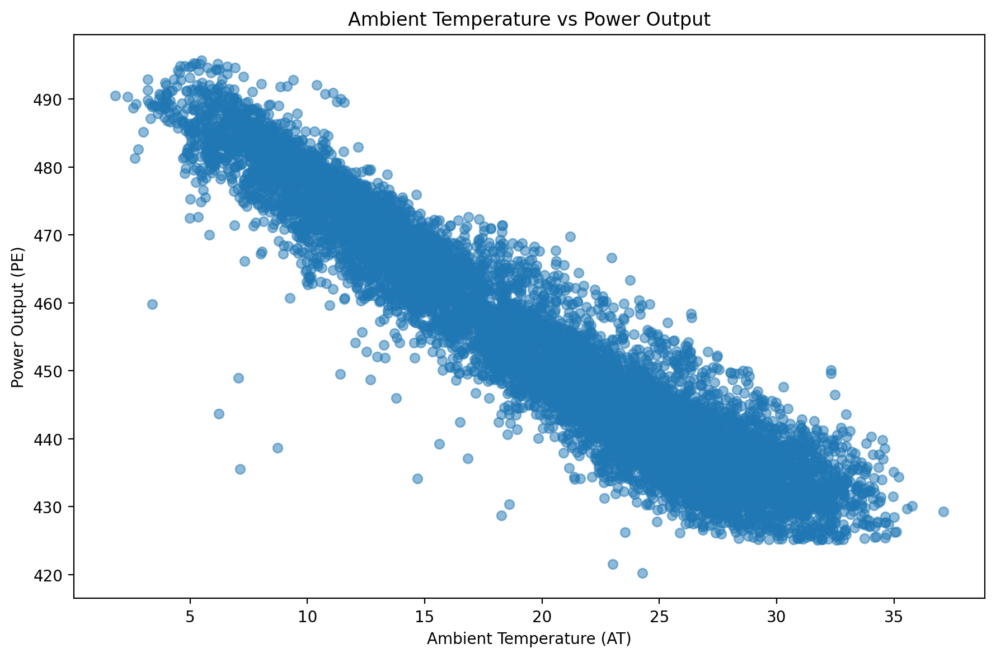
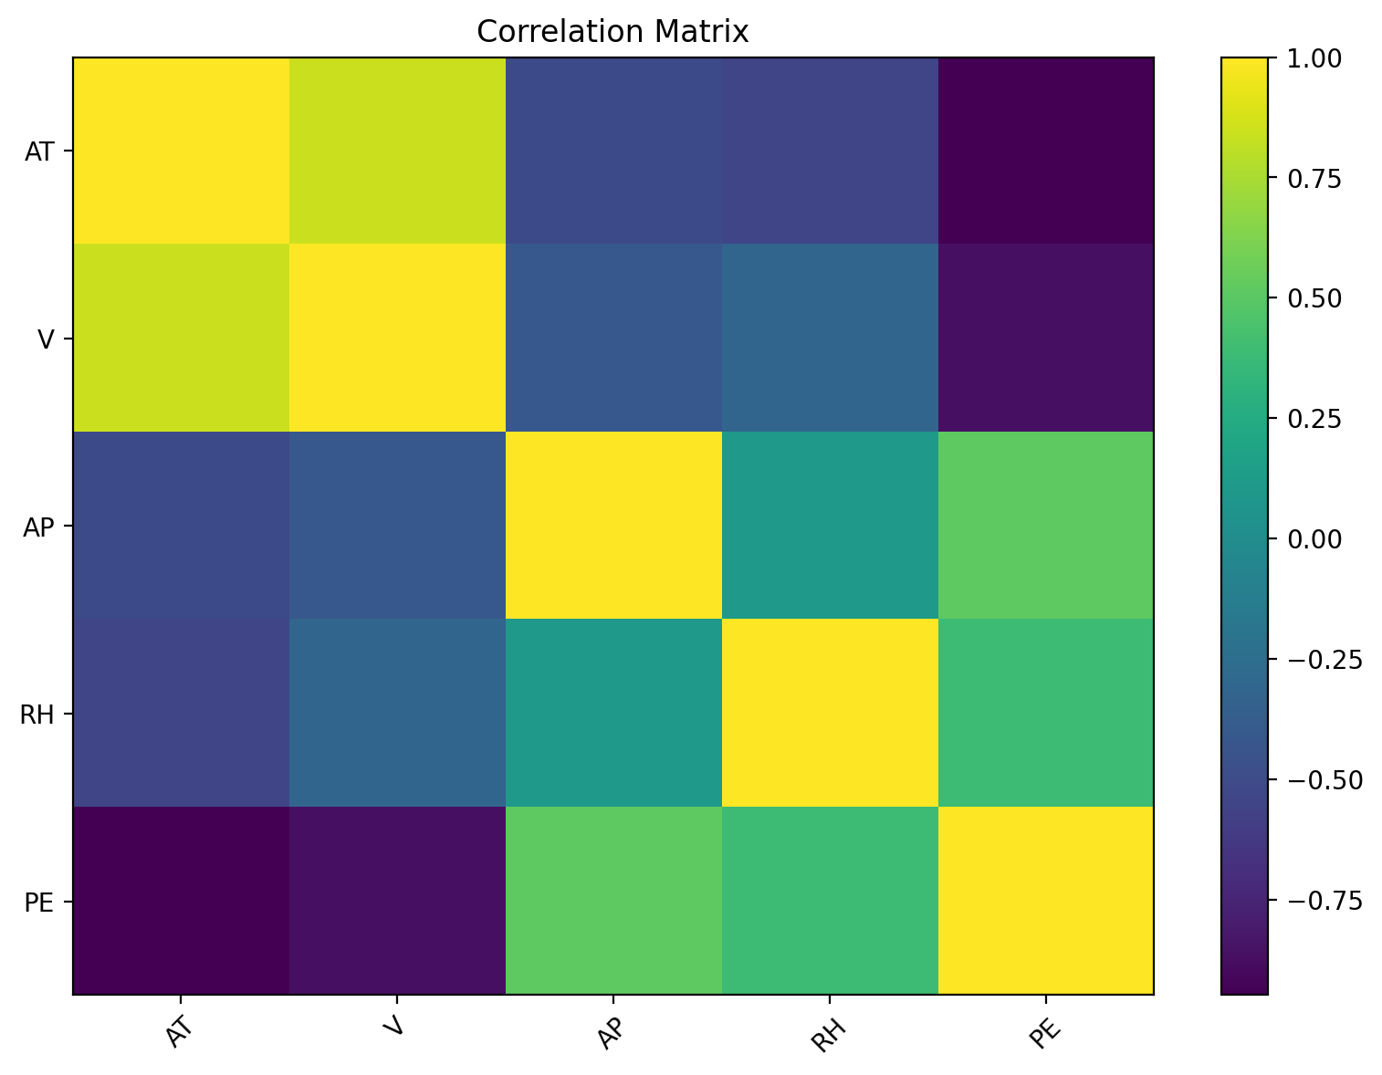
2. Data understanding
The dataset is clean and ready for model training.
9,568
Hourly observations
0
Missing values
4
Predictor features
Variables used
AT Ambient Temperature
V Exhaust Vacuum
AP Ambient Pressure
RH Relative Humidity
PE Target: power output
CCPP ML Project • 3
Notes:
Walk through the data: 9,568 rows, four environmental predictors, and one numeric target. Mention that no missing values were found.

Slide 4
3. Modeling workflow
How the model was trained and validated.
1
Split data
80% training / 20% test
2
Validate
5-fold cross-validation
3
Compare
Linear Regression vs Random Forest
4
Select
Lowest validation RMSE
5
Test once
Evaluate final model
Core model setup in Python
X = df[["AT", "V", "AP", "RH"]] y = df["PE"]
train_test_split(..., test_size=0.20, random_state=42)
LinearRegression() RandomForestRegressor(n_estimators=100, random_state=42)
CCPP ML Project • 4
Notes:
Explain that the test set was held back until the final evaluation. Cross-validation was used only on the training data to choose the best model.

Slide 5
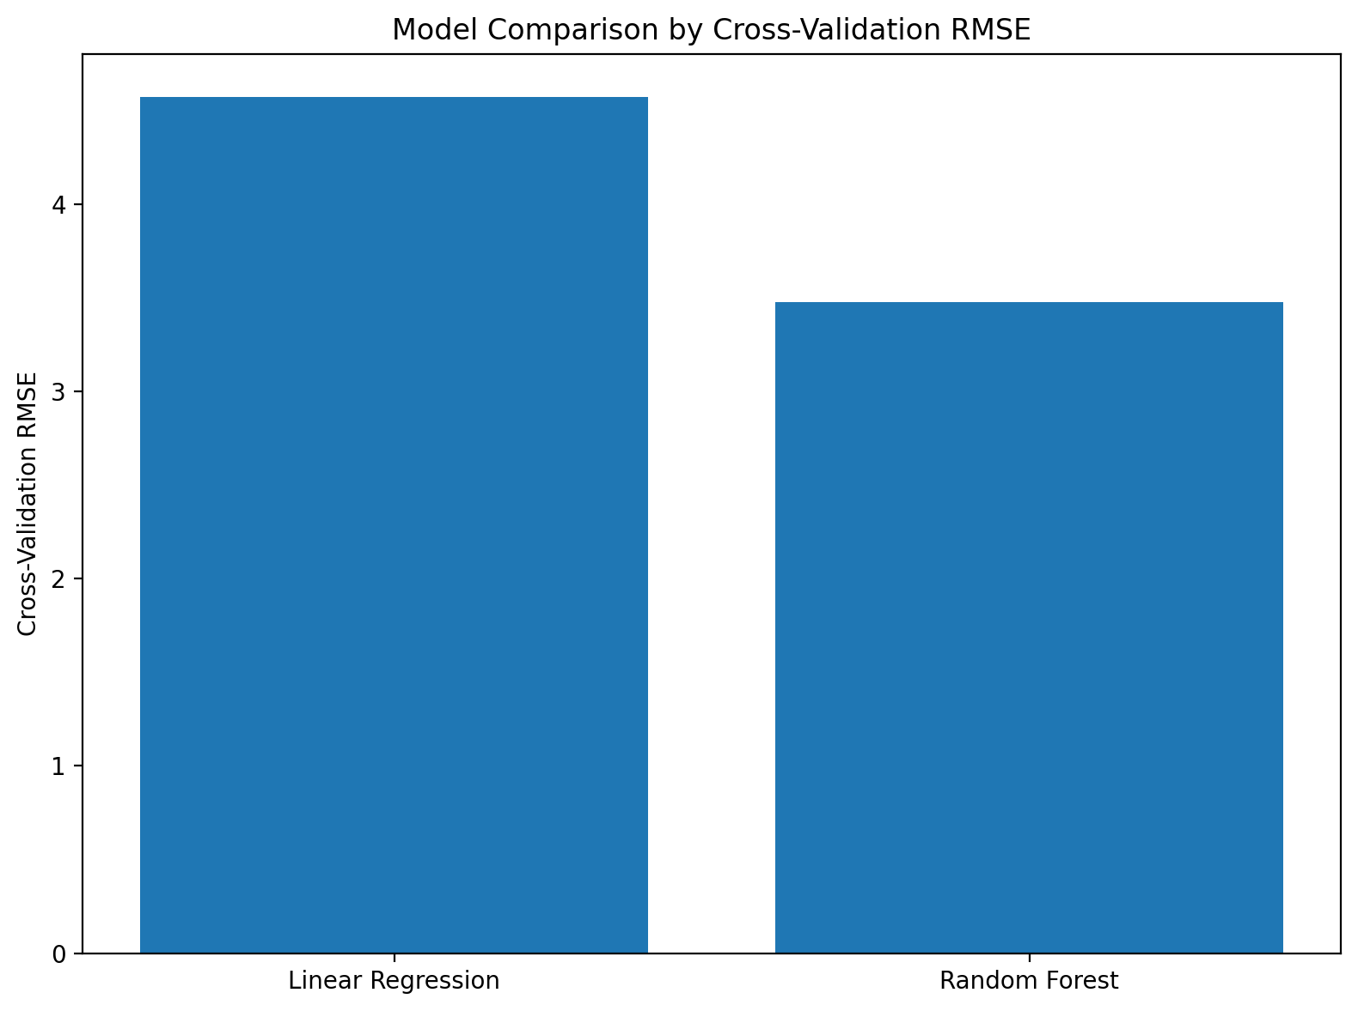
4. Model comparison
Random Forest had the lowest validation error.
Cross-validation results
Linear Regression
CV RMSE: 4.5738
Test RMSE: 4.5026
R²: 0.9301
Random Forest
CV RMSE: 3.4768
Test RMSE: 3.2691
R²: 0.9632
Decision: select Random Forest
It reduced validation RMSE by about 1.10 MW compared with the linear baseline.
CCPP ML Project • 5
Notes:
Describe Linear Regression as the baseline and Random Forest as the final model. The Random Forest was selected because it produced the lowest validation RMSE.

Slide 6
5. Final model performance
Performance on the untouched test set.
3.27 MW
Test RMSE
2.35 MW
Test MAE
0.963
Test R²
Interpretation
The model explains about 96.3% of the variation in electrical output. Predictions are typically within a few megawatts of the actual value.
CCPP ML Project • 6
Notes:
Use this as the main evaluation slide. RMSE is the primary metric. R-squared of 0.963 shows strong predictive performance on unseen data.

Slide 7
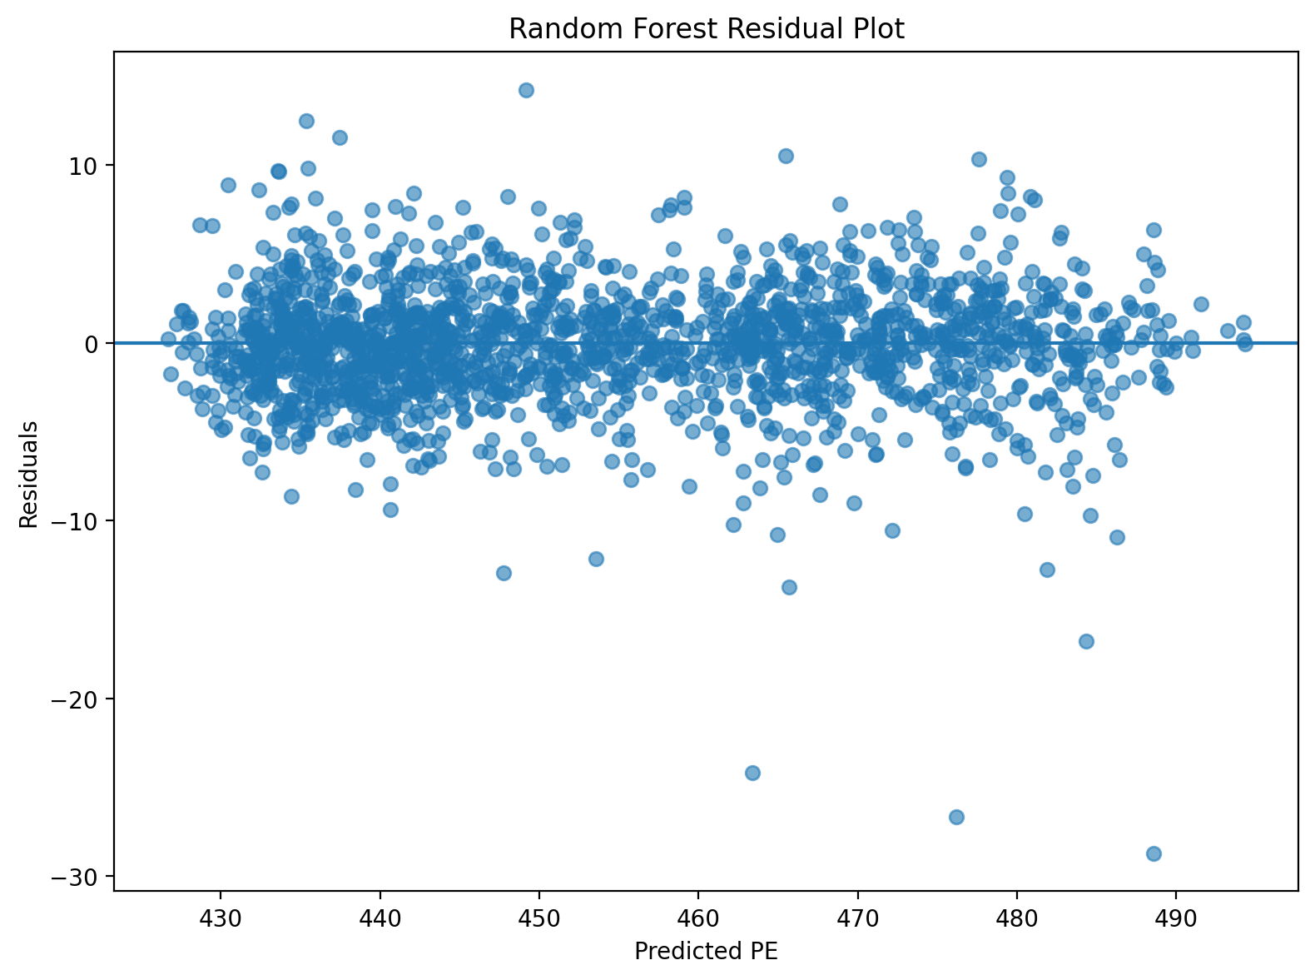
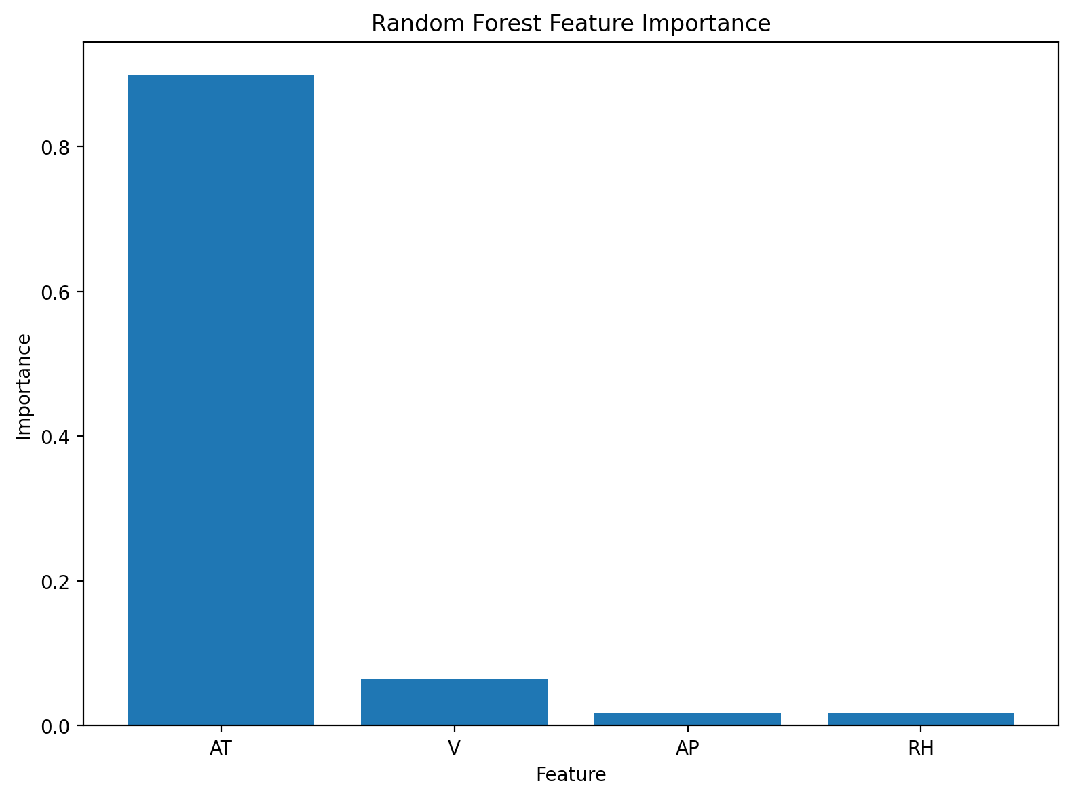
6. Model diagnostics & explanation
Checking errors and understanding which inputs mattered most.
Residuals show whether prediction errors are scattered around zero.
Feature importance shows which sensor readings influenced predictions most.
CCPP ML Project • 7
Notes:
Explain that diagnostics build trust in the model. Residuals show prediction errors, and feature importance helps communicate which variables mattered most.

Slide 8
7. Video close: final takeaway
A concise conclusion for the 5-minute presentation.
Recommended closing script
“I selected Random Forest Regression as my final model because it produced the lowest cross-validation RMSE. After testing it on the untouched test set, the model achieved an RMSE of about 3.27 MW, an MAE of about 2.35 MW, and an R² of 0.963. This means the model predicts combined cycle power plant output with strong accuracy using only four environmental sensor readings.”
What to show in the demo
Model comparison → actual vs. predicted chart → final metrics → feature importance
CCPP ML Project • 8
Notes:
End by restating the final model, why it was selected, and the final metrics. This slide can also serve as speaker notes for recording the video.

