Slide 1
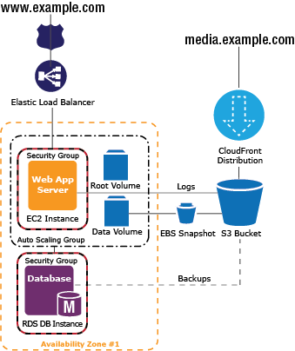

AWS Simple Icons
Usage Guidelines
DEC
Check to make sure you have the most recent set of AWS Simple Icons.
This version was last updated 12/1/2011 (v1.4) Find the most recent set at aws.amazon.com/architecture/icons
Always use Icon labels – Be sure to always include a label below the icon or on the group in Arial. The only exception is in complex diagrams, you have the option to create a key.
Non-AWS Technology – Any server or other non-AWS technology in an architecture diagram should be represented with they grey server (see Slide 6).
Creating diagrams – Model your diagrams after the usage examples (Slides 8 and 9). Try to use direct lines (rather than ‘criss-cross’), use adequate whitespace, and remember to label all icons.
Product Icons – The first icon in most service sets is a product icon. This should be used to represent the service on a more general level when you will not be going into as much depth.
01
Amazon Elastic Compute Cloud (EC2)
Elastic Load
Balancer
Traditional server

Slide 2
Compute
Amazon Elastic Compute Cloud (Amazon EC2)
Amazon Elastic Compute Cloud (EC2)
Instance
Instances
AMI
DB on Instance
Instance
with CloudWatch
Elastic IP
Amazon Elastic MapReduce
Auto Scaling
Amazon Elastic MapReduce
Cluster
HDFS Cluster
Auto Scaling
Storage
Amazon Simple Storage Service (Amazon S3)
AWS Import/Export
Amazon Simple Storage Service (S3)
Bucket
Bucket
with Objects
Object
AWS Import/Export

Slide 3
Storage (continued)
Content Delivery
Amazon Elastic Block Storage (Amazon EBS)
Amazon CloudFront
Amazon Elastic Block Storage (EBS)
Volume
Snapshot
Amazon CloudFront
Download
Distribution
Streaming
Distribution
Edge Location
Monitoring
Networking
Amazon CloudWatch
Amazon Elastic Load Balancing
AWS Direct Connect
Amazon Route 53
Amazon CloudWatch
Alarm
Elastic Load
Balancer
AWS Direct Connect
Amazon Route 53
Hosted Zone
Route Table
Amazon Virtual Private Cloud (Amazon VPC)
Amazon Virtual Private Cloud (VPC)
VPN Connection
VPN Gateway
Customer Gateway
Internet Gateway
Router

Slide 4
Database
Amazon SimpleDB
Amazon SimpleDB
Domain
Item
Items
Attribute
Attributes
Amazon Relational Database Service (Amazon RDS)
Amazon Relational Database Service (RDS)
RDS DB Instance
RDS DB Instance
Standby (Multi-AZ)
RDS DB Instance
Read Replica
Oracle
DB Instance
MySQL
DB Instance
Amazon ElastiCache
Amazon ElastiCache
ElastiCache
Cache Node

Slide 5
Messaging
Amazon Simple Email
Service (Amazon SES)
Amazon Simple Notification Service (Amazon SNS)
Amazon Simple Email Service (SES)
Email
Amazon Simple Notification Service (SNS)
Topic
Email Notification
HTTP
Notification
Amazon Simple Queue Service (Amazon SQS)
Amazon Simple Queue Service (SQS)
Queue
Message
Deployment and Management
AWS CloudFormation
AWS Elastic Beanstalk
AWS CloudFormation
Template
Stack
AWS Elastic
Beanstalk
Application
Notes:
やるしか無いぞ

Slide 6
On-Demand Workforce
Amazon Mechanical Turk
Amazon
Mechanical Turk
Human Intelligence Tasks (HIT)
Assignment/
Task
Workers
Requester
Non-Service Specific
User
Users
Client
Mobile Client
Multimedia
Corporate data center
Traditional server
Internet
AWS Management Console
IAM Add-on
Example:
IAM Add-on

Slide 7
Groups
Auto scaling Group
Availability Zone
Region
Security Group
Elastic Beanstalk Container
EC2 Instance Contents
VPC Subnet
Server Contents
Virtual Private Cloud
AWS Cloud
Corporate Data center

Slide 8
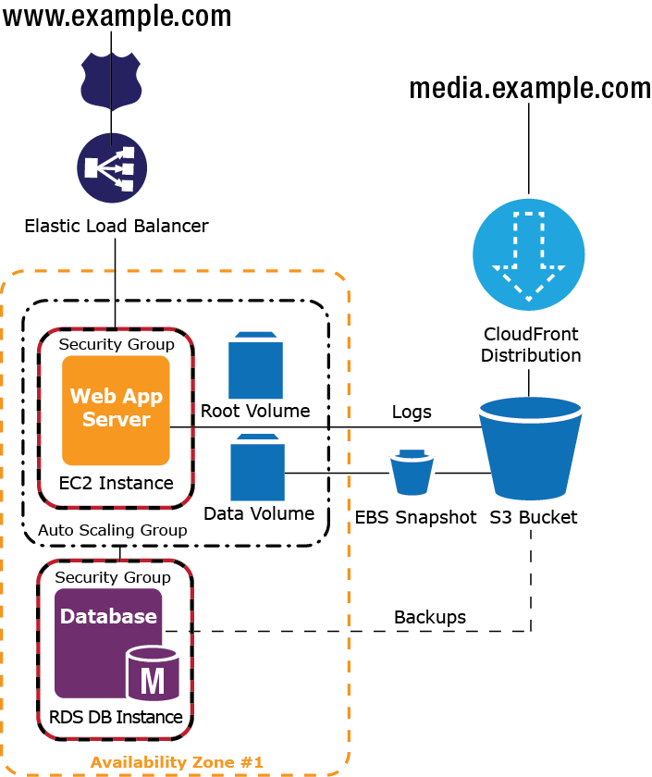
Example 1: 2-Tier Auto-scalable Web Application Architecture in 1 AZ

Slide 9
Example 2: 3-Tier Auto-scalable Web Application Architecture
www.yourApp.com
media.yourApp.com
(Static data)
Amazon Route 53
Hosted Zone
Amazon CloudFront
Elastic Load
Balancer
Amazon EC2
Instances
Amazon
CloudWatch
Alarms
Web
Server
Web
Server
Amazon SNS
Notifications
Amazon S3
Bucket
Auto Scaling Group
App
Server
App
Server
Amazon SimpleDB
Domains
App Tier
Amazon SES
Email
ElastiCache Tier
Amazon RDS
AZ-1
AZ-2
Region
Notes:
Lets put everything in a context of a web application

Slide 10
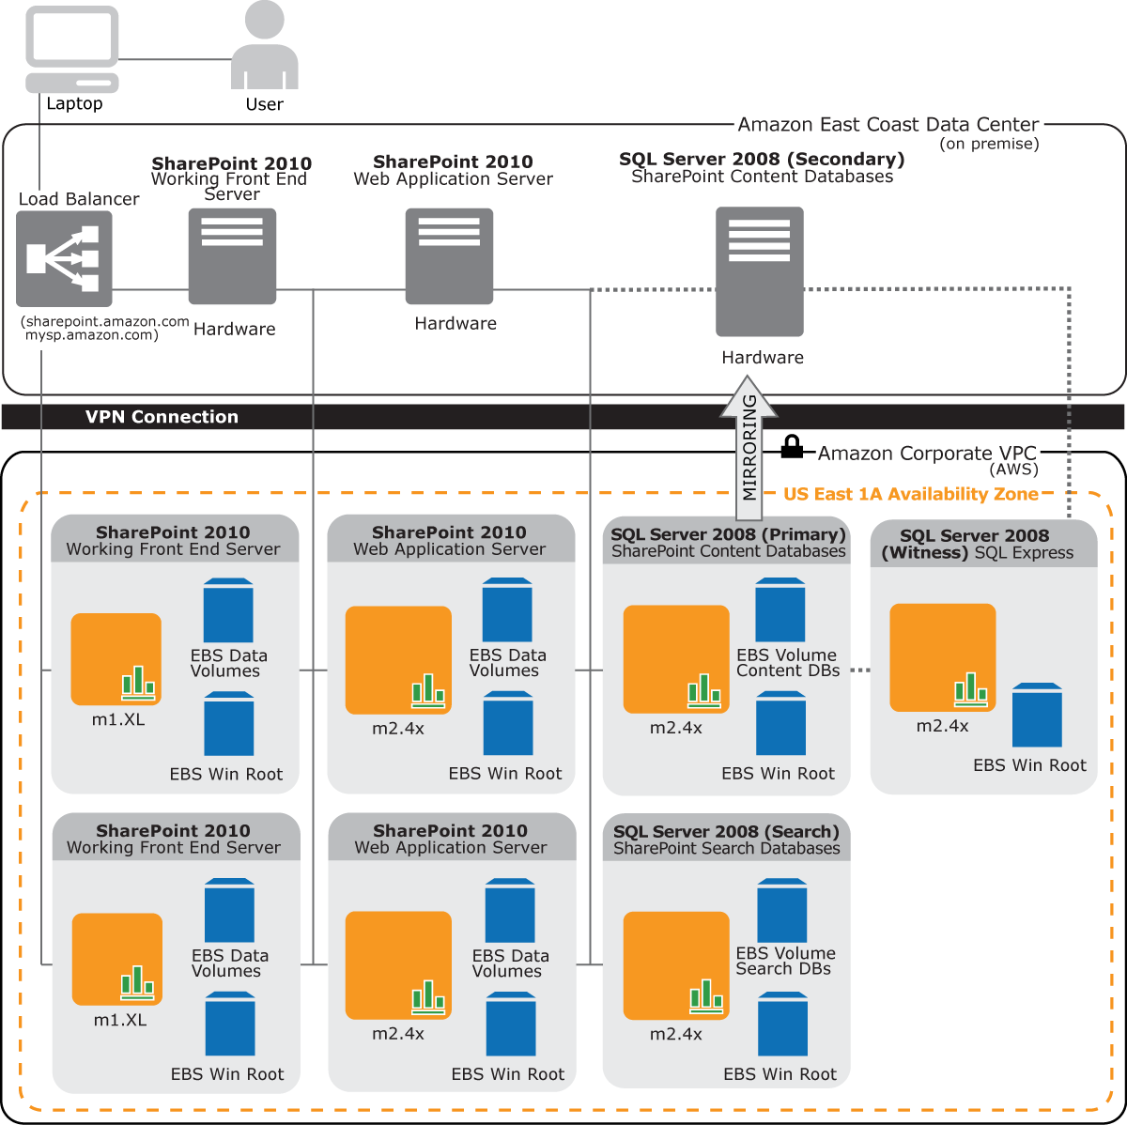
Example 3: AWS Hybrid Application Architecture : SharePoint 2010

Slide 11
Example 4: Using AWS cloud for Disaster Recovery: Architecture that shows onsite and AWS deployments
Not Active for Production Traffic
Active
Amazon Route 53
Elastic Load
Balancer
Reverse Proxy/ Caching Server
Reverse Proxy / Caching Server
Application Data Source Cut Over
Application
Server
Application Server
Slave Database
Server
Master
Mirroring / Replication
Database Server
Scaled down
Standby
Data Volume
Corporate Data center
AWS Region

