Slide 1
EfficientNet
Reading group 27/8/2021

Slide 2
What are proposed in EfficientNet article?
Compound scaling method
EfficientNet (Convultional neural network architect)
Base-model → EfficientNetB0
B0 + Various compound scaling → EfficientNetB1-B7

Slide 3
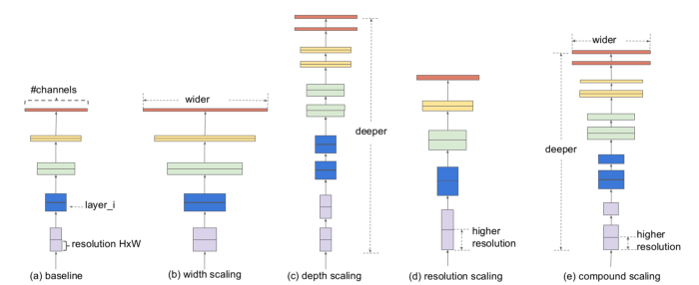
Compound Scaling (1)
There are 3 aspects in scaling a NN model. Depth, Width, and Resolution

Slide 4
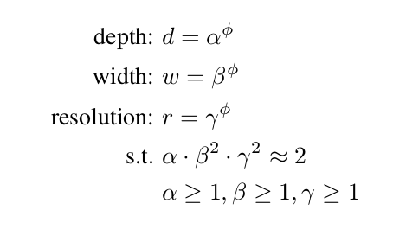
Compound Scaling (2)
Scaling with scaling co-efficient

Slide 5
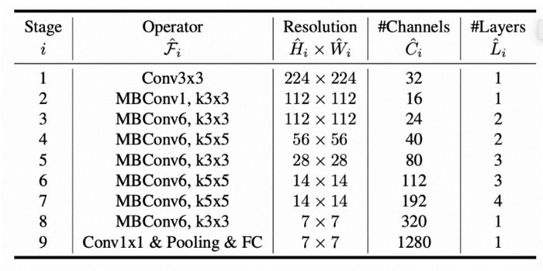
EfficientNet
Key features:
Less parameters
High performance
Key techniques:
Inverted Residual Block
Squeeze and Excitation Block

Slide 6
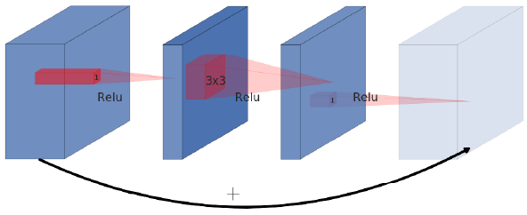
Residual Block (Resnet 16 -200)
Computational expensive
1x1
3x3
1x1

Slide 7
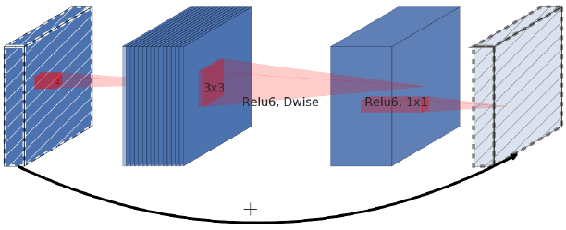
Invert Residual Block (based on residual block)
Using Depth-wise separable convolutional layer to reduce parameters
1x1
Depth-wise
Linear-bottle-neck
3x3
DW
1x1

Slide 8
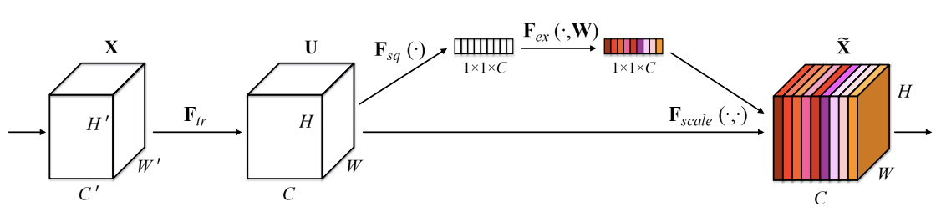
Squeeze and Excitation Block
From SE-Net
Key idea : assign weight to channel

