Slide 1
Transformer

Slide 2
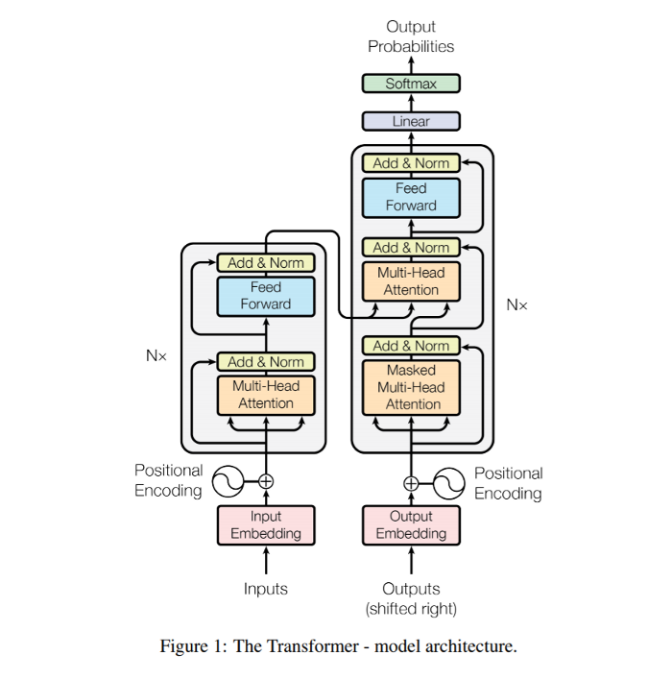
Architecture
Input part
Mix ja mix
Input from
previous run part

Slide 3
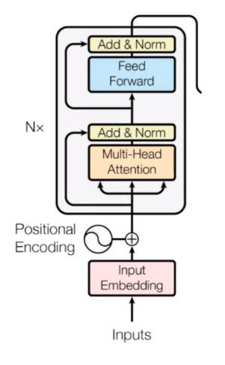
Breakdown : Encoder
Embedding
Multi-head Attention
Feed forward

Slide 4
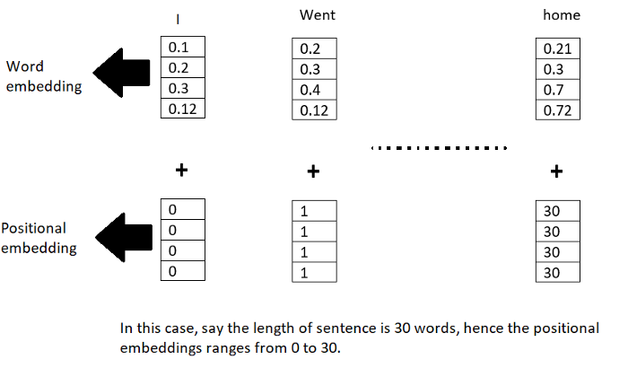
Position encoding

Slide 5
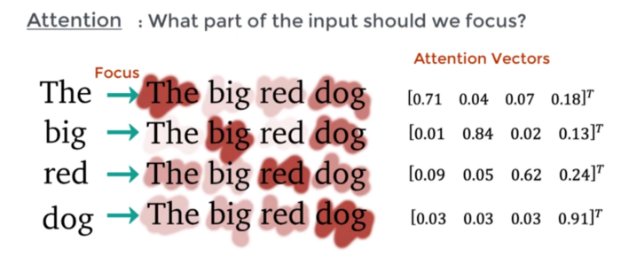
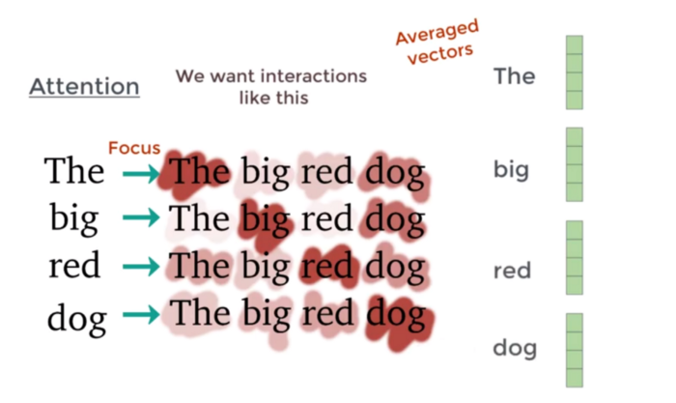
Multi-head attention
Self-Attention
Each word have multiple attention vectors associated with it
X 5,10,20 Up to you

Slide 6
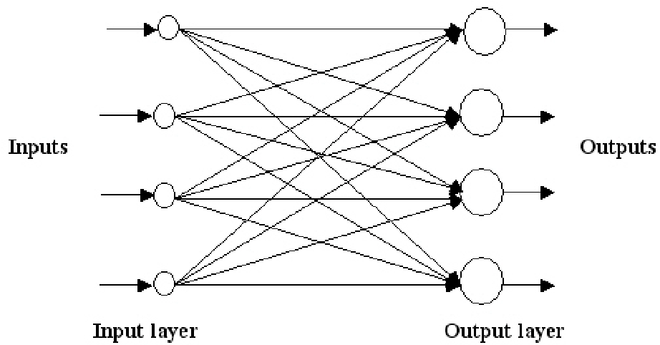
Feed forward
Simple

Slide 7
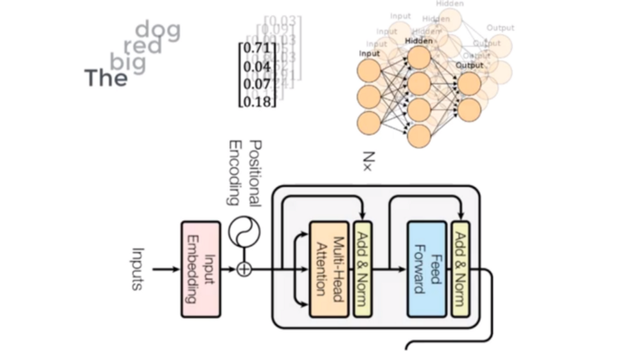
Sum up
Parallelism!!!!!!!!!!

Slide 8
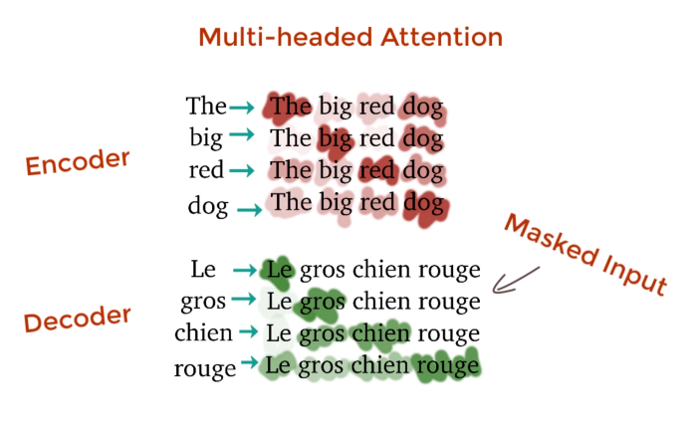
Masked multi-head attention
mask the words appearing later by transforming them into 0’s so that the attention network can’t use them.

