Slide 1

CNN convolutional neural network

Slide 2
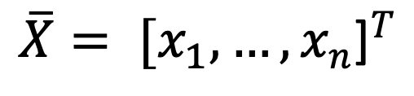
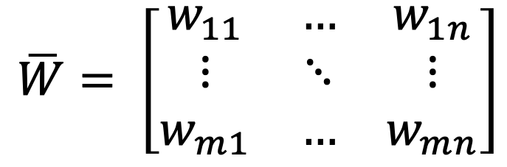
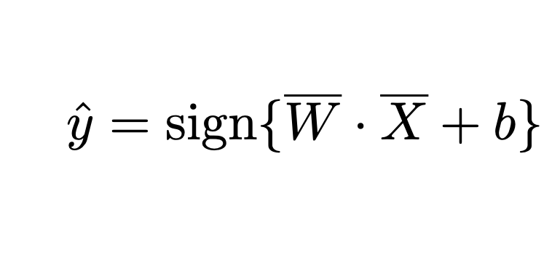
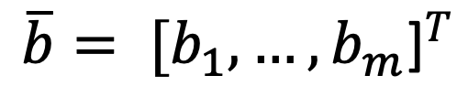
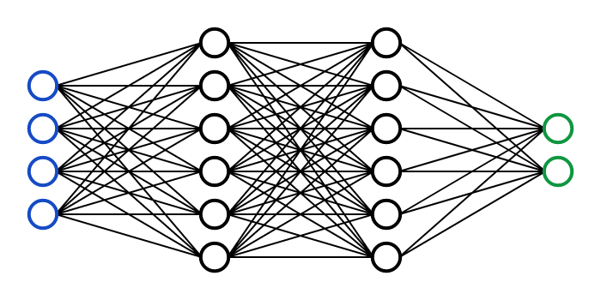
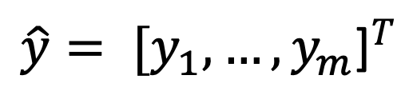
Z
Y
W
X
n
m

Slide 3
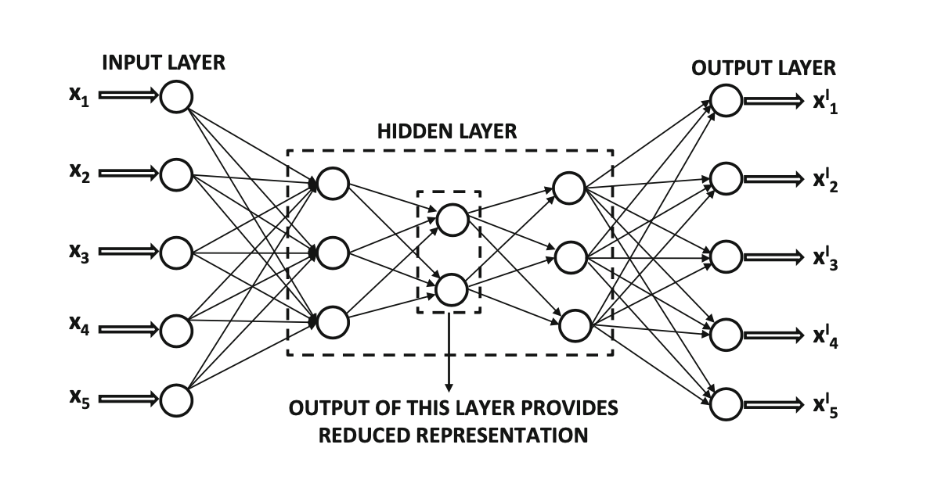
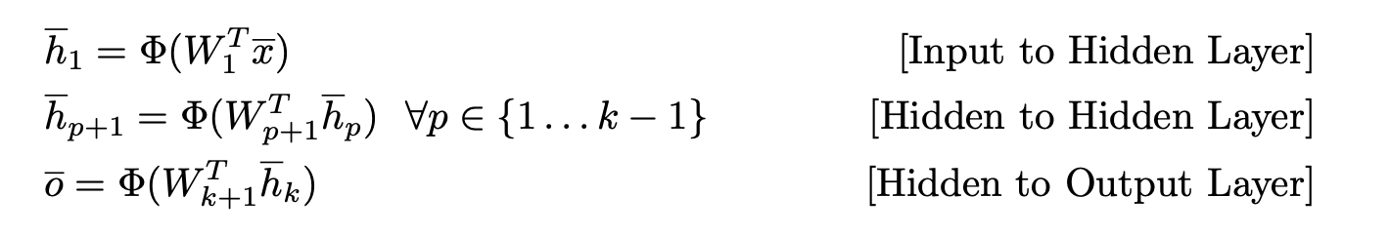

Slide 4
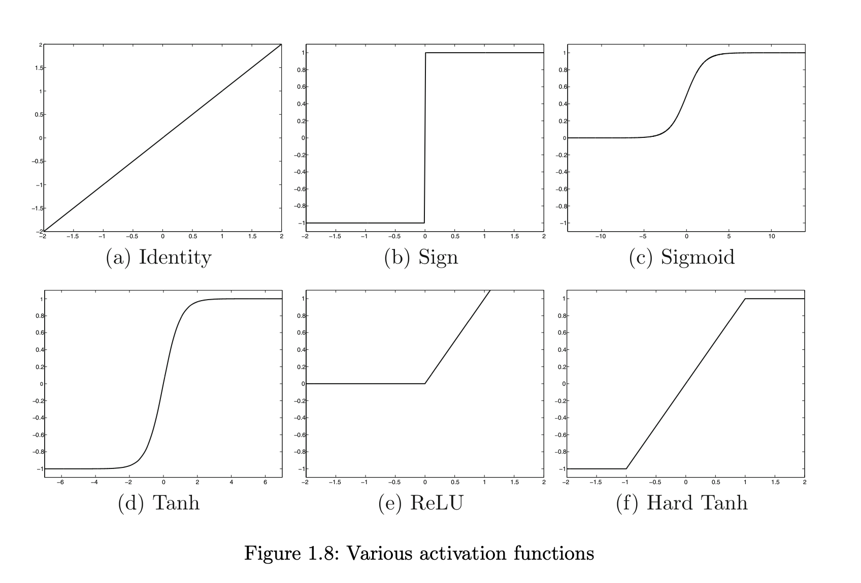
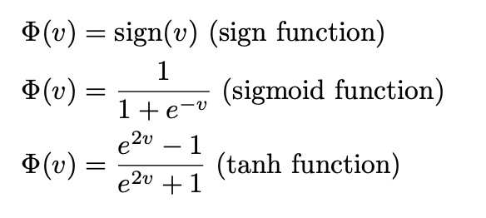
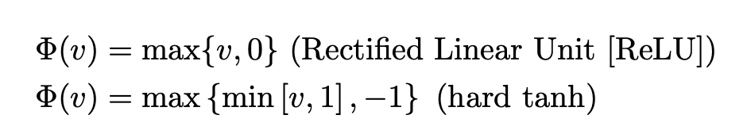

Slide 5
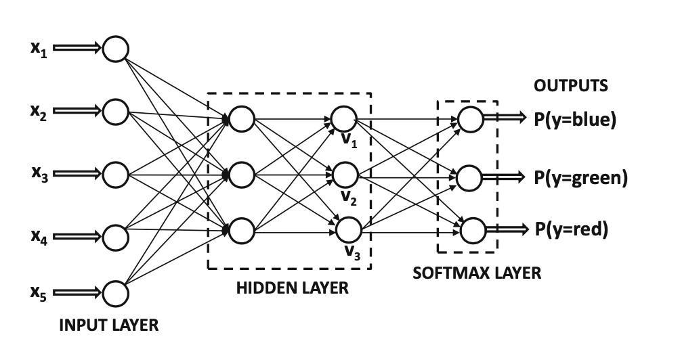
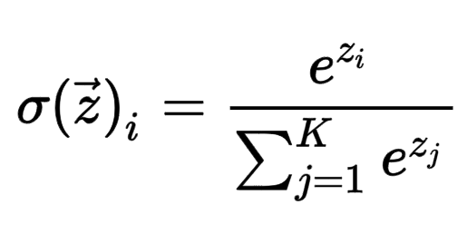
softmax

Slide 6
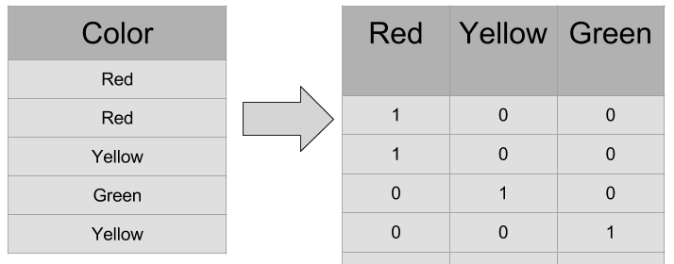

Slide 7
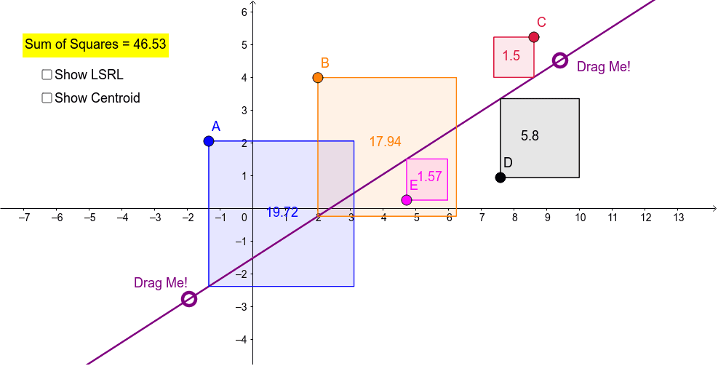
Choice of Loss Function
least-squares regression with numeric outputs:

Slide 8
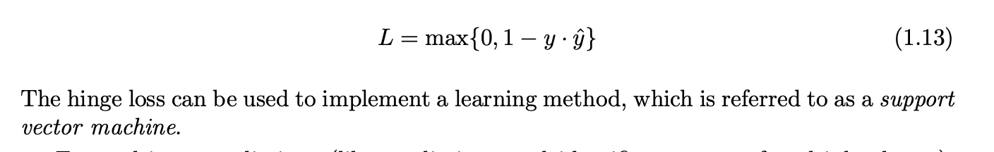
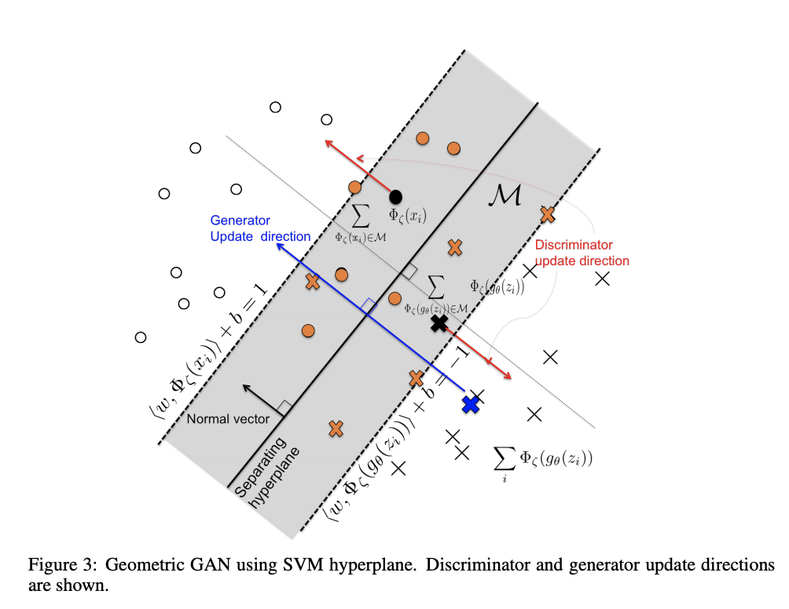
Choice of Loss Function

Slide 9
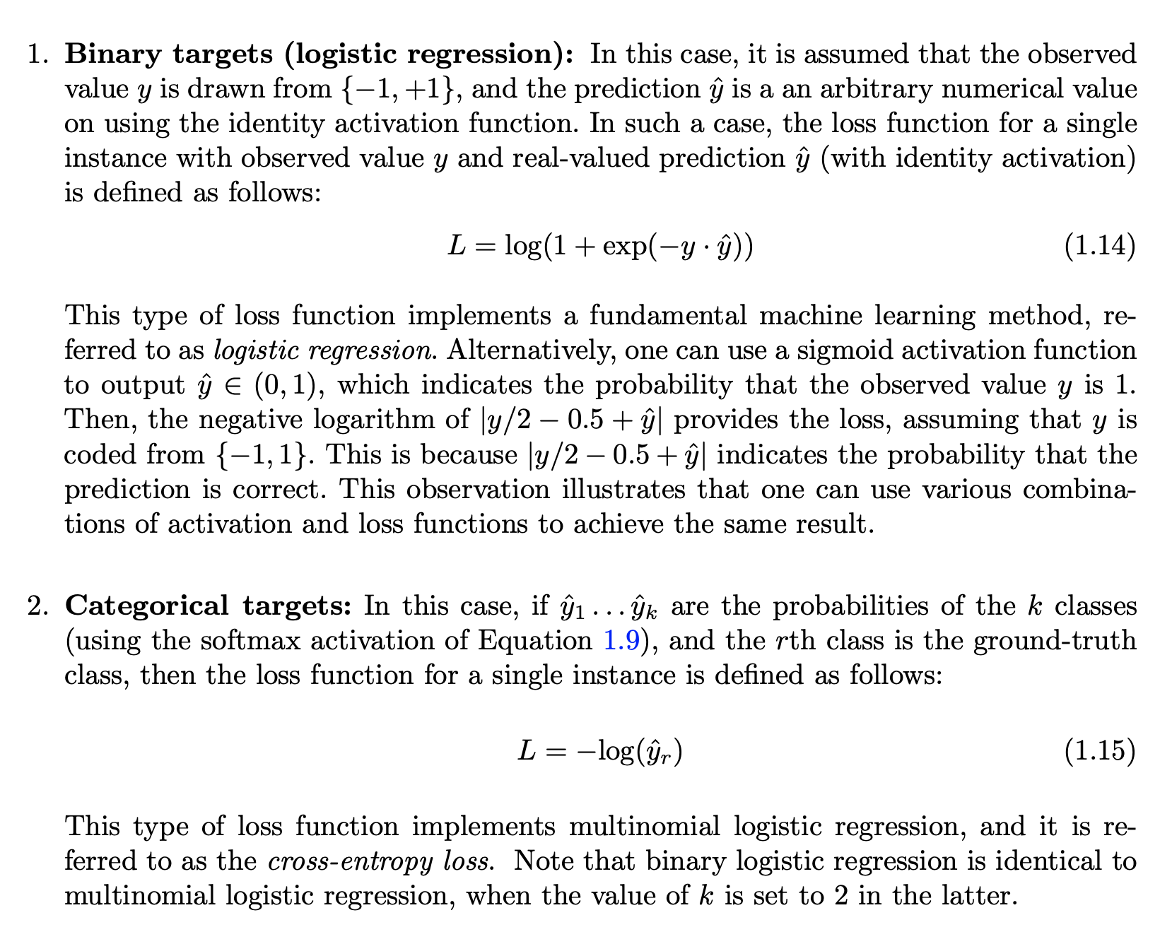
Logistic Loss.
Cross-Entropy Loss

Slide 10
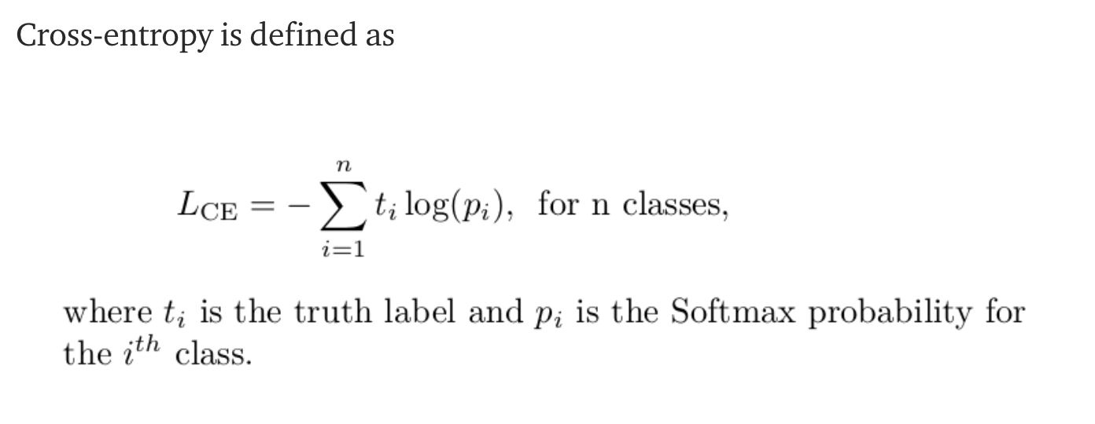
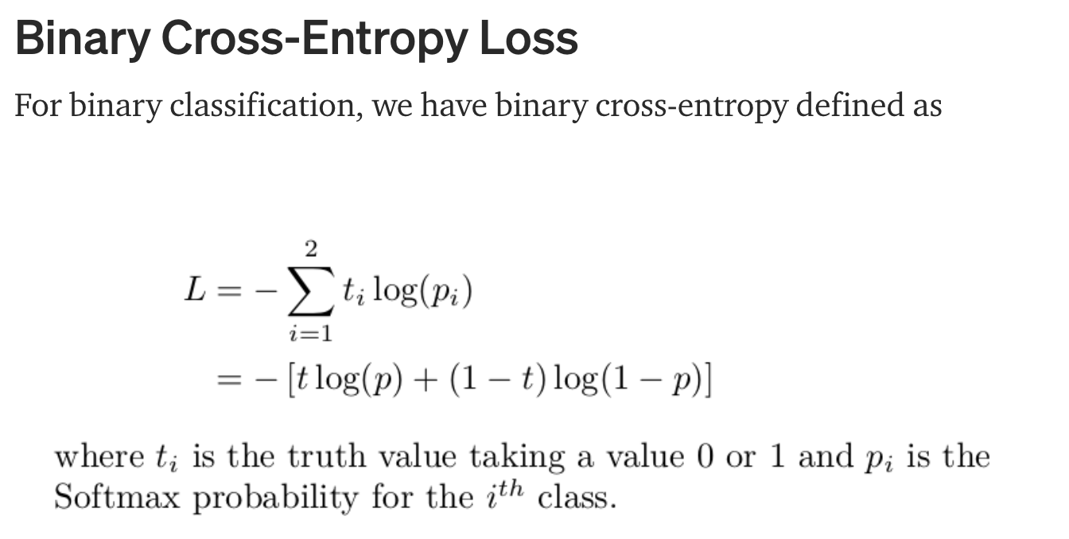
Cross-Entropy Loss Function

Slide 11
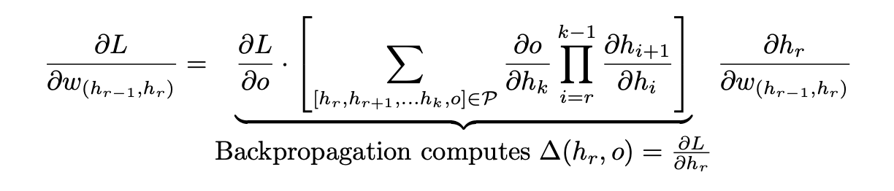

Slide 12
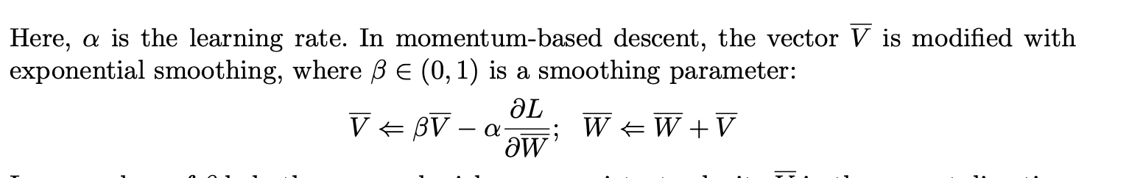
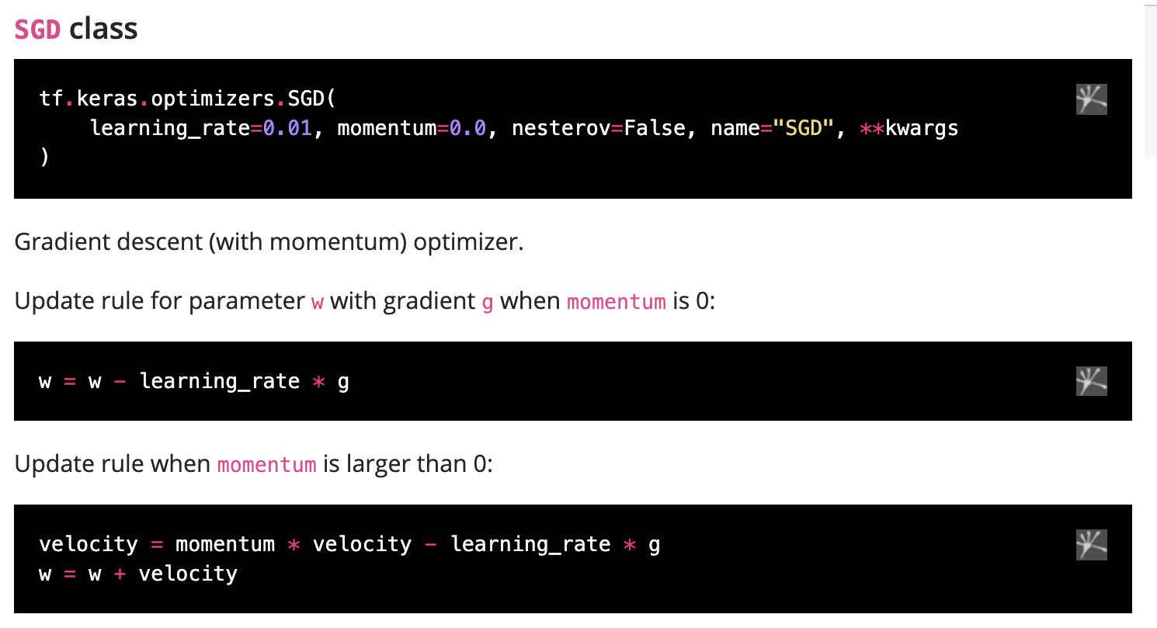

Slide 13
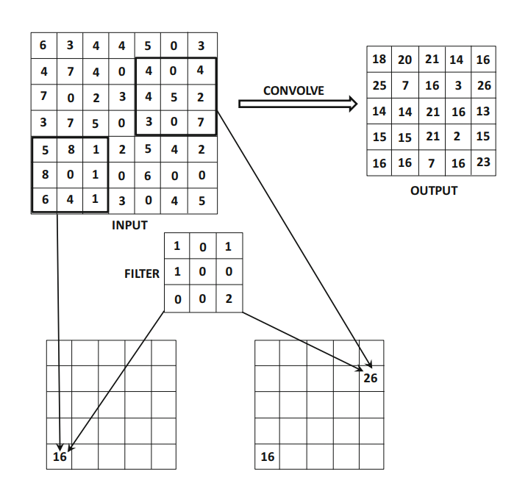
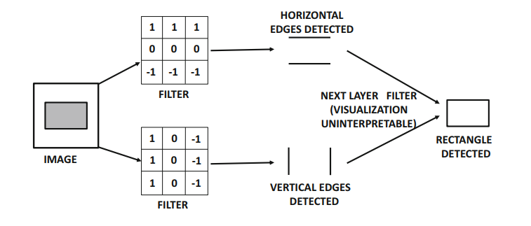
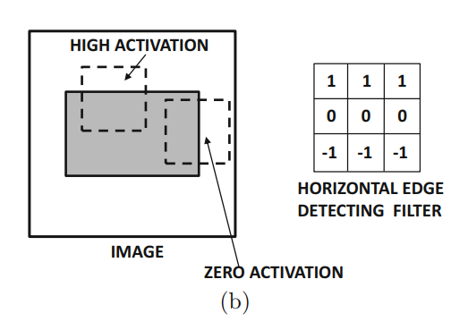
Conv2D(...)

Slide 14
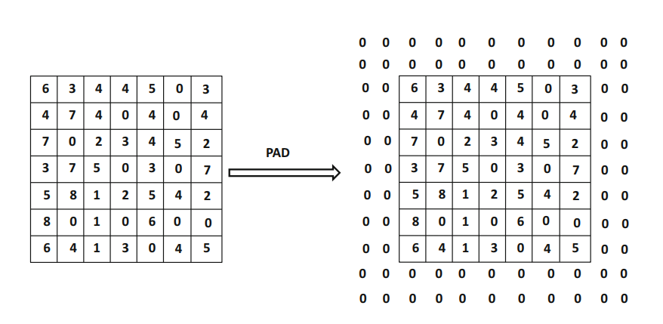
Padding
Padding
Conv2D(filters= 32, kernel_size= (3,3), strides=1, padding='same', activation='relu’)

Slide 15
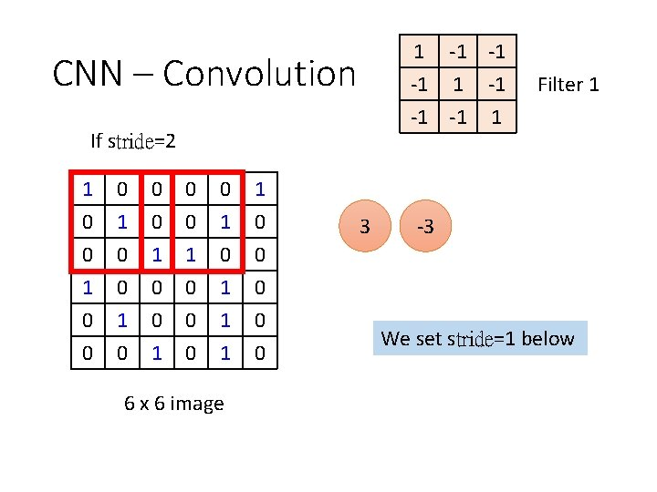
Strides
Conv2D(filters= 32, kernel_size= (3,3), strides=1, padding='same', activation='relu’)

Slide 16
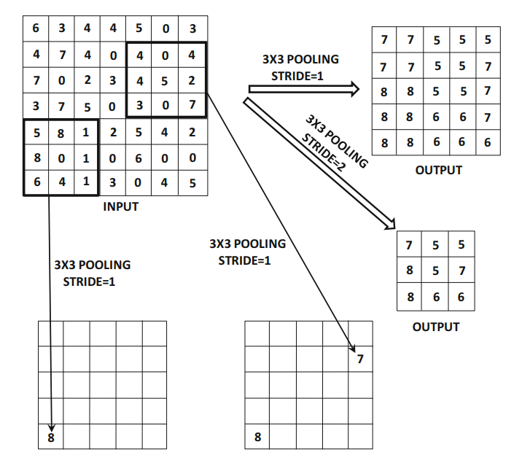
Pooling
Pooling
MaxPooling2D(pool_size=(2,2))

Slide 17
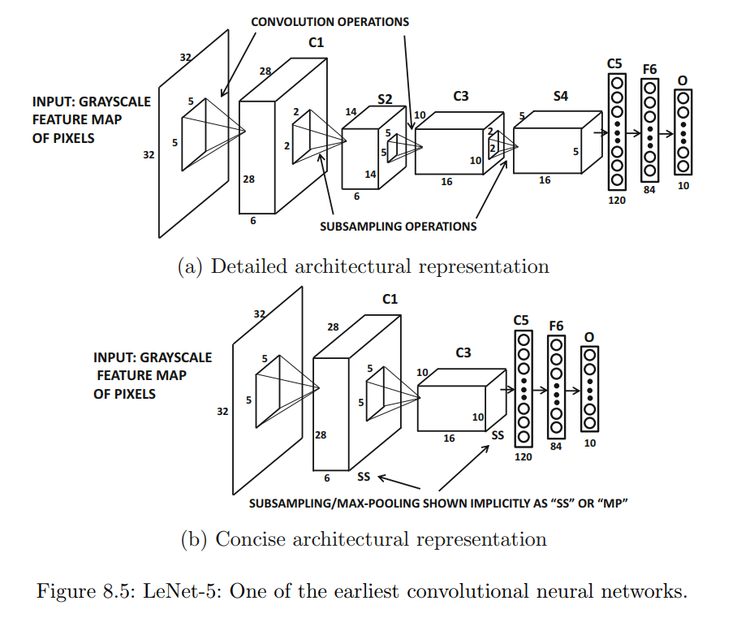
two convolution layers
two pooling layers
three fully connected

Slide 18
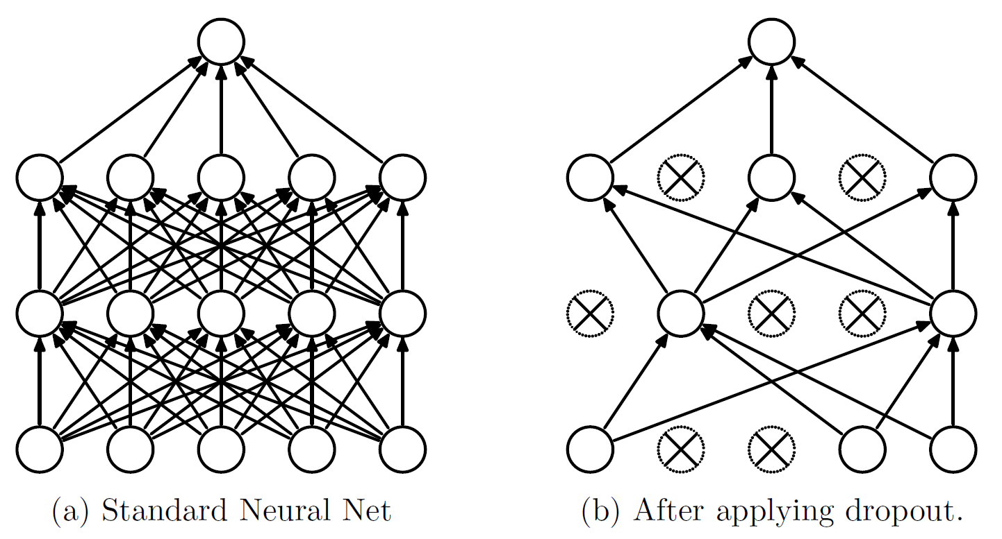
Dropout(0.4)

Slide 19
model = Sequential()
model.add(Conv2D(filters= 32, kernel_size= (3,3), strides=1, padding='same', activation='relu', kernel_initializer='he_uniform', input_shape = (32,32,3)))
model.add(Conv2D(filters= 32, kernel_size= (3,3), strides=1, padding='same', activation='relu', kernel_initializer='he_uniform'))
model.add(MaxPooling2D(pool_size=(2,2)))
model.add(Dropout(rate=0.2))
model.add(Conv2D(filters= 64, kernel_size= (3,3), strides=1, padding='same', activation='relu', kernel_initializer='he_uniform'))
model.add(Conv2D(filters= 64, kernel_size= (3,3), strides=1, padding='same', activation='relu', kernel_initializer='he_uniform'))
model.add(MaxPooling2D(pool_size=(2,2)))
model.add(Dropout(rate=0.2))
model.add(Conv2D(filters= 128, kernel_size= (3,3), strides=1, padding='same', activation='relu', kernel_initializer='he_uniform'))
model.add(Conv2D(filters= 128, kernel_size= (3,3), strides=1, padding='same', activation='relu', kernel_initializer='he_uniform'))
model.add(MaxPooling2D(pool_size=(2,2)))
model.add(Dropout(rate=0.2))
model.add(Flatten())
model.add(Dense(units = 128, activation='relu', kernel_initializer='he_uniform'))
model.add(Dropout(rate=0.2))
model.add(Dense(units = 10, activation='softmax'))

Slide 20
opt = SGD(learning_rate=0.001, momentum=0.9)
model.compile(loss= "categorical_crossentropy", optimizer=opt, metrics = ["accuracy"])

Slide 21
RNN RECURRENT NEURAL NETWORKS

Slide 22
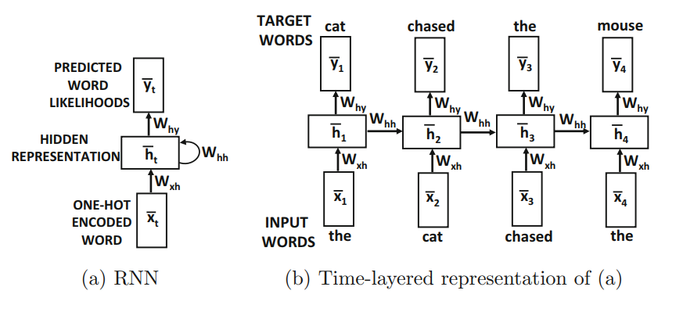

Slide 23
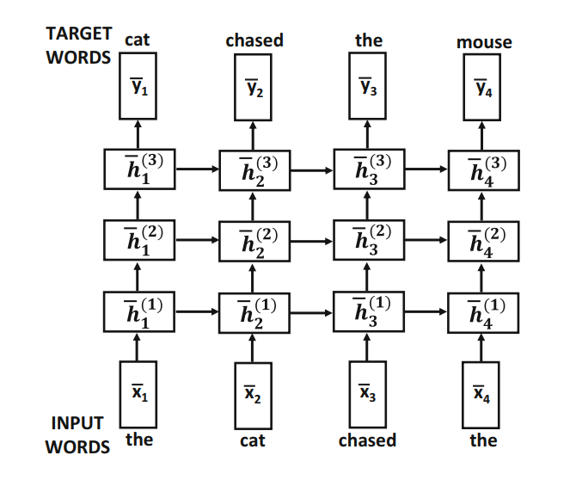
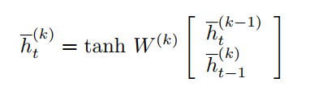
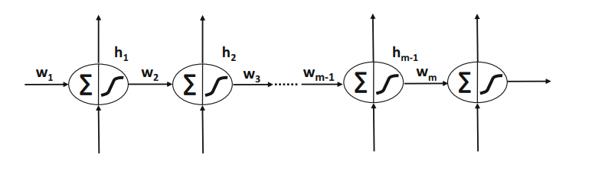

“Recurrent neural networks are very hard to train because of the fact that the time-layered network is a very deep network, especially if the input sequence is long.”

Slide 24
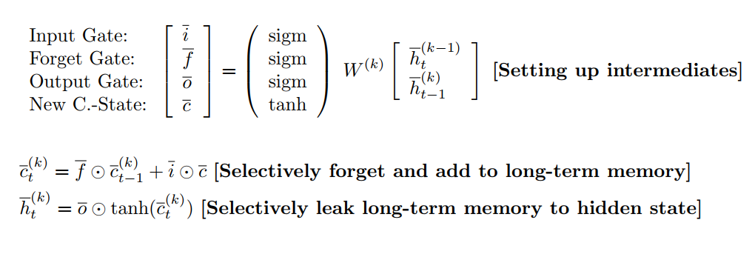
Long Short-Term Memory (LSTM)

Slide 25
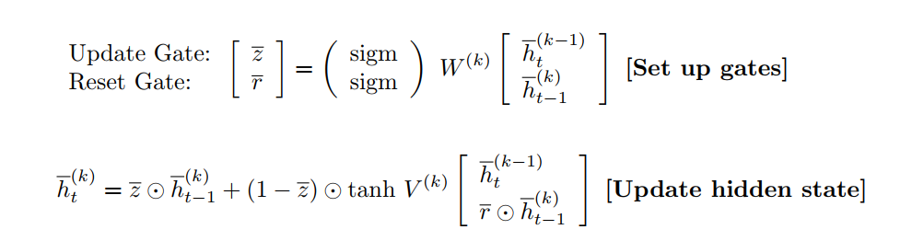
Gated Recurrent Units (GRUs)

Slide 26
LSTM
GRUs

