Slide 1
Optimizer

Slide 2
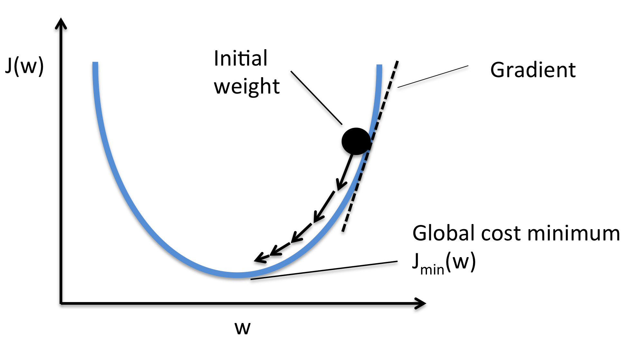
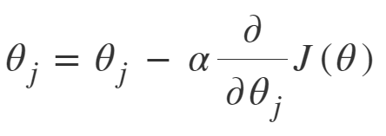
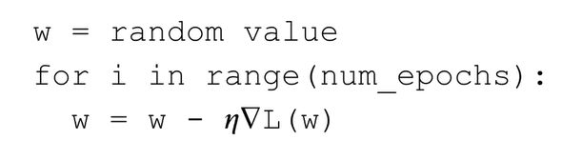
Recap: Gradient Descent

Slide 3
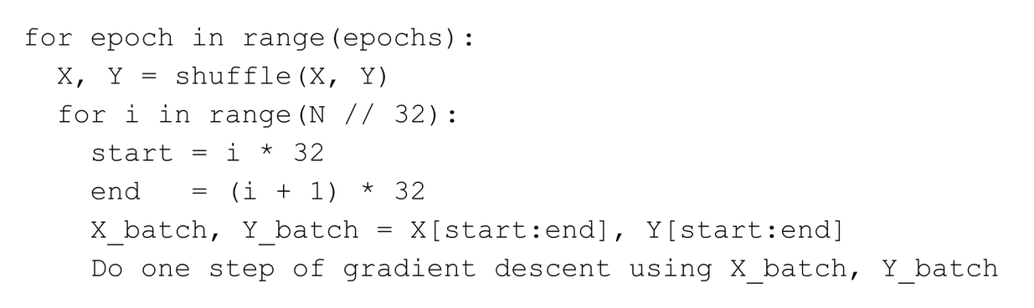
Stochastic (Batch) Gradient Descent

Slide 4
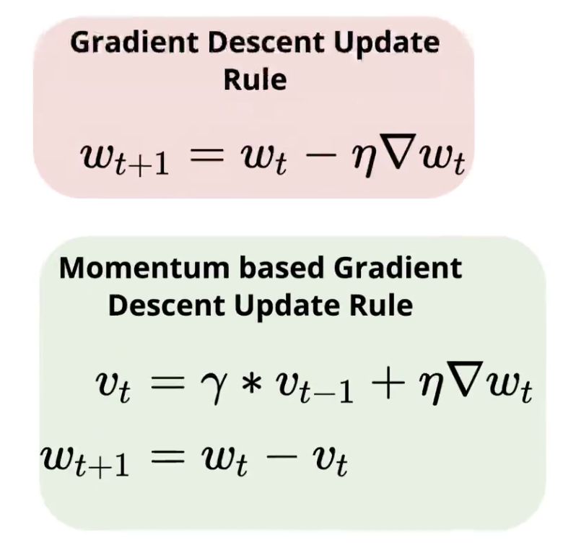
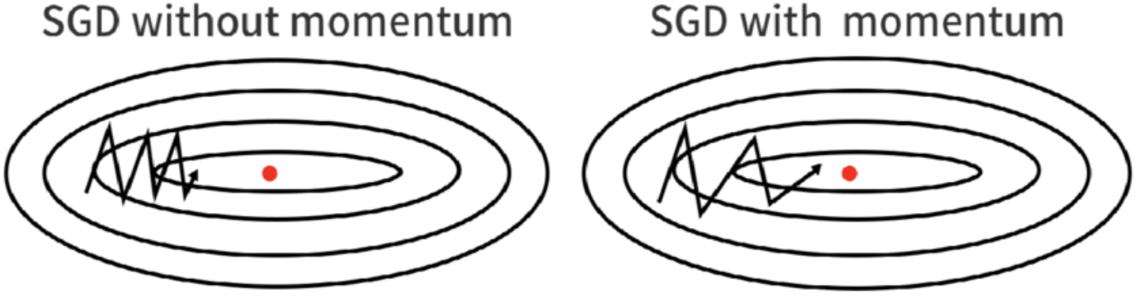
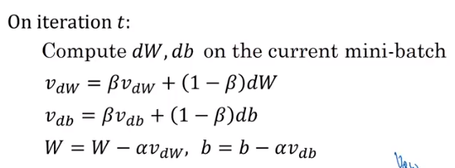
Momentum

Slide 5
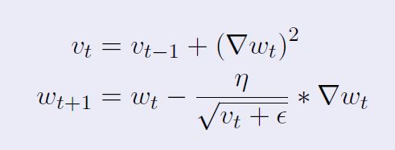
Adaptive Learning Rate: AdaGrad
Adaptive Gradient Algorithm (AdaGrad)

Slide 6
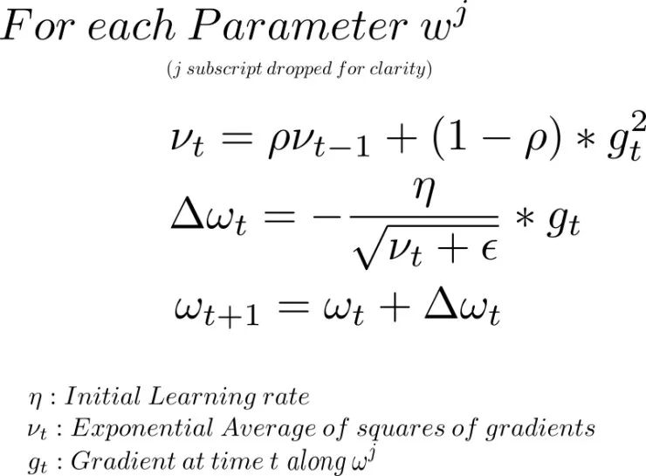
Adaptive Learning Rate: RMSProp
Root Mean Square Propagation (RMSProp)

Slide 7
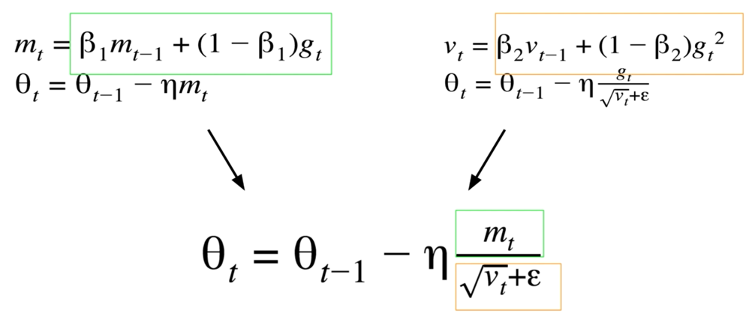
Adam: Momentum + RMSProp

Slide 8
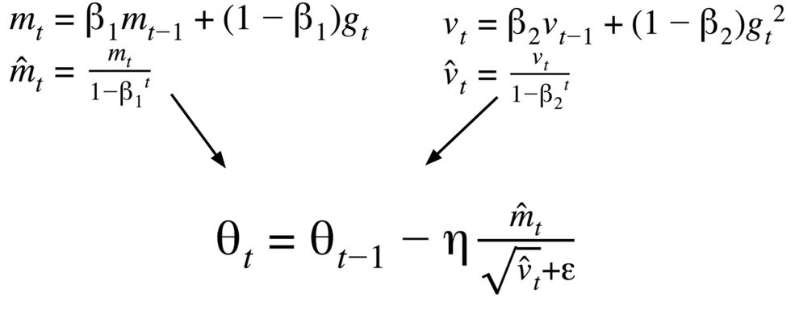
Adam: Bias Correction

Slide 9
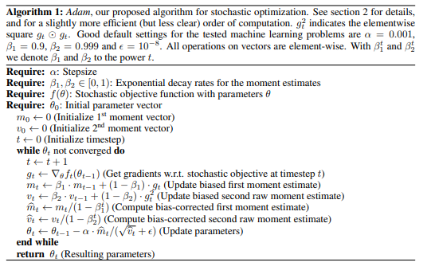
Adam: Pseudocode
Ref: https://arxiv.org/pdf/1412.6980.pdf

Slide 10
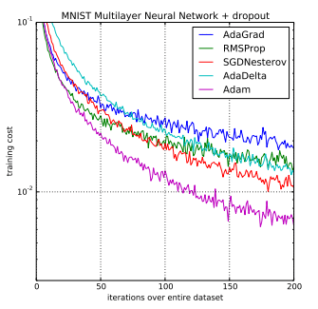
Adam: Performance
Ref: https://machinelearningmastery.com/adam-optimization-algorithm-for-deep-learning/

Slide 11
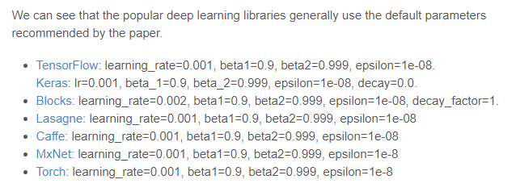
Adam: Hyperparameter
Ref: https://machinelearningmastery.com/adam-optimization-algorithm-for-deep-learning/

