Slide 1
UNET
Image Segmentation

Slide 2
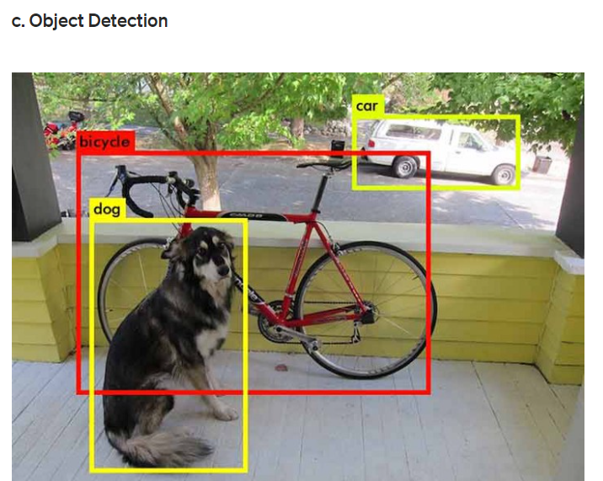
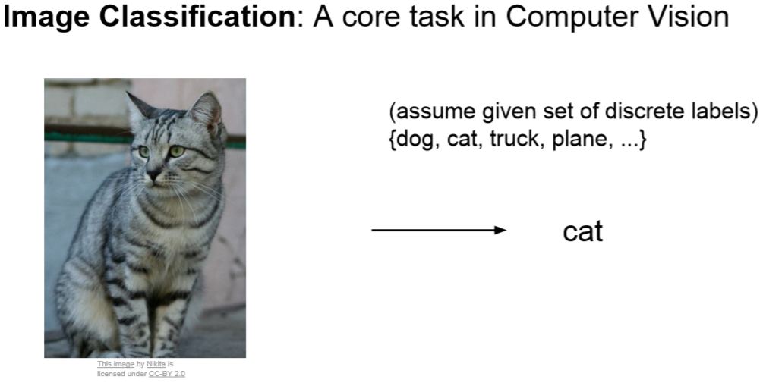
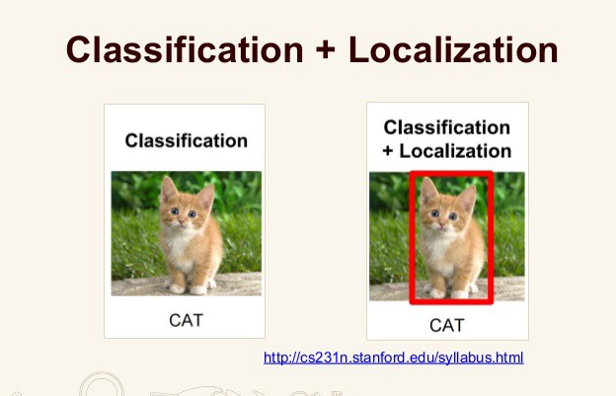
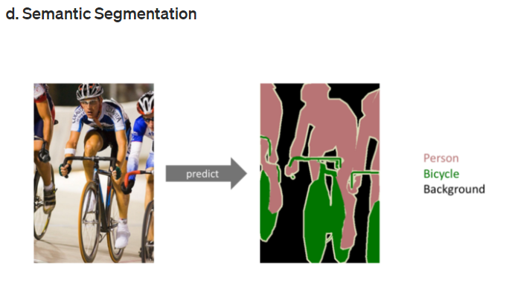
Computer Vision Problems

Slide 3
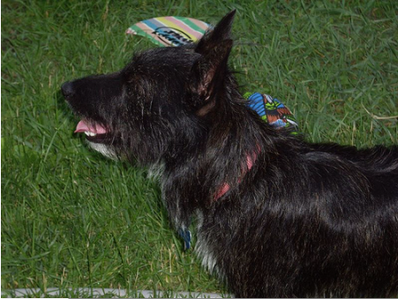

Image Segmentation
By down sampling, the model better understands “WHAT” is present in the image, but it loses the information of “WHERE” it is present.
Note: Classification per pixel (ex. black class 1, grey class 2, white class 3)

Slide 4
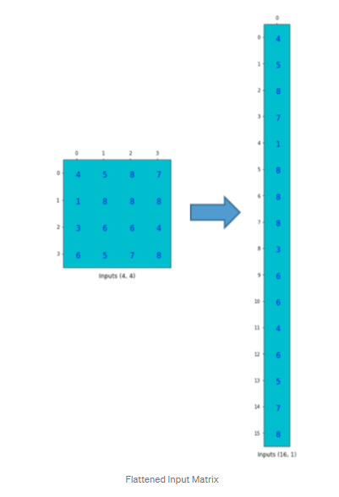
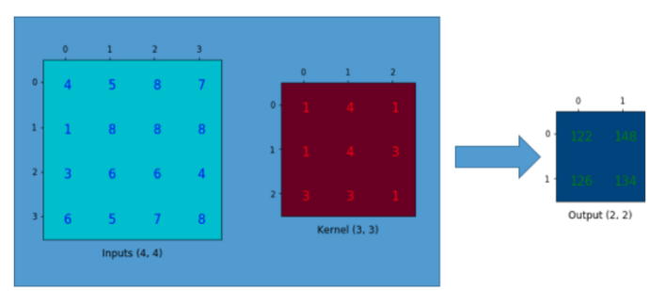
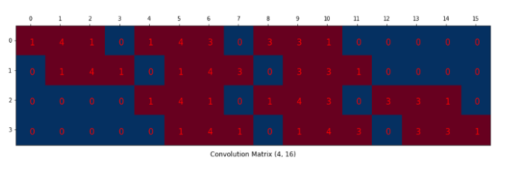
Convolution Operation
Convolution Operation
Flatten Input
Kernel (in matrix format)

Slide 5
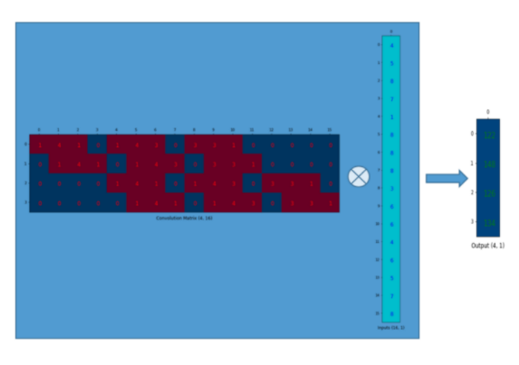
Convolution Operation (cont.)
Matrix Multiplication

Slide 6
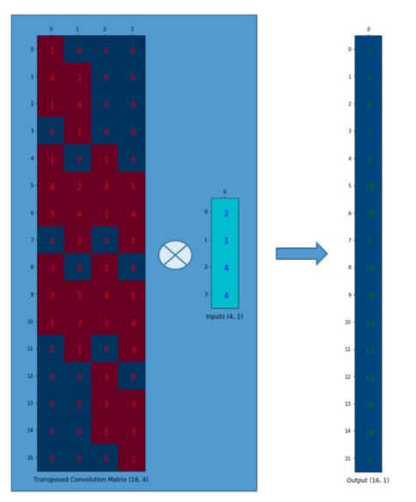
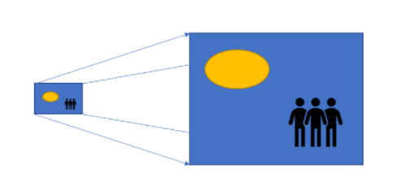
Transposed Convolution Matrix
Up-Sampling

Slide 7
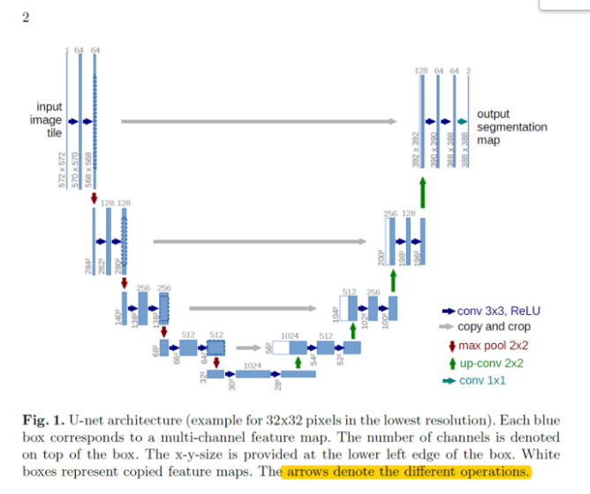
UNET

Slide 8
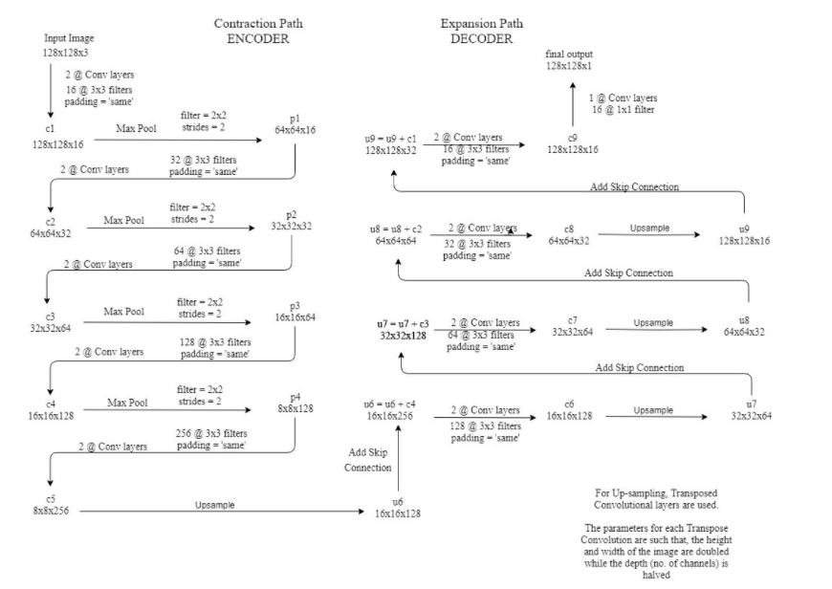
UNET (Cont.)

Slide 9
Reference
https://towardsdatascience.com/understanding-semantic-segmentation-with-unet-6be4f42d4b47
https://naokishibuya.medium.com/up-sampling-with-transposed-convolution-9ae4f2df52d0
https://keras.io/examples/vision/oxford_pets_image_segmentation/

