Slide 1
Attention Is All You Need (2017)
https://arxiv.org/abs/1706.03762

Slide 2
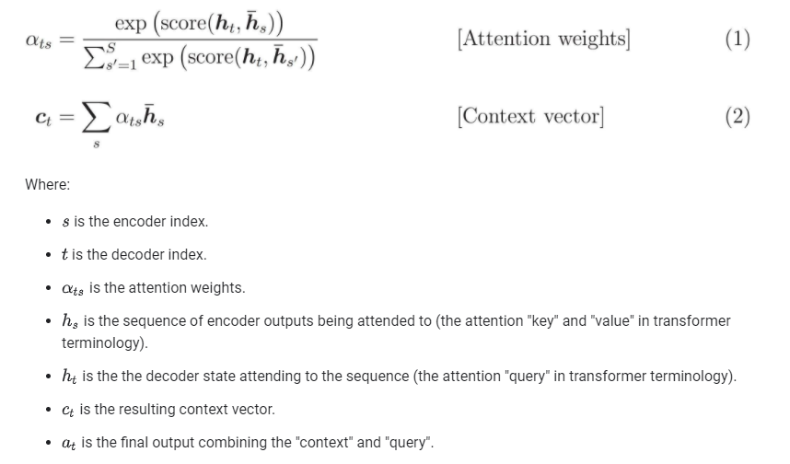
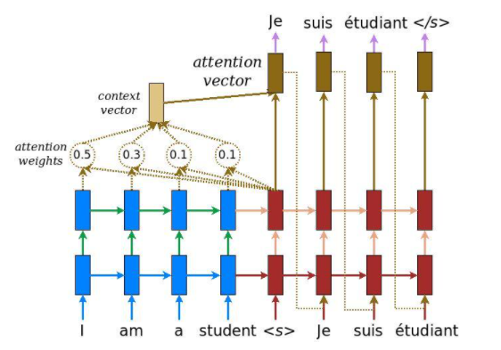
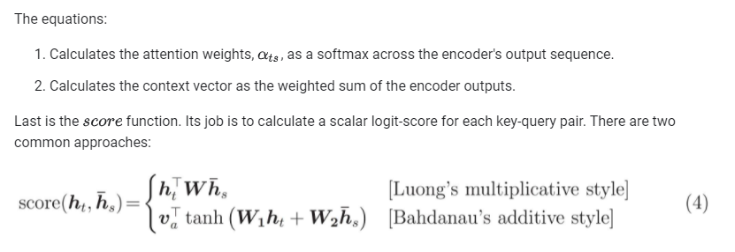
Attention Recap
Neural Machine Translation

Slide 3
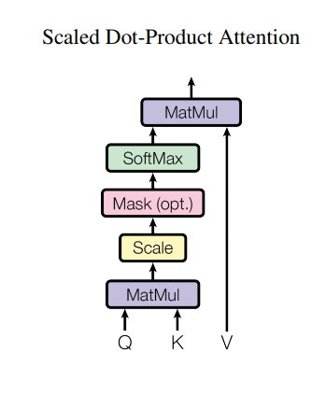
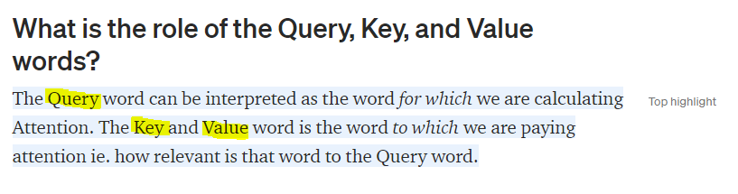
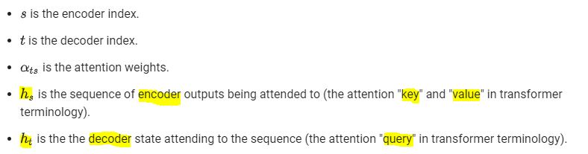

Scaled Dot-Product Attention
Ex. Encoder-Decoder Attention

Slide 4
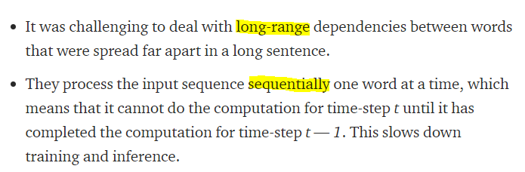
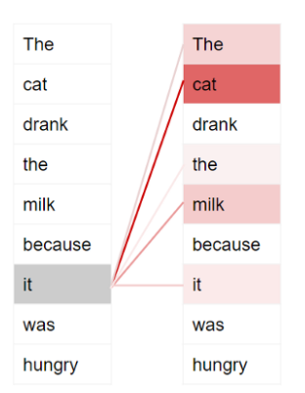
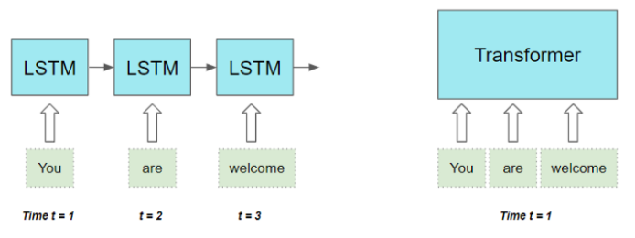
RNN-based sequence-to-sequence models limitations
How to overcome the limitation?
Self-Attention!!!

Slide 5
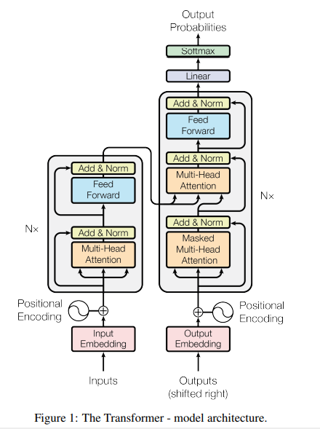
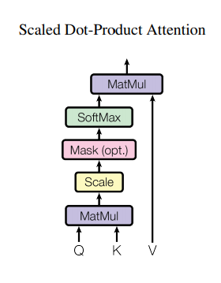
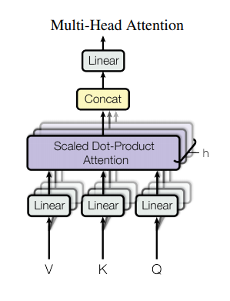
The Transformer
Remind in encoder-decoder attention Value and Key is from encoder.

Slide 6
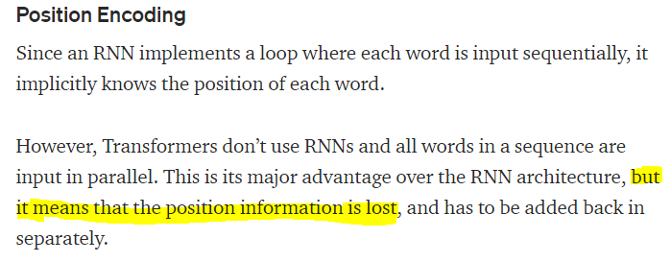
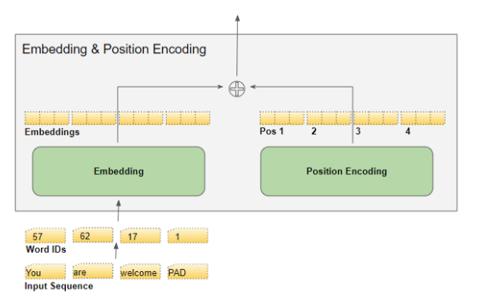
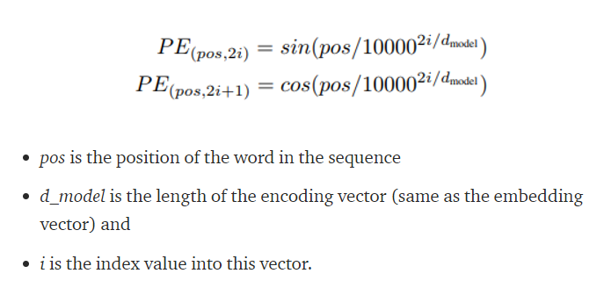
The Transformer: Embedding and Position Encoding
Hint: embedding size = d_model = 3

Slide 7
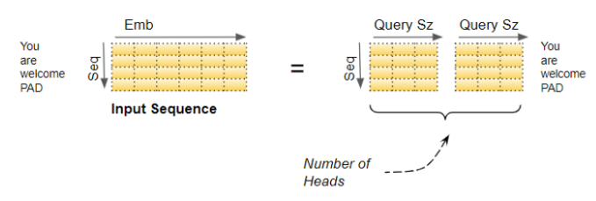
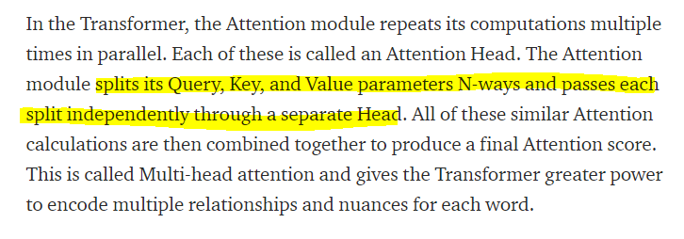
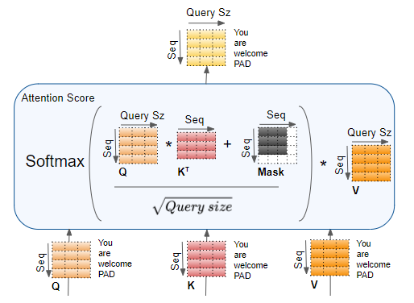
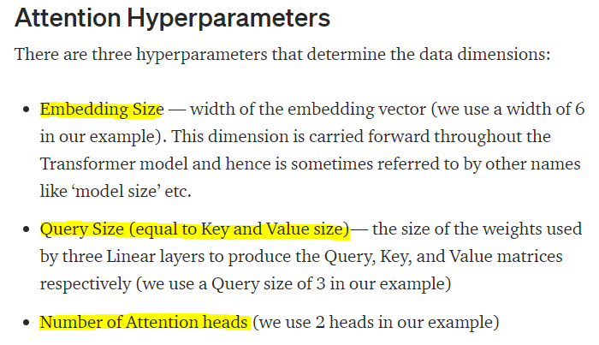

Multi-Head Attention
1. Split Input (logical)
2. Attention for each splited input.

Slide 8
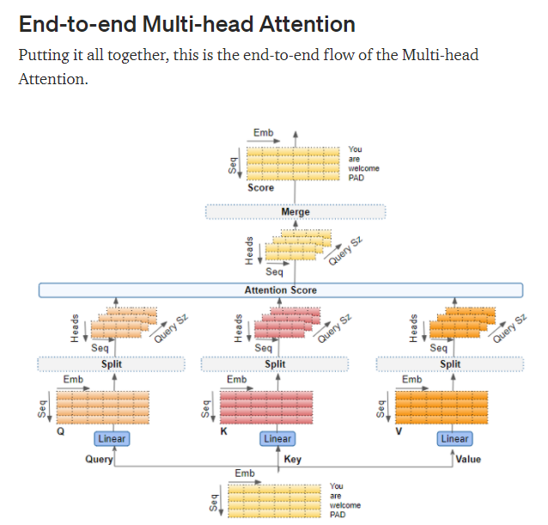
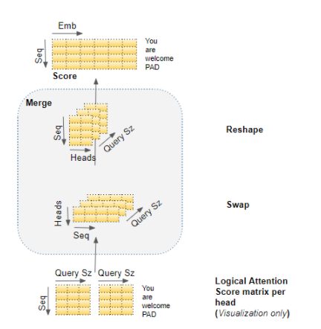
Merge Head

Slide 9

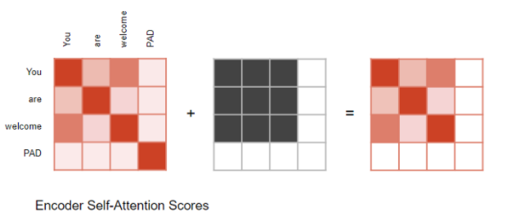
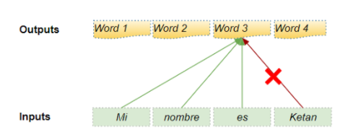
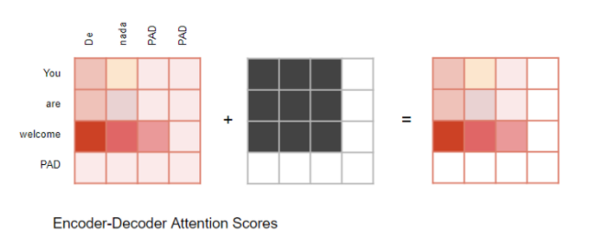
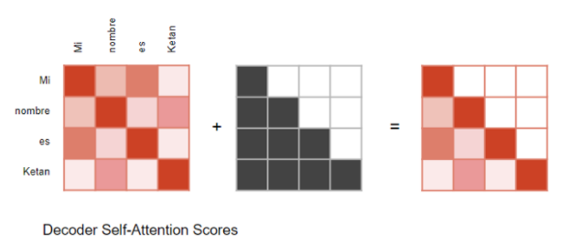
Attention Masks

Slide 10
Coding (TensorFlow)
https://www.tensorflow.org/text/tutorials/transformer

Slide 11
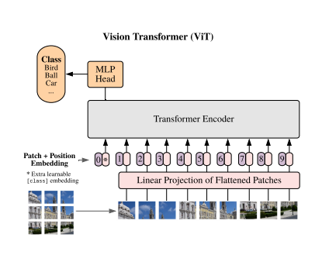
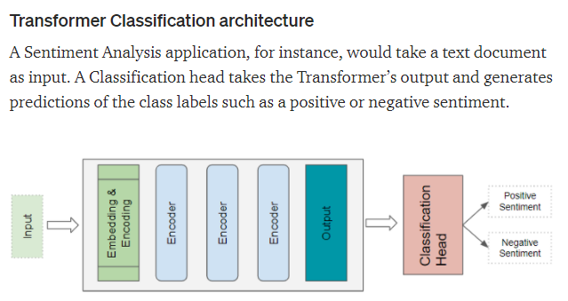
Applied Transformer

Slide 12
Reference
https://arxiv.org/abs/1706.03762
https://towardsdatascience.com/transformers-explained-visually-part-1-overview-of-functionality-95a6dd460452
https://towardsdatascience.com/transformers-explained-visually-part-2-how-it-works-step-by-step-b49fa4a64f34
https://towardsdatascience.com/transformers-explained-visually-part-3-multi-head-attention-deep-dive-1c1ff1024853
https://towardsdatascience.com/transformers-explained-visually-not-just-how-but-why-they-work-so-well-d840bd61a9d3
https://www.tensorflow.org/text/tutorials/nmt_with_attention
https://www.tensorflow.org/text/tutorials/transformer
https://arxiv.org/abs/2010.11929

