Slide 1
Student Expense Tracker
Smart budgeting using DAA algorithms
Design and Analysis of Algorithms | Mini Project
Name | Enrollment No.
Tanavir Sherasiya | 12402080601135
Tajim Kadivar | 12402080601134
Shahejad Mathakiya | 12402080601128
A. D. Patel Institute of Technology | Information Technology
Notes:
Introduce the team and the project title.

Slide 2
1. Problem Definition
Students spend daily but rarely keep a proper record of expenses.
Slow to sort expenses
Hard to find a date
No category view
Problem statement
Design a tracker that stores expenses and uses efficient algorithms to sort, search, summarise and optimise them, with complexity analysis.
2
Notes:
Explain the problem clearly in two sentences.

Slide 3
2. Objectives
1
Store expenses (name, amount, date, category, importance)
2
Sort by amount or date efficiently
3
Search by date in logarithmic time
4
Find Top-K largest expenses
5
Category-wise totals in one pass
6
Optimal budget plan using dynamic programming
7
Analyse complexity with different input sizes
3
Notes:
Read the objectives. Each one maps to an algorithm.

Slide 4
3. Background / Existing Approach
Existing approach
Gap
Notebook, mobile notes or basic spreadsheet
Data kept in entry order, so search is O(n)
Bubble Sort style methods, O(n squared)
No help to choose within a limited budget
No efficient algorithms behind the tool
Slow as data grows
Budget choices made by guess, not by optimisation
This project fills that gap
4
Notes:
Compare the old way with the algorithmic way.

Slide 5
4. Proposed Approach
Feature | Algorithm | Paradigm
Sort by amount or date | Merge Sort | Divide and Conquer
Search by date | Binary Search | Divide and Conquer
Top-K expenses | Max-Heap | Priority Queue
Category totals | Hashing (djb2) | Hash table
Budget planner | 0/1 Knapsack | Dynamic Programming
Implemented as a web simulator using HTML, CSS and JavaScript (single file, runs in any browser).
5
Notes:
Each feature has its own algorithm.

Slide 6
5. Algorithm Selection and Justification
Algorithm | Why chosen
Merge Sort | Always O(n log n), stable; better than Bubble Sort
Binary Search | O(log n) on sorted dates vs O(n) linear search
Max-Heap | Top-K without sorting everything: O(n + k log n)
Hashing | O(1) average update per expense
Knapsack DP | Guaranteed optimal; greedy may miss the best plan
6
Notes:
Say why each algorithm beats the simple alternative.

Slide 7
6. Pseudocode: Merge Sort and Binary Search
Merge Sort
Binary Search
MERGE-SORT(A, l, r)
if l >= r return
m = (l + r) / 2
MERGE-SORT(A, l, m)
MERGE-SORT(A, m+1, r)
MERGE(A, l, m, r)
MERGE: compare A[i], A[j],
copy smaller into T,
copy leftovers,
copy T back to A
BINARY-SEARCH(S, target)
low = 0, high = n - 1
while low <= high
mid = (low + high) / 2
if S[mid] == target
return mid
else if S[mid] < target
low = mid + 1
else high = mid - 1
return NOT-FOUND
7
Notes:
Walk through the logic line by line.

Slide 8
6. Pseudocode: Heap, Hashing, Knapsack
Max-Heap Top-K
Hashing
0/1 Knapsack
build max-heap
for i = n/2-1..0
HEAPIFY(i)
repeat k times
output H[0]
H[0] = last
size = size - 1
HEAPIFY(0)
table T[31]
for each expense e
i = HASH(e.cat) % 31
while slot used by
other key
i = (i + 1) % 31
T[i].total += e.amount
W = budget / 50
for i = 1..n
for w = 0..W
dp[i][w] = dp[i-1][w]
if wt[i] <= w
dp[i][w] = max(
dp[i][w],
dp[i-1][w-wt[i]]
+ val[i])
8
Notes:
Explain each in one line.

Slide 9
7. Complexity Analysis
Algorithm | Best | Average | Worst | Space
Merge Sort | O(n log n) | O(n log n) | O(n log n) | O(n)
Binary Search | O(1) | O(log n) | O(log n) | O(1)
Max-Heap Top-K | O(n) | O(n + k log n) | O(n + k log n) | O(n)
Hashing | O(n) | O(n) | O(n x m) | O(m)
Knapsack DP | O(nW) | O(nW) | O(nW) | O(nW)
n = expenses, k = Top-K size, m = categories, W = budget / 50
9
Notes:
Time and space for every algorithm.

Slide 10
8. System Design and Implementation
Input
Sorting
Search
Heap
Hashing
Planner
Buttons on the page connect all modules
Front end
Logic (JavaScript)
HTML: input boxes, buttons, sections
CSS: layout and dark/light design
Single file: expense-tracker.html
All five algorithms written in JS
Expenses kept in an array of objects
Shows comparisons and search steps
10
Notes:
Show the modules and the two implementations.

Slide 11
8. Implementation: Key JavaScript Code
Merge Sort (JavaScript)
Binary Search (JavaScript)
function mergeSort(arr,key){
if(arr.length<2) return arr;
var m=arr.length>>1,
l=mergeSort(arr.slice(0,m),key),
r=mergeSort(arr.slice(m),key),
o=[],i=0,j=0;
while(i<l.length&&j<r.length){
cmps++;
if(l[i][key]<=r[j][key])
o.push(l[i++]);
else o.push(r[j++]);
}
return o.concat(l.slice(i))
.concat(r.slice(j));
}
var lo=0, hi=S.length-1;
while(lo<=hi){
var m=(lo+hi)>>1;
if(S[m].d==t){
found=m; break;
} else if(S[m].d<t){
lo=m+1;
} else {
hi=m-1;
}
}
// S is the date-sorted copy
// made with mergeSort()
11
Notes:
Show only these two snippets; explain in one line each.

Slide 12
9. Testing with Different Input Sizes
n | Merge Sort | Bubble Sort | Binary Search steps | Knapsack cells
10 | 19 | 45 | 4 | 671
50 | 226 | 1,225 | 6 | 3,111
100 | 545 | 4,950 | 7 | 6,161
500 | 3,839 | 124,750 | 9 | 30,561
1000 | 8,727 | 499,500 | 10 | 61,061
Random amounts between Rs 10 and Rs 2000. Knapsack budget Rs 3000 (W = 60).
12
Notes:
Operation counts were measured, so they do not depend on computer speed.

Slide 13
10. Results and Performance Comparison
Comparisons to sort n = 1000 expenses
Key results
Binary Search: only 10 steps for 1000 items
Knapsack plan: importance 28 within Rs 3000
More than one optimal plan can exist
13
Notes:
Merge Sort is about 57 times fewer comparisons at n = 1000.

Slide 14
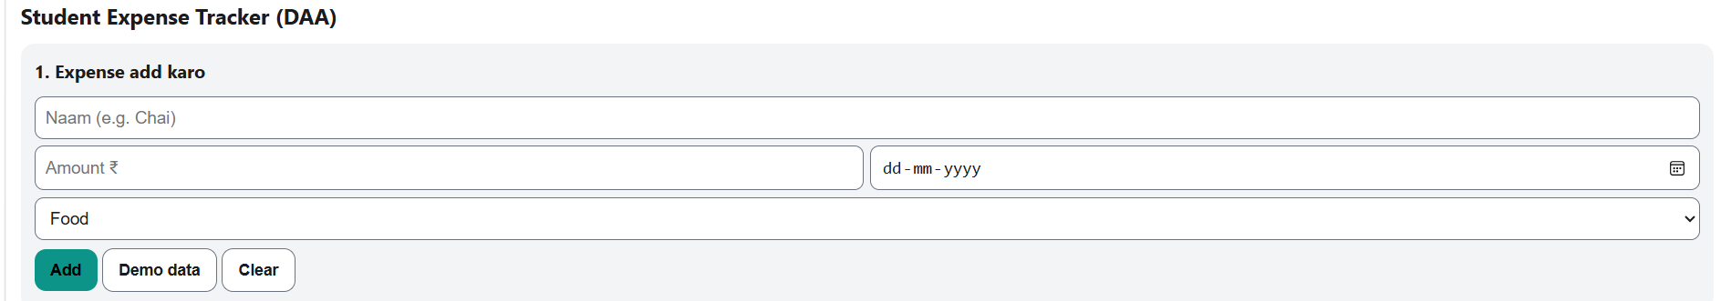
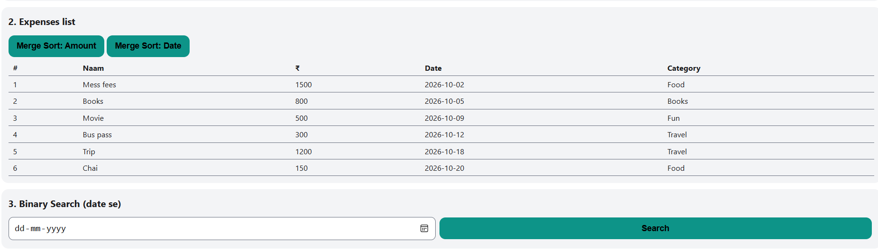
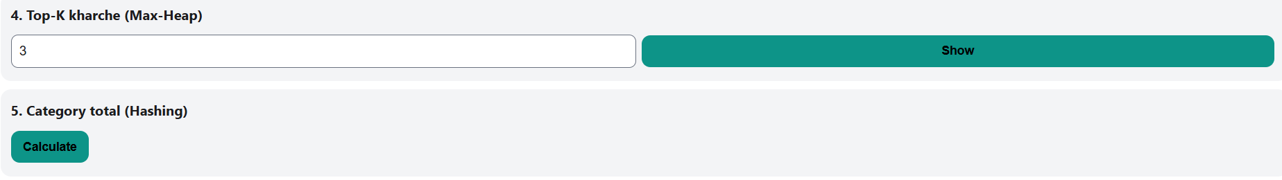
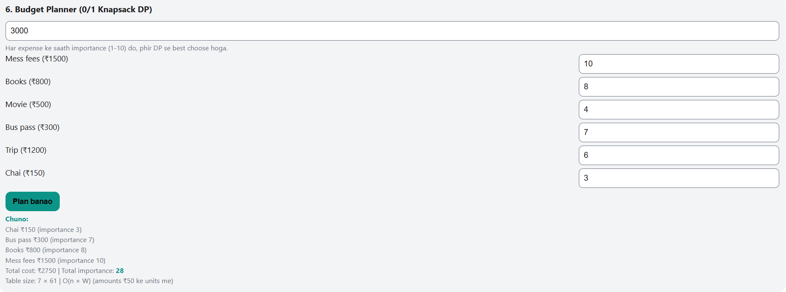
11. Screenshots of Working Project
Insert screenshot
Simulator home: add expense
Insert screenshot
Merge Sort and Binary Search
Insert screenshot
Top-K and category totals
Insert screenshot
Knapsack budget planner
14
Notes:
Replace each box with a real screenshot before presenting.

Slide 15
12. Advantages and Limitations
Advantages
Limitations
Efficient algorithm for every feature
Guaranteed O(n log n) sorting
Very fast date lookup
Optimal budget plan
Runs in any browser, no install
Shows comparison counts and steps
Data is lost on page refresh
No database or user login
Single user, one browser
Amounts rounded to Rs 50 in DP
Very large data limited by browser memory
No charts yet
15
Notes:
Be honest about limitations; examiners like it.

Slide 16
13. Future Scope
Save data in a database or local storage
Mobile app with cloud sync
Weekly and monthly charts
Alerts when a category crosses its limit
Import UPI or bank history
Balanced tree or hash map for large data
16
Notes:
Pick two or three to speak about.

Slide 17
14. Conclusion
Five DAA algorithms solve real student problems.
Tests confirm theory: Merge Sort grows as n log n, Bubble Sort as n squared.
Dynamic programming gives an optimal budget plan instead of a guess.
Thank you! Questions?
17
Notes:
Summarise in three lines, then thank the audience.

Slide 18
15. References
T. H. Cormen, C. E. Leiserson, R. L. Rivest, C. Stein, Introduction to Algorithms, MIT Press.
A. Levitin, Introduction to the Design and Analysis of Algorithms, Pearson.
E. Horowitz, S. Sahni, S. Rajasekaran, Fundamentals of Computer Algorithms, Universities Press.
B. W. Kernighan, D. M. Ritchie, The C Programming Language, Prentice Hall.
DAA course notes, A. D. Patel Institute of Technology.
18
Notes:
Read titles only.

