Slide 1
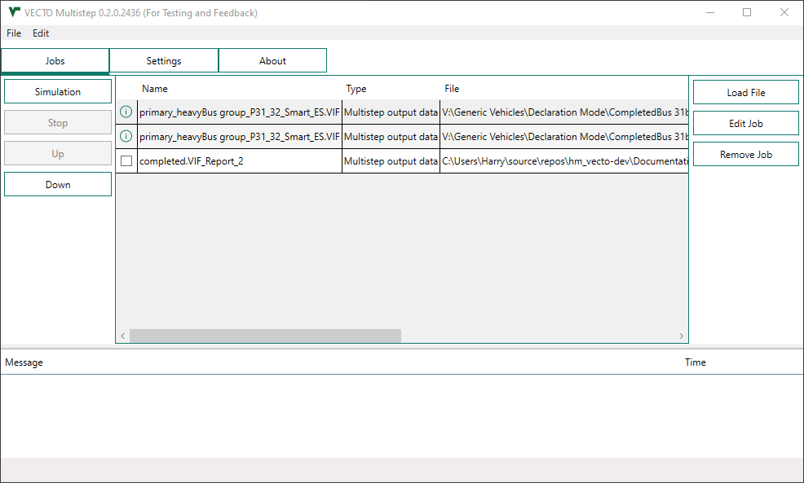
Simulation-
and Job Commands
Joblist
File Section
Messages

Slide 2

Progress
Status Messages
Status

Slide 3
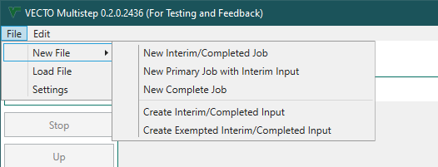

Slide 4
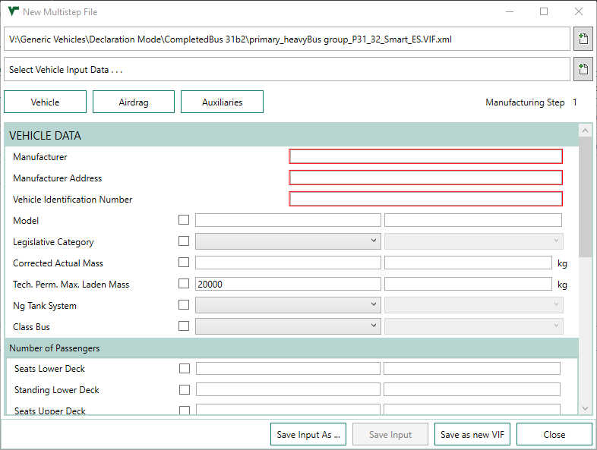
1
2
3
4
5
6
7
8

Slide 5
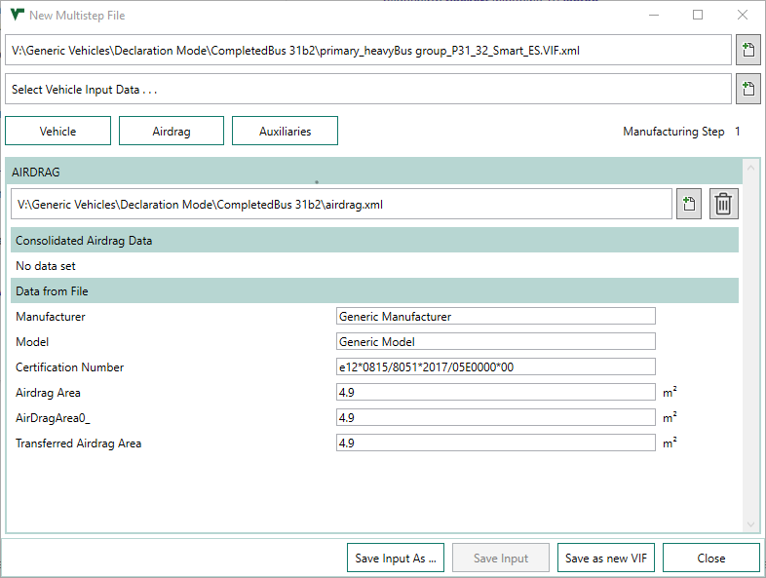
1
2
3

Slide 6
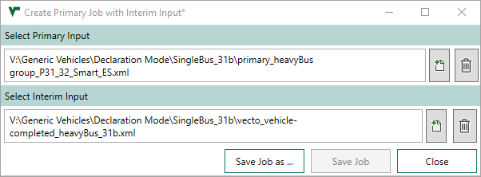
1
2
3

Slide 7
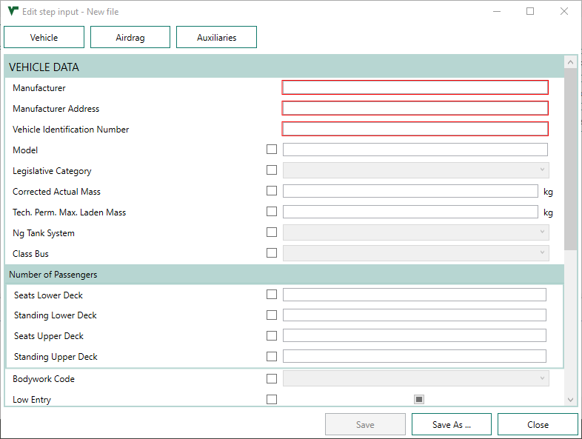
1
2
3
4

Slide 8
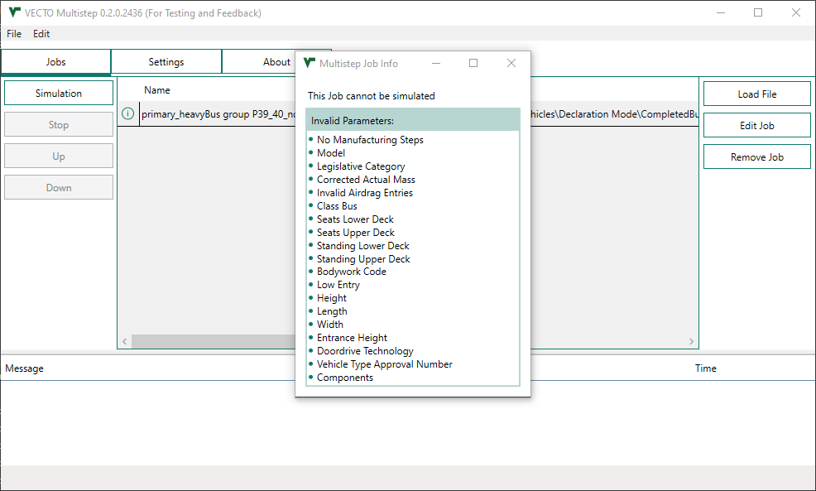
1

Slide 9
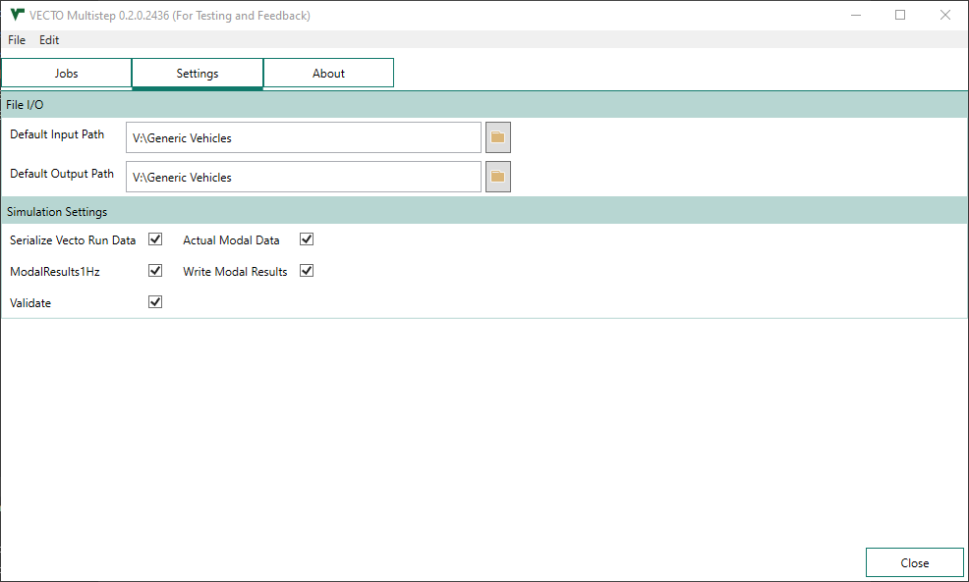
1
2

Slide 10
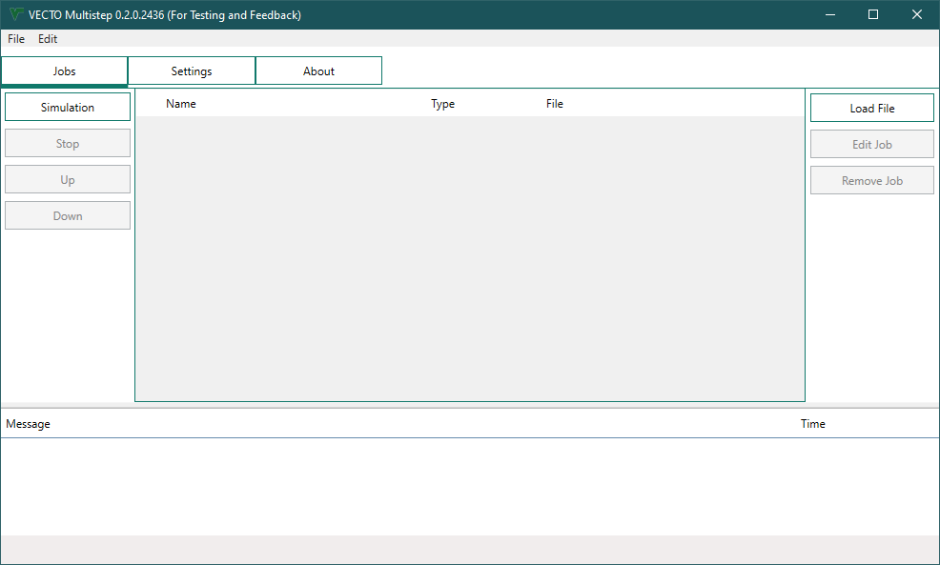
1

Slide 11
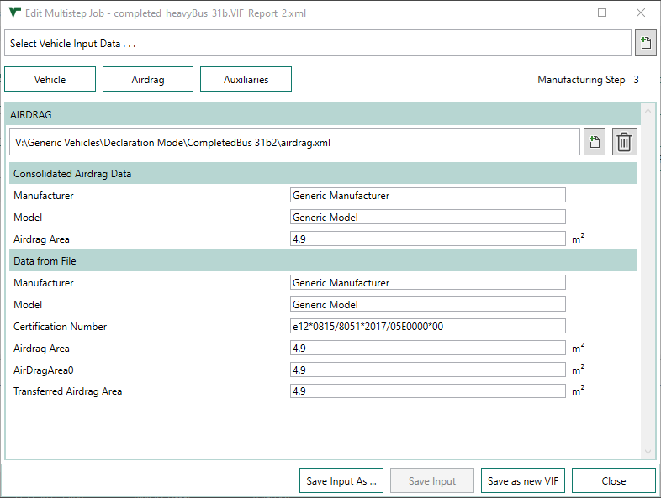
1
2
3

