Slide 1
AI-Driven Predictive Diagnosis Chatbot for Healthcare
By:
Sonam Bhul MITU21BTIT0058
Ayushi Tiwari MITU21BTIT0018
Tanay Kumar MITU21BTIT0060
Guided By:
Prof. Dr. Mohit Kumar & Prof. Ashvini Jadhav

Slide 2
AI-Driven Predictive Diagnosis Chatbot for Healthcare
Problem Statement:
Implementing Retrieval-Augmented Generation (RAG) with lightweight LLMs like LLaMA 2 or Mistral or Gemini-Pro to deliver clear, easy-to-understand guidance on symptoms and medications for common ailments.
This system combines advanced retrieval techniques with LLMs to simplify medical information, making it more accessible and user-friendly.

Slide 3
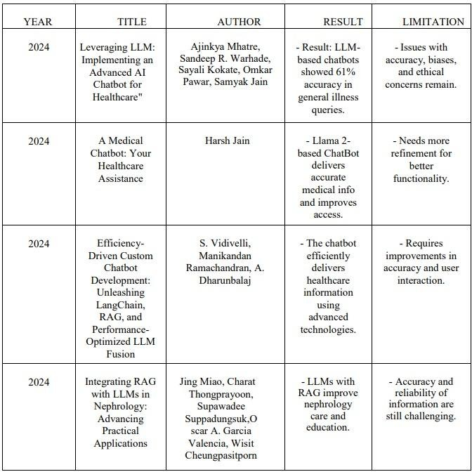
Literature survey

Slide 4
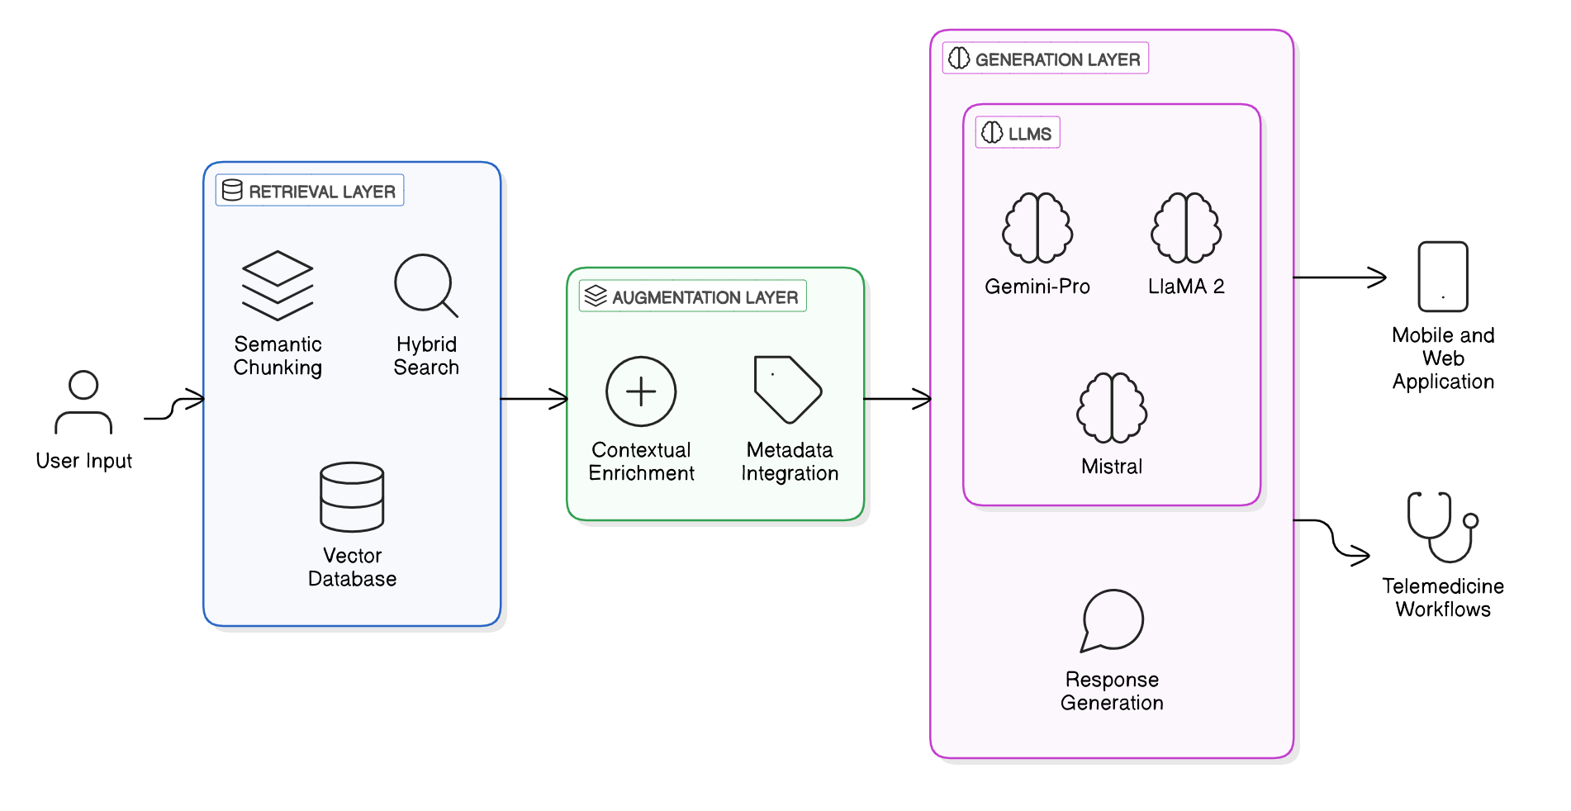
langchain Architecture
6
•

Slide 5
AI-Driven Predictive Diagnosis Chatbot for Healthcare
Proposed Solution:
Users upload medical documents in various formats.
The system processes and extracts relevant medical information from these documents.
Extracted data is indexed and organized into a searchable knowledge base.
When a user queries the system, it retrieves pertinent information from the indexed data.
A lightweight Large Language Model (LLM) generates a clear, concise response based on the retrieved information.
The system delivers personalized and accurate medical guidance efficiently.

Slide 6
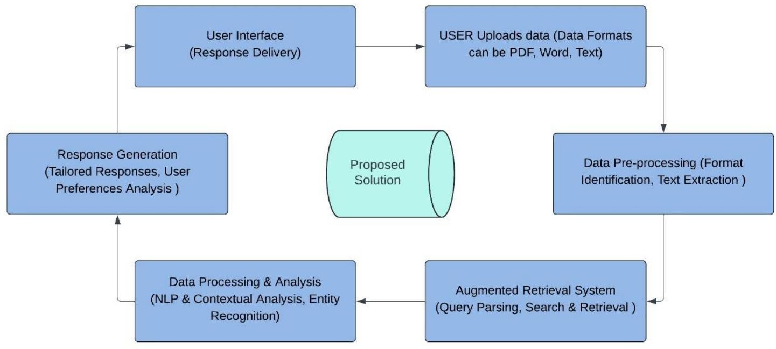
PROPOSED SOLUTION

Slide 7
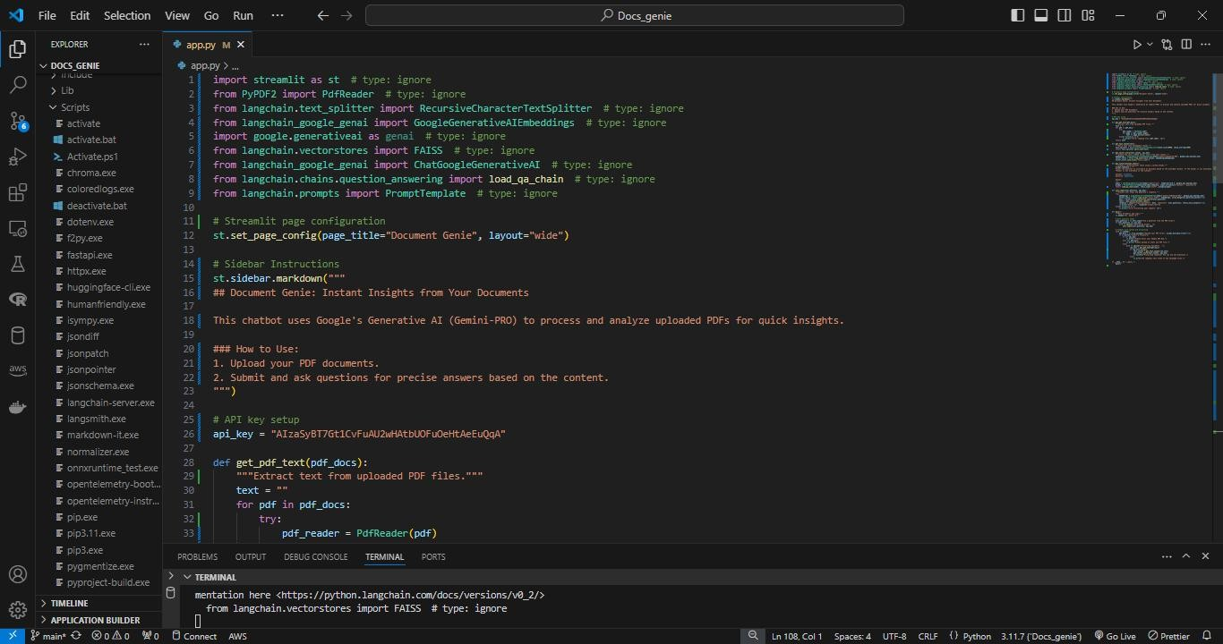
CODE

Slide 8
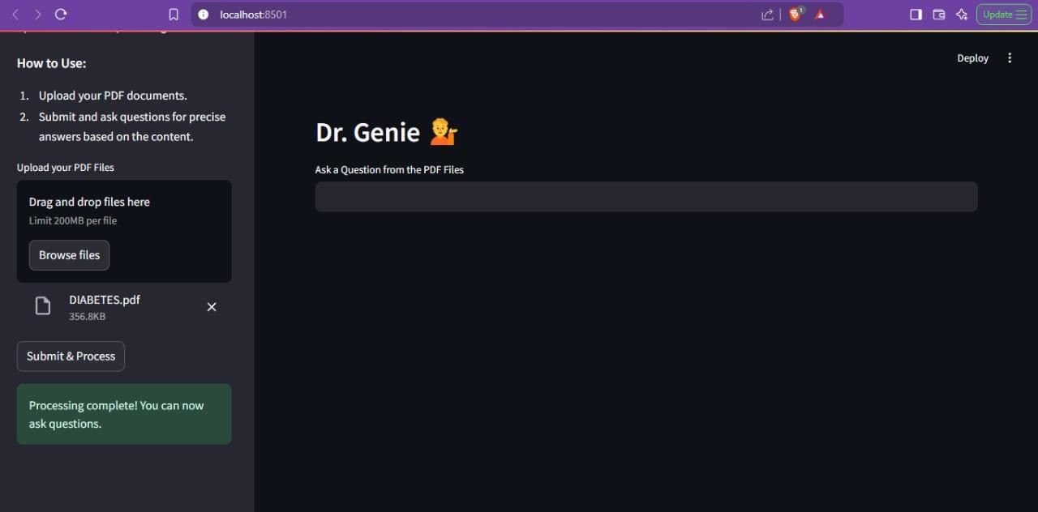
OUTPUT

Slide 9
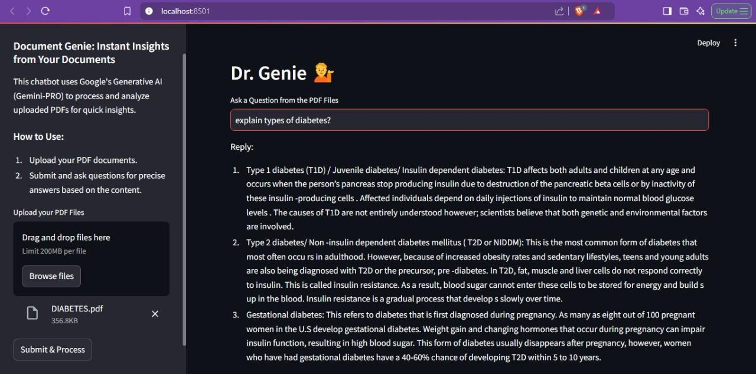
OUTPUT

Slide 10
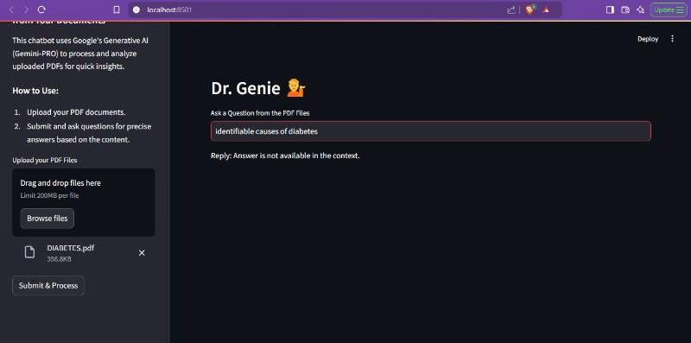
OUTPUT

Slide 11




FEASIBILITY AND VIABILITY
Potential Challenges and Risks:
Data Privacy and Security
Data Quality and Bias
Your title here
Presentations are communication tools that can be used as demonstrations.
Presentations are communication tools that can be used as demonstrations.
Presentations are communication tools that can be used as demonstrations.
Symptom analysis, medication recommendations
12

Slide 12
IMPACT AND BENEFITS
Early Detection of Health Issues:
Benefit: Identifies potential health problems before they become serious. Outcome: Enables earlier treatment, potentially preventing severe conditions. Personalized Treatment:
Benefit: Moves away from a one-size-fits-all approach.
Outcome: Tailors treatment plans based on individual health data, improving patient care.
Economic Savings:
Benefit: Reduces the need for expensive treatments and hospital stays.
Outcome: Lowers healthcare costs, reduces missed workdays, and boosts productivity.
Environmental Benefits:
Benefit: Minimizes unnecessary tests and treatments.
Outcome: Reduces medical waste and, if remote monitoring is used, decreases travel to healthcare facilities.
Improved Quality of Life:
Benefit: Healthier individuals with fewer severe health issues.
Outcome: Enhances overall well-being and quality of life.

Slide 13
FUTURE SCOPE
Enhanced Diagnostic Accuracy: Achieve greater precision by integrating real-time data streams and training the system in specialized medical domains.
Integration of Multiple LLMs: Leverage multiple lightweight Large Language Models for improved context understanding and diverse query handling.
Chat History Functionality: Provide users with access to past queries and responses for better continuity and reference.
Support for Multiple Input Formats: Enable compatibility with various file types to streamline data ingestion and processing.

Slide 14
RESEARCH AND REFERENCES
Leveraging LLM: Implementing an Advanced AI Chatbot for Healthcare, Ajinkya Mhatre, Sandeep R. Warhade, Sayali Kokate,
Omkar awar, Samyak Jain, May 2024 https://ijisrt.com/assets/upload/files/IJISRT24MAY1964.pdf
A Medical Chatbot: Your Healthcare Assistance, Harsh Jain, June 2024 https://www.irjmets.com/uploadedfiles/paper//issue_6_june_2024/58850/final/fin_irjmets1717770049.pdf
Efficiency-Driven Custom Chatbot Development: Unleashing LangChain, S. Vidivelli, Manikandan Ramachandran, A. Dharunbalaji,
August 2024
https://file.techscience.com/files/cmc/2024/TSP_CMC-80-2/TSP_CMC_54360/TSP_CMC_54360.pdf
Integrating RAG with LLMs in Nephrology: Advancing Practical Applications, Jing Miao, Charat Thongprayoon, Supawadee Suppadungsuk, Oscar A. Garcia Valencia, Wisit Cheungpasitporn, March 2024 https://www.ncbi.nlm.nih.gov/pmc/articles/PMC10972059/
Health-LLM: Personalized Retrieval-Augmented Disease Prediction Model, Mingyu Jin, Qinkai Yu, Chong Zhang, Dong Shu,
February 2024
h t t p s : / / w w w. r e s e a r c h g a t e . n e t / p u b l i c a t i o n / 3 7 7 9 6 8 11 7 _ H e a l t h _ x 0 0 0 2 _ L L M _ P e r s o n a l i z e d _ R e t r i e v a l - Augmented_Disease_Prediction_Model

Slide 15
Thank You !!!

