Slide 1


AUTOREPAIR APP
TEAM S

Slide 2
ACKNOWLEDGEMENT
VIT MENTOR:
Prof. Lakshmanna K
MICROSOFT MENTORS:
Rohit Singh (GD)
Sanklan Saxena

Slide 3


PROBLEM STATEMENT
What do you do?
Notes:
Consider a situation where you’re travelling on the road and your car breaks down in the middle of nowhere, you have no contacts to any automobile repair shop and no cellular data. What do you do?
Or consider that your car is very low on petroleum and only petrol station you know of is out of the way and you’re on a schedule to reach a destination. How would you find the closest petroleum station?

Slide 4
INTRODUCTION
The AutoRepair application is aimed to provide the nearest gas stations and repair shops in a situation of despair with no internet connectivity.
Notes:
The AutoRepair application is aimed to be a universal application that enables the user either, choose a starting point and a destination to display the shortest route possible along with AutoRepair facilities along the way.
Or, gather their current location and find shops present within a circular radius, displayed by passing the longitudes and latitudes for points within the given person’s circular area.

Slide 5
MOTIVATION
We hope that through our app, no person ever feels helpless in any situation while on the road.
Notes:
The motivation behind building this universal application is the lack of options a person has in case of vehicle breakdown.
If only there were a way of getting to know of the nearest gas stations and repair shops in a situation where you have no connectivity due to bad network receptivity.
We hope that through our app no person will ever be in this helpless situation.

Slide 6
ARCHITECTURE
Find Repair Shops/Petrol Pumps
By route
By current location
Input start and end locations
Retrieve current location using GPS
Retrieve repair shops/petrol pump details within a 1.6km radius from
Our database on Bing Spatial Service
Retrieve repair shops/petrol pump details within data stored offline when route locations were entered Or Get new Data for defined radius (Here 100km) from present Location
Notes:
First of all the user needs to select the operation on the Start screen, whether to find shops by route or by given location.
If they chooses the former, the user has to input the start and the end locations of his journey and click on the submit button.
Else if the user needs shops near his current location, he can click on Use my location to be rerouted to shops on the map.
The user can get details of the desired shop or hotel etc. by Tapping on the pushpin and the contact details of the nearest desired location will be displayed.

Slide 7
ARCHITECTURE SCOPE
The implementation of the architecture is limited to the Prototype Data [including our own location coordinates for Repair Shops and Petrol Pumps for the test cases]. The project if or when carried forward can use a database of all the repair shops and petrol pumps over the world.
Notes:
First of all the user needs to select the operation on the Start screen, whether to find shops by route or by given location.
If they chooses the former, the user has to input the start and the end locations of his journey and click on the submit button.
Else if the user needs shops near his current location, he can click on Use my location to be rerouted to shops on the map.
The user can get details of the desired shop or hotel etc. by Tapping on the pushpin and the contact details of the nearest desired location will be displayed.

Slide 8


IMPLEMENTATION
BING maps API: Rest API & SPATIAL API.
C#, XAML, Windows Phone Maps.
Notes:
This application is made on Microsoft Visual Studio Professional 2013.
For the implementation of Maps, BING maps API was used along with the BING MAPS REST API & BING MAPS SPATIAL DATA API.
To make the app offline, we are currently working on implementing an SQLite Database to the app.
Languages used in implementation are C#, XAML SQL.

Slide 9
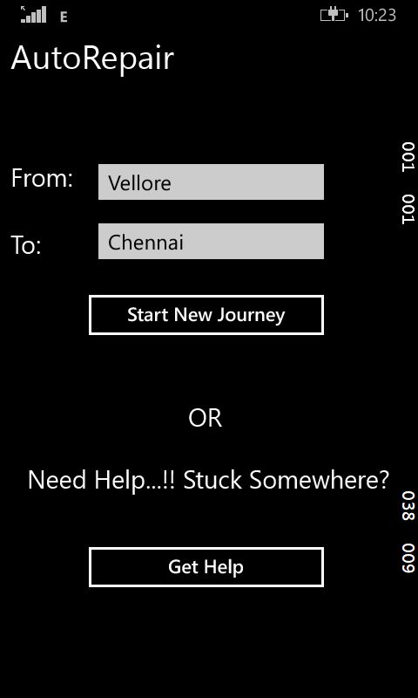
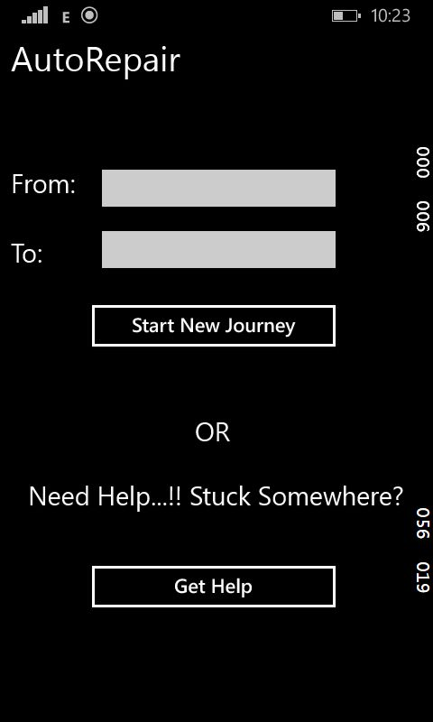
DESIGN
Notes:
First of all the user needs to select the operation on the Start screen, whether to find shops by route or by given location.
If they chooses the former, the user has to input the start and the end locations of his journey and click on the submit button.
Else if the user needs shops near his current location, he can click on Use my location to be rerouted to shops on the map.
The user can get details of the desired shop or hotel etc. by Tapping on the pushpin and the contact details of the nearest desired location will be displayed.

Slide 10
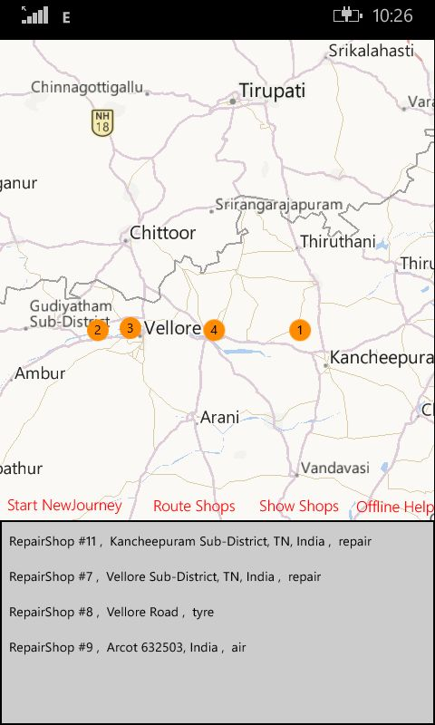

Slide 11
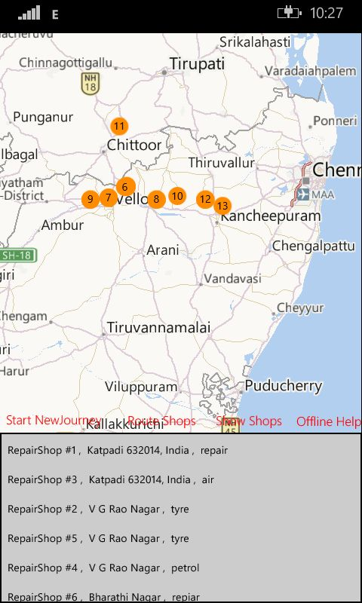

Slide 12
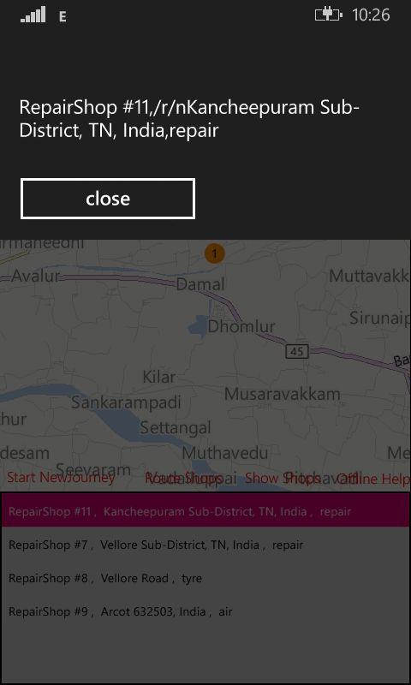

Slide 13
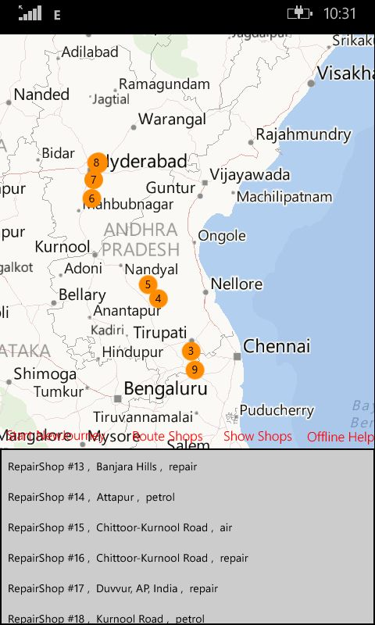

Slide 14
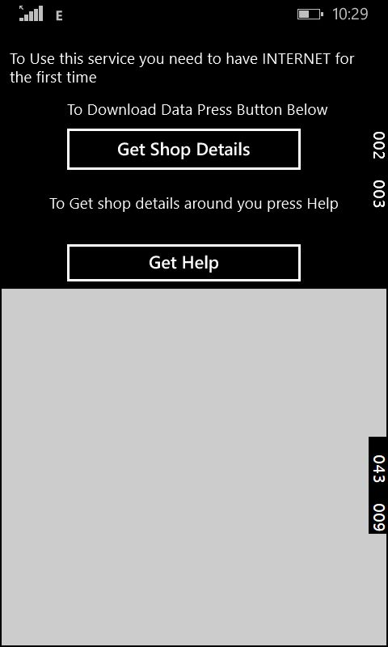

Slide 15
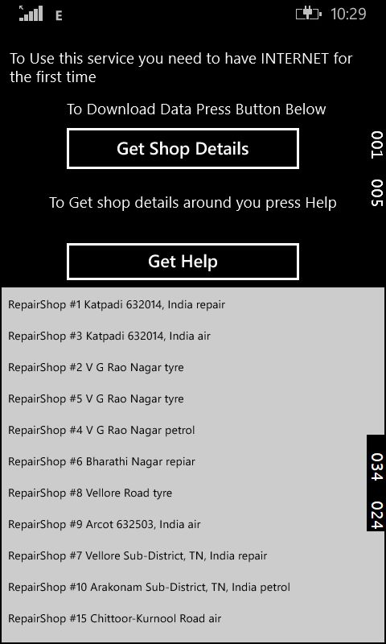

Slide 16
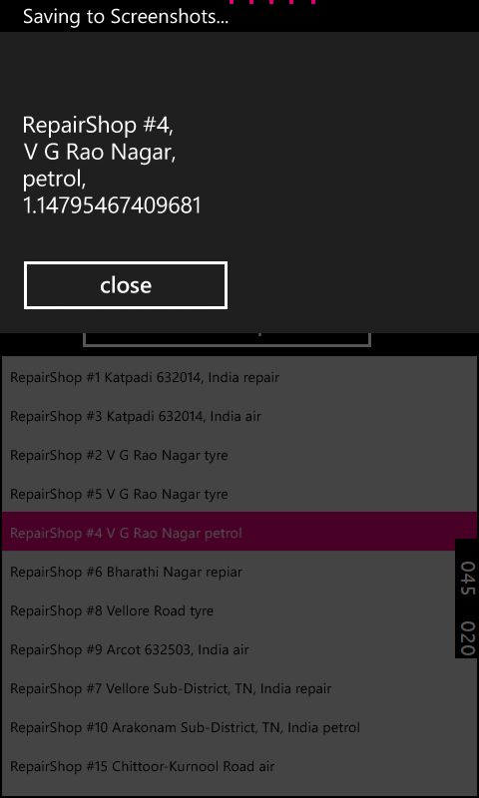

Slide 17
MODULES
Map Service / Bing Map Rest Service – To Geocode and Get Data for Routes etc.
Geolocator Class – to Get Current Location.
Json Data – Serializing and Deserializing.
Storage Folder/Storage File – to Store in Local storage.
Bing Maps Spatial Data Service – To store Data of shops and retrieve info about it.
Notes:
First of all the user needs to select the operation on the Start screen, whether to find shops by route or by given location.
If they chooses the former, the user has to input the start and the end locations of his journey and click on the submit button.
Else if the user needs shops near his current location, he can click on Use my location to be rerouted to shops on the map.
The user can get details of the desired shop or hotel etc. by Tapping on the pushpin and the contact details of the nearest desired location will be displayed.

Slide 18
CONCLUSION
Benefits:
Get details of all repair shops and gas stations:
Near you (offline/online)
Along your route (online)
Limitations:
Offline functionality requires initial route setup
Only prototype data used

Slide 19
REFERENCES
www.microsoftvirtualacademy.com/
https://www.bingmapsportal.com/
https://code.msdn.microsoft.com/
http://stackoverflow.com/questions/
http://www.newtonsoft.com/json/help/html/Introduction
http://blogs.bing.com/maps/2012/11/05/getting-started-
with-bing-maps-windows-store-apps-native/
https://msdn.microsoft.com/en-us/library/ff701734.aspx
http://blogs.msdn.com/b/wsdevsol/archive/2014/01/09/c
onsuming-rest-services-in-your-windows-store-and-
phone-applications.aspx

