Slide 1

METEROLOGICAL STATION
An IOT Based Embedded System Project
-Rishabh Kulshrestha 13BCE0410
-Tanay Agrawal 13BCE0177
-Rishabh Chaddha 13BCE0034

Slide 2
AIM
To Make a Weather / Meteorological Station With a Raspberry Pi appropriate sensors.

Slide 3
ABSTRACT
Meteorological station is a real time IOT based system which allows real time control of meteorological data like wind speed and direction it also measures temperature, relative humidity, atmospheric pressure and precipitation rate. In this way the data captured by the system can be stored for further studies and decision making. This data can be fetched on remote device from the online server using Internet.

Slide 4
INTRODUCTION
Continuous measurement of meteorological parameters
Real-time information to customers and citizens
Weather control
Detailed analysis of the results

Slide 5
FEATURES
Temperature (Celsius)
Relative humidity
Wind speed
Wind direction
Precipitation rate (cubic millimeters)
Light intensity

Slide 6
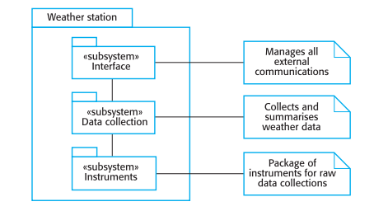
PROPOSED SYSTEM

Slide 7
PROPOSED SYSTEM
Interface
This subsystem helps in transferring data between the raspberry pi and the cloud based web application. It basically provides an interface and way to transmit data between the hardware and cloud.

Slide 8
PROPOSED SYSTEM
Data Collection and Display
This subsystem retrieves the data from the cloud web application and displays it on the web page with the help of a suitable GUI. Moreover, from the web page the user can download the data for off-line usage as well.

Slide 9
PROPOSED SYSTEM
Instruments
This subsystem gathers data from the surrounding environment with the help of the sensors used with the hardware, processes the data and stores them on a database on the raspberry pi. then with the help of Interface system it uploads this data on the cloud web application.

Slide 10
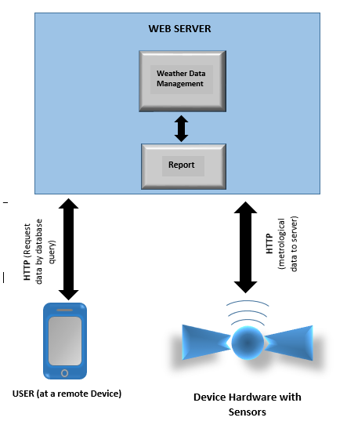
SYSTEM DESIGN DIAGRAM

Slide 11
SOFTWARE REQUIREMENTS
Web Server - Web Hosting + Database + Backend (PHP 5)
HTML, CSS, JavaScript – for remote application front end
Python – for programming on Raspberry Pi

Slide 12
HARDWARE REQUIREMNTS
Raspberry Pi
Breadboard
Wires
WIFI module(if not on chip)

Slide 13
HARDWARE REQUIREMNTS
Sensors:-
Temperature DHT11/22
Temperature BMP180
Humidity DHT11/22
Pressure BMP180
Dew point temperature DHT11/22
Altitude BMP180
Light intensity LDR

Slide 14
MODULES
Setup the Temperature / Humidity Sensor- Temperature sensor gather temperature data.
Setup the Waterproof Temperature Sensor- To monitor average rainfall
Setup the Digital wind Sensor- To monitor how fast the wind blows and in which direction
Setup the Barometric Pressure Sensor- To monitor pressure at sea level
Then all the information will be gathered to predict weather patterns

Slide 15
MODULES
The data will be analyzed and parameters(pressure, temperature etc.) will be calculated and stored in BMP280 datasheet.
We will finish off by recording the measurements in a MySQL database hosted on the Pi and will deploy our weather station.
For the display section we will create website to display the measurements being collected by our weather station. We will upload our measurements to the Oracle cloud database so that they can be used by other people.
Last module will be the interpretation of weather in which we will discern patterns in weather data, analyze them and use them to inform predictions about future weather. This will be done for both local weather (using our own data) and national weather (using data from the Oracle cloud database online).

Slide 16
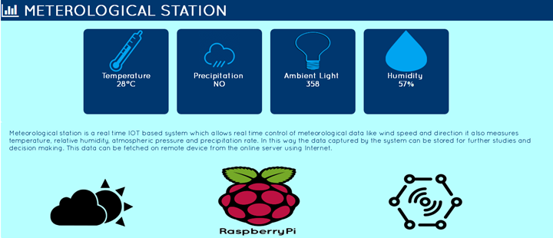
REMOTE APPLICATION UI

Slide 17
FUTURE WORK
Adding of more sensors to monitor other environmental parameters such as Soil PH Sensor, CO2 and oxygen Sensor while allowing the replacing of current sensors if a wider range of measurements is desired. And also Integration of additional monitoring devices such as a Wi-Fi camera to monitor growth of agricultural product. And also the data can be uploaded to web server continuously.

Slide 18
REFERENCES
[1] Kang. J. and Park S. “Integrated comfort sensing system on indoor climate” Sensors and Actuators. 2000. 302-307.
[2] Moghavvemi M. and Tan. S. “A reliable and economically feasible remote sensing system for temperature and relative humidity measurement”.Sensors and Actuators. 2005. 181-185.
[3] Campbell Scientific, Data loggers, Sensors and Weather stations,http://www.campbellsci.co.uk.
[4] Visala, Automatic weather stations, http://www.vaisala.com/en/products.
[5] Prodata, Affordable automatic weather stations,http://www.weatherstations.co.uk.
[6] Sparks L. & Sumner G., “Microcomputer Based Weather Station Monitoring System”, Journal of Microcomputer Applications, 7, pp. 233-24, 1984.
[7] Bagiorgas H.S, Margarita N. A, Patentalaki. A, Konofaos. N, Dmetrios P, Matthopoulos & Mihalakakou G., The Design Installation and Operation of A FullyComputerised, Automatic Weather Station for High Quality Meteorological Measurements”, Fresenius Environmental Bulletin, 16–8, pp.948- 962. 2007.
[8] Guo X. & Song Y., “Design of Automatic Weather Station Based on GSM Module”, Int. Conf. on Computer,Mechatronics, Control and Electronic Engineering.
[9] Hettiarachchi H.A.P.K. & Fernando I.M.K., “USB Based High Speed Data Acquisition System for an Unmanned Weather Station”, 2nd Int. Conf. on e-governance, 2004.
[10] Modicon Inc. Industrial Automation System, “Modicon Modbus Protocol Reference Guide-PI-MBUS-300”, Rev.J, June 1996,http://www.modbustools.com/PI_MBUS_300.pdf,
Accessed June 1st, 2011.

