Slide 1

IILM UNIVERSITY
FINANCIAL CYBERSECURITY AWARENESS WEB PAGE
Building & Brand-Styling a Customer Cybersecurity-Tips Page for Commonwealth Bank
TANAY SETH | 25SCS1003004674 | 2CSE27 School of Computer Science and Engineering, IILM University, Greater Noida
Introduction to Software Engineering, Virtual Job Simulation, Forage

Slide 2


The Simulation & the Organization
Forage – Virtual Job Simulations
40%
17M+
3
A free platform offering self-paced, task-based simulations designed with real companies – complete with pre-recorded briefings, brand assets and example team feedback.
of all Australian
payments processed
customers served by
CommBank technology
iterative engineering
tasks completed
Commonwealth Bank of Australia
The Task
Australia's leading technology bank – its engineering teams build both the customer apps and the underlying systems that power the nation's banking.
Build and secure a website providing financial cybersecurity tips to CommBank's clients – stepping into the shoes of a software engineering team member.
Commonwealth Bank – Introduction to Software Engineering (Forage)
2 / 6

Slide 3


Problem Statement & Objectives
Project Objectives
Why It Matters
Build a functional, semantic web page listing key cybersecurity tips
As banking moves online, customers face rising threats – phishing, credential theft, unauthorized account access. Banks need clear, on-brand education that builds customer trust while reducing fraud.
Iteratively expand & refine content based on review feedback
Apply Commonwealth Bank's official style guide precisely
The engineering challenge: translate that need into a working, accessible, on-brand web page – built and refined the way a real front-end team would.
Ensure legibility, accessibility and clear visual hierarchy
Prepare the finished page for public hosting
Commonwealth Bank – Introduction to Software Engineering (Forage)
3 / 6

Slide 4



Methodology – Three Iterative Tasks
Build → review → refine → brand-align → release, mirroring a real front-end engineering workflow
Task 1
Task 2
Task 3
Build the Base Page
Expand & Refine Content
Brand Guide & Hosting
→
→
Minimal semantic HTML5 structure with 3 core tips (passwords, MFA, phishing). Baseline CSS establishes visual hierarchy.
Tips rewritten with explanatory depth; 2 more added (public Wi-Fi, device updates) – 5 tips total. Layout & readability refined.
Re-skinned to CommBank's colours, type & layout rules. Semantic landmarks added; page finalised for public hosting.
Commonwealth Bank – Introduction to Software Engineering (Forage)
4 / 6

Slide 5
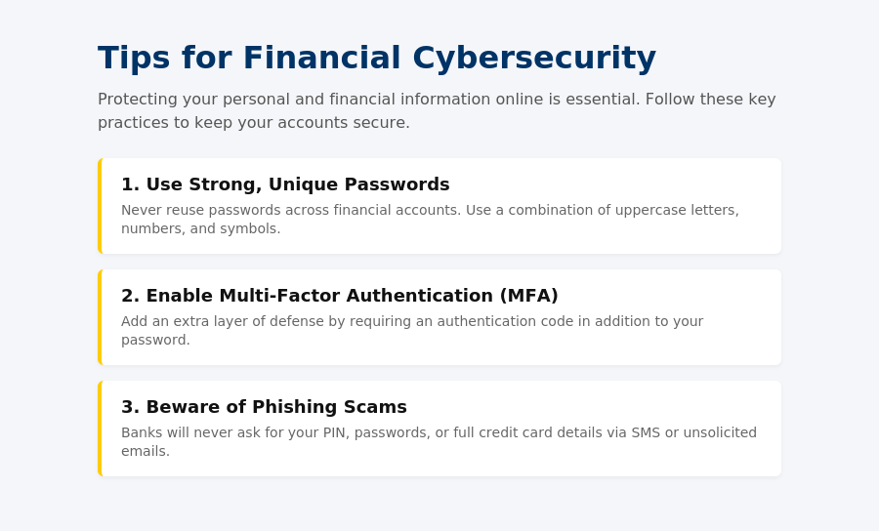
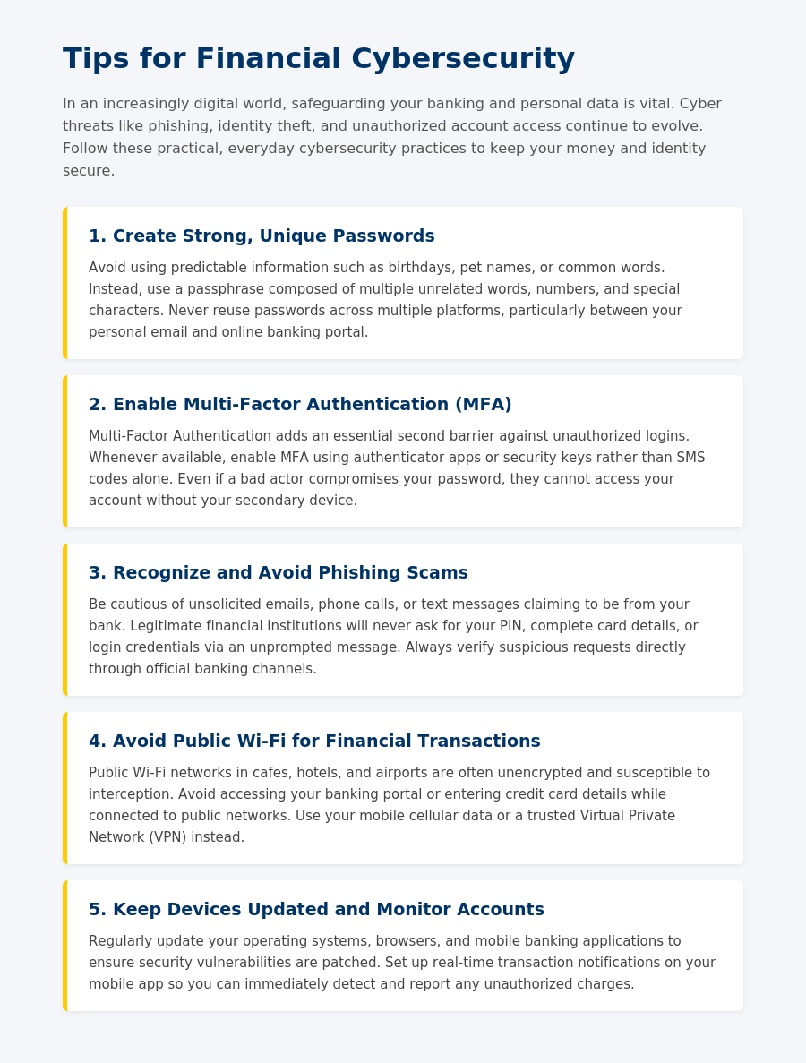
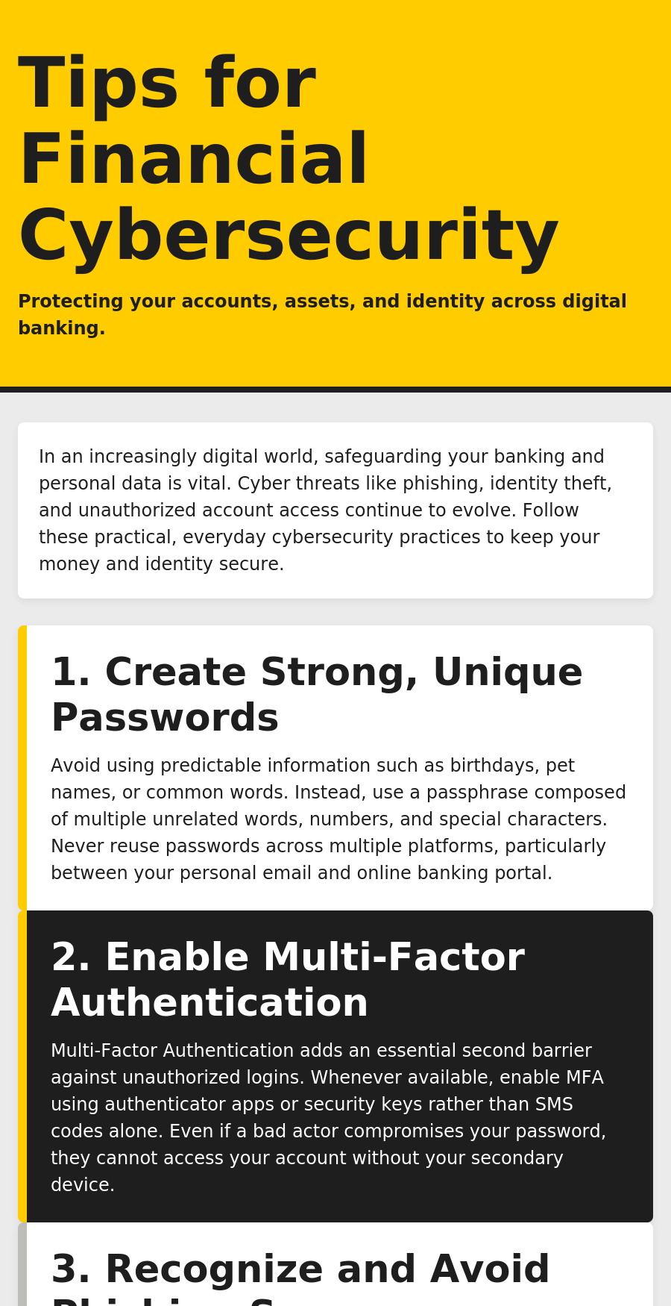
From Draft to Brand-Compliant Page
Task 1 – Base (3 tips)
Task 2 – Expanded (5 tips)
Task 3 – CommBank Brand
Commonwealth Bank – Introduction to Software Engineering (Forage)
5 / 6

Slide 6




Technology & Key Outcomes
Tech Stack
Key Outcomes
HTML5 (semantic structure)
Verifiable Forage certificate of completion, added to resume/LinkedIn
CSS3 & Flexbox (styling, layout)
Practical experience of an iterative, feedback-driven engineering workflow
Brand style-guide implementation
Static hosting (public deployment)
Accessibility-aware design skills – contrast, large-print typography
Confidence implementing a formal brand/design system faithfully
Commonwealth Bank – Introduction to Software Engineering (Forage)
6 / 6

