Slide 1


VISHWAKARMA INSTITUTE OF TECHNOLOGY, PUNE
Department of Artificial Intelligence and Machine Learning
FEW-SHOT TEMPORAL ANOMALY GENERATION AND DETECTION IN BRAIN CONNECTIVITY SUBGRAPHS FOR AUTISM DISORDER
Branch: AIML-B
GRN: 4
Day: Tuesday
Date: 13/10/2026
Group Members
Sr. No. | Roll No. | Name | PRN | Email ID
1 | 58 | Hanil Shah | 12414322 | hanil.shah24@vit.edu
2 | 59 | Harsh Patel | 12413448 | patel.harsh24@vit.edu
3 | 62 | Tanaya Hartalekar | 12410318 | tanaya.hartalekar24@vit.edu
4 | 73 | Shravani Dixit | 12415111 | shravani.dixit24@vit.edu
Project Guide
Dr. Premanand Ghadekar
1
Notes:
1

Slide 2
INTRODUCTION
The Problem
Project Framing
  Autism Spectrum Disorder (ASD) is associated with differences in functional brain connectivity, measurable through resting-state fMRI (rs-fMRI).
  Representing the brain as a graph - regions of interest (ROIs) as nodes, functional connectivity as weighted edges - captures relational structure a single time series cannot.
  Connectivity is not static: dividing a scan into sliding time windows yields a temporal sequence of graphs, so a purely static representation can miss dynamics that unfold over time.
  Rather than a direct disease classifier, this project asks whether unusual spatio-temporal subgraph behavior can be identified relative to dynamics learned only from healthy (control) subjects.
  Real abnormal (ASD) examples are limited relative to what a data-hungry detector needs - motivating a second question: can structure-aware synthetic anomalies support detection in this few-shot setting?
The project investigates whether meaningful structure-aware anomalies can be generated from learned normal brain-network structure, and whether they can subsequently support few-shot anomaly detection.
Scope note: this is a research prototype for anomaly generation and detection, not a clinical diagnostic tool. No claim of ASD diagnosis is made.
2
Notes:
2

Slide 3
OBJECTIVES
1
Build time-resolved brain graphs
2
Track brain-region subgraphs
Convert 871 ABIDE I scans (360 regions) into sliding-window brain graphs.
Follow 20 selected regions and their neighbours across time windows.
✓ COMPLETED
✓ COMPLETED
3
Learn normal brain dynamics
4
Detect anomalies
Train a GIN + GRU on control scans only to predict the next window.
Score prediction errors and set thresholds from validation controls.
✓ COMPLETED
✓ COMPLETED
5
Generate synthetic anomalies
6
Evaluate few-shot and severity
Gradient-guided edge edits on control subgraphs (7,200 records, 0 rule violations).
Test 1, 5, 10 ASD scans (accuracy, F1, AUROC); severity and demo app.
✓ COMPLETED
✓ COMPLETED
3
Notes:
3

Slide 4
LITERATURE SURVEY
Theme | Key Paper | Key Insight | Relevance to Project
ABIDE dataset | A. Di Martino et al. (2014) | Openly shares rs-fMRI + phenotypic data for 539 ASD / 573 control subjects across 17 sites; reports baseline hypoconnectivity in ASD. | Grounds the ABIDE I dataset (871 subjects, 20 sites) used throughout.
GNN expressive power | Keyulu Xu et al. (2018) | Proves common GNN variants are weaker than the Weisfeiler-Lehman test; introduces GIN, which matches it. | Justifies the weighted GIN encoder used to embed each subgraph.
Dynamic functional connectivity | R. Matthew Hutchison et al. (2013) | Defines and surveys sliding-window estimation of time-varying connectivity and its methodological pitfalls. | Grounds the 30-TR / stride-10 sliding-window graph construction.
Graph anomaly detection | Xiaoxiao Ma et al. (2021) | Taxonomizes deep graph-anomaly-detection methods by anomaly type and technique; flags scarce labels as an open challenge. | Frames the prediction-error, threshold-calibrated anomaly score.
Gradient-based graph perturbation | Kaidi Xu et al. (2019) | Formulates graph structure attacks as constrained optimization solved with projected gradient descent (PGD). | Grounds the PGD-style iterative edge-weight perturbation.
Existing Work → Our Focus
Graph
representation
Temporal
modeling
Anomaly
detection
Few-shot
learning
Our
contribution
Our focus: existing work provides graph representations, temporal modeling, classification, and anomaly detection; this project additionally investigates structure-aware, gradient-guided anomaly generation for a few-shot brain-subgraph setting. Full 20-paper analysis: GRAPH_ANOMALY_Literature_Review.xlsx
4
Notes:
4

Slide 5
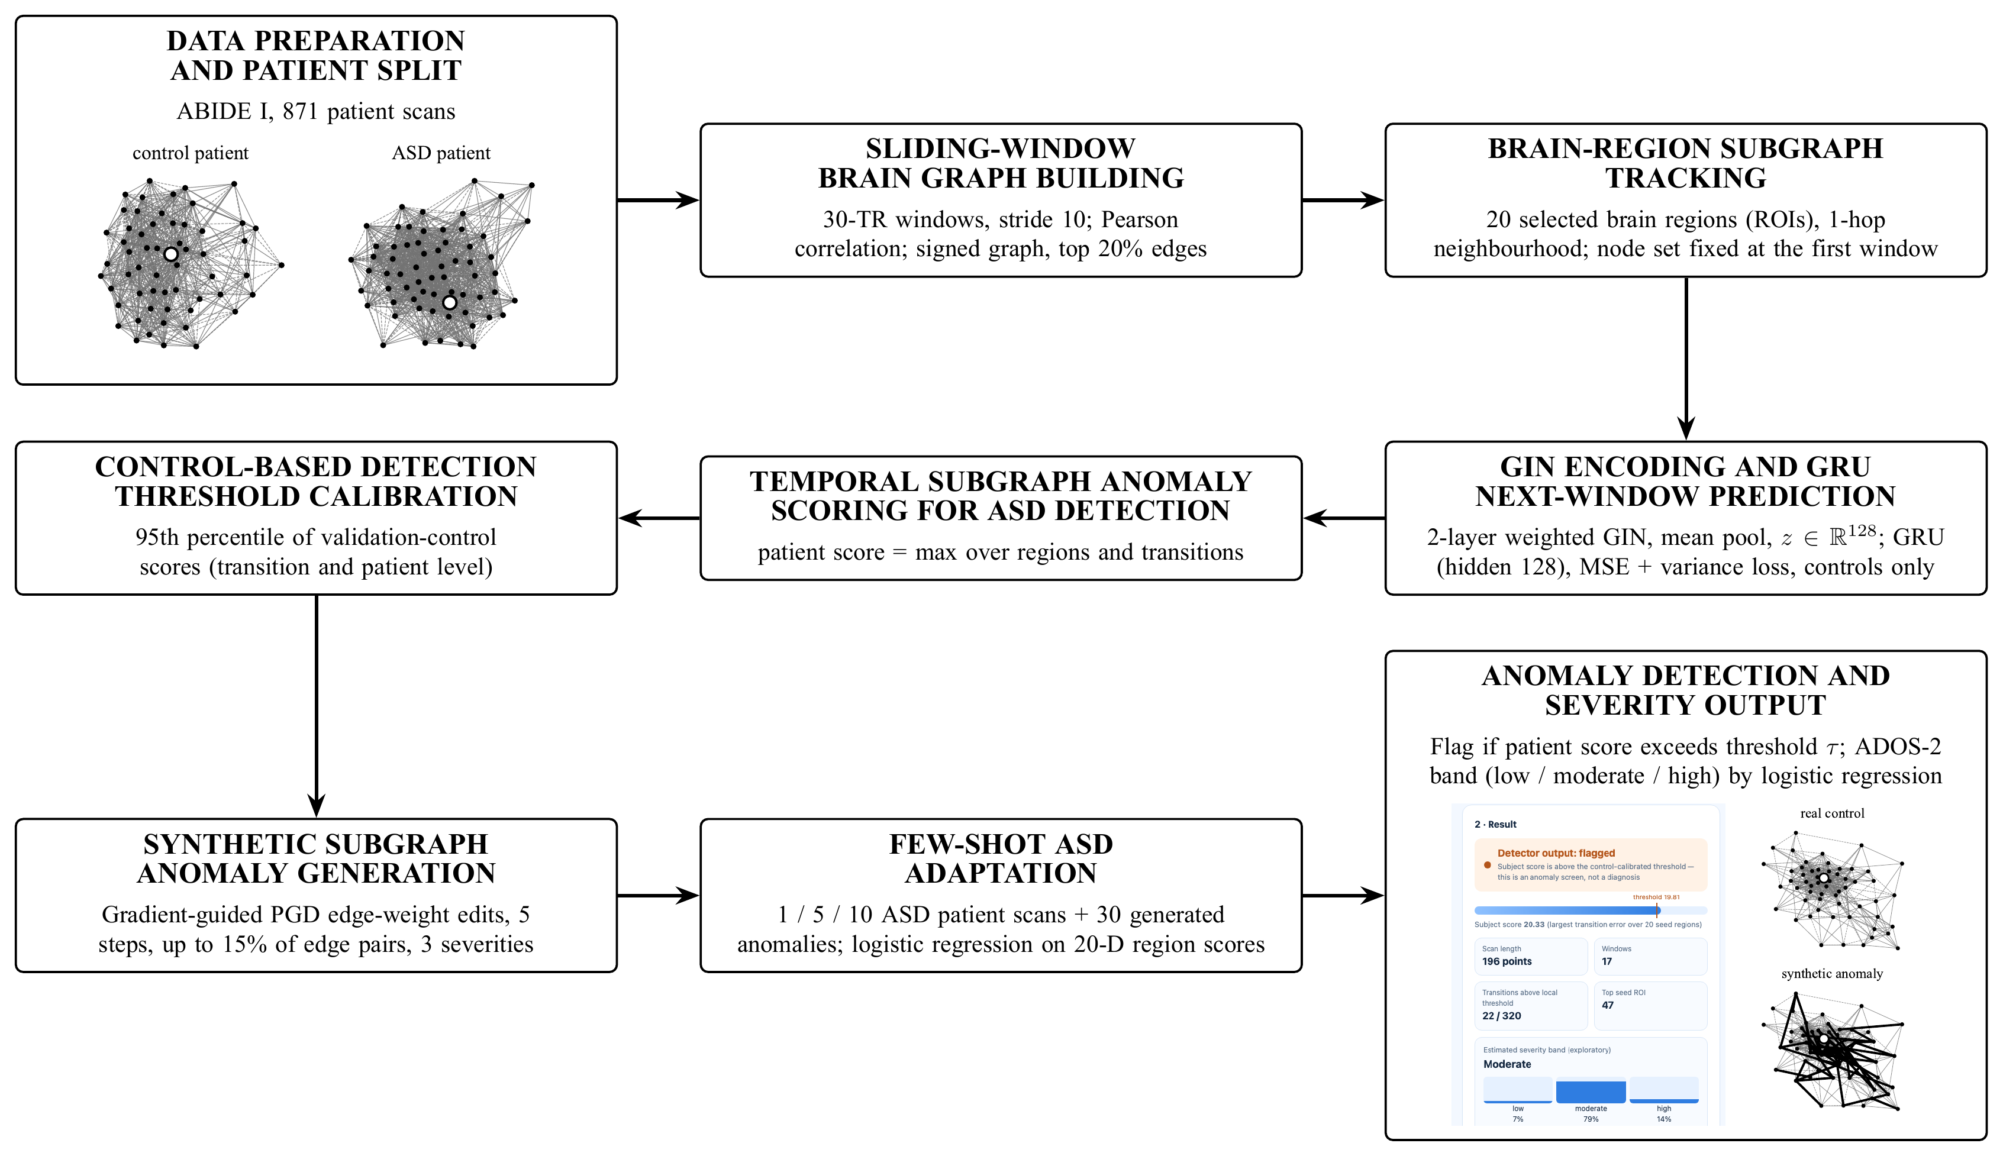
PROPOSED METHODOLOGY
5

Slide 6
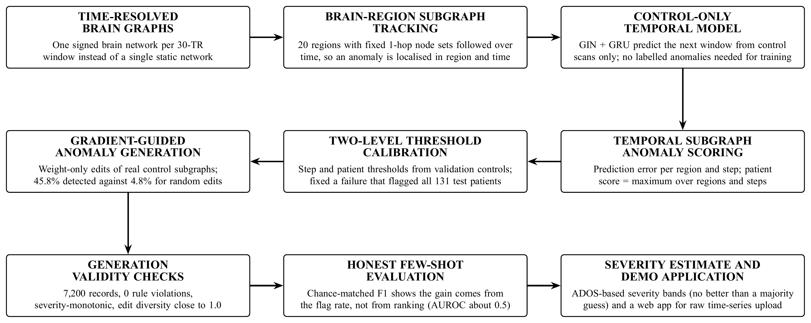
MAJOR CONTRIBUTIONS
Same pipeline order as the methodology; each box states what is new at that step.
6

Slide 7
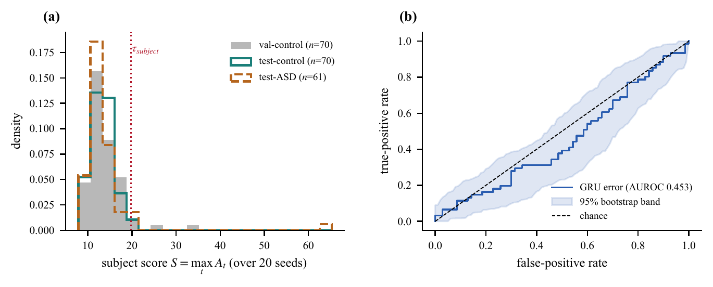
RESULTS: DETECTOR
Detector on 131 test patients
Metric | Value
Accuracy | 53.4%
Precision | 0.500
Recall | 0.033
F1 score | 0.062
AUROC | 0.453
AUROC 95% CI | 0.353 – 0.552
Flagged | 4 of 131
Left: person scores with the control-calibrated threshold. Right: ROC curve with 95% bootstrap band (131 test patients).
Does modelling time help? Three scoring methods on the same frozen encoder (131 test patients)
Scoring method | Accuracy | Precision | Recall | F1 | AUROC [95% CI]
Static (distance to control mean) | 54.2% | 0.556 | 0.082 | 0.143 | 0.452 [0.356, 0.553]
Persistence (change from previous window) | 53.4% | 0.500 | 0.033 | 0.062 | 0.485 [0.380, 0.582]
GRU prediction error (ours) | 53.4% | 0.500 | 0.033 | 0.062 | 0.453 [0.353, 0.552]
7

Slide 8
RESULTS: FEW-SHOT COMPARISON
Shots | Approach | Accuracy | Precision | Recall | F1 score | AUROC
– | Baseline detector (no few-shot data) | 53.4% | 0.500 | 0.033 | 0.062 | 0.453
1 | Few-shot data only (normal detection) | 53.4% ± 0.5 | 0.200 ± 0.40 | 0.003 ± 0.01 | 0.006 ± 0.01 | 0.515 ± 0.06
 | Random anomaly generation + detection | 51.8% ± 2.6 | 0.473 ± 0.04 | 0.357 ± 0.09 | 0.403 ± 0.07 | 0.506 ± 0.04
 | Sub-structure anomaly generation + detection | 49.5% ± 3.3 | 0.445 ± 0.05 | 0.344 ± 0.04 | 0.388 ± 0.04 | 0.497 ± 0.03
5 | Few-shot data only (normal detection) | 52.4% ± 2.1 | 0.430 ± 0.13 | 0.092 ± 0.04 | 0.149 ± 0.07 | 0.485 ± 0.02
 | Random anomaly generation + detection | 49.9% ± 1.7 | 0.451 ± 0.03 | 0.361 ± 0.06 | 0.399 ± 0.05 | 0.502 ± 0.02
 | Sub-structure anomaly generation + detection | 49.6% ± 1.4 | 0.447 ± 0.02 | 0.348 ± 0.04 | 0.390 ± 0.03 | 0.486 ± 0.02
10 | Few-shot data only (normal detection) | 50.5% ± 2.7 | 0.433 ± 0.07 | 0.249 ± 0.09 | 0.311 ± 0.09 | 0.524 ± 0.05
 | Random anomaly generation + detection | 51.3% ± 2.1 | 0.474 ± 0.03 | 0.400 ± 0.06 | 0.431 ± 0.04 | 0.515 ± 0.05
 | Sub-structure anomaly generation + detection | 49.3% ± 3.3 | 0.445 ± 0.05 | 0.367 ± 0.05 | 0.402 ± 0.05 | 0.502 ± 0.05
Reading the table: mean ± SD over five support-set draws on 131 test patients (61 ASD, 70 control); green = best of the three approaches within each shot count.
Generated anomalies raise recall and F1 (1-shot F1 0.006 → about 0.39–0.40), but AUROC stays near 0.50 and accuracy near 50%: random and sub-structure generation perform alike.
Chance references: AUROC 0.5; accuracy 53.4% (always answer control); F1 of a random flagger at the same flag rate ≈ 0.40–0.42.
8

Slide 9
RESULTS: COMPARISON CHARTS
Few-shot data only vs. random anomaly generation vs. sub-structure (gradient-guided) anomaly generation, mean of five draws.
Anomaly generation raises F1 through a higher flag rate; AUROC and accuracy do not improve (chance: AUROC 0.5, accuracy 53.4%).
Sub-structure generation is detected 45.8% of the time against 4.8% for random edits (generation test), yet gives no extra gain in the few-shot comparison.
9

Slide 10
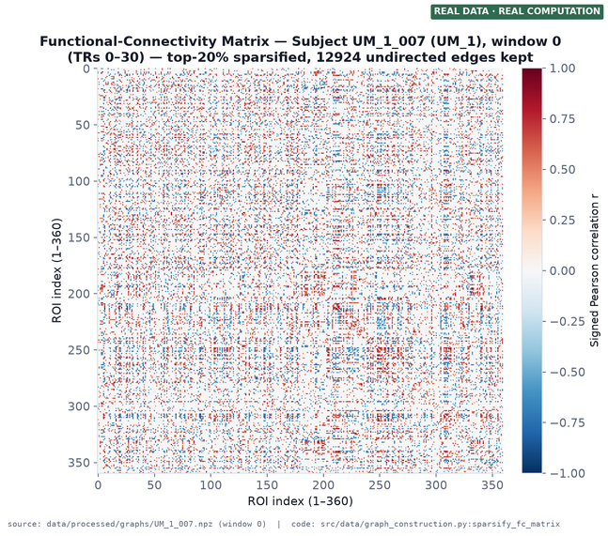
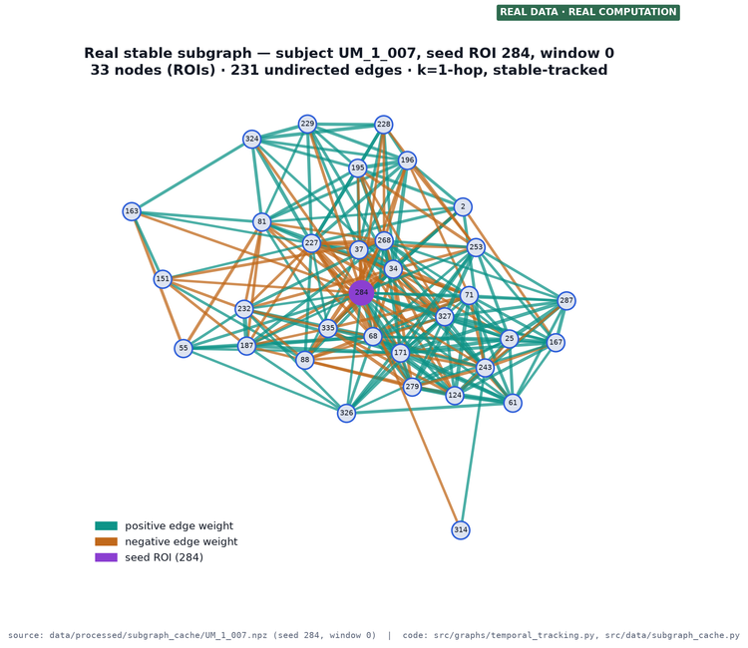
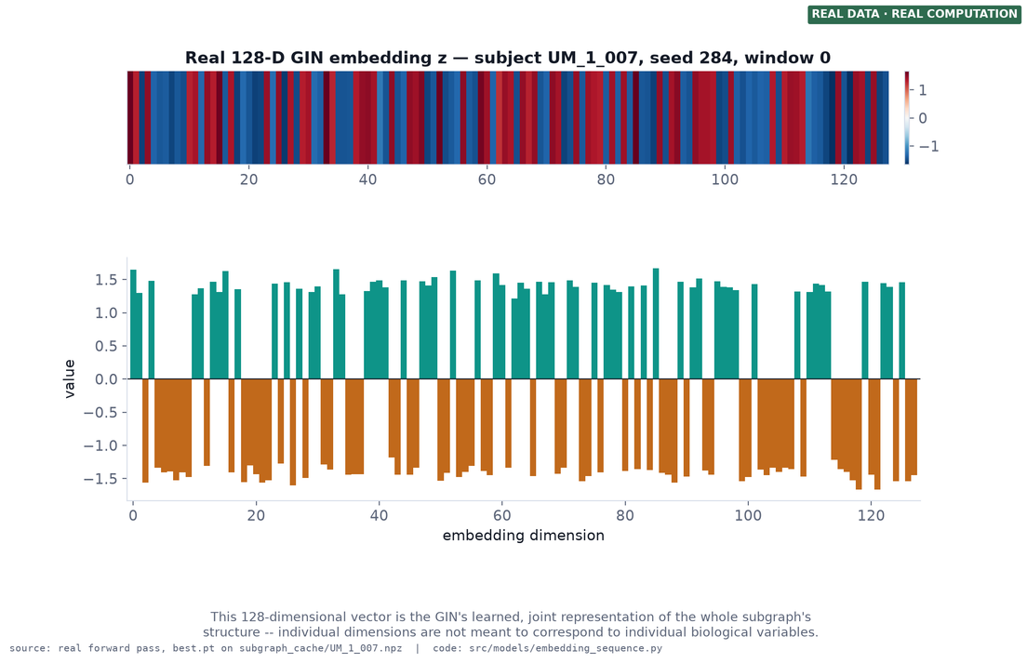
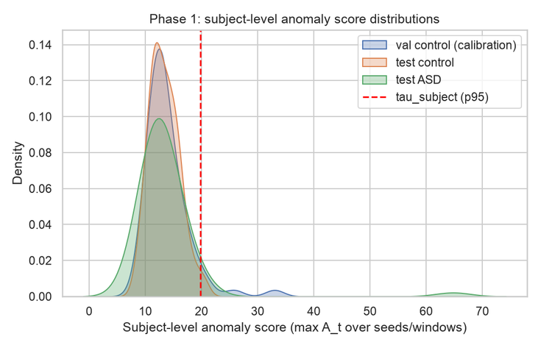
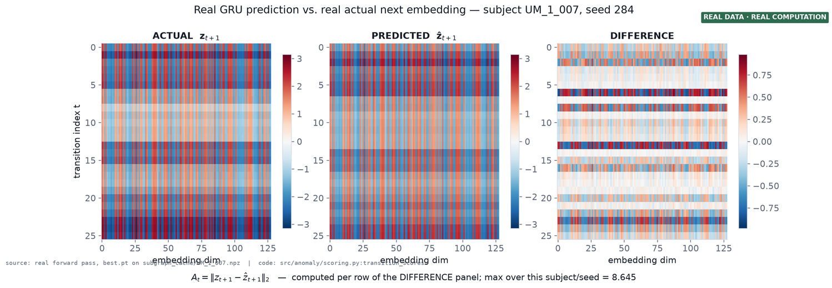
RESULTS: PIPELINE OUTPUTS
10
Notes:
6

Slide 11
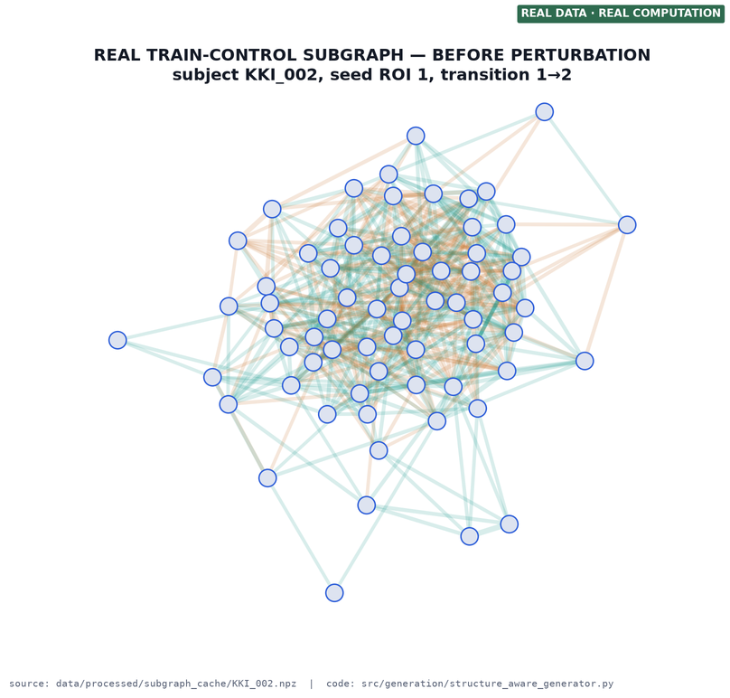
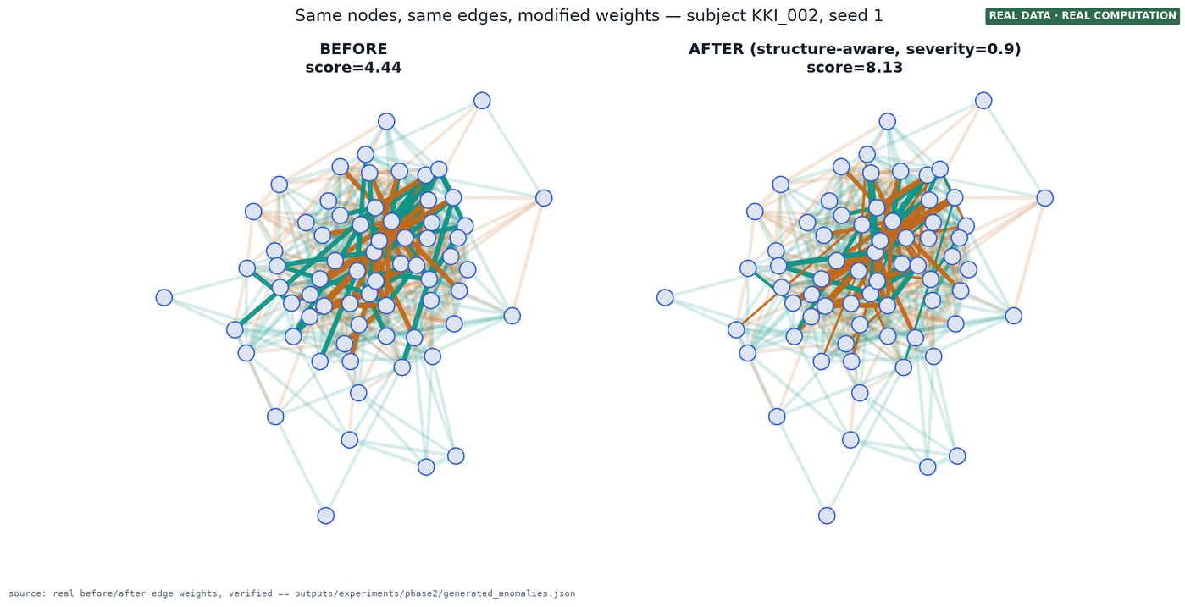
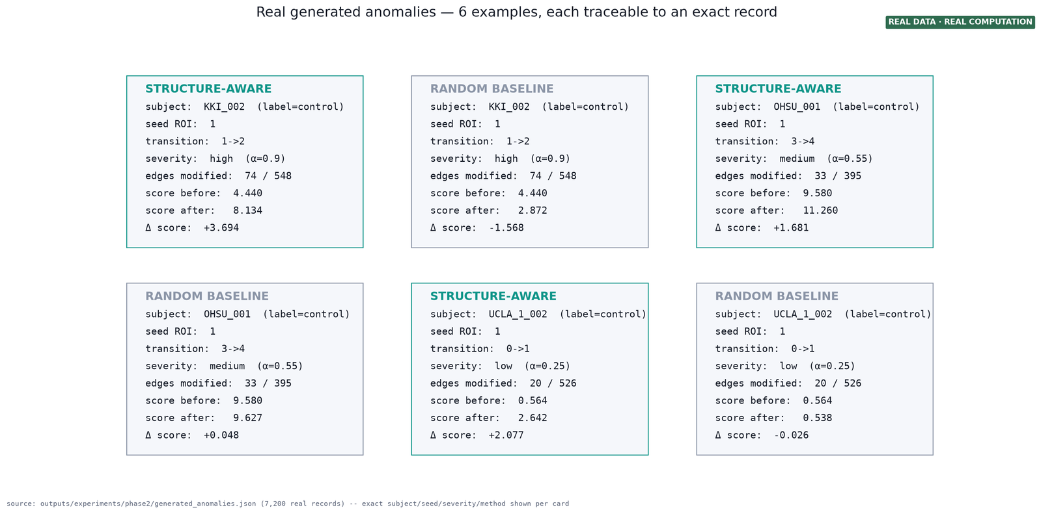
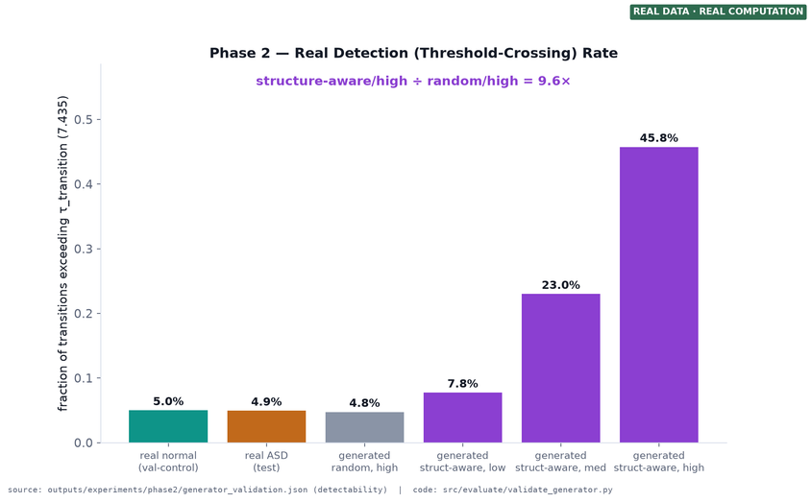
RESULTS: SYNTHETIC ANOMALIES

Slide 12
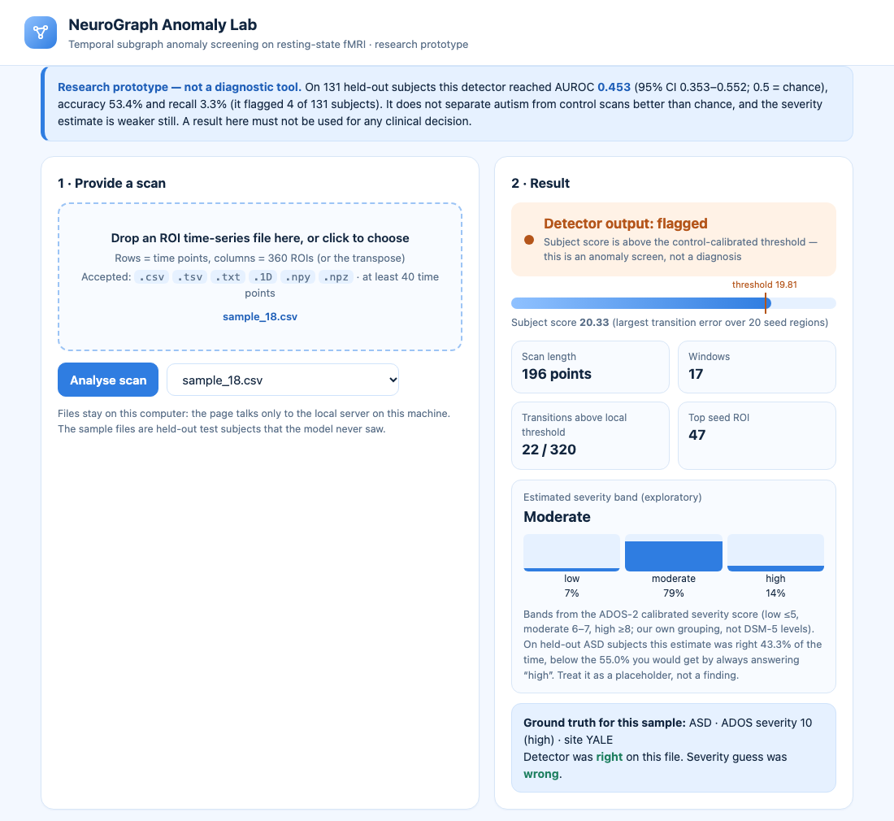
RESULTS: SEVERITY AND DEMO
Severity estimation (exploratory)
Evaluation | n | Accuracy | Macro-F1 | Majority guess
Held-out ASD patients | 60 | 0.433 | 0.395 | 0.550
5-fold CV × 10 | 193 | 0.391 | 0.372 | 0.430
Severity bands come from the ADOS-2 calibrated severity score: low (≤5), moderate (6–7), high (≥8).
Estimate is below a majority guess (43.3% vs 55.0%): the scores carry no usable severity signal.
Predicted vs true severity score: Spearman 0.13 (p = 0.32).
Demo web app: upload a raw ROI time series, get the detector flag and a severity band.
On 20 random held-out test files the output was right for 11 and the detector flagged 1.
Demo web application (research prototype, runs locally)
12

Slide 13
DISCUSSION
WHAT WORKED
CHALLENGES
INTERPRETATION
  Stable training with no representation collapse (embedding std 1.03–1.16).
  Generator works as designed: 7,200 records, 0 rule violations, severity-monotonic.
  Sub-structure edits detected 45.8% of the time vs 4.8% for random edits (9.6×).
  Leakage-safe protocol: patient-level split, thresholds from validation controls only.
  Complete pipeline plus a demo application and 20 sample scans.
  Detector is at chance on ABIDE I: AUROC 0.453, accuracy 53.4%.
  A single step-level threshold flagged all 131 test patients; fixed with a patient-level threshold.
  Few-shot F1 gains come from flagging more patients; AUROC stays about 0.50.
  Severity estimate is below a majority guess (43.3% vs 55.0%).
  Only 20 of 360 regions, one training run, no site-level test.
  A diagnosis label is a weak sign of unusual connectivity dynamics; ASD is highly varied.
  Site effects and short, noisy windows may hide a real signal.
  Detectability of generated anomalies is self-referential: the same model guides and scores the edits.
  Guided and random generation behave alike in the few-shot test.
  Research prototype: no clinical claim.
13
Notes:
7

Slide 14
CONCLUSION
Built and tested an end-to-end pipeline: time-resolved brain graphs, brain-region subgraph tracking, temporal anomaly scoring, synthetic anomaly generation, few-shot adaptation and a severity output.
All six objectives were completed, including a working demo web application.
The anomaly generator works as designed: 0 rule violations, and 45.8% of sub-structure edits are detected against 4.8% for random edits.
On ABIDE I the detector is at chance (AUROC 0.453, accuracy 53.4%); few-shot F1 gains come from a higher flag rate (AUROC about 0.50).
Severity estimation is below a majority guess (43.3% vs 55.0%).
Research prototype only: no clinical claim, and all results are reported as found.
14

Slide 15

REFERENCES (1/2)
  [1] E. Bullmore and O. Sporns, “Complex brain networks: Graph theoretical analysis of structural and functional systems,” Nat. Rev. Neurosci., vol. 10, no. 3, pp. 186–198, Mar. 2009, doi: 10.1038/nrn2575.
  [2] S. M. Smith et al., “Network modelling methods for FMRI,” NeuroImage, vol. 54, no. 2, pp. 875–891, Jan. 2011, doi: 10.1016/j.neuroimage.2010.08.063.
  [3] S. Parisot et al., “Disease prediction using graph convolutional networks: Application to autism spectrum disorder and Alzheimer's disease,” Med. Image Anal., vol. 48, pp. 117–130, Aug. 2018, doi: 10.1016/j.media.2018.06.001.
  [4] X. Li et al., “BrainGNN: Interpretable brain graph neural network for fMRI analysis,” Med. Image Anal., vol. 74, Art. no. 102233, Dec. 2021, doi: 10.1016/j.media.2021.102233.
  [5] H. Cui et al., “BrainGB: A benchmark for brain network analysis with graph neural networks,” IEEE Trans. Med. Imag., vol. 42, no. 2, pp. 493–506, Feb. 2023, doi: 10.1109/TMI.2022.3218745.
  [6] X. Kan, W. Dai, H. Cui, Z. Zhang, Y. Guo, and C. Yang, “Brain network transformer,” in Adv. Neural Inf. Process. Syst. (NeurIPS), vol. 35, 2022.
  [7] A. Abraham et al., “Deriving reproducible biomarkers from multi-site resting-state data: An autism-based example,” NeuroImage, vol. 147, pp. 736–745, Feb. 2017, doi: 10.1016/j.neuroimage.2016.10.045.
  [8] M. Yu et al., “Statistical harmonization corrects site effects in functional connectivity measurements from multi-site fMRI data,” Hum. Brain Mapp., vol. 39, no. 11, pp. 4213–4227, Nov. 2018, doi: 10.1002/hbm.24241.
  [9] E. A. Allen, E. Damaraju, S. M. Plis, E. B. Erhardt, T. Eichele, and V. D. Calhoun, “Tracking whole-brain connectivity dynamics in the resting state,” Cereb. Cortex, vol. 24, no. 3, pp. 663–676, Mar. 2014, doi: 10.1093/cercor/bhs352.
  [10] R. M. Hutchison et al., “Dynamic functional connectivity: Promise, issues, and interpretations,” NeuroImage, vol. 80, pp. 360–378, Oct. 2013, doi: 10.1016/j.neuroimage.2013.05.079.
  [11] B.-H. Kim, J. C. Ye, and J.-J. Kim, “Learning dynamic graph representation of brain connectome with spatio-temporal attention,” in Adv. Neural Inf. Process. Syst. (NeurIPS), vol. 34, 2021, arXiv:2105.13495.
  [12] S. Gadgil, Q. Zhao, A. Pfefferbaum, E. V. Sullivan, E. Adeli, and K. M. Pohl, “Spatio-temporal graph convolution for resting-state fMRI analysis,” in Med. Image Comput. Comput.-Assist. Intervent. (MICCAI), 2020, pp. 528–538, doi: 10.1007/978-3-030-59728-3_52.
  [13] X. Ma et al., “A comprehensive survey on graph anomaly detection with deep learning,” IEEE Trans. Knowl. Data Eng., vol. 35, no. 12, pp. 12012–12038, Dec. 2023, doi: 10.1109/TKDE.2021.3118815.
  [14] K. Ding, J. Li, R. Bhanushali, and H. Liu, “Deep anomaly detection on attributed networks,” in Proc. SIAM Int. Conf. Data Mining (SDM), 2019, pp. 594–602, doi: 10.1137/1.9781611975673.67.
  [15] A. Behrouz and M. Seltzer, “Anomaly detection in human brain via inductive learning on temporal multiplex networks,” in Proc. Mach. Learn. Healthcare Conf., PMLR vol. 219, 2023, pp. 50–75.
  [16] S. Sadeghian, X. Li, and M. Seltzer, “HyperBrain: Anomaly detection for temporal hypergraph brain networks,” arXiv:2410.02087, Oct. 2024.
  [17] K. Ding, Q. Zhou, H. Tong, and H. Liu, “Few-shot network anomaly detection via cross-network meta-learning,” in Proc. Web Conf. (WWW), 2021, pp. 2448–2456, doi: 10.1145/3442381.3449922.
  [18] K. Xu et al., “Topology attack and defense for graph neural networks: An optimization perspective,” in Proc. Int. Joint Conf. Artif. Intell. (IJCAI), 2019, pp. 3961–3967, doi: 10.24963/ijcai.2019/550.
  [19] A. Madry, A. Makelov, L. Schmidt, D. Tsipras, and A. Vladu, “Towards deep learning models resistant to adversarial attacks,” in Proc. Int. Conf. Learn. Represent. (ICLR), 2018, arXiv:1706.06083.
  [20] A. Di Martino et al., “The autism brain imaging data exchange: Towards a large-scale evaluation of the intrinsic brain architecture in autism,” Mol. Psychiatry, vol. 19, no. 6, pp. 659–667, Jun. 2014, doi: 10.1038/mp.2013.78.
  [21] M. F. Glasser et al., “A multi-modal parcellation of human cerebral cortex,” Nature, vol. 536, no. 7615, pp. 171–178, Aug. 2016, doi: 10.1038/nature18933.
  [22] A. Abraham et al., “Machine learning for neuroimaging with scikit-learn,” Front. Neuroinform., vol. 8, Art. no. 14, 2014, doi: 10.3389/fninf.2014.00014.
  [23] A. Brahim and N. Farrugia, “Graph Fourier transform of fMRI temporal signals based on an averaged structural connectome for the classification of neuroimaging,” Artif. Intell. Med., vol. 106, Art. no. 101870, 2020, doi: 10.1016/j.artmed.2020.101870.
  [24] K. Xu, W. Hu, J. Leskovec, and S. Jegelka, “How powerful are graph neural networks?” in Proc. Int. Conf. Learn. Represent. (ICLR), 2019, arXiv:1810.00826.
  [25] K. Cho et al., “Learning phrase representations using RNN encoder-decoder for statistical machine translation,” in Proc. Conf. Empirical Methods Natural Lang. Process. (EMNLP), Doha, Qatar, Oct. 2014, pp. 1724–1734, doi: 10.3115/v1/D14-1179.
15
Notes:
9

Slide 16
REFERENCES (2/2)
  [26] A. Bardes, J. Ponce, and Y. LeCun, “VICReg: Variance-invariance-covariance regularization for self-supervised learning,” in Proc. Int. Conf. Learn. Represent. (ICLR), 2022, arXiv:2105.04906.
  [27] A. Paszke et al., “PyTorch: An imperative style, high-performance deep learning library,” in Adv. Neural Inf. Process. Syst. (NeurIPS), vol. 32, 2019, arXiv:1912.01703.
  [28] M. Fey and J. E. Lenssen, “Fast graph representation learning with PyTorch Geometric,” in ICLR Workshop Representation Learn. Graphs Manifolds, 2019, arXiv:1903.02428.
  [29] K. Gotham, A. Pickles, and C. Lord, “Standardizing ADOS scores for a measure of severity in autism spectrum disorders,” J. Autism Dev. Disord., vol. 39, no. 5, pp. 693–705, May 2009, doi: 10.1007/s10803-008-0674-3.
  [30] A. S. Heinsfeld, A. R. Franco, R. C. Craddock, A. Buchweitz, and F. Meneguzzi, “Identification of autism spectrum disorder using deep learning and the ABIDE dataset,” NeuroImage Clin., vol. 17, pp. 16–23, 2018, doi: 10.1016/j.nicl.2017.08.017.
  [31] S. I. Ktena et al., “Distance metric learning using graph convolutional networks: Application to functional brain networks,” in Med. Image Comput. Comput.-Assist. Intervent. (MICCAI), 2017, pp. 469–477, doi: 10.1007/978-3-319-66182-7_54.
  [32] T. N. Kipf and M. Welling, “Semi-supervised classification with graph convolutional networks,” in Proc. Int. Conf. Learn. Represent. (ICLR), 2017, arXiv:1609.02907.
  [33] J. Kawahara et al., “BrainNetCNN: Convolutional neural networks for brain networks; towards predicting neurodevelopment,” NeuroImage, vol. 146, pp. 1038–1049, Feb. 2017, doi: 10.1016/j.neuroimage.2016.09.046.
  [34] T. Lanciano, F. Bonchi, and A. Gionis, “Explainable classification of brain networks via contrast subgraphs,” in Proc. ACM SIGKDD Int. Conf. Knowl. Discovery Data Mining (KDD), 2020, pp. 3308–3318, doi: 10.1145/3394486.3403383.
  [35] M. G. Preti, T. A. Bolton, and D. Van De Ville, “The dynamic functional connectome: State-of-the-art and perspectives,” NeuroImage, vol. 160, pp. 41–54, Oct. 2017, doi: 10.1016/j.neuroimage.2016.12.061.
  [36] P. Aggarwal and A. Gupta, “Multivariate graph learning for detecting aberrant connectivity of dynamic brain networks in autism,” Med. Image Anal., vol. 56, pp. 11–25, Aug. 2019, doi: 10.1016/j.media.2019.05.007.
  [37] T. Chatterjee, R. Albert, S. Thapliyal, N. Azarhooshang, and B. DasGupta, “Detecting network anomalies using Forman-Ricci curvature and a case study for human brain networks,” Sci. Rep., vol. 11, no. 1, Art. no. 8121, Apr. 2021, doi: 10.1038/s41598-021-87587-z.
  [38] G. Pang, C. Shen, L. Cao, and A. van den Hengel, “Deep learning for anomaly detection: A review,” ACM Comput. Surv., vol. 54, no. 2, 2022, doi: 10.1145/3439950.
  [39] L. Ruff et al., “Deep one-class classification,” in Proc. Int. Conf. Mach. Learn. (ICML), PMLR vol. 80, 2018, pp. 4393–4402.
  [40] R. Ma, G. Pang, L. Chen, and A. van den Hengel, “Deep graph-level anomaly detection by glocal knowledge distillation,” in Proc. ACM Int. Conf. Web Search Data Mining (WSDM), 2022, pp. 704–714, doi: 10.1145/3488560.3498473.
  [41] W. Yu, W. Cheng, C. C. Aggarwal, K. Zhang, H. Chen, and W. Wang, “NetWalk: A flexible deep embedding approach for anomaly detection in dynamic networks,” in Proc. ACM SIGKDD Int. Conf. Knowl. Discovery Data Mining (KDD), 2018, pp. 2672–2681, doi: 10.1145/3219819.3220024.
  [42] L. Zheng, Z. Li, J. Li, Z. Li, and J. Gao, “AddGraph: Anomaly detection in dynamic graph using attention-based temporal GCN,” in Proc. Int. Joint Conf. Artif. Intell. (IJCAI), 2019, pp. 4419–4425, doi: 10.24963/ijcai.2019/614.
  [43] A. F. Marquand, I. Rezek, J. Buitelaar, and C. F. Beckmann, “Understanding heterogeneity in clinical cohorts using normative models: Beyond case-control studies,” Biol. Psychiatry, vol. 80, no. 7, pp. 552–561, Oct. 2016, doi: 10.1016/j.biopsych.2015.12.023.
  [44] Y. Wang, Q. Yao, J. T. Kwok, and L. M. Ni, “Generalizing from a few examples: A survey on few-shot learning,” ACM Comput. Surv., vol. 53, no. 3, Art. no. 63, 2020, doi: 10.1145/3386252.
  [45] C. Finn, P. Abbeel, and S. Levine, “Model-agnostic meta-learning for fast adaptation of deep networks,” in Proc. Int. Conf. Mach. Learn. (ICML), PMLR vol. 70, 2017, pp. 1126–1135.
  [46] J. Snell, K. Swersky, and R. Zemel, “Prototypical networks for few-shot learning,” in Adv. Neural Inf. Process. Syst. (NIPS), vol. 30, 2017, arXiv:1703.05175.
  [47] Y. Yang et al., “Data-efficient brain connectome analysis via multi-task meta-learning,” in Proc. ACM SIGKDD Int. Conf. Knowl. Discovery Data Mining (KDD), 2022, pp. 4743–4751, doi: 10.1145/3534678.3542680.
  [48] X. Wei, K. Zhao, Y. Jiao, L. He, and Y. Zhang, “A brain graph foundation model: Pre-training and prompt-tuning across broad atlases and disorders,” arXiv:2506.02044, 2025.
  [49] N. J. Dhinagar, V. Santhalingam, K. E. Lawrence, E. Laltoo, and P. M. Thompson, “Few-shot classification of autism spectrum disorder using site-agnostic meta-learning and brain MRI,” in Proc. Annu. Int. Conf. IEEE Eng. Med. Biol. Soc. (EMBC), 2023, doi: 10.1109/EMBC40787.2023.10340852.
  [50] T. Zhao, X. Zhang, and S. Wang, “GraphSMOTE: Imbalanced node classification on graphs with graph neural networks,” in Proc. ACM Int. Conf. Web Search Data Mining (WSDM), 2021, pp. 833–841, doi: 10.1145/3437963.3441720.
16

