Slide 1
EEG-Based Motor Action and Motor Imagery Classification Using Machine Learning
Harsada K · V Tanay Darshan · K Nikhitha · S Sai Tejesh Reddy
Guide: Dr. Abhishek S
Group 18 · Amrita School of Artificial Intelligence, Coimbatore
Notes:
Introduce the team and the topic: classifying real versus imagined limb movements from a 14-channel consumer EEG headset.

Slide 2
Problem and objectives
Can a low-cost 14-channel headset tell whether a person is moving a limb or only imagining it, and which limb?
1
2
3
Action vs imagery
Which limb
Left vs right imagery
Separate real movement from imagined movement (2 classes).
Identify the body part: right/left arm, leg, wrist (6 classes) and limb × condition (12 classes).
Decide the side of an imagined movement, the core control signal of a motor-imagery BCI.
Constraint throughout: evaluation on unseen people only (person-wise cross-validation), with no information leaking from test subjects.
Notes:
Three levels of difficulty. Person-wise validation is the key constraint: every reported number comes from people the model never saw during training.

Slide 3
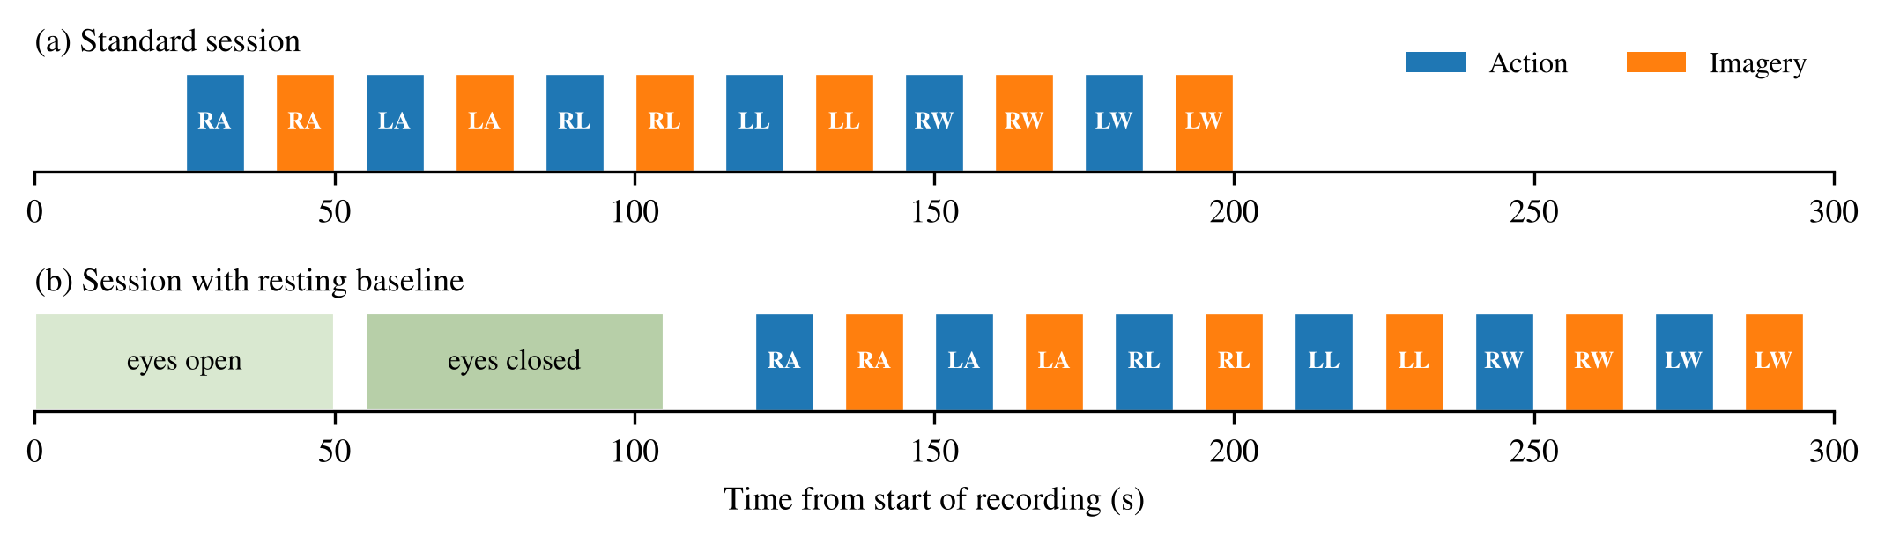
Dataset and recording protocol
47
14 ch
12
476
participants
Emotiv EPOC X
tasks
clean trials
51 recordings used
128 Hz, plus motion sensor
6 limbs × action / imagery
235 action, 241 imagery
Notes:
Each session cycles through the six limbs, first performing and then imagining each movement. 59 recordings were collected; 53 passed onset checks; after trial rejection 476 trials from 47 people remain.

Slide 4
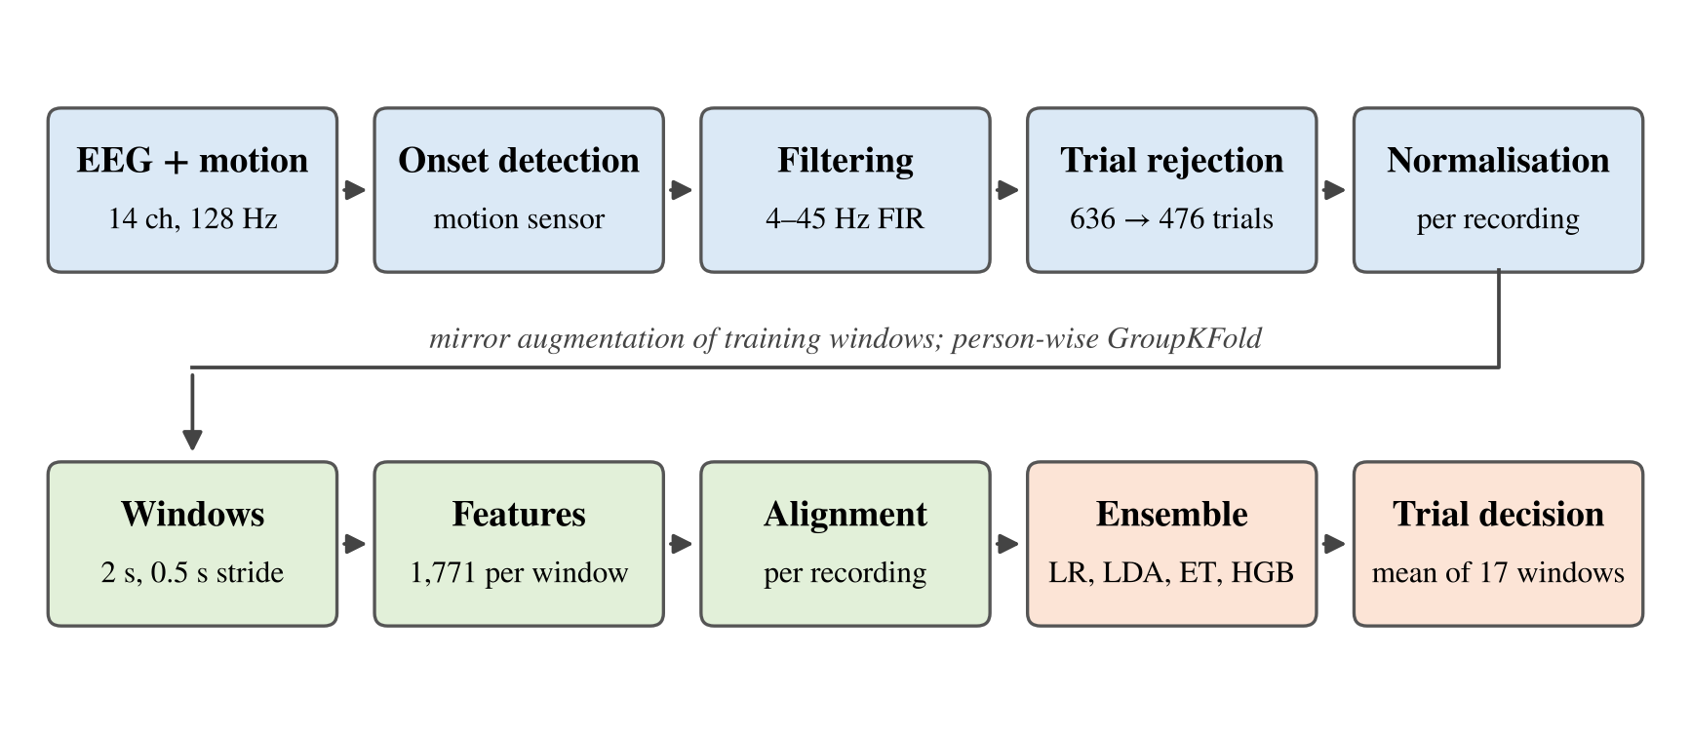
Processing pipeline
All normalisation steps are label-free; every learned step is fitted on training people only.
Notes:
Walk left to right: raw EEG and motion, onset detection, filtering, trial rejection, per-recording normalisation, 2 s windows, 1,771 features, per-recording alignment, ensemble, and finally averaging the 17 window predictions of each trial.

Slide 5
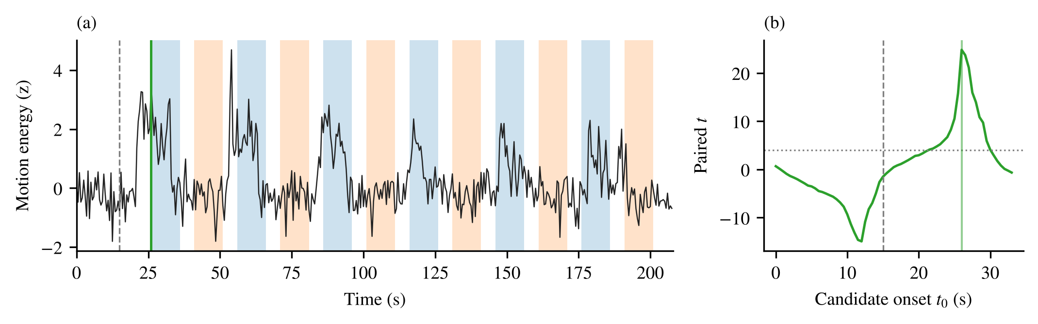
Finding when the tasks start
Task start varied between recordings, so fixed timing would mislabel windows.
Head-motion energy from the motion sensor is high during real movement and low during imagery; the schedule offset that best separates them is taken as the onset.
Accepted when the contrast is strong (t ≥ 4, all 6 pairs agree): 48 recordings; 5 more checked against recording length; 2 excluded.
Notes:
Without this step the action and imagery labels would be shifted in several sessions. A ±2 s onset shift changes binary accuracy by about 1 to 4 points, reported later.

Slide 6
Filtering, cleaning and normalisation
Band-pass 4–45 Hz zero-phase FIR (MNE): removes drift and line noise, keeps theta to gamma.
Trial rejection flat signal, peak amplitude ≥ 150 µV, or mean |kurtosis| ≥ 10.
Per-recording z-score of each channel, then of each feature: removes headset fit and session offsets without using labels.
Windows 2 s long, 0.5 s stride: 17 windows per trial, 8,092 windows in total.
Trials
636 → 476
Amplitude ≥ 150 µV | 158
Kurtosis ≥ 10 | 29
Window overlap | 27
Rejection reasons can overlap; 160 trials removed in total.
Notes:
Most rejections were large amplitude artefacts from movement and blinks, which is expected with a dry consumer headset.

Slide 7
Features: 1,771 per window
Family | What it captures | Count
Handcrafted | Band powers (Welch), ratios, asymmetry, Hjorth, statistics, fractal, DWT (db4) | 336
Spectrogram (STFT) | Short-time Fourier power over time and frequency | 560
Scalogram (CWT) | Morlet wavelet power: fine time detail at high frequencies | 714
Connectivity | Coherence between channel pairs | 56
Riemannian | Covariance matrix mapped to tangent space, recentred per recording | 105
Total |  | 1,771
Every feature is z-scored within its own recording before classification.
Notes:
The handcrafted set is the classic EEG feature set. Spectrogram and scalogram features add time-frequency detail; the Riemannian features describe how channels co-vary.

Slide 8
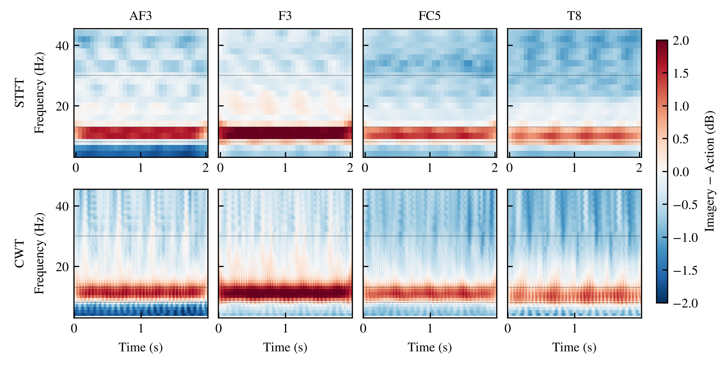
Spectrogram and scalogram analysis
Mu (8–13 Hz) power drops during movement over the motor cortex; the drop is weaker for imagery.
The scalogram resolves short bursts that the spectrogram smears.
Used alone: STFT 76.47%, CWT 77.52%, STFT+CWT 78.15% (binary). All features together: 79.62%.
Notes:
Feature-family results are trial-level without mirror augmentation. Each family is useful alone, but combining them is best.

Slide 9
Classifier: a four-model ensemble
Logistic Regression
C = 0.01
Linear models handle the many weak spectral cues; tree models pick up non-linear interactions. Averaging is more stable than any single model.
LDA
shrinkage
Average
probabilities
Trial vote
mean of 17 windows
Extra Trees
500 trees
Hist. Gradient Boosting
200 iterations
Mirror augmentation: training windows are copied with left/right channels swapped and labels flipped (RA↔LA).
Validation: GroupKFold by person, 5 folds (binary, L/R) and 3 folds (6/12-class).
Notes:
Each model outputs class probabilities per window; they are averaged, then averaged again over the 17 windows of a trial. Mirror copies are added only to training folds, never to test people.

Slide 10
Results on unseen participants
80.25%
26.68%
21.43%
58.09%
Action vs imagery
Body part (6 classes)
Limb × condition (12)
Left vs right imagery
382 / 476 trials
chance 50%
127 / 476 trials
chance 16.7%
102 / 476 trials
chance 8.3%
140 / 241 trials
chance 50%, p = 0.007
Trial-level accuracy, pooled over all test folds. Fold mean ± SD: 80.19 ± 6.59 (binary), 26.68 ± 1.79 (6-class), 21.42 ± 1.21 (12-class).
Body-part and 12-class accuracies are 1.6× and 2.6× chance: above chance, but far from usable control.
Notes:
Window-level accuracies are lower: 68.53% binary, 21.01% six-class, 15.75% twelve-class. Averaging the 17 windows of a trial adds roughly 12 points for binary.

Slide 11
Comparison with other models
Model (window level, best feature set) | Action vs imagery | 6-class | 12-class
Our ensemble | 68.53 | 21.01 | 15.75
Hist. Gradient Boosting | 64.45 | 20.27 | 13.91
Random Forest | 63.81 | 20.37 | 13.35
LDA | 63.35 | 20.30 | 13.44
SVM (RBF) | 62.89 | 20.70 | 14.32
Riemannian MDM | 62.31 | 19.92 | 12.05
EEGNet | 62.15 | 17.49 | 10.61
FBCSP + classifier | 61.60 | 19.47 | 11.50
CNN–LSTM | 58.38 | – | –
Same folds and same people for every model.
Deep models (EEGNet, CNN–LSTM) trail the feature-based models: 476 trials is too little data to learn filters from raw EEG.
FBCSP alone is weaker than the full feature set.
AdaBoost (62.85) and Naive Bayes (59.80) were tested on the binary task only.
Notes:
These are window-level accuracies so all models are on equal footing. The ensemble's trial-level result is the 80.25% from the previous slide.

Slide 12
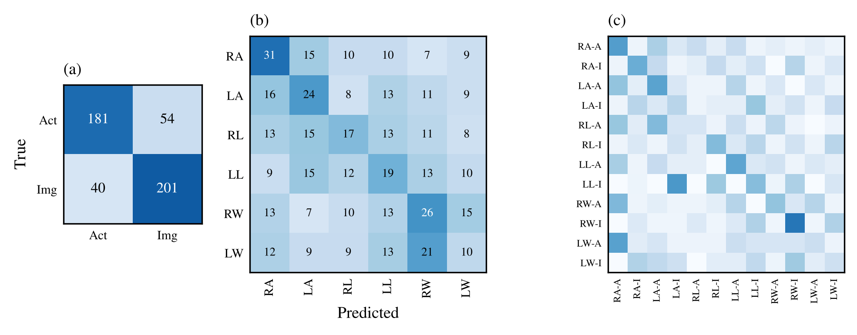
Where the model makes mistakes
(a) action vs imagery (b) six body parts (c) twelve classes
Imagery recall 83.4%, action 77.0%. Arms are recognised best (RA 37.8%); left wrist worst (13.5%). In the 12-class task the condition is right 78.2% of the time but the body part only 25.8%.
Notes:
The model separates action from imagery well but confuses limbs, especially wrists and legs, which have small or deep cortical representations that 14 scalp channels capture poorly.

Slide 13
Left vs right imagery
Requested by the guide. Imagery trials only, 241 trials, 5-fold person-wise CV.
What helped: calibrating features on each person's imagery trials only, plus mirror augmentation.
Baselines: FBCSP + LDA 52.70%; standard calibration + mirror 53.53%.
Overall 58.09% is significant (p = 0.007); arm imagery reaches 74.07%.
Notes:
Left versus right imagery is the hardest binary task because imagery produces weak, lateralised mu changes. Arms show the clearest lateralisation, matching their large cortical area.

Slide 14
Left vs right: every model, with and without CSP
Model (241 imagery trials) | Base: correct | Base % | + FBCSP: correct | + FBCSP %
Ensemble (LR+LDA+ET+HGB) | 140 | 58.09 | 138 | 57.26
Logistic Regression | 139 | 57.68 | 143 | 59.34
LDA | 137 | 56.85 | 143 | 59.34
SVM (RBF) | 131 | 54.36 | 132 | 54.77
Extra Trees | 122 | 50.62 | 124 | 51.45
Hist. Gradient Boosting | 121 | 50.21 | 128 | 53.11
AdaBoost | 117 | 48.55 | 131 | 54.36
Naive Bayes | 109 | 45.23 | 116 | 48.13
Random Forest | 108 | 44.81 | 105 | 43.57
Same 5 person-wise folds, imagery calibration and mirror augmentation for every model.
Linear models work best: the left/right signal is a weak, roughly linear power difference between hemispheres.
CSP: +4 trials for LR and LDA (59.34%, p = 0.002), no gain for the ensemble. The rise is within fold spread (±5%), so CSP is optional, not a clear improvement.
Trees and Naive Bayes stay near chance with 241 trials.
Notes:
Answers the guide: all eight models were run on left versus right imagery, each with and without filter-bank CSP features fitted inside each training fold. Chance is 50 percent. Ensemble 140 of 241, p = 0.007. LR or LDA with CSP 143 of 241, p = 0.002.

Slide 15
Action vs imagery: every model, with and without CSP
Model (476 trials) | Base | Base % | + FBCSP | + FBCSP % | Δ trials
Ensemble (LR+LDA+ET+HGB) | 382 | 80.25 | 387 | 81.30 | +5
Logistic Regression | 383 | 80.46 | 380 | 79.83 | −3
LDA | 382 | 80.25 | 381 | 80.04 | −1
Hist. Gradient Boosting | 377 | 79.20 | 381 | 80.04 | +4
AdaBoost | 375 | 78.78 | 380 | 79.83 | +5
Extra Trees | 371 | 77.94 | 376 | 78.99 | +5
SVM (RBF) | 371 | 77.94 | 366 | 76.89 | −5
Random Forest | 369 | 77.52 | 374 | 78.57 | +5
Naive Bayes | 348 | 73.11 | 347 | 72.90 | −1
Same 5 person-wise folds; CSP filters are fitted on training people only.
Tree models gain 4–5 trials; LR, LDA, SVM and NB lose 1–5.
Ensemble + CSP: 387/476 (81.30%), +5 trials (+1.05 points), well inside the fold spread (±5–7%).
On left vs right the same ensemble loses 2 trials with CSP. CSP's band-power contrasts largely repeat our band-power and covariance features.
Notes:
Every model was rerun with and without filter-bank CSP features. The effect is small and inconsistent in sign, so we report CSP as an optional add-on rather than changing the main pipeline. 6- and 12-class runs are still in progress.

Slide 16
Is the accuracy real? Leakage checks
✓
Person-wise folds
✓
Label permutation
No participant appears in both training and test sets in any fold; no duplicate EDF files.
Shuffled labels give chance: action/imagery 50–55% (real 80.25), body part 17–19% (real 26.68), left/right 44–51% (real 58.09).
✓
Reproducibility
✓
Onset sensitivity
Same seed twice: 382 / 476 both times. Seeds 1, 2, 3: 384, 384, 386. Mean 80.59 ± 0.35%; changes come from the seed, not from learning across runs.
Shifting the onset by ±2 s: binary 75.9–79.2%, so the reported figure may be about 3 points optimistic.
Notes:
Every scaler, alignment and model is refitted inside each fold. Normalisation per recording uses no labels. Permutation tests at chance confirm the pipeline is not memorising subject identity.

Slide 17
Response to review feedback
Question | Finding / action
v10 results differ from earlier report | The executed notebook prints both v9 (79.62%) and v10 (80.25%) summaries; the deep models (EEGNet, CNN–LSTM) are not deterministic and shift by about 0.5–2 points between runs. The final numbers are v10.
Accuracy rising each run: leakage? | No. Same seed gives identical results (382/476 twice); other seeds give 384–386 (80.59 ± 0.35% over 5 runs); shuffled-label tests give chance on action/imagery, body part and left/right; folds are split by person. Nested CV still running.
Only LR for left vs right | Done. The reported 58.09% is the ensemble. All 8 models were run on the same folds: LR 57.68%, LDA 56.85%, SVM 54.36%; tree models and NB 45–51%.
Add CSP features to every model? | Tested on all models. Ensemble: +5 trials on action vs imagery (81.30%), −2 on left vs right (57.26%). Gains are small, mixed and within fold noise, so CSP stays optional. 6/12-class still running.
Notes:
CSP learns spatial filters for two-class variance differences. Our feature set already includes band power per channel and Riemannian covariance features, which carry the same information, so CSP is expected to add little.

Slide 18
Limitations and next steps
Limitations
Next steps
14 saline channels with sparse motor-cortex coverage (no C3/C4).
Onset estimated from motion; small timing errors remain.
One session per person: no cross-session tests.
Six- and twelve-class accuracy is above chance but too low for control.
Finish nested CV and per-model ± CSP comparison; update paper.
Event markers during recording to remove onset estimation.
Short per-user calibration for left vs right imagery.
More recordings per person to allow deep models to learn.
Notes:
Be honest about the multi-class results; the main contribution is a leakage-free pipeline and a strong action versus imagery result on a consumer headset.

Slide 19
Thank you
Action vs imagery 80.25% · Left vs right imagery 58.09% · person-wise validation
Questions and suggestions welcome

