Slide 1

C : The Mother of All Languages
Team :
1) Sarvadnya Kshirsagar - 1262252627
2) Surabhi Haridas - 1262250657
3) Noureen Tak - 1262251826
4) Tanay Dhoot - 1262252662
5) Sanidhya Choukse - 1262251582
Faculty : Dr. Uma Pujeri
Notes:
Team - 1) Sarvadnya Kshirsagar - 1262252627 2) Surabhi Haridas - 1262250657 3) Noureen Tak - 1262251826 4) Tanay Dhoot - 1262252662 5) Sanidhya Choukse - 1262251582

Slide 2
Introduction to C Programming
C is a general-purpose, procedural programming language.
It balances high-level programming features with low-level system control.
C is used to develop efficient and high-performance software.
It supports structured programming for better code organization.
C allows direct interaction with hardware through memory management.
C is known as the "Mother of All Programming Languages" due to its influence.

Slide 3
Origin and History of C Programming
01
02
C was developed in 1972 at Bell Laboratories by Dennis Ritchie.
It was originally created for system programming, particularly for developing
03
04
C was designed to rewrite the UNIX operating system, replacing assembly language.
The language evolved from earlier languages such as BCPL and B.
05
06
During the 1980s, C gained widespread adoption in academia and industry.
To ensure consistency and portability, C was standardized as ANSI C (1989) and later as ISO C (1990).

Slide 4
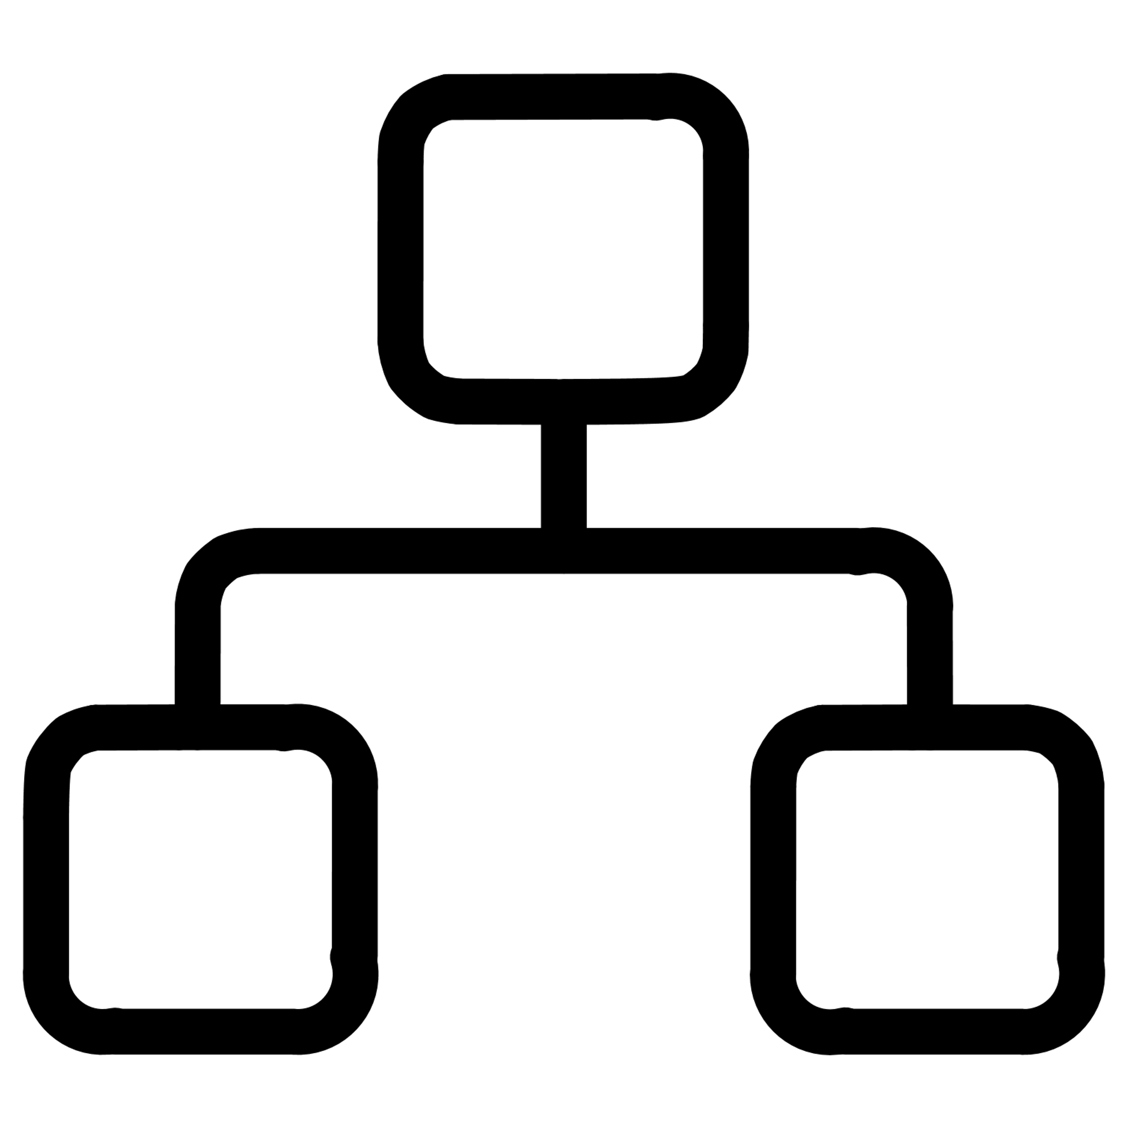




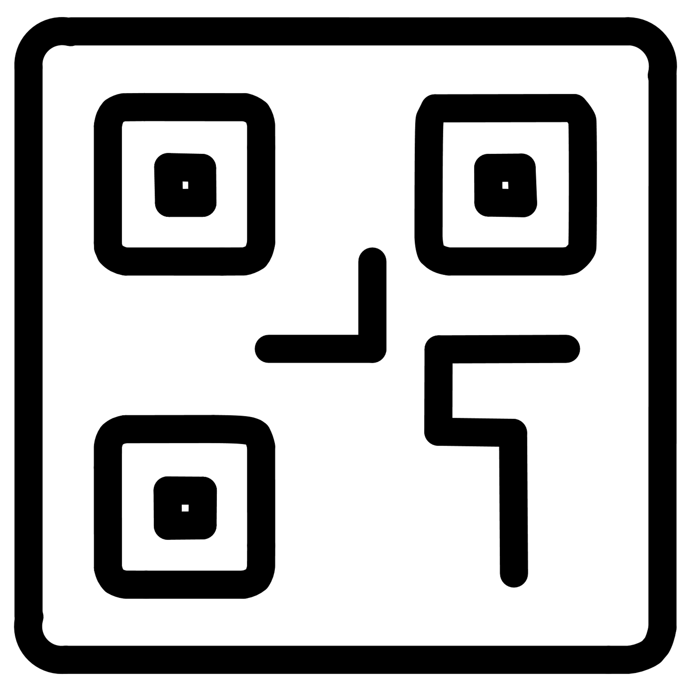

Key Features of the C Language
Structured Programming
High Execution Speed
Direct Memory Access
Portability
It offers high execution speed and efficiency.
It is a portable language that runs on multiple platforms.
C is a structured programming language that uses functions, loops, and conditions.
C allows direct memory access using pointers.
Rich Operators
Modular Programming
Standard Library
C provides a rich set of operators for various operations.
C supports modular programming for better code organization.
C includes a standard library for input/output and memory management.

Slide 5
Why Is C Considered the Mother of All Programming Languages?
C influenced the design of many modern programming languages.
Several languages follow C-based syntax and structure.
C introduced key structured programming concepts.
It allows direct control over memory and system resources.
C is widely used in system and operating system development.
Many compilers and runtimes are written in C.
C connects low-level hardware operations with high-level logic.
Learning C builds a strong foundation for other languages.

Slide 6
Why C Is Relevant Today?
C is widely used in the development of operating system kernels.
It plays a crucial role in embedded systems and IoT devices.
C is preferred for performance-critical and low-level applications.
Many modern languages and systems are built on C-based foundations.
C provides a strong understanding of memory management and system architecture.
It remains an essential language for teaching core programming fundamentals.

Slide 7

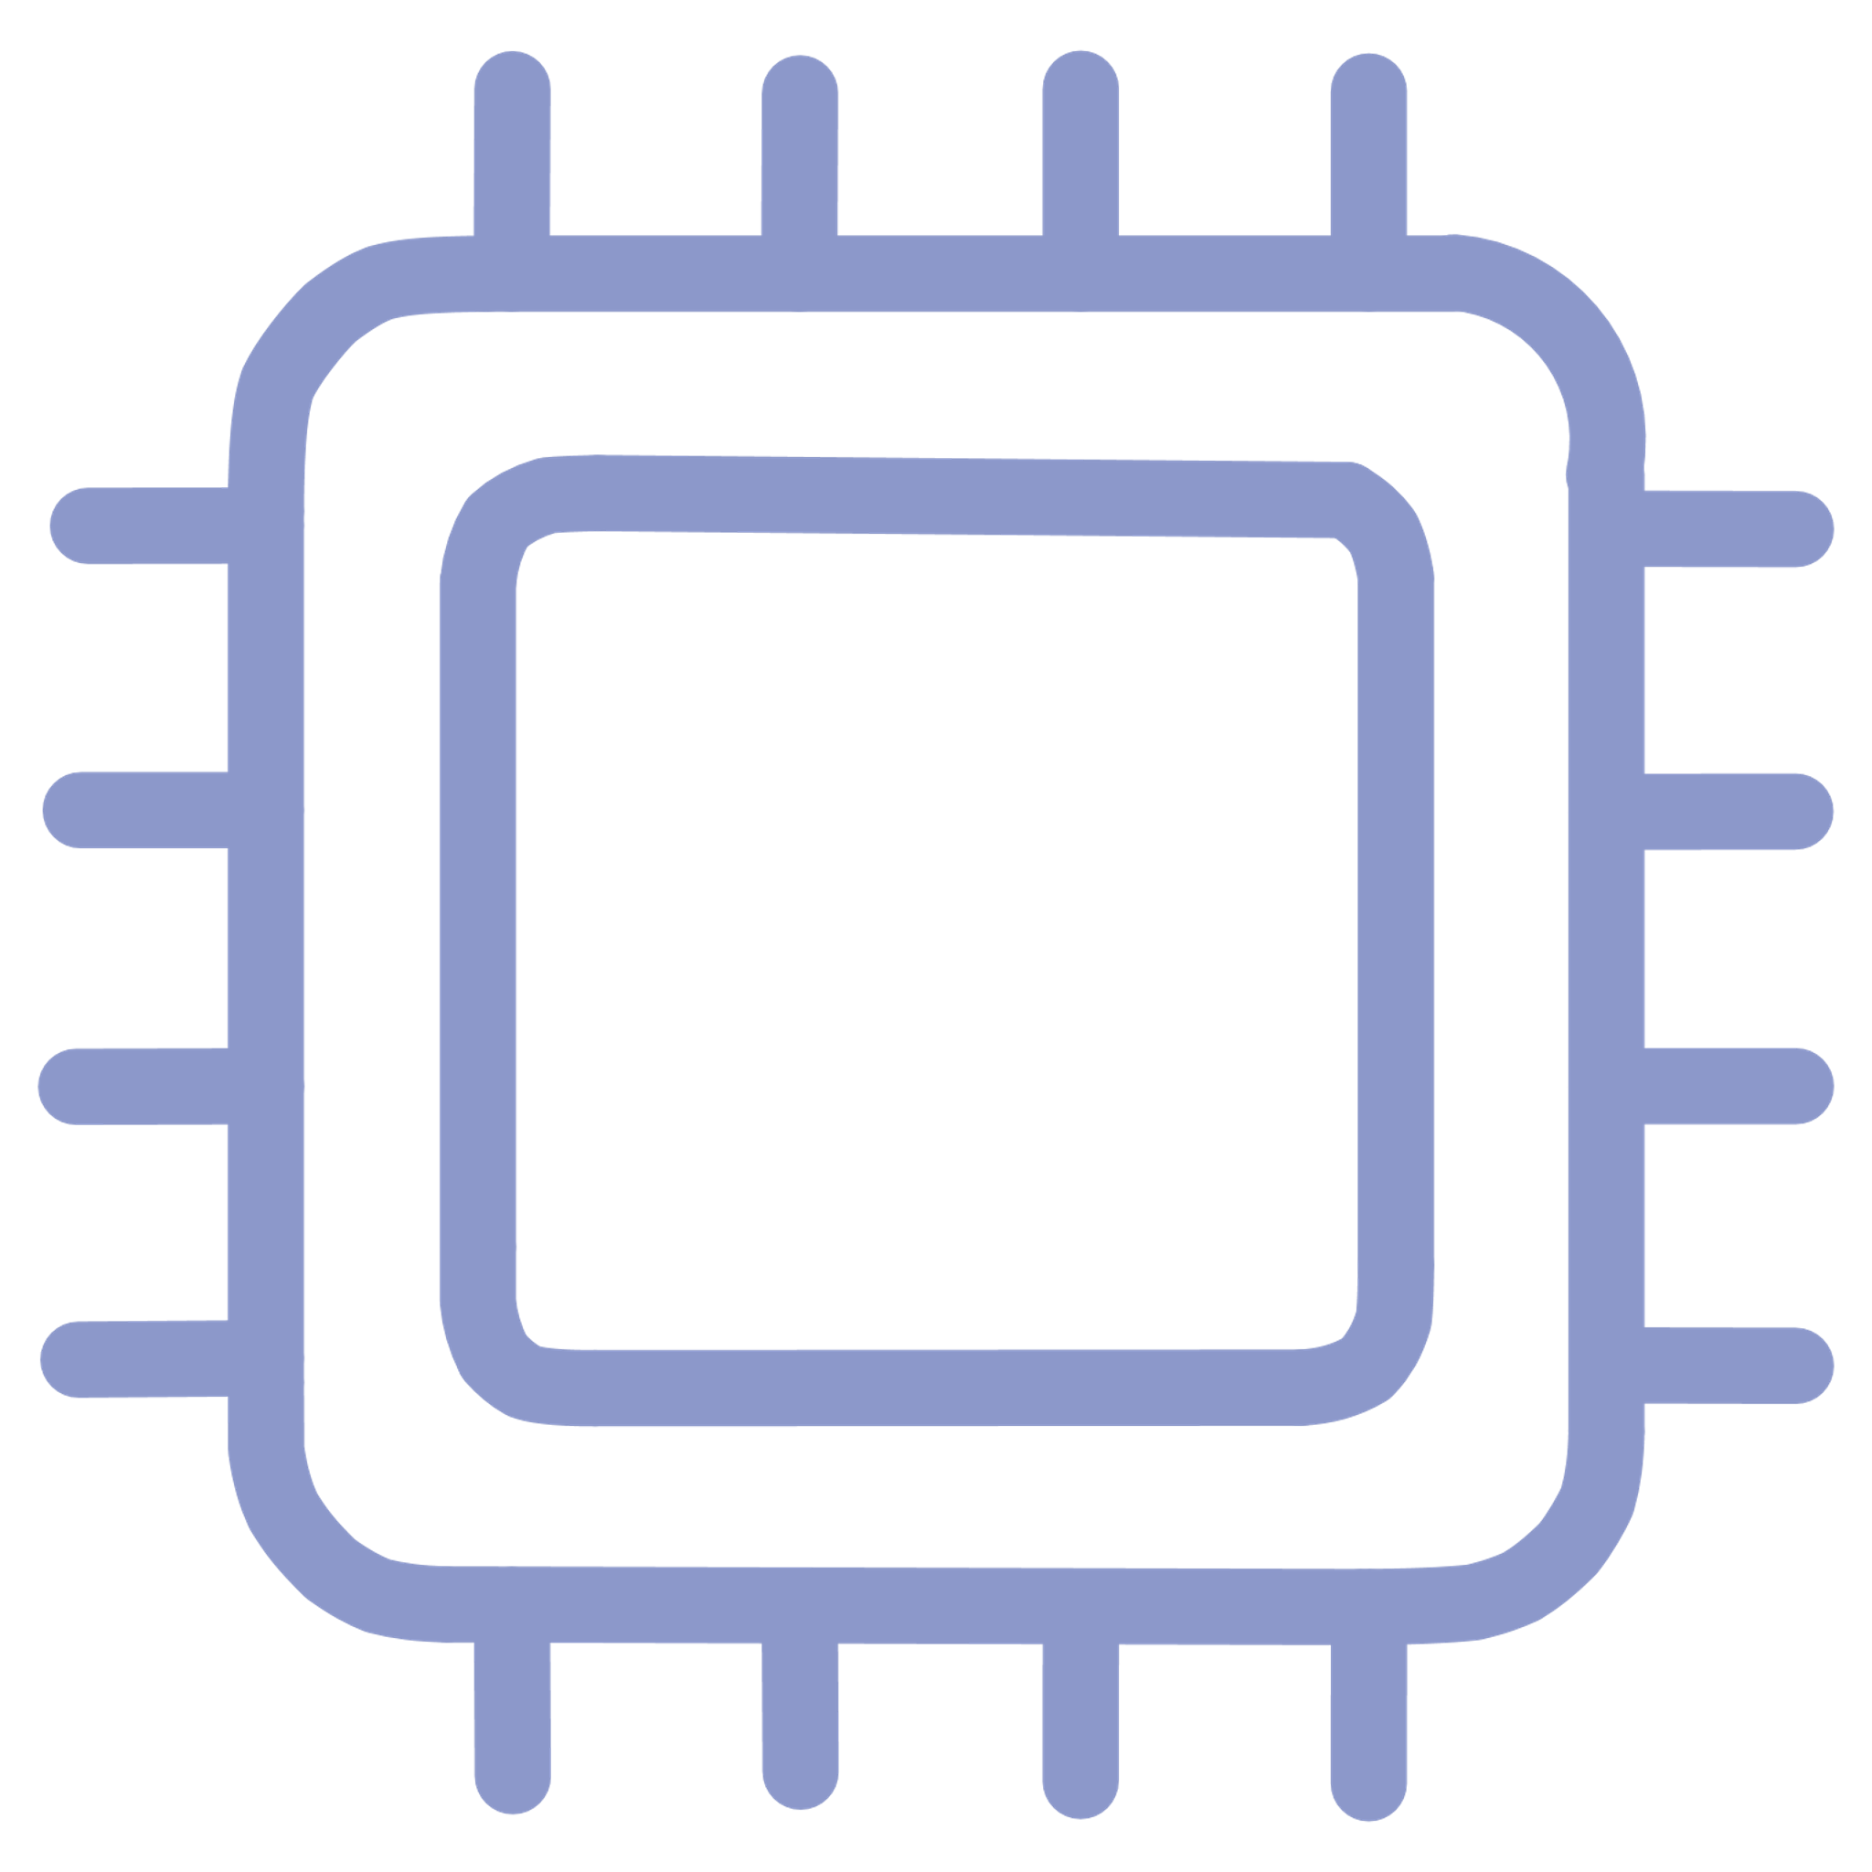




Applications of the C Language
Operating Systems
Embedded Systems
Compilers & Interpreters
Used extensively in the development of operating systems such as UNIX and Linux.
Widely applied in embedded systems and microcontroller-based devices.
Utilized in the development of compilers and interpreters.
Game Engines
Database Systems
GUI
Applied in game engines and graphics-intensive applications.
Used for database systems requiring high performance and efficiency.
C languages is used intensively in GUI applications and graphics.

Slide 8
Conclusion - C: Mother of All Languages
Built the foundation of modern programming
Introduced core concepts used everywhere today
Powers systems, compilers, and embedded technologies
Influenced languages like C++, Java, and Python
Remains timeless for learning true programming logic

Slide 9
Thank you!

