Slide 1
Web Design
Georgia Tech
My name is
Tanay Sheth.
LinkedIn
Stackfolio
Contact Me

Slide 2
My name is Tanay Sheth. I am a student at Georgia Tech
Georgia Tech – Finance, Business Administration, Engineering & Management
Stackfolio – Digital Advertising, Web Design, Email Campaigning
Contact Me
LinkedIn

Slide 3
Hi there! My name is Tanay Sheth. Welcome to my portfolio.
I am a student at Georgia Tech in Atlanta, Georgia. I study finance, engineering, and design.

Slide 4
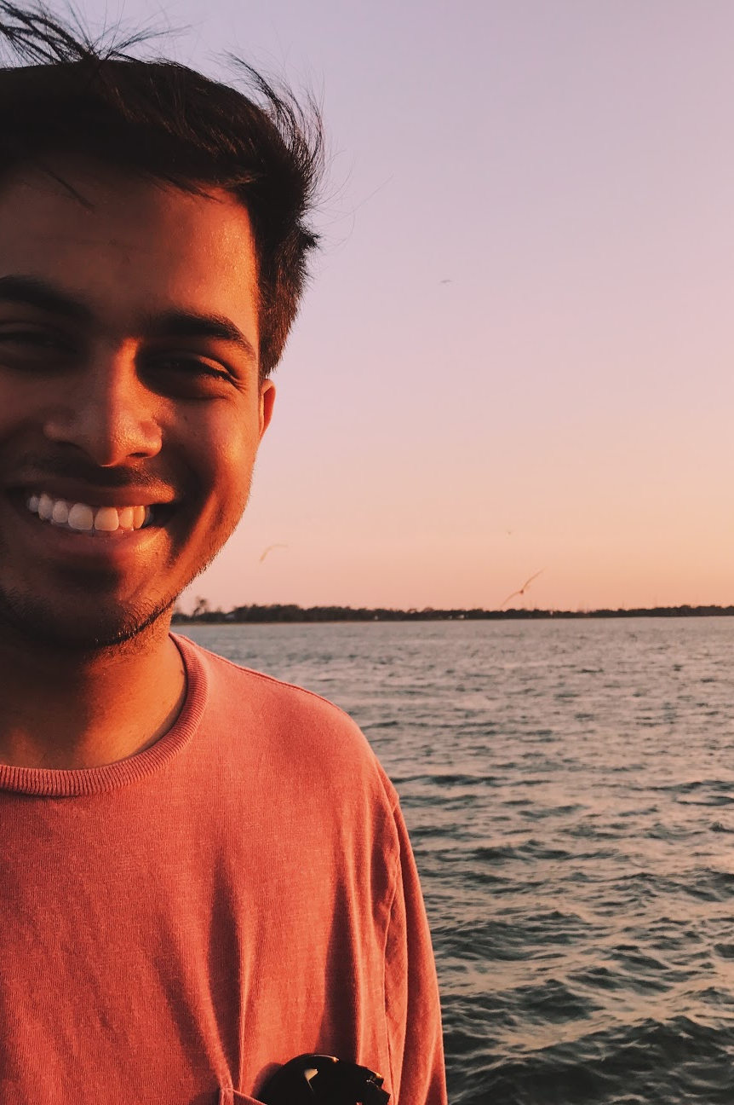
Hi there! My name is Tanay Sheth, and I am a student at Georgia Tech.
Say hi on LinkedIn ➞
Experience
Previously, I spent 15-months at a fintech startup in Atlanta called Stackfolio as a Sales & Marketing Intern.
⁰¹ Platform Growth
⁰² Digital Advertising
⁰³ Web Design
⁰⁴ Email Campaigning
Visit Stackfolio’s website ➞
Education
I am a third-year student at Georgia Tech, majoring in Business Administration with a concentration in Finance and a minor in Engineering & Management.
Let’s talk: email tanaysheth[at]gatech.edu

Slide 5
