Slide 1

DESIGN AND ANALYSIS OF ALGORITHMS
Divide and
Conquer
Presenter: Tanay Vijay Gulhane
PRN: 25070521308
Batch: C2(2025-29)
Generated using : Gamma AI

Slide 2
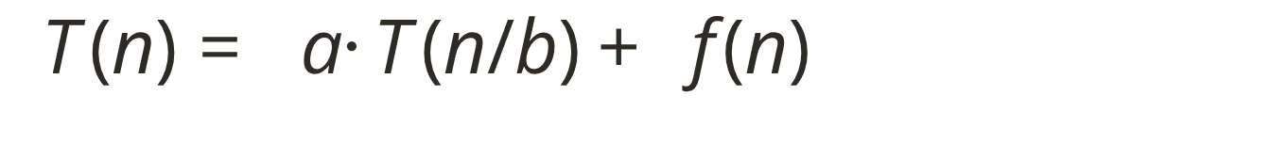
Divide and conquer breaks one hard problem into smaller ones
A technique that solves a big problem by breaking it into smaller subproblems of the same type. Each subproblem has the same shape as the original, so recursion does the repeated work.
01
02
03
Divide
Conquer
Combine
Split the problem into smaller subproblems.
Solve each one, usually by recursion.
Merge the sub-solutions into the final answer.
a = number of subproblems · b = shrink factor · f(n) = divide-and-combine cost

Slide 3
Binary Search discards half the range each time
Sorted array: compare the middle, then discard half the range.
01
02
03
Compare 40
Compare 20
Find 30
30 is smaller → go left.
30 is larger → go right.
The remaining middle value is the target.
[10, 20, 30, 40, 50, 60, 70]
Time: O(log n)

Slide 4
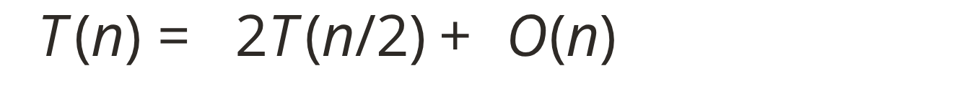
SORTING
Merge Sort delivers predictable performance
Halve the array until each part has one element, then merge sorted halves.
01
02
03
04
Split
Halve
Sort
Merge
Time: O(n log n) in best, average, and worst cases · Extra space: O(n)
Trade-off: predictable and stable, but needs extra memory.
[8, 4, 6, 2]
[8, 4] + [6, 2]
[4, 8] + [2, 6]
[2, 4, 6, 8]

Slide 5
Quick Sort partitions around a pivot
Merge Sort and Quick Sort comparison
Feature | Merge Sort | Quick Sort
Main work | Combine (merge) step | Divide (partition) step
Worst case | O(n log n) | O(n²)
Extra space | O(n) | O(log n) average (recursion stack)
Stable | Yes | No (standard version)
Choose a pivot; put smaller elements on the left and larger elements on the right, then sort each side recursively.
Time: average O(n log n); worst O(n²) when partitions are very unbalanced
Pivot 5
Recurse
[6, 3, 8, 2, 5]
→ [3, 2] 5 [6, 8]
[2, 3, 5, 6, 8]

Slide 6
Strassen reduces matrix multiplication from eight blocks to seven
Both methods split each matrix into four blocks; Strassen reduces the expensive multiplication count.
Standard method
Strassen
Eight block multiplications give O(n³).
Seven block multiplications (M1 to M7), plus additions and subtractions.
Time: O(n^2.807); useful for large matrices, though practical speed depends on implementation.

Slide 7
Divide and conquer can find both extremes efficiently
Split the array into two halves, find the maximum and minimum of each, then compare the two results.
Time: O(n)
Comparisons: about 3n/2 − 2, versus about 2n for the simple method
01
02
03
Split
Conquer
Combine
[12, 5, 30] + [8, 20, 3]
(max 30, min 5) + (max 20, min 3)
Max = 30 · Min = 3

Slide 8
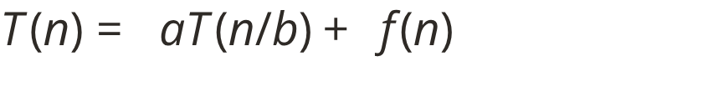
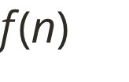
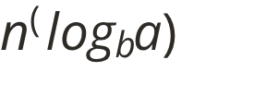
The Master Theorem turns recurrences into complexity
For , compare with .
Case 1
Case 2
Case 3
f(n) is smaller
f(n) is equal
f(n) is larger, plus a regularity condition
Θ(n^(log_b a))
Θ(n^(log_b a) · log n)
Θ(f(n))
Merge Sort
Binary Search
Strassen
a = 2, b = 2, f(n) = n → Θ(n log n)
a = 1, b = 2, f(n) = 1 → Θ(log n)
a = 7, b = 2, f(n) = n² → Θ(n^2.807)

Slide 9
Complexity summary
Compare the algorithms by their time complexity and the trade-offs behind each growth rate.
Algorithm | Time complexity
Binary Search | O(log n)
Merge Sort | O(n log n)
Quick Sort | Average O(n log n), worst O(n²)
Strassen's Matrix Multiplication | O(n^2.807)
Max and Min | O(n)

Slide 10


Advantages
Limitations
Simplifies hard problems, gives efficient algorithms, and suits parallel execution.
Recursion overhead and extra memory; overlapping subproblems are often better handled by dynamic programming.
THE TAKEAWAY
Divide,
conquer,
combine.
Conclusion
Understand the algorithm, write the recurrence, then find the complexity.
Then choose wisely.
Thank you!

