Slide 1
Review response
Quantum-inspired annealing
for multi-stage reasoning
What the review asked for, what the pipeline does now,
and blank pages for the benchmark you will append.
main · October 2026

Slide 2
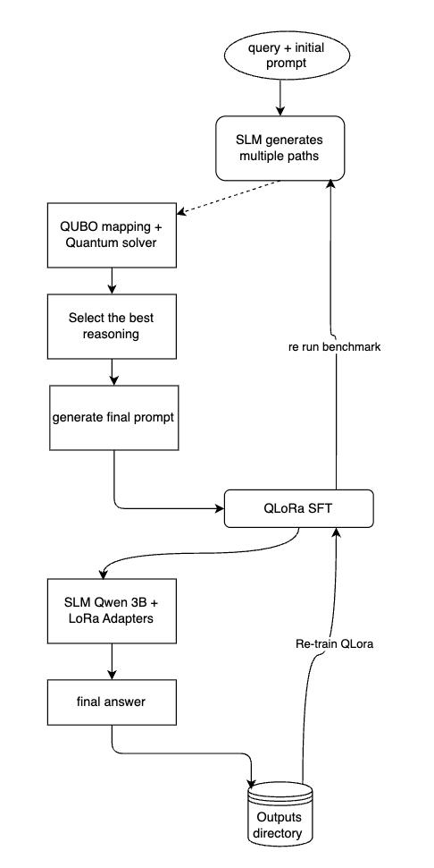
Architecture
Why each step is there
1
1
One question in
Everything after this box is about a single query. The prompt is not rewritten until a subset of traces has been chosen.
2
3
2
Several traces, on purpose
Four prompt styles and four samples. Selection only means something if there is a set to choose from, not one greedy trace.
4
3
Scores become an energy
5
Correctness and redundant wording are one cost. The search is locked to exactly K traces. At this size that search is exhaustive, not a quantum processor.
4
One answer, then the wording
The majority answer is chosen first. QUBO then picks diverse rationales inside that answer, so conflicting finals never share the prompt.
5
The prompt the model actually sees
Only the surviving rationales are written into the final prompt. The answer is generated from that prompt.
Review response · main
2 / 17

Slide 3
Architecture
Why the loop comes back
1
The adapter learns this prompt
QLoRA trains on the selected prompt plus the gold completion. The next round samples with the saved adapter, not the base model.
2
Same model, LoRA on
The figure says Qwen 3B. The default config is Qwen2.5-1.5B-Instruct. The fast config is Qwen2.5-3B-Instruct.
5
3
The line that gets graded
Greedy decode from the selected prompt. This string is the prediction. It is not an input to the trace score.
1
4
The only handoff
Traces, the adapter, and the benchmark files land in the outputs directory. The next round reads that directory.
2
3
5
Two loops, two jobs
Re-run the benchmark on held-out questions. Retrain from the saved adapter. Gold grades the benchmark. It does not score the traces.
4
Review response · main
3 / 17

Slide 4
Scoring
Gold is not part of the trace score
S_final = 0.40 S_SC + 0.30 S_NLI + 0.20 S_Conf + 0.10 S_Arith
Math weights. Commonsense uses 0.50, 0.30, 0.20, and 0.
Self-consistency
Share of traces that land on this same answer.
Entailment
Probability that the rationale entails the question.
Confidence
Exponential of the mean log probability of the generated tokens.
Arithmetic
Checked equations over equations found. Used for math. Weight zero on commonsense.
Commonsense weights are 0.50, 0.30, 0.20, 0. Gold remains the training completion and the grader.
Review response · main
4 / 17

Slide 5
The review
Seven comments, and where each stands
01
Exact subset size
Addressed
02
Same generation budget
Addressed
03
Sample size and noise
Partial
04
Train, validate, test
Addressed
05
Do not mix conflicting answers
Addressed
06
Learn the weights
Partial
07
Verified preference pairs
Addressed
Protocol checks: tests/test_protocol.py, 15 passed. No benchmark number in this deck is from the new run.
Review response · main
5 / 17

Slide 6
01 of 7
Force a subset of size K
Addressed
The comment
The energy had no cardinality term, so any extra trace with a small score could be kept. Coefficients should be tuned on a validation set, never on the test set.
What changed
The solver now returns exactly K traces. K is the subset size, default 6.
The soft penalty is off. Size K is the search space, not a weighted hint.
With 20 or fewer candidates, every size-K subset is scored. That result is the optimum.
Above 20, annealing never leaves the exact-K slice.
The tuner reads a GSM8K train hold-out. The checked-in coefficients are marked stale until that script is run.
pipeline/qubo_math.py · pipeline/solver.py · scripts/tune_qubo_params.py
Review response · main
6 / 17

Slide 7
02 of 7
Compare at the same budget
Addressed
The comment
QUBO saw 16 traces and chain-of-thought saw one, so a gain could be sampling rather than selection. At 16 variables, exhaustive search is cheap enough to be the ground truth.
What changed
One pool of 16 traces: four templates, four samples.
Self-consistency, best-of-16, and QUBO all read that same pool.
The comparison to quote is QUBO against self-consistency on those 16.
Greedy and chain-of-thought stay on the page as single-sample references.
For 16 traces and K = 6 the solver enumerates all 8,008 size-K subsets.
pipeline/matched_baselines.py · scripts/run_all_benchmarks.py
Review response · main
7 / 17

Slide 8
03 of 7
Eighty or a hundred is noisy
Partial
The comment
Reported runs of 81 or 100 questions are too small. Differences on MMLU and BBH can be sampling noise.
What changed
The report now carries a Wilson 95% interval on each accuracy.
A calibration helper, expected calibration error, is in the code.
The configured slice is 200 questions, and full evaluation is still off.
Old 81 and 100 figures are not results of this protocol.
A claim waits on a larger run. The tables at the end are blank for that run.
pipeline/stats_utils.py · config/config.yaml evaluation.subset_size 200
Review response · main
8 / 17

Slide 9
04 of 7
Keep the test set unseen
Addressed
The comment
GSM8K was used both to build training chains and to evaluate. Train on the training split, tune on a held-out slice of that split, and do not touch test questions while designing prompts, weights, or thresholds.
What changed
Supervised traces are sampled from the GSM8K training split.
The benchmark pass uses the test split, and it runs after training.
The QUBO grid never loads the official test set.
Training data keeps a 90 / 10 split inside the training pool.
The verifier does not receive gold. There is no near-duplicate filter yet.
training/sft.py · scripts/generate_training_data.py · scripts/tune_qubo_params.py
Review response · main
9 / 17

Slide 10
05 of 7
One answer in the prompt
Addressed
The comment
Do not penalise every pair of traces that share a final answer. Penalise duplicate rationales inside an answer group. Do not mix traces that support conflicting answers.
What changed
Sharing an answer is no longer a penalty. That weight is zero.
The cosine penalty runs inside the winning answer group.
The winning group is the majority answer, with score as the tie-break.
QUBO then chooses which rationales from that group to keep.
The final prompt drops any trace whose answer conflicts with that group.
pipeline/answer_groups.py · pipeline/qubo_builder.py · pipeline/inference.py
Review response · main
10 / 17

Slide 11
06 of 7
Learn weights on accuracy
Partial
The comment
Learn the fusion weights and the QUBO coefficients with nested validation. The target is final-answer accuracy and calibration, not correlation with an internal score.
What changed
The grid ranks QUBO coefficients by final-answer accuracy on the train hold-out.
It does not rank them by correlation with the verifier’s own score.
Calibration can be measured. The grid does not yet maximise it.
Fusion weights are still the hand-set values on the scoring slide.
There is no nested cross-validation.
scripts/tune_qubo_params.py · config/config.yaml verifier.weights
Review response · main
11 / 17

Slide 12
07 of 7
Verified correct against incorrect
Addressed
The comment
Preference pairs should come from the same prompt. One solution is independently verified correct, the other incorrect. A self-score by itself is not a label.
What changed
A pair is kept only when gold confirms one chain and rejects another.
Both chains are answers to the same question.
Self-score only picks which confirmed chain and which rejected chain.
The DPO trainer consumes those pairs.
That trainer has not been run, so this deck has no DPO accuracy.
pipeline/preference_labels.py · scripts/generate_preference_pairs.py · training/run_dpo.py
Review response · main
12 / 17

Slide 13
Before the results
What this deck does not claim
No new accuracy.
The benchmark and the QLoRA round were not finished. Disk was full before the adapter was saved.
Fusion weights are chosen, not learned.
Math is 0.40, 0.30, 0.20, 0.10. Commonsense drops arithmetic.
The solver is exact enumeration.
For the 16-trace pool it is not a quantum processor and not simulated annealing.
The default model is 1.5B.
Qwen2.5-1.5B-Instruct. The 3B in the figure is the fast config.
A legacy script still reads old test files.
scripts/prepare_training_data.py is not the training path.
Review response · main
13 / 17

Slide 14
Append after the run
Outcomes
The next three slides are empty on purpose.
Paste the matched-budget table and the QLoRA round here.
Notes:
Fill after scripts/run_all_benchmarks.py and training/sft.py. Quote QUBO against SC-16, with the Wilson interval. Do not reuse the July 81-question or 100-question numbers.

Slide 15
Outcomes
Matched budget, same 16 traces
Benchmark | Greedy | CoT | SC-16 | Best-16 | QUBO | vs SC-16 | 95% CI
GSM8K | — | — | — | — | — | — | —
BBH | — | — | — | — | — | — | —
StrategyQA | — | — | — | — | — | — | —
ARC | — | — | — | — | — | — | —
MMLU | — | — | — | — | — | — | —
Replace each dash after the run. The gain that answers the review is QUBO minus SC-16, not QUBO minus chain-of-thought.
Review response · main
15 / 17
Notes:
Source: the markdown and json written by scripts/run_all_benchmarks.py. Columns already match pred_sc16, pred_best16, pred_qubo and ci95.

Slide 16
Outcomes
QLoRA round
Round
Questions trained
Questions graded
—
—
—
Adapter path
Accuracy before
Accuracy after
—
—
—
Review response · main
16 / 17
Notes:
Source: outputs/qlora_rounds/round_*/summary.json and benchmark.jsonl. The previous 40-question run stopped before the adapter was saved, so these cells are empty.

Slide 17
Outcomes
Where the numbers will come from
Benchmark table
scripts/run_all_benchmarks.py writes the per-benchmark accuracies, the SC-16 and best-of-16 columns, and the Wilson interval.
QLoRA card
training/sft.py writes outputs/qlora_rounds/round_*/summary.json after the test pass. The adapter is under checkpoints/.
Per-question detail
benchmark.jsonl in that same round folder. One row per question if a worked example is needed.
Do not paste
The July runs of 81 and 100 questions, and the old 0.7778 tuning figure. Both predate this protocol.
Review response · main
17 / 17

