Slide 1
AMD & Treatment Options

Slide 2
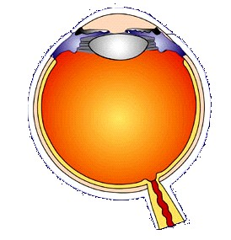
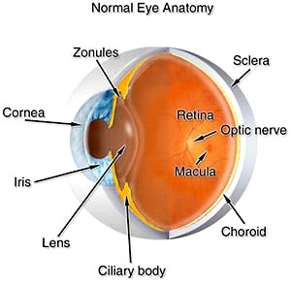
Eyeball
Made up of 3 layers (outside to inside)
  Sclera
  Choroid
  Retina

Slide 3
Age Related Macular Degeneration

Slide 4
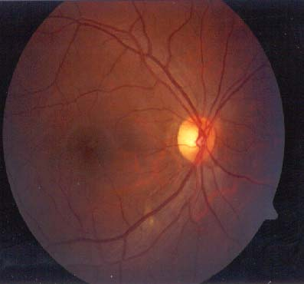
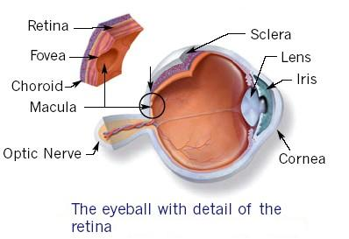
Macula
Macula / Macula Lutea
Small central area of retina (Located in centre of retina)
About 5 - 5.5 mm in diameter
Responsible for central vision
Fovea
At the centre of macula
About 1.5 mm in diameter (the same as that of an average optic disc)

Slide 5
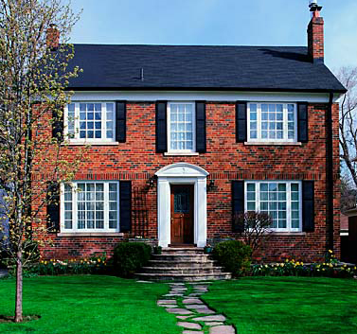
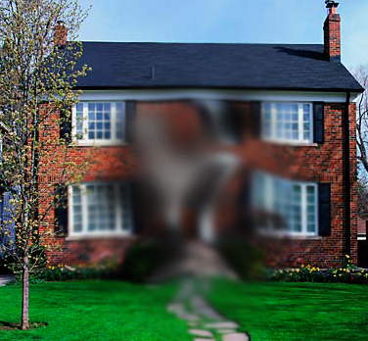
Impact of AMD

Slide 6
Impact of AMD

Slide 7
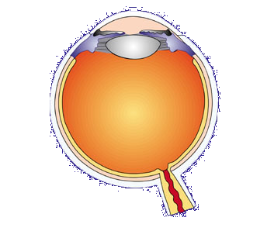
AMD Damages the Macula
Lens
Retina
Optic nerve
Macula
Notes:
Vision loss in AMD occurs when the macula becomes damaged. The macula is a region at the center of the retina where images are focused. It is responsible for perception of images in the center of the visual field and for the high-acuity vision necessary for detailed tasks such as reading or writing. Damage to the macula will also affect the appreciation of color.

Slide 8
Age Related Macular Degeneration (AMD)
Retinal degenerative disease
Risk increases with age
Progressive central vision loss
Most common cause of vision loss in > 50 yrs age
Death of photoreceptors in macula

Slide 9

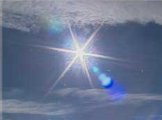
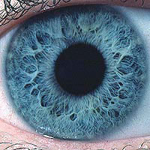

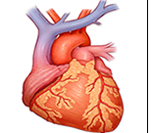

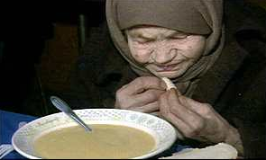
AMD – Risk Factors
Sunlight
Cigarette Smoke
Light coloured iris
Oldage & Family history
Cardiovascular disease
Female Sex
Low Diet intake

Slide 10
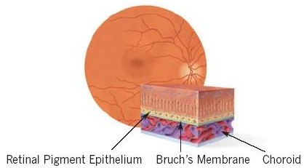
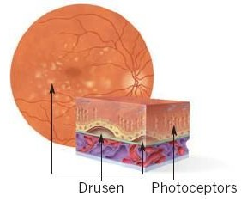
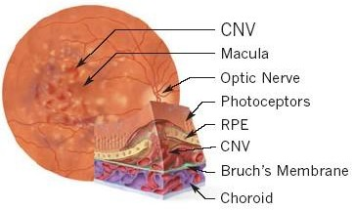
Types of AMD
Dry AMD
Wet AMD

Slide 11
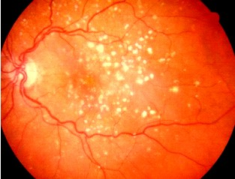
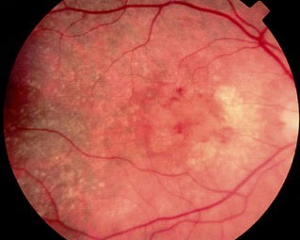
Types of AMD
Dry AMD
Wet AMD

Slide 12
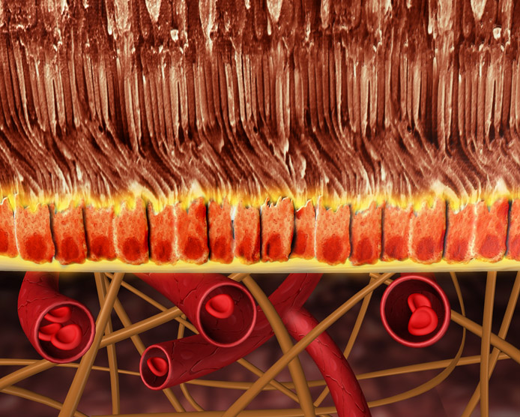
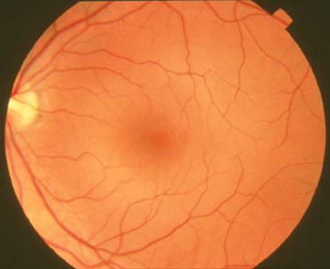
Etiology of Neovascular AMD:
Normal Retina
Photoreceptors
RPE
Choroid
Copyright protected
Notes:
In a normal retina, the retinal pigment epithelium (RPE) separates the choroid from the retinal neurons or photoreceptors. The choroid provides the blood supply to the retina.
When the RPE is intact, it blocks the inward migration of small molecules from the choriocapillaris into the subretinal space.
Reference:
Kincaid 1992

Slide 13
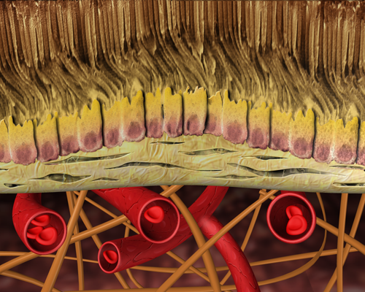
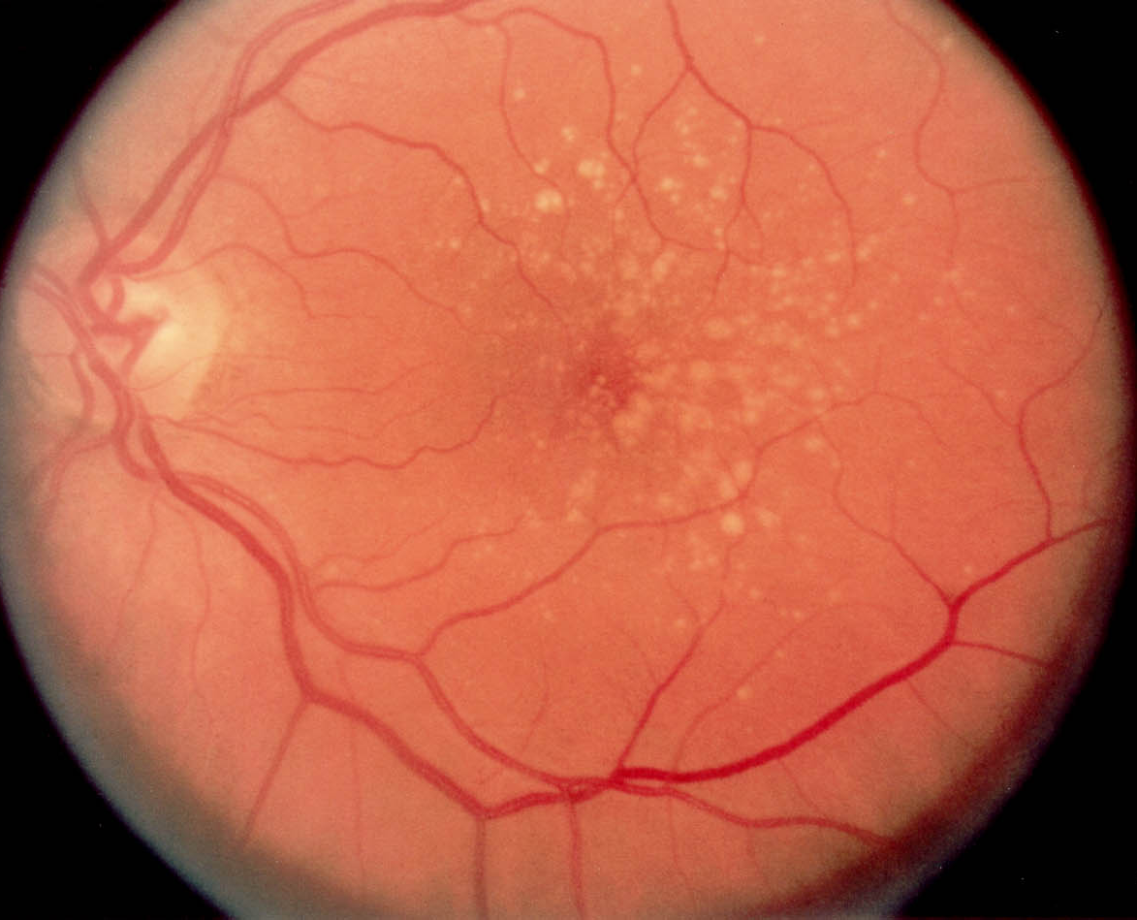
Etiology of Neovascular AMD:
Development of Drusen
Copyright protected
Bruch’s membrane thickens and drusen develop
Notes:
Drusen (arrowed) are the first clinically detectable sign of AMD. There is accumulation of debris, with thickening of the basement membrane of the RPE (Bruch’s membrane) leading to drusen formation.
Reference:
Kincaid 1992

Slide 14
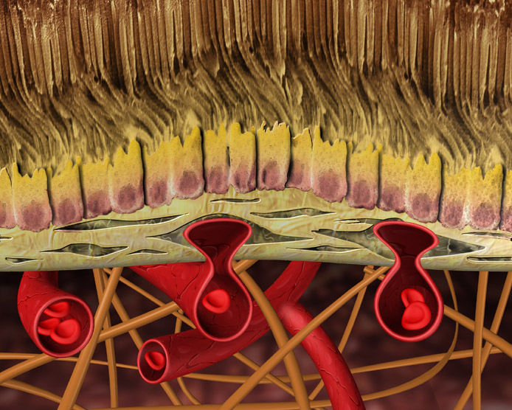
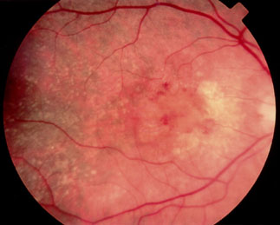
Etiology of Neovascular AMD:
Formation of New Vessels
Copyright protected
New, abnormal blood vessels (CNV) proliferate
and penetrate Bruch’s membrane
Notes:
In neovascular AMD, the development of soft, diffuse drusen is associated with breaks in Bruch’s membrane. These breaks may provide sites through which new, abnormal blood vessels (arrowed) from the underlying choriocapillaris grow and proliferate. These new blood vessels are known as CNV.
References:
Kincaid 1992
Alexander 1993

Slide 15
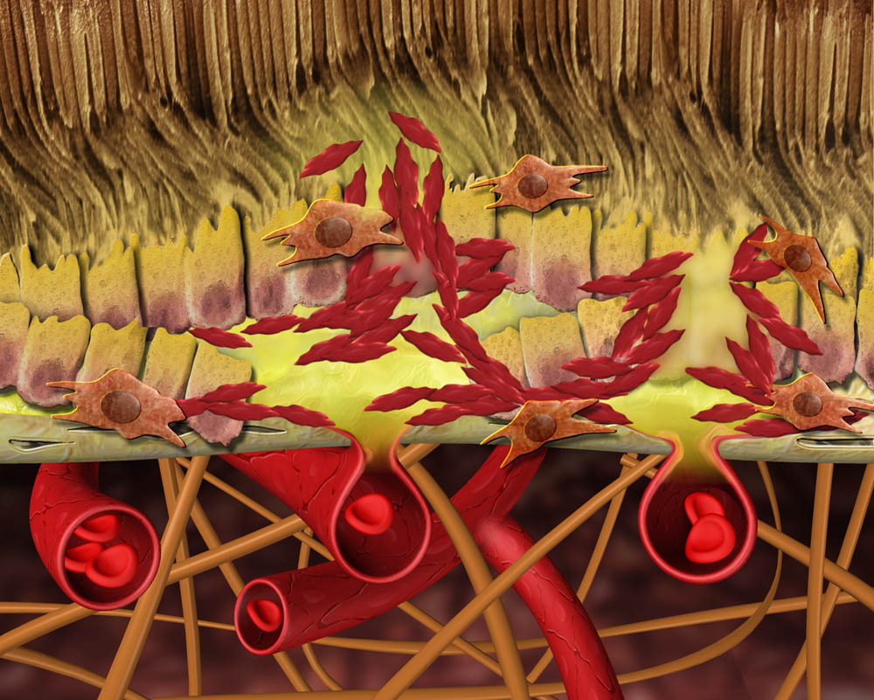
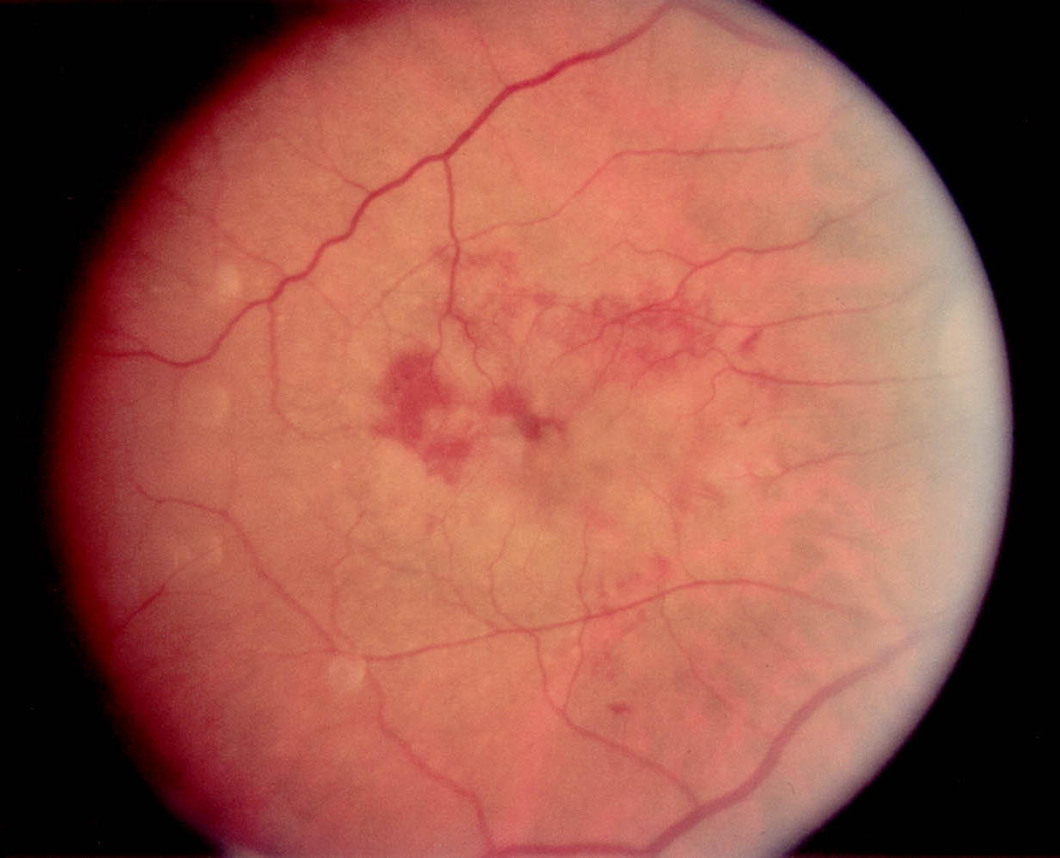
Etiology of Neovascular AMD:
Leakage of Fluid and Blood from CNV
Copyright protected
New blood vessels leak blood and fluid
Notes:
The newly formed blood vessels are fragile and leak blood (arrows) and fluid, which can lead to detachment of the RPE or neurosensory retina, formation of a fibrovascular scar, and a loss of outer retinal tissue. These changes lead to distorted vision and may result in profound, irreversible central vision loss.
Reference:
Alexander 1993

Slide 16
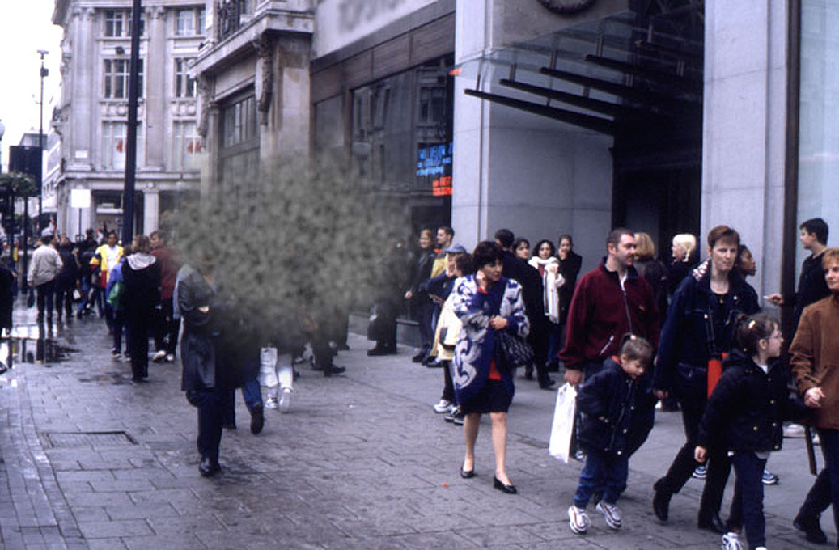
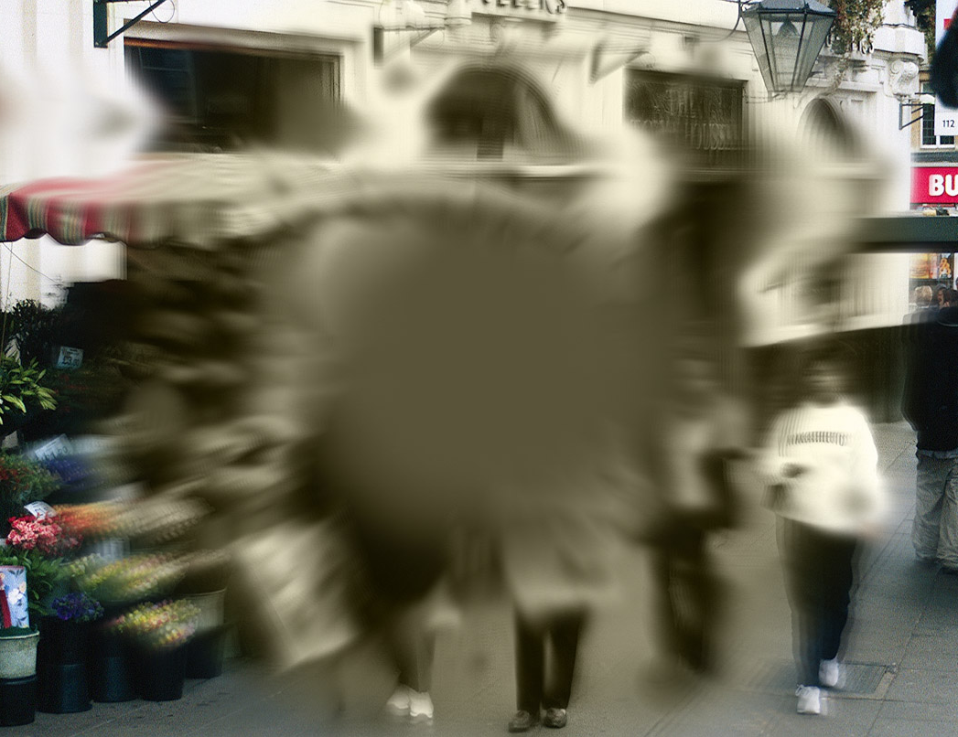
Symptoms of AMD
Blurred (central) vision
Peripheral vision is intact
Wavy appearance to straight lines (for example, a telephone pole may appear to be bent) (Distorted vision)
A dark patch in the middle of words as you read
A worsening of your color vision
Copyright protected
Notes:
Regardless of the cause, patients who develop CNV are likely to experience a number of symptoms, including reduced central vision and a central scotoma (blind spot) in the visual field. Metamorphopsia (distorted vision), decreased contrast sensitivity (the ability to distinguish between visual targets), and decreased color vision are also reported by many patients.

Slide 17
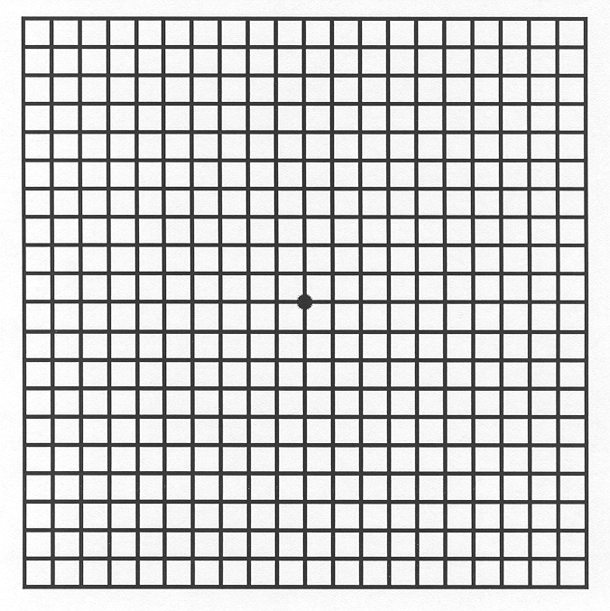
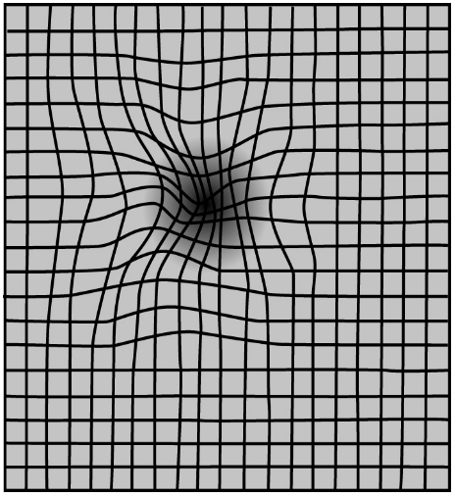
Detection:
The Amsler Grid
  Useful and simple tool
  Regular use at home
  Monitor any change in vision
  Esp. for dry AMD patients
  Dry AMD - Appearance of wavy lines or scotoma - Heralds onset of wet AMD
Signs suggestive of neovascular AMD include:
  Distortion
  Blurring
  Darkening or discoloration of the grid lines
  Inability to fix on the central dot
  Disappearance of lines on the grid
Notes:
The chances of an early diagnosis may be improved if patients are encouraged to report early symptoms of neovascular AMD.
It may be possible to facilitate early detection by providing patients with Amsler grids. Patients at risk of neovascular AMD should be encouraged to use the grid to check the vision in each eye at daily intervals and to report any signs suggestive of neovascular AMD.
These signs include distortion of the lines, blurring, darkening, or discoloration of the grid or an inability to fix on the central dot.
Reference:
Mattice 1986
Figures from Monograph figure 2.9

Slide 18
How to manage Dry AMD
Lifestyle modifications
  Quit smoking
  Improve dietary intake of fruits and vegetables
  UV protection
Monitoring through Amsler’s grid and regular visits to ophthalmologist
Antioxidant vitamins and minerals

Slide 19
How to manage Wet AMD
Lifestyle modifications
  Quit smoking
  Improve dietary intake of fruits and vegetables
  UV protection
Monitoring through Amsler’s grid and regular visits to ophthalmologist
Antioxidant vitamins and minerals
Pharmacologic treatments for wet AMD

Slide 20
Treatment Options in Wet AMD
3 Licensed Treatments
  Lucentis ( Ranibizumab )
  Macugen ( pegaptanib )
  Visudyne ( Verteporfin )
1 Unlicensed treatment
  Avastin ( Bevacizumab )

Slide 21
Macugen
An anti-VEGF - studied to see how safe it is and how well it works in AMD
  It stops VEGF-A from causing further damage to the eye
  Given in the eye once every 6 weeks
However there are several types of VEGF-A that can damage the eye
  Macugen stops just one of them
Slows further vision loss , but CANNOT improve vision

Slide 22
Lucentis
An anti-VEGF - studied to see how safe it is and how well it works in AMD
  It stops VEGF-A from causing further damage to the eye and can even repair some of the damage that has occurred.
There are several types of VEGF-A that can damage the eye
  Lucentis stops all types of VEGF-A
The 1st and only therapy proven to improve vision
  > 70 % patients showed atleast some improvement
  > 33 % patients showed improvement by 3 lines

Slide 23
Visudyne
Also called Photo Dynamic Therapy ( PDT )
Unique among Wet AMD treatments
  Seals leaky blood vessels that causes wet AMD.
Administered through a vein in the arm and then activated by Laser for 83 seconds
Proven to slow down vision loss but cannot improve vision
Indicated in some types of Wet AMD , not all – consult Doctor.

Slide 24
Avastin-Unlicensed
NOT Licensed to treat Wet AMD
Treatment for cancer , to be administered through vein in the arm
  Not designed to treat Wet AMD
Small studies have reported improvement in vision
  For Wet AMD given in the eye as an injection
Never studied in large clinical trials for Wet AMD
No robust data to show what percentage of people improve vision
No data to show safety

Slide 25
Summary of Treatment Options
 | Macugen | Lucentis | Visudyne | Avastin
How it works | Anti-VEGF | Anti-VEGF | Seals Blood vessels | Anti-VEGF
Slows Vision Loss | Yes | Yes | Yes | ?
Improves Vision | No | Yes | No | ?
Proven & Licensed | Yes | Yes | Yes | No

