Slide 1
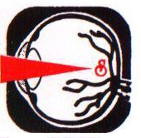
SURYA
Core Anterior Vitrectomy
following Posterior Capsular Rupture

Slide 2
SURYA
DR. AJAY DUDANI
ZEN EYE CENTRE, Khar
SURYA EYETECH, Mulund

Slide 3
Posterior capsule rupture
Most frequent significant complication encountered by Phaco surgeons in their learning curve
Can happen even with masters
Incidence of PCR 0.05 - 10 %
Incidence of Vitreous Loss 0.8 – 1.25 %
SURYA

Slide 4
Can happen at various stages
SURYA
At the time of hydro dissection
Phacoemulsification
Cortex removal by I / A
During IOL insertion

Slide 5
Vitreous Anatomy
SURYA
Gel like due to arrangement of long thin non branching collagen fibrils suspended in a network of glycosaminoglycan chains.
Is attached densely to Ora serrata and is loosely adherent to optic nerve and macula.
Therefore Vitreous loss can lead to complications like CME and RD.

Slide 6
Basic Principle
SURYA
Vitreous is supposed to be in the posterior segment.
Best strategy is to prevent vitreous loss in the first place.
Next best strategy is to minimize the potential vitreous loss following PCR.

Slide 7
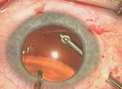
Management
Total and safe removal of remaining lens material
Preserve as much capsule as possible to place IOL
Thorough removal of vitreous from wound and anterior chamber
SURYA

Slide 8
SURYA
First two points are to be dealt by master Phaco surgeon
I will stick to tips for the removal of vitreous by anterior vitrectomy

Slide 9
SURYA
If PCR occurs, closed chamber system necessary.
If remaining surgery managed without disturbing the anterior hyaloid phase, then vitrectomy may not be required.
However, once anterior hyaloid is breached, then vitrectomy necessary.

Slide 10
SURYA
Establishment of semi-closed pressurized system necessary as chamber collapse will promote forward movement of vitreous.
Avoid burnt hand reflex – Phaco tip should not be removed. Aspiration stopped immediately after identification of PCR.
Continue in position 1 ( irrigation ).
Second instrument removed from side port and Viscoelastic filled in AC.
Then Phaco tip is removed from eye.

Slide 11
Vitreous as Slinky Toy
SURYA
Vitreous body similar to semi elastic material - slinky toy
If one pulls on the top few coils of the slinky, it stretches but no tensions are exerted through out the remaining toy.
Similarly if amount of anterior vitreous disturbed is limited, then tensions are not exerted throughout the vitreous body, therefore CME and RD is decreased.

Slide 12
Vitreous as Slinky Toy
SURYA
If one forcefully pulls on all coils of the slinky toy, tension is exerted all the way down the toy.
This is similar to extensive vitreous loss exerting traction at vitreo-macular interface and vitreous base causing CME and RD.
So DO NOT STRETCH THE SLINKY.

Slide 13
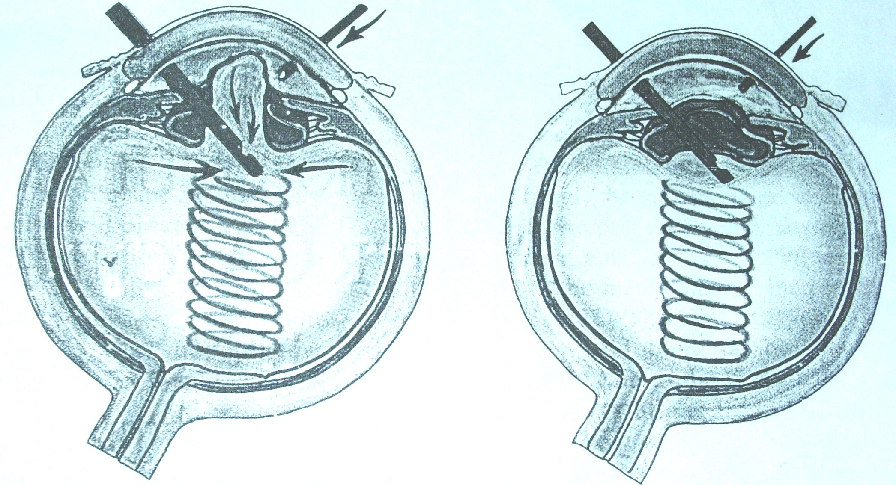
Vitreous as Slinky Toy
SURYA

Slide 14
Co-axial infusion not to be used
SURYA
Force can rip open the posterior capsule permitting more vitreous loss.
Hydrates the vitreous causing forward movement.
Shakes and wiggles the vitreous causing forward movement.

Slide 15
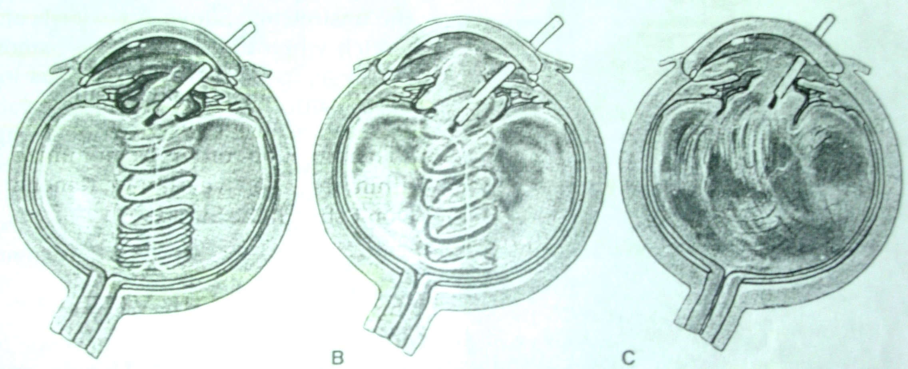
SURYA

Slide 16
Procedure
Infusion and cutter should be divorced.
Main Phaco incision should not be used.
Eye filled with visco.
New incision little right to Phaco incision for vitrectomy tip (if only one side port).
Left side port for infusion, right side for vitrectomy.
Phaco incision closes spontaneously.
Therefore closed system vitrectomy.
SURYA

Slide 17
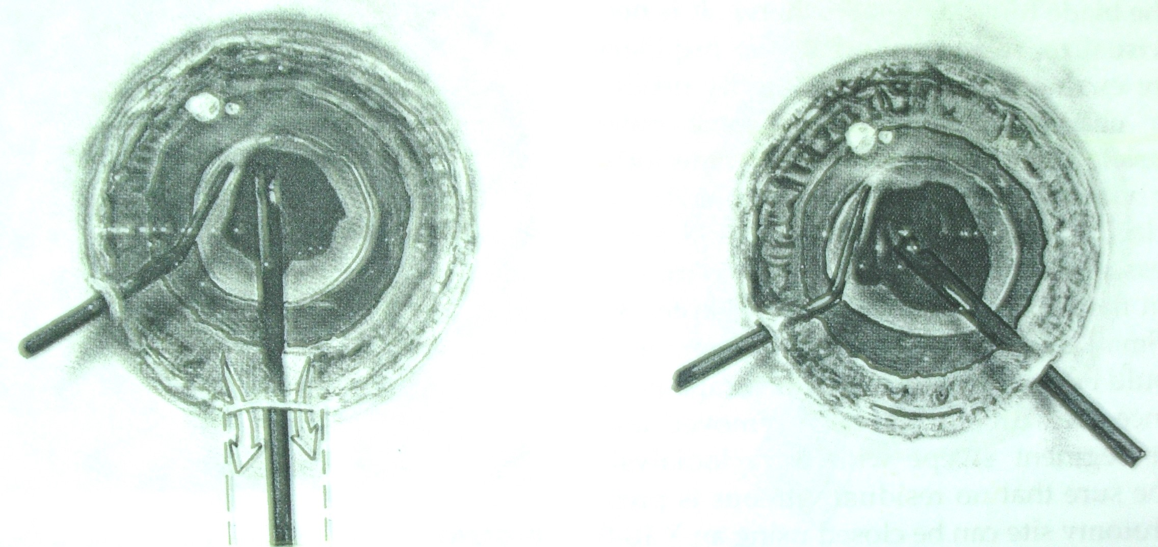
SURYA

Slide 18
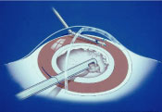
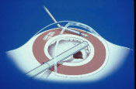
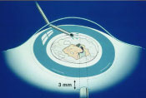
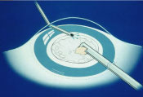
SURYA

Slide 19
SURYA
Infusion should be gentle and limited to AC with Canula parallel to iris.
Vitrector should be passed below the posterior capsule at the point at which minimal anterior vitrectomy should be done and stopped when the vitreous is removed below the level of posterior capsule.
Fill the eye with Visco, put IOL.

Slide 20
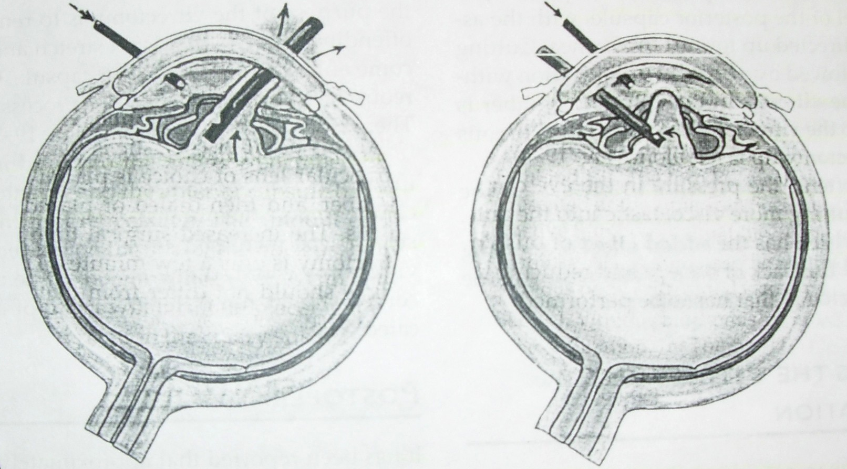
SURYA

Slide 21
SURYA
Cutter setting should be
Cutter rate : 500 - 600
Vacuum : 50 - 100

Slide 22
SURYA
Instead of using original incision, a pars plana vitrectomy with low suction, high cutting rate can be done if surgeon well versed.
PC rent should be converted to a PCC if possible.

Slide 23
SURYA
Alternative technique : Dry (no infusion) vitrectomy – viscoelastic agent used to maintain anterior segment while vitrectomy performed through opening in torn capsule.
Cutting rate and vacuum settings same.

Slide 24
Post - Op
SURYA
Monitor IOP
Monitor post-op inflammation

Slide 25
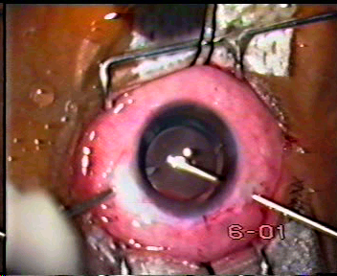
SURYA

Slide 26
DON’T STRETCH THE SLINKY
SURYA

Slide 27
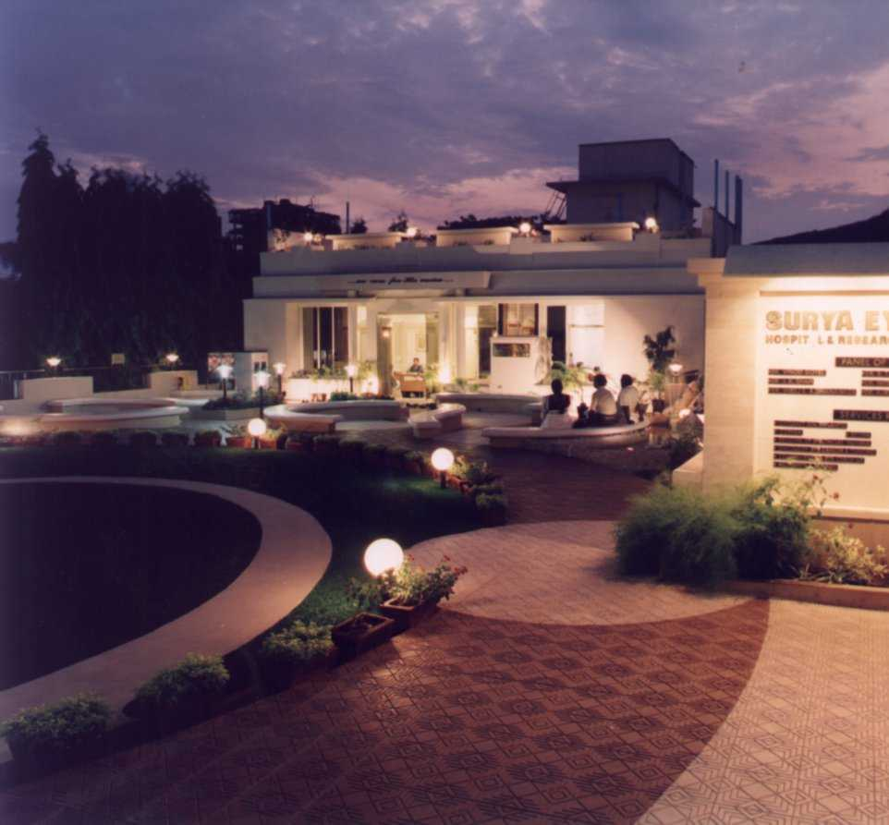
THANK YOU
SURYA EYETECH, MULUND, MUMBAI
ISO 9001 : 2000 Certified Eye Institute

