Slide 1
Eales’ disease
(Update)
DR. AJAY DUDANI
MUMBAI RETINA CENTRE
S.V. ROAD
SANTACRUZ (W)
DR. YASHESH MANIAR
MANIAR EYE CLINIC
MAHAVIRNAGAR
KANDIVLI (W)

Slide 2
Eales’ disease
History:
In 1880, Henry Eales first described it in healthy young men with abnormal retinal veins and recurrent vitreal hemorrhages.

Slide 3
Eales’ disease
Definition:
Idiopathic obliterative perivasculitis
Unknown etiology
Healthy young adult (97.6%) of Indian subcontinent
Extensive retinal nonperfusion
Perivascular sheathing
Neovascularization of disc and retina

Slide 4
Aetiology
Idiopathic
Nontuberculous mycobacteria M. fortuitum and M. chelonae
isolated from classical eales’ disease pt’s aqueous and ERM
(J. Biswas)
Higher phenotype frequency of HLA B5, DR1 and DR 4
Probably this HLA predisposition could be responsible for the
presence of sequestered mycobacterium

Slide 5
Classification
Periphlebitis of unknown aetiology
Vasculitis with tuberculous chorio retinitis

Slide 6
Clinical findings
Characterized by
Avascular areas in the retina periphery
Microaneurysms, dilatation of capillary channels, tortuosity of
neighboring vessels
Spontaneous chorioretinal scars.
It is a diagnosis of exclusion, as many other retinal disorders
can mimic Eales disease, especially conditions of retinal
inflammation or neovascularization

Slide 7
Pathophysiology
Mostly unknown
primary, noninflammatory disorder of the walls of
peripheral retinal vessels, namely the shunt vessels
vascular occlusions, peripheral neovascularization,
and vitreous hemorrhage

Slide 8
Pathophysiology
The microvascular abnormalities are seen at the
junction of perfused and nonperfused zones of the retina.
Although associations with tuberculosis and multiple
sclerosis have been suggested, these findings have not
been substantiated in other studies

Slide 9
Physical Findings
The physical findings mostly involve the retina and vitreous. Vascular sheathing with adjacent nerve fiber layer hemorrhages is seen in most patients. The sheathing can manifest as thin white lines, limiting the blood column on both sides of the sheathed vessel to heavy exudative sheathing that can cause vascular occlusion. Although believed to affect primarily the retinal veins, others have reported the same prevalence of both venules and arterioles.

Slide 10
Clinical features
The anterior chamber may exhibit cell and flare with keratic precipitates. Vitreous debris and cells often are seen, even in the absence of vitreous hemorrhage. Macular edema can occur in eyes with vascular sheathing, and it often is cystoid in nature.
Epiretinal membranes with or without macular edema can compromise visual acuity. The etiology of the macular edema is thought to be associated with low-grade inflammation

Slide 11
Peripheral nonperfusion
Peripheral nonperfusion is a typical feature of Eales disease
The temporal retina is affected most commonly, often in a confluent area
The surrounding vasculature is tortuous with microvascular abnormalities, which include the following: microaneurysms, arteriovenous shunts, venous beading, hard exudates, and cotton-wool spots. Fine solid white lines occasionally can be seen, representing obliterated larger vessels

Slide 12
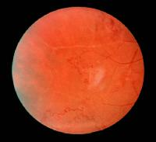

Slide 13
BRVO
Branch retinal vein occlusion (BRVO) can be seen in patients with Eales disease and may be limited to one area or may be multifocal.
BRVO alone can be differentiated from BRVO in the presence of Eales disease by the more extensive peripheral retinal involvement in Eales disease.
BRVO alone usually is confined to a single affected quadrant.
BRVO alone also respects the anatomical distribution of the horizontal raphe, unlike Eales disease.

Slide 14
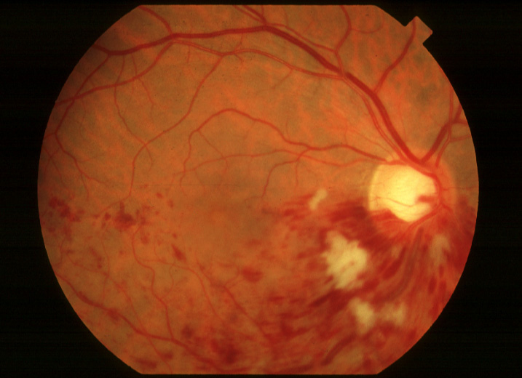
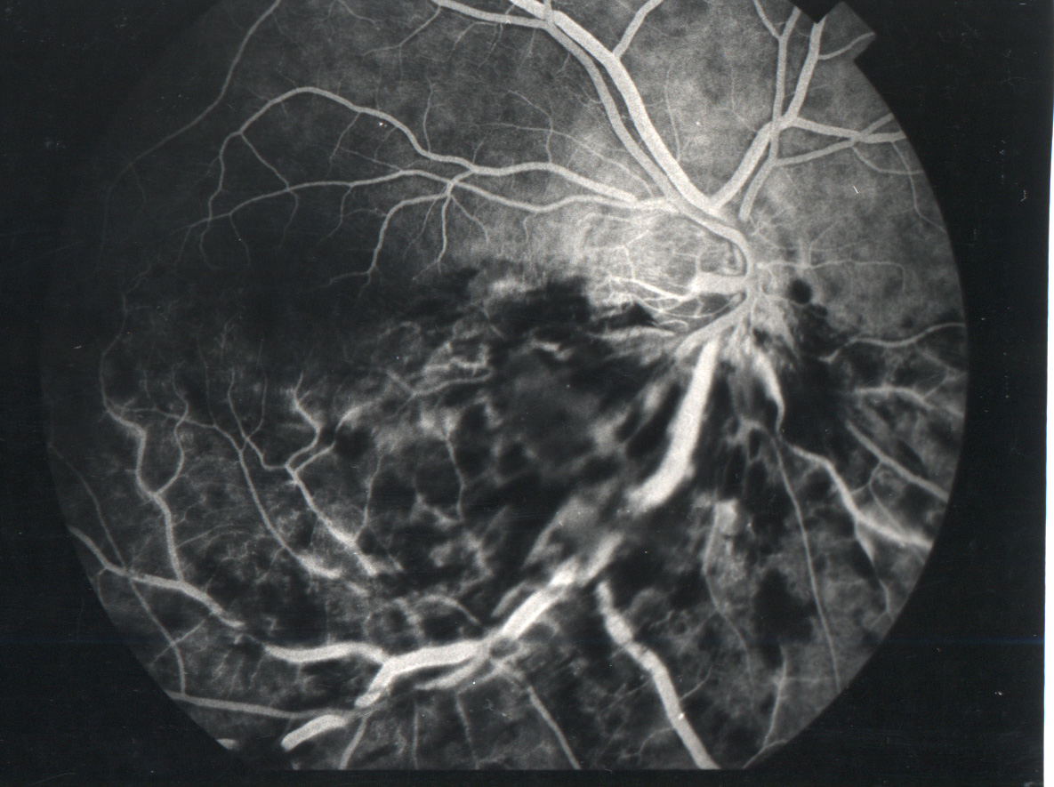
BRVO

Slide 15
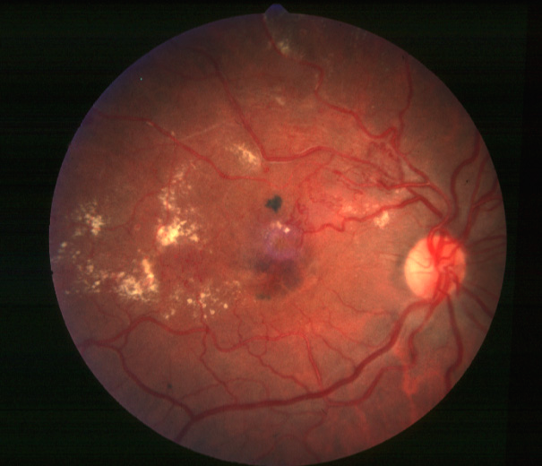
BRVO

Slide 16
Neovascularization
Neovascularization of the disc (NVD) or neovascularization elsewhere (NVE) in the retina is observed in up to 80% of patients with Eales disease.
The NVE usually is located peripherally, at the junction of perfused and nonperfused retina. The neovascularization often is the source of vitreous hemorrhage in these eyes, compromising vision.
Rubeosis iridis or neovascularization of the iris can develop and may lead to neovascular glaucoma.
Fibrovascular proliferation on the surface of the retina may accompany retinal neovascularization. These eyes have associated anteroposterior traction that could lead to retinal detachment.

Slide 17
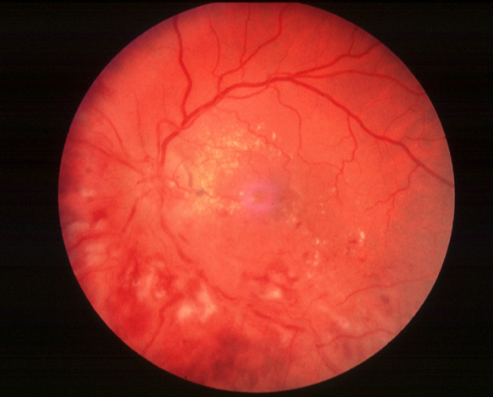
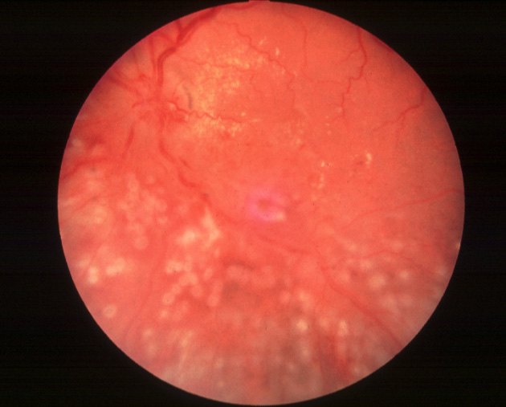
Neovascularization

Slide 18
Cystoid macular edema
Cystoid macular edema can occur in patients with Eales disease due to increased capillary permeability.
Associated with significant vision loss.

Slide 19
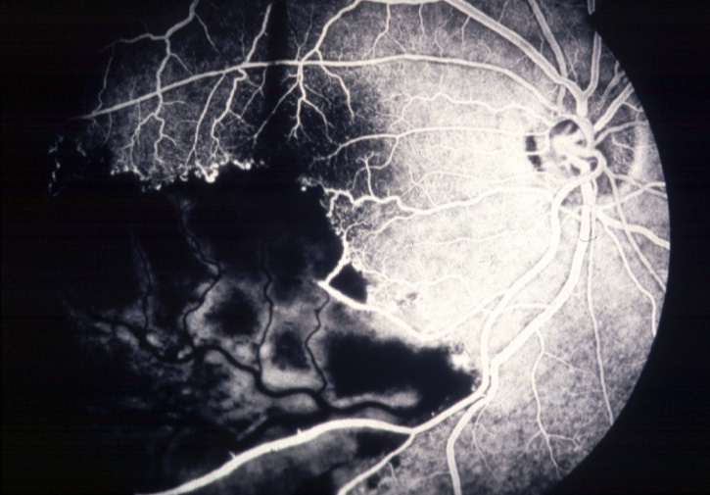
Cystoid macular edema

Slide 20
PVD
A posterior vitreous separation has been reported in 27% of patients with Eales disease
Several patients have been found to have concomitant macular holes.
Macular hole surgery may effectively repair this abnormality and lead to significant visual improvement similar to that seen in patients with idiopathic macular holes.

Slide 21
Systemic association
Systemic abnormalities have been reported in association with Eales disease, mostly neurologic findings.
Myelopathy, ischemic stroke, hemiplegia, and multifocal white matter abnormalities have been reported.
A higher incidence of vestibuloauditory dysfunction is seen in patients with Eales disease when compared to the general population of the same age.
It is presumed that a similar mechanism of vascular occlusion and hypoxia leads to these systemic findings.

Slide 22
PCR
In the retrospective study, 70% ERM samples were positive for one or more Mycobacterium spp. Tested by snPCR.
M.fortuitum and M. chelonae were isolated from two VFs, which were also positive by snPCR in the prospective study.
Statistical evaluation of the results of both retrospective and prospective investigations showed a statistically significant association of Mycobacterium spp. With eales’ disease.
Study by Dr J biswas, Dr Madhavan

Slide 23
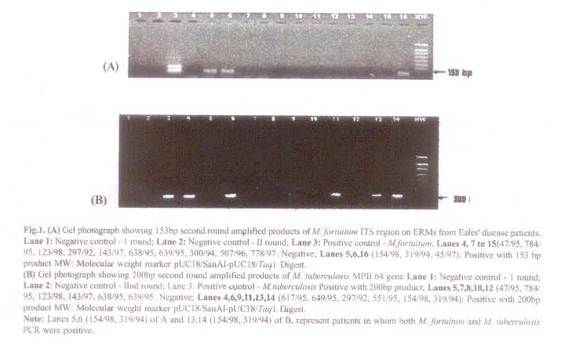
PCR

Slide 24
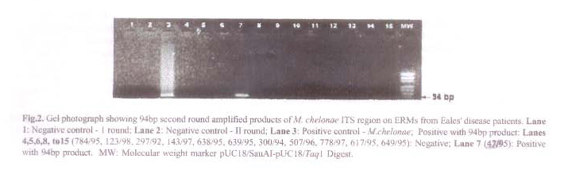
M. chelonae

Slide 25
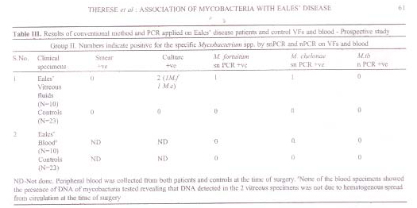
Association of mycobacteria with eales’

Slide 26
Investigations
FFA
FA can be useful to determine the nature of the microvascular abnormalities
Neovascularization and exudative sheathing of vessels will leak fluorescein dye
The area and degree of nonperfusion can be determined on FA and help delineate where to apply laser photocoagulation, when indicated

Slide 27
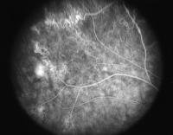

Slide 28
Other Investigations
Ultrasound can determine the presence or absence of a retinal detachment or vitreoretinal traction
Echographic evaluation often is useful to evaluate the retina in the setting of vitreous hemorrhage. When the details of the fundus are obscured
A chest x-ray may be considered to rule out sarcoidosis or a history of tuberculosis, in the setting of a positive tuberculin skin test.
Magnetic resonance imaging (MRI) of the brain may reveal multifocal white matter abnormalities, but this study probably is not warranted in the absence of neurologic symptoms

Slide 29
Other tests
Recent studies have found an increased level of oxidation and peroxidation products in vitreous samples from patients with Eales disease (ie, an increased amount of thiobarbituric acid reacting substances).
A decreased level of antioxidant enzymes also has been found in vitreous samples from patients with Eales disease (ie, a decreased amount of reduced glutathione, superoxide dismutase, and glutathione peroxidase).
Hearing and balance should be tested formally, as patients with Eales disease may have associated vestibuloauditory dysfunction.

Slide 30
Treatment
The natural course of the disease may be variable and can lead to total blindness in the most severe cases
Treatment approaches consist mainly of oral corticosteroids and laser or vitreoretinal surgery. However, new therapeutic strategies have been shown to improve vision outcomes in this rare ocular disorder

Slide 31
Medical care
Several treatments have been proposed for Eales disease; however, none of these treatments is of proven benefit
Treatments include thyroid extract, osteogenic hormones, androgenic hormones, and systemic steroids. The antioxidant vitamins A, C, and E have been suggested recently as a possible therapy because antioxidizing enzymes are deficient in the vitreous samples of patients with Eales disease

Slide 32
Triamcinolone acetonide
In cases complicated by cystoid macular edema, intravitreal triamcinolone acetonide has been effectively used in reversing the edema and in leading to visual improvement.
Doses of 1-25 mg of triamcinolone have been reported; however, doses of 2-4 mg of triamcinolone are more commonly used in clinical practice.

Slide 33
Photocoagulation
Moderately light, full-scatter laser photocoagulation to areas of nonperfused retina has become the treatment of choice in patients with Eales disease
The junctional area between perfused and nonperfused retina is to be treated
This treatment results in resolution of neovascularization of the disc, elsewhere in the retina, or the iris, and lowers the incidence of vitreous hemorrhage

Slide 34
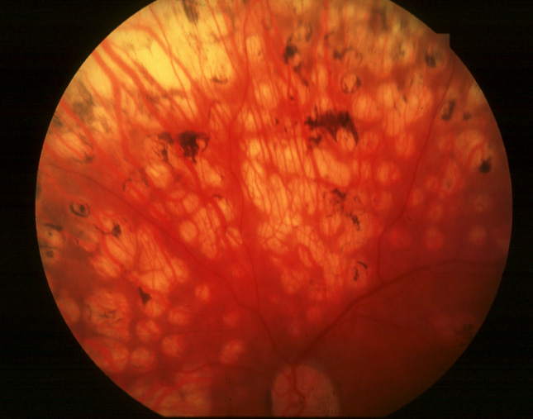
Photocoagulation

Slide 35
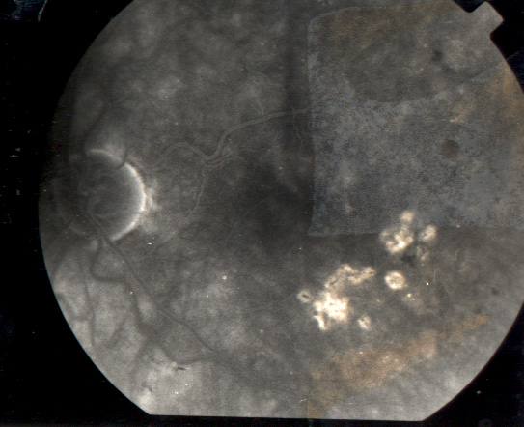

Slide 36
Pars plana vitrectomy
A major cause of visual loss in patients with Eales disease results from recurrent vitreous hemorrhage
Although the hemorrhage often settles in the inferior portion of the vitreous and reabsorbs within several weeks, surgical intervention occasionally is indicated
Pars plana vitrectomy is effective in removing nonclearing vitreous hemorrhage and enabling adequate scatter laser photocoagulation
In cases of tractional retinal detachment, vitrectomy in combination with membrane dissection is necessary

Slide 37
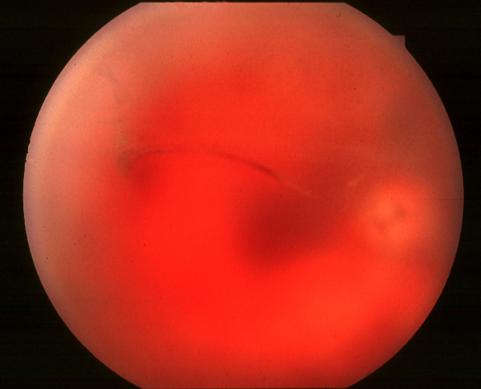
Persistant vitreous hamorrhage with traction

Slide 38
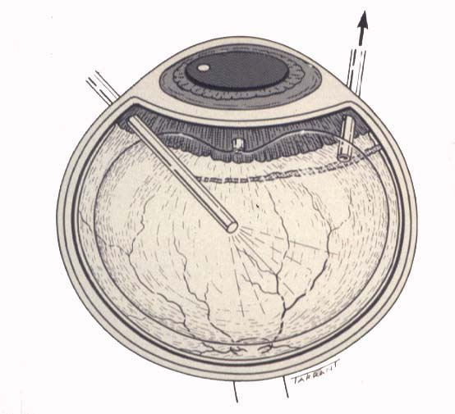
Pars plana vitrectomy

Slide 39
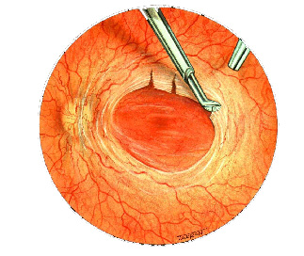
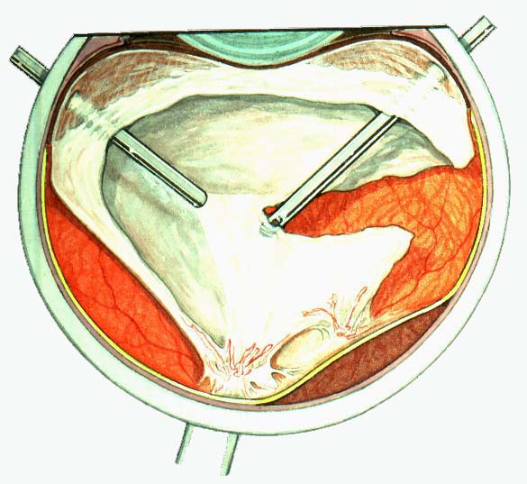
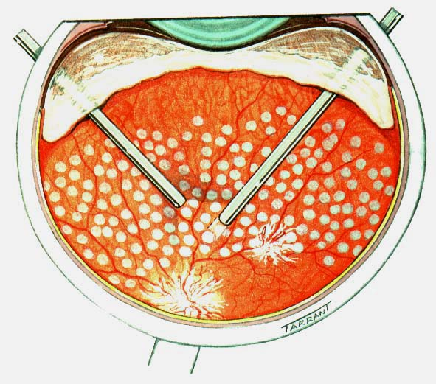
Vitrectomy, traction release and endolaser

Slide 40
Anti VEGF
Establishment of vascular endothelial growth factor as the primary mediator for neovascularization int the eye has led to the emergence of a number of drugs for treating various neovascular ocular disease
Bevacizumab (Avastin) is a humanized monoclonal antibody that inhibits VEGF and is currently emerging as an effective treatment for neovascular age related macular degeneration, macular edema secondary to CRVO and PDR
0.05 ml (1.25mg) bevacizumab intravitreally may eliminate the need for further laser photocoagulation as per one study
Rapid regression of disc and retinal neovascularization in a case of eales’ ds after intravitreal bevacizumab have been reported

Slide 41
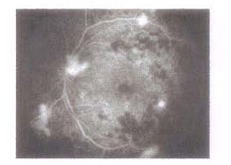
FFA showing NVD and NVE

Slide 42
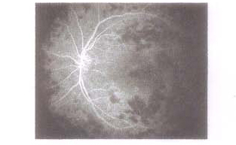
1 month after bevacizumab

Slide 43
THANK YOU

