Slide 1
Vitrectomy techniques in Paediatric Cataract Surgery
Dr.Ajay I.Dudani
Zen Eye Center
Surya Eye Tech.

Slide 2
Immediate Imminent PCO is the bug bear of Pead.Catatact Surgery.
This can lead to irreversible amblyopia.
Post.Capsule & Ant.Vitreous Phase are the scaffold for proliferation of LES
Hence the Rationale of primary PCCC with ant.Vit. With optic capture

Slide 3
Approaches for Ant.Vit.
Ant. Approach from limbal side port.
Pars Plana approach 3mm post to limbus.

Slide 4
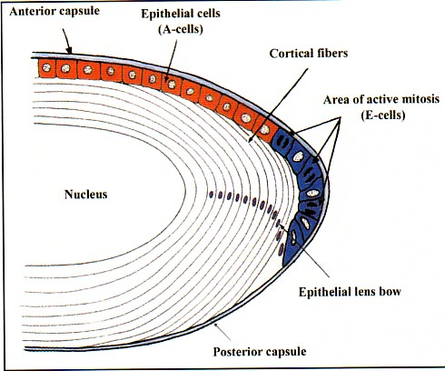
Pathogenesis
The term PCO is misleading.
A-cells : fibrousmetaplasia
fibrous PCO
E-cells : mitosis
PCO with ‘pearls’

Slide 5
Other cells involved in formation of PCO
Infammatory cells –WBCs
RBCs
Collagen deposition
Iris melanocytes

Slide 6
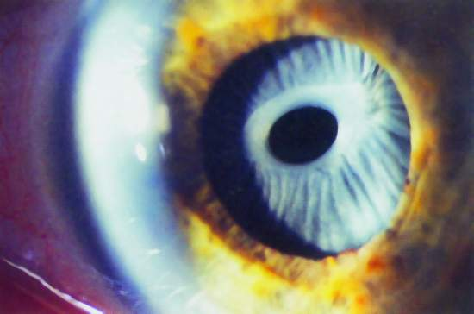
Anterior capsule opacification [ACO]
in extreme cases results in capsule contraction syndrome[CCS].
.

Slide 7
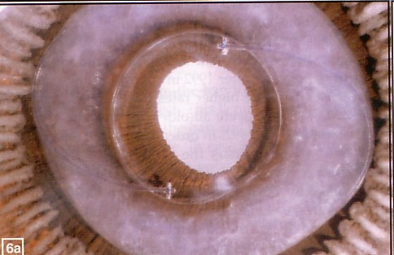
Interlenticular opacification
Soemmerring’s ring

Slide 8
Ant. Vitrectomy approach - Vitrector Technique of Paediatric Cataract
G/A With ketamine with Local Lignocane Block
Scleral Tunnel
CCC With needle / Vitreous cutter
Hydrodissection
AC Maintainer inserted.
IA Done with Vitreous cutter from side port.

Slide 9
Vitrector Technique of Paediatric Cataract
IOL inserted in the bag.
Post. CCC with Generous Ant. Vitrectomy from side port with cutter.
Wound and side port hydration

Slide 10
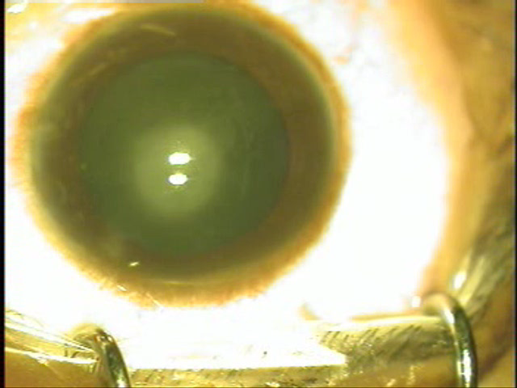
Video

Slide 11
Automated I/A Technique
Scleral Tunnel
CCC
Hydro-dissection
Automated I/A (irrigation/aspiration) through side ports.
IOL Inserted
Ant.Vit.+ PCC from side port.

Slide 12
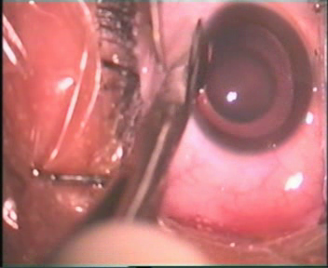

Slide 13
Post. Pars Plana Approach
3mm from limbus
2port
Infusion- bent 20G needle
Direct clean anatomical approach for generous ant. Vit.
PCCC done from behind
Less chance of vit.Prolapse in AC.

Slide 14
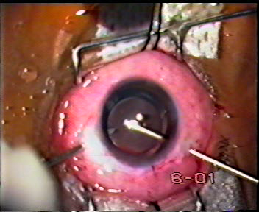

Slide 15
Thank You

Slide 16

BioTex
Medical presentations
Medical Software
Posters
Medical videos
Slide shows
Net search for publications
Phone: 09819561247 email:biotexinternational@yahoo.com
www.geocities.com/biotexinternational

