Slide 1
SQUINT
Dr. Ajay Dudani,
Mumbai Retina Centre

Slide 2
DEFINITION
Squint is a disorder in which one eye misaligns with the other when focusing in a primary direction of gaze. It is an imbalance in the normal tone or coordination of one or more extra ocular muscle which results in a manifest deviation of the affected eye.

Slide 3
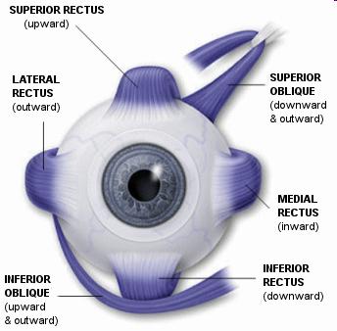
EXTRAOCULAR MUSCLES

Slide 4
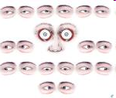
CARDINAL GAZES

Slide 5
CLASSIFICATION
1. Direction of deviation:
- convergent (esotropia)
- divergent (exotropia)
- hypodeviation
- hyperdeviation
2. Comitancy:
- comitant or non paralytic
- incomitant or paralytic

Slide 6
3. Constancy:
- intermittent
- constant
4. Onset:
- childhood (congenital)
- adult (acquired)
5. Unilateral or Alternating

Slide 7
6. Apparent (psuedostrabismus)
Manifest (tropias)
Latent (phorias)

Slide 8
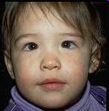
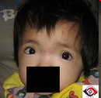
PSEUDOSTRABISMUS
Pseudoesotropia- in prominent epicanthal folds, high myopia
Pseudoexotropia- in hypertelorism

Slide 9

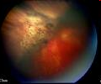
ETIOLOGY
High Refractive errors - High degree of uncorrected refractive error in children may cause deviation of the most affected eye.
Ocular conditions- causing visual axis obstruction eg. cataract, corneal opacities, retinoblastoma, ROP, macular disease etc.

Slide 10

3. Trauma
4. Lesions affecting the EOM’s or CN’s especially no. III
5. Systemic dis- DM, stroke, botulism

Slide 11
PREDISPOSING FACTORS
General debility and lowered vitality
Psychosis, neurosis and mental stress
Inadequacy of fusional reserve
Precision of job
Advancing age

Slide 12
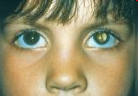

CAUSES OF CHILDHOOD STRABISMUS
Cataract
Corneal opacities
ROP
Retinoblastoma
Traumatic brain injury
Hemangioma near the eye during infancy
Trisomy 18
Congenital rubella
Cerebral palsy

Slide 13
SYMPTOMS
Deviated eye
Abnormal head posture
Poor vision
Headache
Diplopia

Slide 14
EXAMINATION
1.HISTORY
A. Deviation: Age of onset
Description of deviation
Previous treatment
B. Pre and post natal factors
Growth and development
Family history of strabismus
2.GENERAL OBSERVATION.
Abnormal head posture

Slide 15
3. VISUAL ACUITY
a. Without glasses and with glasses
b. Near and distant vision
c. Amblyopia testing
4.MOTOR:
a. Extra ocular movements.
b. Phorias or tropias
c. Near point of convergence and near point of accommodation.

Slide 16
5. MEASUREMENT OF DEVIATION.
Distance and near
Without glasses and with glasses( if worn)
6. SENSORY TESTS
Worth 4 dot test.
Stereopsis
7. FIXATION: monocular , alternating, binocular
8. SLIT LAMP EXAMINATION.

Slide 17
9 . FUNDUS EXAMINATION.
10 . CYCLOPLEGIC REFRACTION.

Slide 18
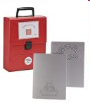
VISION TESTS
In infants:
- fixation and following light
- Catford drum test
- preferential looking test
- Cardiff acuity test
- VER
- reflex responses

Slide 19
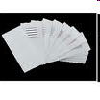
In 1 to 2 yr old:
- Boeck candy test
- Worth’s ivory ball test
In 2 to 3 yr old:
- coin test
- miniature toys test
- dot visual acquity test

Slide 20


In 3 to 5 yr old:
- tumbling E test
- Landolt’s C test
- Sheridan letter test

Slide 21
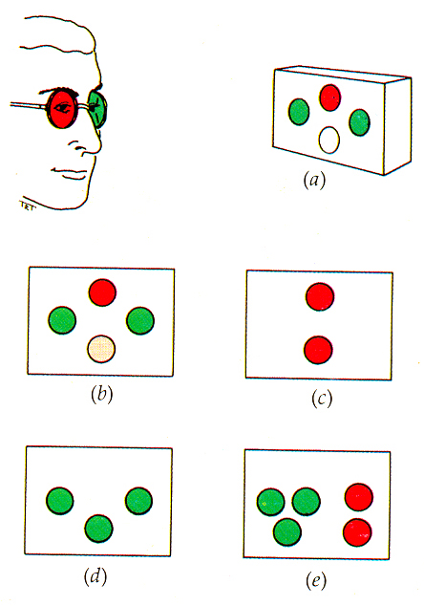
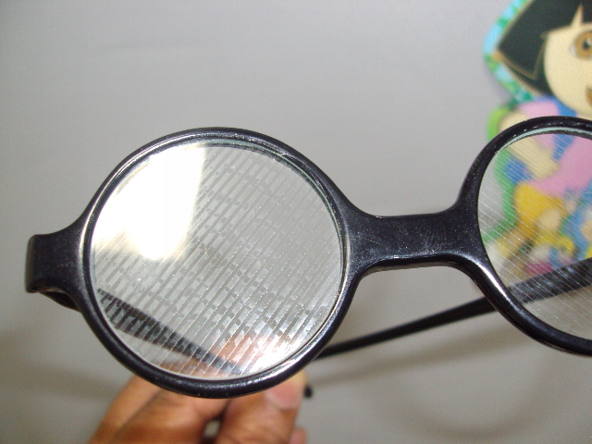
SENSORY TESTS
Worth’s 4 dot test
Bielchowsky’s after image test
Striated glasses of Bagolini
4 diopter prism base out test
Synaptophore

Slide 22
STEREOPSIS TESTS
Titmus stereo test
Random dot stereogram test
Random dot e test
TNO test
Lang test
Frisby test
2 pencil test

Slide 23
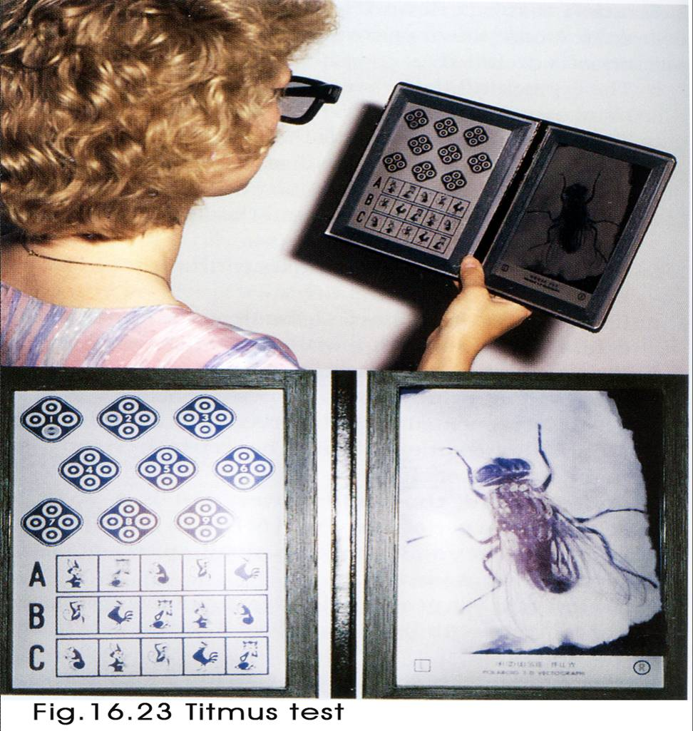
Titmus fly test

Slide 24
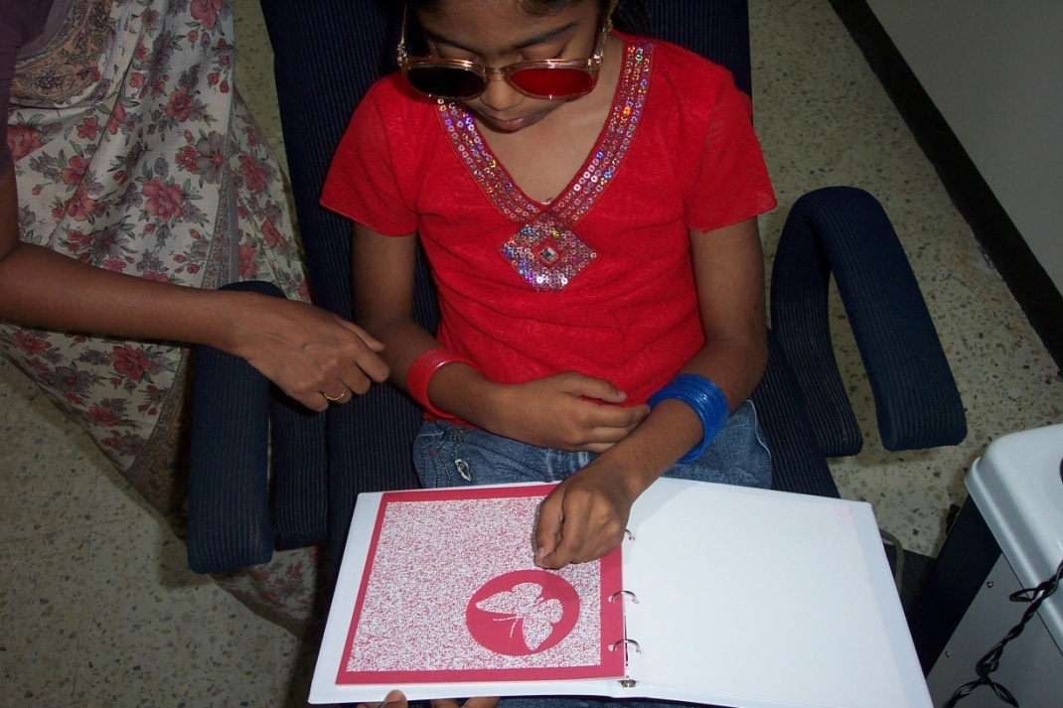
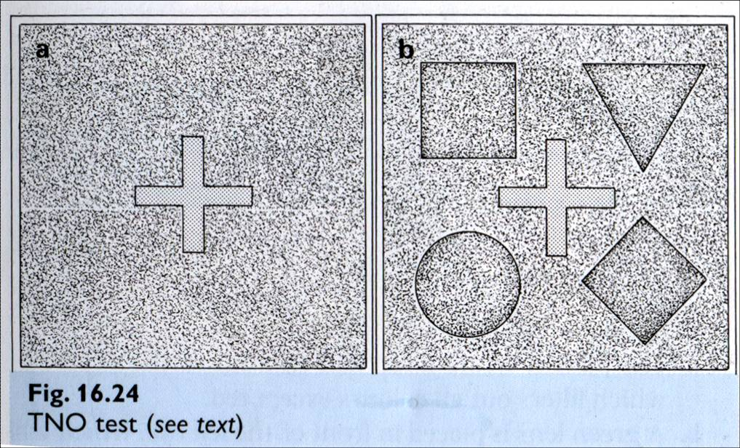
TNO test

Slide 25
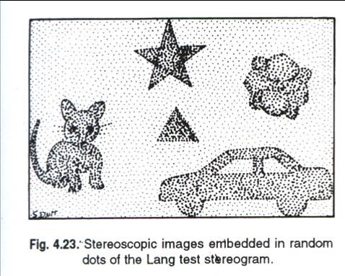
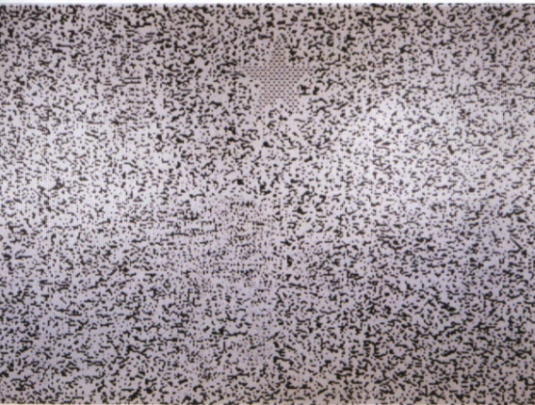
Lang test

Slide 26
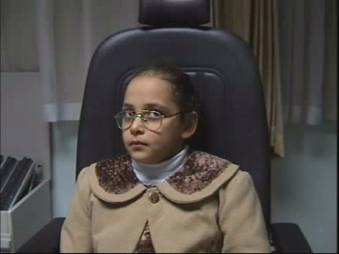
HEAD POSTURE
Incomitant squint
Position of head in which the eyes are in a position of no deviation or very small deviation so that fusion is possible.
3 components:
-Chin
-Face turn
-Head tilt

Slide 27
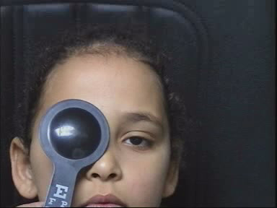
TESTS TO MEASURE DEVIATION ANGLE
Hirschberg corneal reflex test
Krimsky’s test
Cover test
Alternate cover uncover test
Prism bar cover test
Maddox wing test
Maddox rod test

Slide 28
MOTILITY TESTS
Ocular movements
- versions
- ductions
Near point of convergence- RAF rule
Near point of accomodation- RAF rule
Fusional amplitudes- with prism bar or synaptophore

Slide 29
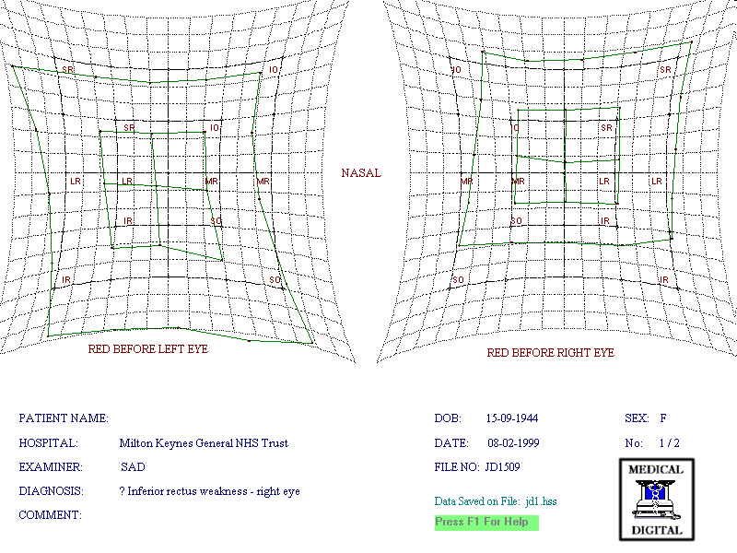
DIPLOPIA TESTS
Hess test
Lees screen

Slide 30
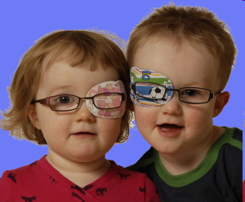
AMBLYOPIA
Unilateral or bilateral DOV due to form deprivation &/or abnormal binocular interaction for which there is no ocular or visual pathway pathology
Most commonly due to squint, large uncorrected refractive errors etc.
Treatment:
- occlusion
- penalisation

Slide 31
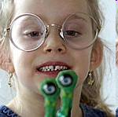
MANAGEMENT
Refractive error correction by spectacle lenses, prisms, orthoptic exercises.
Patching, reducing the VA or occluding the good eye so as to activate the deviated eye. This is only done in children with unilateral deviation.

Slide 32
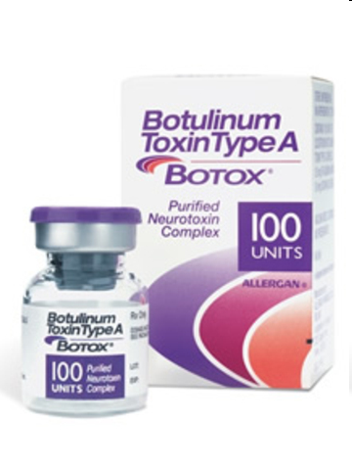
Medical :
- miotics in accomodative esotropia
- cycloplegics in accomodative esotropia
- levodopa, carbidopa in amblyopia
- botulinum toxin A (botox)

Slide 33
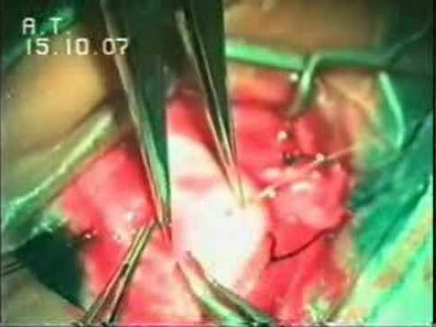
Surgery:
- weakening procedures eg. recession, marginal myotomy, myectomy.
- strengthening procedures eg. resection, tucking, advancement.

Slide 34
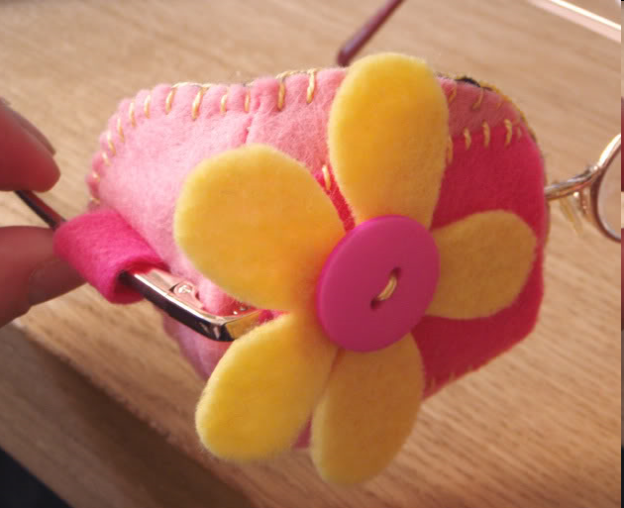
THANK YOU

