Slide 1
RETINOPATHY OF PREMATURITY
DR. AJAY I DUDANI
M.S.,DNB,FCPS,DOMS
ASSOCIATE PROFFESSOR, K.J. SOMAIYA HOSPITAL,
CONSULTANT VITREORETINAL SURGEON,
BOMBAY HOSPITAL

Slide 2
ROP – why important?
India shares 20% of world childhood blindness.
Out of 100 preterm infants, 20-40 develop ROP, out of which 3-7 become ultimately blind.
The incidence of ROP is increasing due to better survival of LBW & preterm babies availing modern neonatal facilities and care.
With early detection and timely intervention blindness is preventable.

Slide 3
INTRODUCTION
1st described by Terry in 1942 in 6 month premature infant.
Campbell first brought to notice relationship of intensive oxygen therapy & subsequent development of ROP.
Kinsey clearly established that ROP was inversely proportional to birth weight.

Slide 4
TWO OVERLAPPING PHASES
Acute phase- normal vasculogenesis is interrupted & a response to injury is observable in retina.
Chronic or late proliferative phase- membranes grow into vitreous causing tractional RD, ectopia or scarring of macula leading to severe visual loss.
>90% cases undergo spontaneous regression, <10% cases develop significant cicatrization.

Slide 5
RISK FACTORS
Prematurity & LBW.
(<31 wks,<1500gms)
<28wks,<1000gms are at highest risk.
Factors causing shift in oxygen –Hb dynamics like :
-multiple blood transfusions
-intraventricular haemorrhage
- cyanosis, apnoea , seizures
- neonatal sepsis
- shock

Slide 6
Endogenous antioxidant deficiency.(vit E and others)
In multiple pregnancy, those with better wt gain develop severe ROP
Supplemental oxygen did not cause additional progression of prethreshold ROP (STOP-ROP)
Ambient light reduction in hospital nurseries has no effect on the development of ROP (LIGHT-ROP)
Progression to threshold ROP may be influenced by genetic differences in VEGF production.

Slide 7
INTERNATIONAL CLASSIFICATION OF ROP
On the basis of
Location on the retina
Degree or stage of proliferation
Extent of proliferation in circumferential manner.

Slide 8
STAGES OF ROP
1) Demarcation line
2) Demarcation ridge
3) Ridge with extraretinal fibrovascular
proliferation
4A) Subtotal RD
B) Subtotal RD involving the macula
5) Total RD

Slide 9
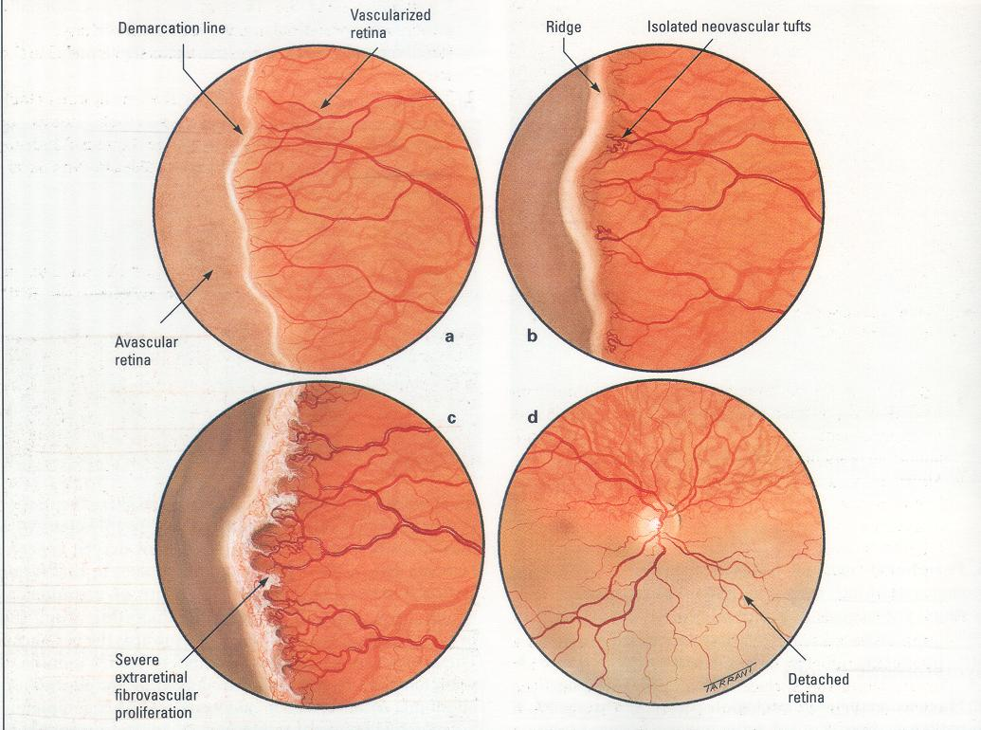
STAGES OF ROP

Slide 10
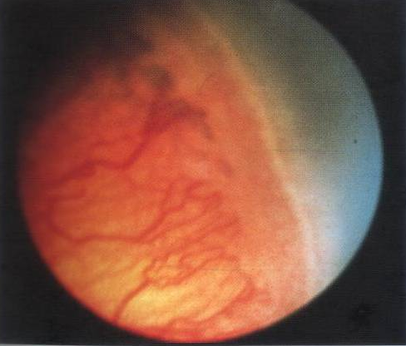
STAGE 2—DEMARCATION RIDGE

Slide 11
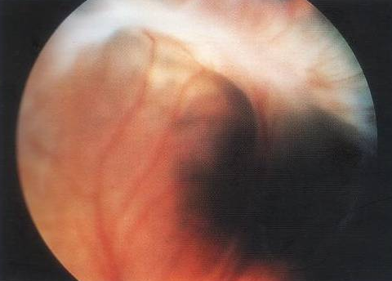
STAGE 3 ROP

Slide 12
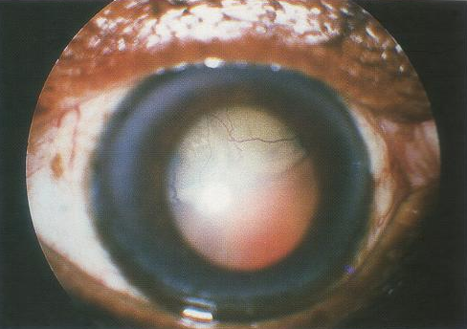
STAGE 5 ROP

Slide 13
ZONES OF ROP
Circle drawn from center of the disc with a radius of twice the distance from the disc to the macula
Nasal edge of zone 1 to the ora nasally and upto the equator temporally
Temporal crescent of retina anterior to zone 2.

Slide 14
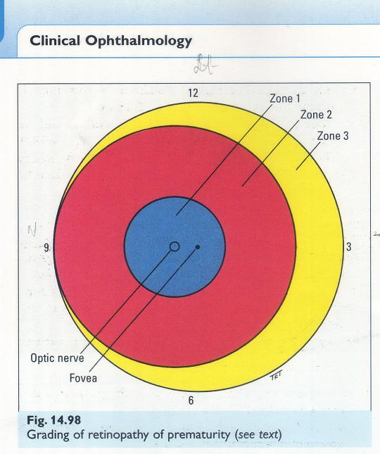
ZONES OF ROP

Slide 15
PLUS DISEASE
Increased dilatation & tortuosity of posterior pole vessels
Iris vascular engorgement
Pupillary rigidity
Vitreous haze
Normal posterior pole vasculature is a reliable marker for the absence of stage 3,
when examination is difficult on account of poor pupillary dilatation in premature infants

Slide 16
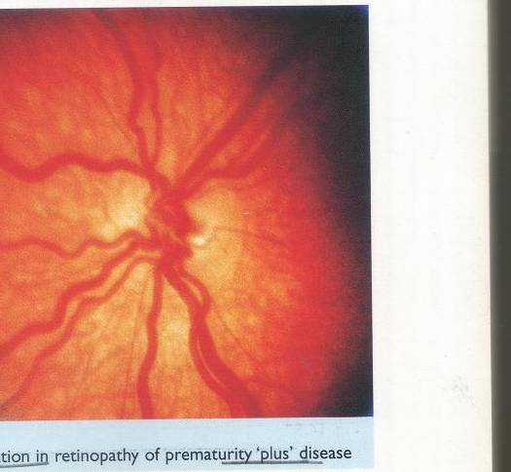
PLUS DISEASE

Slide 17
THRESHOLD ROP
Stage 3 disease involving >5 contiguous or 8 interrupted clock hrs with plus disease
PRETHRESHOLD ROP
Any extent stage 3 in zone 1 with or without plus ds
Zone 2 stage 3, < (5 contiguous or 8 noncontiguous clock hrs)
Zone 2 stage 3, 5 contiguous or 8 noncontiguous clock hrs without plus ds

Slide 18
RUSH DISEASE & CICATRICIAL ROP
Unusually aggressive pattern which may proceed very rapidly to severe ROP & RD
Cicatrization
Sequelae include high myopia, vitreretinal membranes, areas of irregular pigmentation in periphery & dragging of vessels including macula to periphery. Falciform retinal folds in severe cases
In most severe cases, totally detached retina forms thickened mass behind lens- Retrolental fibroplasia

Slide 19
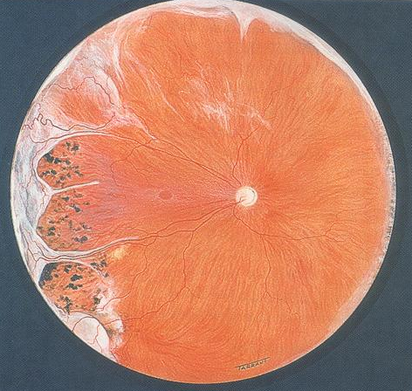
CICATRITIAL ROP

Slide 20
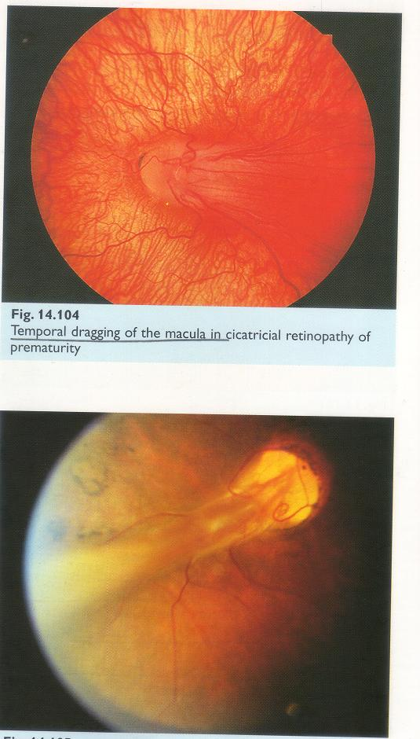
TEMPORAL DRAGGING OF MACULA
FALCIFORM VITREORETINAL FOLD

Slide 21
TREATMENT OF ROP
Cryotherapy
Laser therapy
Surgical management
Threshold ROP is treated within 72hrs by ablation
of the avascular retina by laser or cryotherapy.

Slide 22
CRYOTHERAPY
Advantages
Less expensive
Widely available
Faster to administer
Can bypass the thick vasculosa lentis
It acts by eliminating the production of
vasoproliferative factor from avascular retina

Slide 23
Multicentric Cryotherapy Trial for ROP concluded that cryotreatment reduces the risk of unfavourable retinal & functional outcome from threshold ROP
CRYO-ROP Study Group – 15 yr follow up of 254 survivors from 291 preterms with birth wts <1251gms & severe threshold ROP in one or both eyes.

Slide 24
Treated eyes
30%
4.5%
44.5%
Control Eyes
51.9%
7.7%
64.3%
Unfavourable structural outcome
Between 10 &15 yrs of age, new retinal folds detachments or obscuring of view of posterior pole
Unfavourable visual acuity outcomes

Slide 25
RESULTS OF CRYO ROP STUDY
Benefit of cryo for treatment of threshold ROP for both structural & visual functions was maint ained across 15 yrs of follow up
New detachments in eyes with good structural findings at 10, emphasize value of long term regular follow up of eyes with threshold ROP

Slide 26
LASER PHOTOCOAGULATION
Advantages
Ease of delivery
No need of general anaesthesia
More effective in zone1 (posterior pole ds)
Less irritating
Scars less pronounced
Less induce myopia

Slide 27
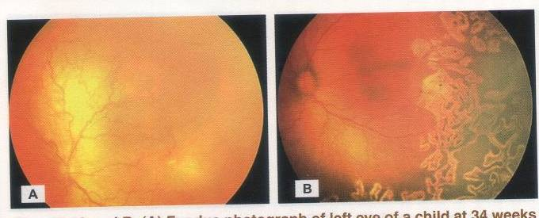
OS AT 34wks with ROP
4wks Post Laser Regressed ROP

Slide 28
EARLY TREATMENT OF ROP
(ETROP)
This group supported retinal ablative therapy for
Type 1 ROP-
Zone 1, any Stage with plus ds
Zone 1, Stage 3 without plus ds or
Zone 2, Stage 2 or 3 with plus ds
And a wait & watch approach for
Type 2 ROP
Zone 1, Stage 1 or 2 without plus ds
Zone 2, Stage 3 without plus ds

Slide 29
SURGICAL MANAGEMENT
Stage 4A & 4B – scleral buckling
Stage 5 – difficult, anatomical & visual results disappointing.
Lensectomy & pupilloplasty, mandatory for peripheral approach
Retrolental membranes dissected from center to periphery with minimal traction on retina
No attempt to drain SRF, Air fluid exchange done
Funnel configuration useful to prognosticate surgical outcome

Slide 30
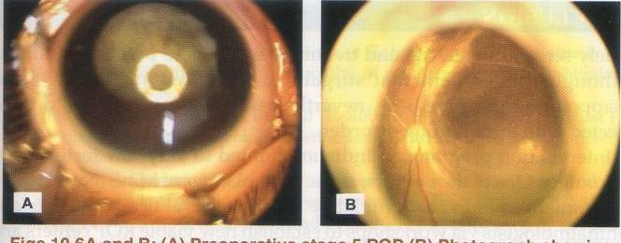
PREOP STAGE 5 ROP
ATTACHED POSTERIOR POLE 12 WKS POST OP

Slide 31
REASONS FOR POOR POST-OP OUTCOME
Late disease identification & presentation
Lack of prior treatment (cryo or laser)
Narrow configuration of RD
Associated ocular abnormalities like cataract & glaucoma

Slide 32
SCREENING GUIDELINES FOR ROP
First done at 32 wks of gestation or 4-5 wks after birth, whichever is earlier
At 3 critical stages
32-34 wks
35-37 wks
39-42 wks
If no ROP- incomplete vascularisation examined every 2 wkly
Early ROP- (Zone 3 & 2 < than prethreshold)- wkly
Prethreshold- twice wkly.
Last screening till complete retinal vascularisation- 42-45 wks

Slide 33
RETCAM FOR ROP DOCUMENTATION
Wide angle digital paediatric retinal imaging system
Mobile, self contained system for use in nursery, ICU, O.T
Easily used by technicians or nurses
Avoids stress & expertise of I/O examination & indentation, but as specific and sensitive as I/O
Useful for diagnosis, F/U & documentation

Slide 34
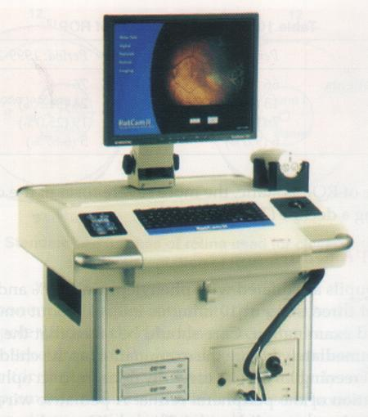
RETCAM FOR ROP DOCUMENTATION

Slide 35
CONCLUSION
Timely screening, referral & treatment is key to
prevent blindness
With,
ROP screening programs
Awareness amongst ophthalmologists & neonatologists
Referral services
Advanced vitreoretinal surgical techniques
Visual outcome of child suffering from ROP will be
brighter!

Slide 36

THANK YOU

