Slide 1
Telegram Chatbot RGITBT
Guide – Sakshi ma’am

Slide 2
Table of contents
01
02
03
04
05
06
Introduction
Problem & solution
Packages
& Code
Material &
Methods
Market value & opportunity
Chatbot
demo

Slide 3
01
Introduction

Slide 4
Introduction
Basic chat bot
Our Chat bot
A simple chatbot is an automated conversational tool designed to handle basic tasks such as answering frequently asked questions, providing information, or guiding users through a predefined set of actions.
This Telegram chatbot is designed to streamline communication and enhance student engagement within the college environment.
It provides instant access to essential information such as course schedules, announcements, and student services, while facilitating administrative tasks like assignment submission and event updates.
Powered by rule-based responses, these bots are easy to develop and maintain, making them ideal for enhancing customer support, streamlining communication, and improving user engagement across various platforms.
The bot’s customizable features ensure easy integration with existing college systems, offering a smart, scalable solution to improve both academic and campus life for students and staff.
They offer a cost-effective solution for businesses and organizations seeking to automate routine tasks efficiently.

Slide 5
Types of Chat Bot
Rule – based chatbots
self- learning chatbots
Bots use sets of questions and answers initially entered by the programmer
Bots use machine learning algorithms to learn how to provide answers
React to questions that match in the database
A chatbot of this kind is artificially intelligent are very advanced.
Can only respond to predefined questions within the context of their programming.
Can respond to both known and unexpected question
The more resources are made available, the more capable the system becomes.
It is sophisticated chatbots, but requires more programming effort.

Slide 6
02
Problem & solution

Slide 7
Problem & solution
Difficulty in Navigation
Lack of Engagement
Limited Availability
Users often struggle to find specific information on websites due to complex navigation and heavy amount of content.
Websites can feel static and unengaging, leading to low interaction rates and missed opportunities to connect with users.
Websites rely on users to find answers themselves, often offering limited live support, and human agents may not be available 24/7.
Solution
Solution
Solution
A chatbot offers quick, direct access to information by allowing users to ask questions in natural language, retrieving answers instantly without browsing through pages.
Chatbots create interactive, conversational experiences that engage users in real-time, answering questions, guiding them through processes, and providing a personalized experience.
Chatbots provide 24/7 support, instantly answering user queries at any time, reducing wait times and improving user satisfaction.

Slide 8
Problem & solution
Poor Mobile Experience
Inconsistent User Experience
Overwhelming Information
Websites can be difficult to navigate on mobile devices due to design limitations and small screen sizes.
Websites may not always provide a consistent experience across devices or browsers, leading to frustration.
Websites often display too much information at once, overwhelming users with choices or irrelevant details.
Solution
Solution
Solution
Chatbots provide a seamless, conversational interface on mobile, allowing users to interact quickly without the need for navigating through cumbersome mobile layouts.
Chatbots offer a unified, consistent experience regardless of device, delivering the same fast and intuitive interaction whether on desktop or mobile.
Chatbots provide focused, relevant information based on the user’s specific query, eliminating the need to sift through excessive content.

Slide 9
03
Packages & Code
from typing import Final
from telegram import Update
from telegram.ext import Application, CommandHandler, MessageHandler, filters, ContextTypes
import asyncio

Slide 10
Final: | A constant from the typing module, used to indicate that a variable's value should not be modified.
Update: | Represents an incoming update from the user (e.g., a message).
Application: | The main interface that handles updates and dispatches them to the appropriate handlers.
CommandHandler: | Handles Telegram commands like /start or /help.
MessageHandler: | Handles text messages sent by users.
filters: | Used to filter specific types of messages (e.g., text, images, etc.).
ContextTypes: | Allows access to the context of updates, such as chat or user-specific data.
asyncio: | A library to write concurrent code using the async/await syntax.

Slide 11
04
Material & Methods

Slide 12
Materials & Methods
Developed using Python and the python-telegram-bot library.
Telegram API key (from BotFather).
Utilized Telegram API for seamless integration with the platform.
Python (v3.7+), python-telegram-bot library.
Bot programmed to handle commands, respond to user queries, and automate common tasks.
Hosting platform (optional: cloud services for 24/7 availability).

Slide 13
05
Market value & opportunity

Slide 14
Market value & opportunities
Educational Chatbots market projected to grow by 27% annually.
Streamline administrative tasks like scheduling and announcements.
Basic bots valued at 40k – 1.5 lakh.
Enhance student engagement through real-time interactions.
Advanced, integrated bots for large institutions valued up to 10 to 12 lakh.
Reduce operational costs with 24/7 support.
Growing demand for automated student services in colleges and universities.
Expand to new features like personalized academic assistance, enrollment management, and feedback collection.

Slide 15
06
Chatbot demo

Slide 16
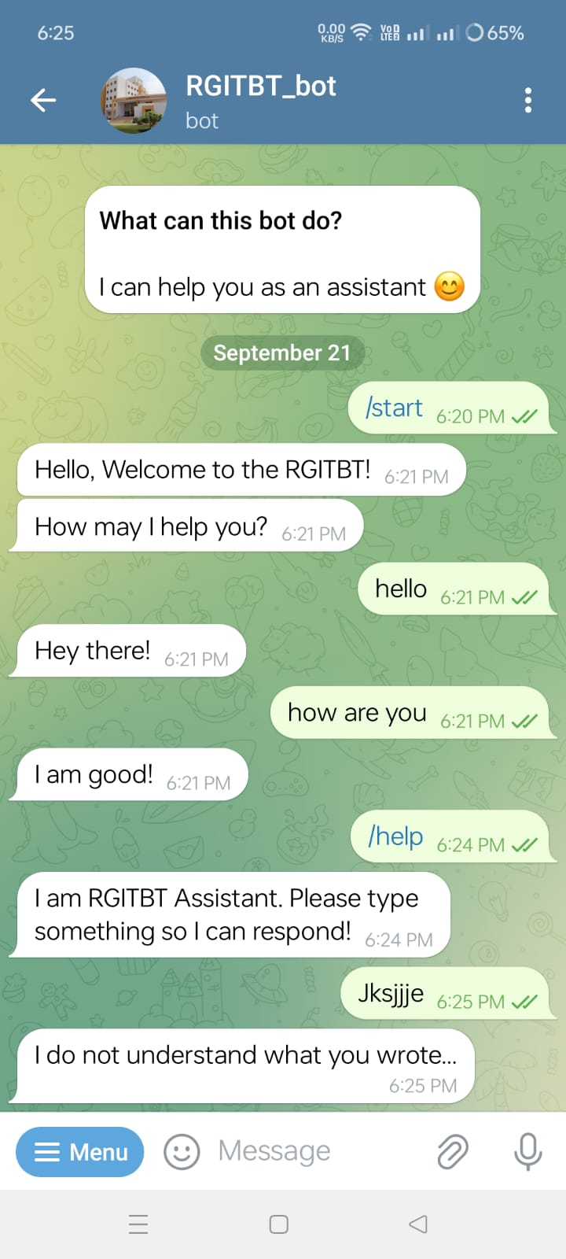
Bot’s infographic
RGITBT_bot
Visuals
Showcase is based on the Telegram and anyone can access
Features
It can help you as a RGITBT assistant
Price
It is depend upon the maintance and durability
Users
Speak about the target Questions
Custom command
It provides answers on the predefined commands
Updates
Provides all the updates from the conversation

Slide 17
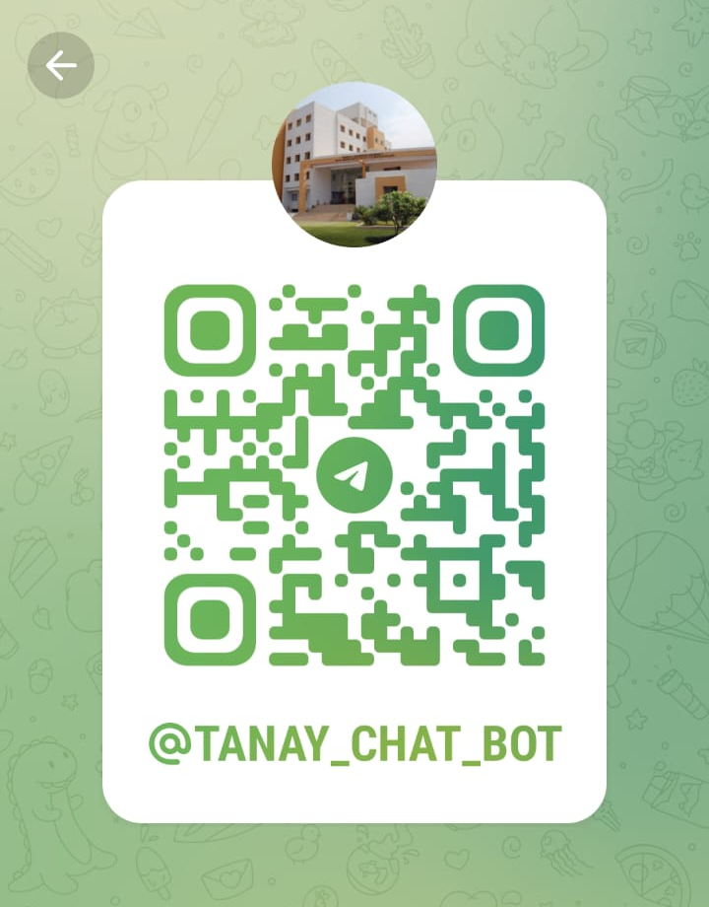

Slide 18
Thank You

