Slide 1

Store Sales Prediction
XGBoost and Deep Learning Algorithms

Slide 2
Overview
What are we trying to do?
Predict 6 weeks of daily sales for 1,115 stores located across Germany.
Why are we doing it?
Reliable sales forecasts enable store managers to create effective staff schedules that increase productivity and motivation.
How will we do this?
By analysis of historical sales data and using that understanding to build a model which which will have the ability to forecast future sales.

Slide 3
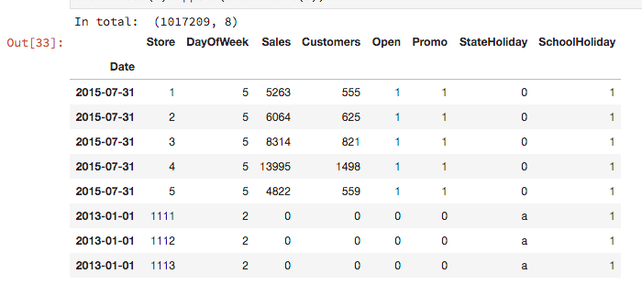
Data Set

Slide 4
Process
Other datasets
Sales dataset
Data Wrangling
Data Story
EDA
Time series analysis
Model training
Forecasting
Sales Forecast

Slide 5
Discoveries
The StoreType is A is most crowded with highest sales.
StoreType D with highest Sale per Customer indicates a strong and more valuable Buyer Cart.
Low SalePerCustomer amount for StoreType B alludes to the possibility that people are essentially shopping for sundry items.
Customers tends to buy more on Mondays when there's a single promotion running (Promo) and on Sundays when there is no promotion at all (both Promo and Promo1 are equal to 0).

Slide 6
Data Wrangling
To convert non-numerical features into numerical features.
Feature Engineering -- combine multiple features into a single feature for improved insights.
Feature Engineering -- combine Sales data with public datasets to add context to problem.
To account for seasonality in data.
To identify and account for holidays.
To frame a time series forecasting problem as supervised learning.
To develop an autoregressive forecast model using lagged observations.

Slide 7
Algorithmic experimentation
Algorithm | Observations
ARIMA | Good starting point for initial exploration and modeling Accurate forecasting
Seasonal ARIMA | Good starting point for initial exploration and modeling Accurate forecasting Can account for Seasonality in the data. Need a lot of experimentation to get it right.
Neural Nets/ Deep Learning | Require large volume of data. Difficult to setup and find an optimum architecture Expensive to train because of the requirement for large scale computing resources. Increased flexibility in terms of available architectural choices and learning methods.

Slide 8
Algorithmic experimentation(contd.)
XGBoost | Model Features Stochastic Gradient Boosting with sub-sampling at the row, column and column per split levels. Regularized Gradient Boosting with both L1 and L2 regularization. System Features Parallelization of tree construction using all of available CPU cores during training. Distributed Computing for training very large models using a cluster of machines. Out-of-Core Computing for very large datasets that don’t fit into memory. Cache Optimization of data structures and algorithm to make best use of hardware. Algorithm Features Sparse Aware implementation with automatic handling of missing data values. Continued Training so that you can further boost an already fitted model on new data.

