Slide 1
Linear Algebra Photo Studio
Matrix multiplication, inversion and photo filters
UE25MA242A | Mathematical Foundation for AI & Data Science (MFAD 2026)
Experiential Learning Level 2 | Orange Problem Mini Project
a photo = a grid of numbers
Team: Tanay Shah, Shriram Krishnan, Siddhant Chawla, Shyam Sooraj
Notes:
Our topic: matrix multiplication, inversion and photo filters. The idea in one line: a photo is a matrix, so every edit is a matrix operation, and undoing it is a matrix inverse.

Slide 2
A photo is a matrix; every edit is a matrix product
Photo
Edit
Edited photo
Undo
Recovered
H × W × 3 array
M × pixel
what you see
M⁻¹ × edited
if M allows it
Multiplication
Inversion
Photo filters
applies the edit
undoes the edit
what the user sees
colour: 3×3 × [R,G,B]
geometry: 3×3 × [x,y,1]
blur / sharpen: P × kernel
original = M⁻¹ × edited
Gauss-Jordan, written by hand
needs det ≠ 0
sepia, grayscale, rotate, shear,
blur, sharpen, edges, emboss
in a Streamlit app
Notes:
Pipeline: load photo as array, apply M, optionally apply M inverse. Whether the recovered photo matches the original depends on the matrix. That is the core of the project.

Slide 3
Whether an inverse is safe depends on the matrix
 | Good matrix | Bad matrix
Matrix | [[2, 0], [0, 1]] | [[1, 1], [1, 1.0001]]
Determinant | 2 | 0.0001
Condition number | 2 | 40,004
Change b by 0.0001 | x: [1, 1] → [1.00005, 1] | x: [1, 1] → [0, 2]
Hand-written core (matrix_ops.py)
Multiply: C[i][j] = sum of A[i][k]·B[k][j]
Determinant: Gaussian elimination, partial pivoting
Inverse: Gauss-Jordan on [A | I] → [I | A⁻¹]
Condition number: cond(A) = ‖A‖ · ‖A⁻¹‖
The determinant says whether an inverse exists. The condition number says how safely you can use it: expect to lose about log₁₀(cond) digits. Near 1 is perfect, ∞ is singular, and around 10¹⁶ is hopeless in double precision.
22
tests pass; results agree with NumPy to about 1e-14
Grayscale: det = 0, no inverse. Full sepia: cond ≈ 28,600. Soft sepia: cond ≈ 5.
Notes:
Determinant answers does an inverse exist; condition number answers can I trust it. The bad matrix is invertible but nearly singular, so a 0.0001 change in b moves the answer by a whole unit.

Slide 4
Three kinds of edit, all matrix operations
1
Colour filters
2
Geometric transforms
3
Convolution filters
3×3 matrix × pixel [R, G, B]
3×3 homogeneous matrix × [x, y, 1]
neighbourhood rows P × kernel
[200, 120, 80]
→ [191.6, 147.3, 109.4]
[100, 50] → [81.9, 81.4]
edge patch: box 73.3
sharpen −180, Sobel 760
Soft sepia. Undo with M⁻¹ gives [200, 120, 80] again. Grayscale has det = 0 and cannot be undone.
Rotate 30° about the centre (det = 1). Matrices combine by multiplication, and S·R ≠ R·S. Warping uses T⁻¹ to find each source pixel.
im2col turns each pixel's neighbourhood into one row of P. The whole filter is also one big matrix T.
Notes:
Worked examples on one pixel and one 3x3 patch. These are exactly the operations applied to every pixel of a real photo. Convolution flips the kernel, so Sobel prints -760; the sign disappears in the edge magnitude.

Slide 5
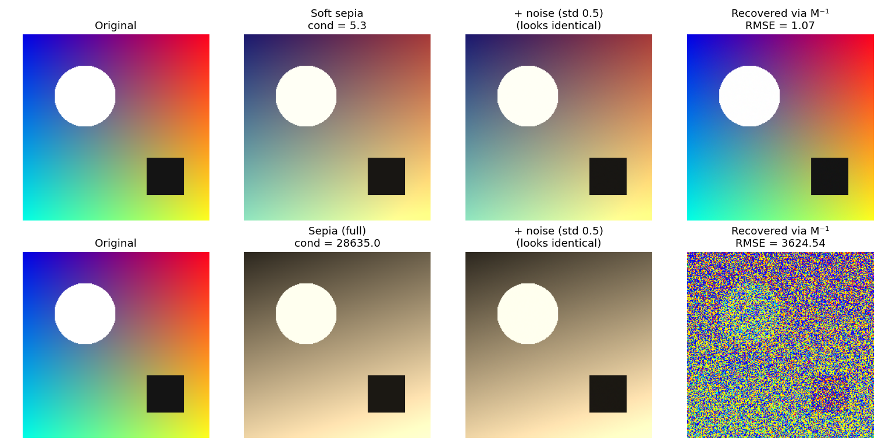
Undoing an edit: four outcomes
Clean
soft sepia, swap, rotation: cond near 1, exact recovery
Noise amplified
full sepia: cond ≈ 28,600, noise × 7,246; soft sepia only × 2.2
Impossible
grayscale: det = 0, different colours become the same grey
Soft sepia (top) and full sepia (bottom) after the same tiny noise (std 0.5), then inverted.
Information lost
8-bit clipping at 255 (10.9% of pixels) or pixels rotated off-frame
Notes:
Same matrix idea, four different fates. Both noisy images look identical to the eye, yet one recovers cleanly and the other turns to static. Clipping and cropping lose information that no inverse can restore.

Slide 6
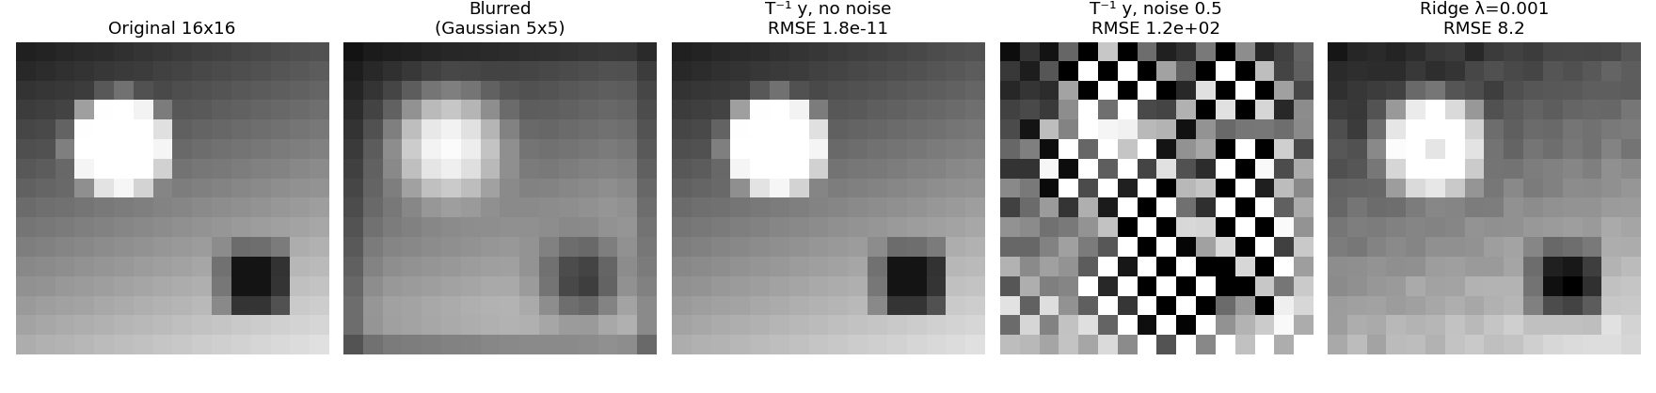
Deblurring needs regularisation; hand-written code costs speed
1,930
119
8.2
~1,400×
condition number of the 256×256 blur matrix
error after plain inverse with noise 0.5 (blurred input: 30)
error with ridge, λ = 0.001 (best case, chosen using the true image)
slower: per-pixel loop vs one NumPy product on a 128×128 image
Notes:
Deblurring uses a 16x16 grayscale image so the blur matrix is 256x256. Plain inversion explodes with noise; ridge (T'T + lambda I)^-1 T'y fixes it. Our code matches NumPy to 1e-14 but is much slower, and less accurate than LAPACK on very ill-conditioned matrices such as Hilbert n=10.

Slide 7
Takeaway
In the repository
matrix_ops.py
multiply, determinant, inverse, cond
color_ / geometric_ / convolution_filters.py
the three kinds of edit
inversion_recovery.py, benchmark.py
recovery, noise, deblurring, speed
app.py, app_logic.py
Streamlit interface and logic
tests/
22 tests
Run
pip install -r requirements.txt, then streamlit run app.py
A photo is a matrix. The determinant tells you whether an edit can be undone; the condition number tells you how safely.
Streamlit app: colour, geometry, convolution and deblurring modes on your own photo.
Limits: deblurring on 16×16 grayscale, photos shrunk to 384 px, ridge λ tuned against the true image.
github.com/tanayshah-gh/linear-algebra-photo-studio
Notes:
One-paragraph answer: we treat a photo as a matrix and filters as matrix operations, undo them with a hand-written Gauss-Jordan inverse, and use the determinant and condition number to explain when that works.

