Slide 1

DPM PROJECT
Real Estate Price Prediction
By
Tanay Singhal
Manish Jethmalani

Slide 2
Objective:
To come up with a web portal in which user would be able to give the features such as number of rooms, locality, area, etc. as input and the portal will return the best possible price w.r.t the location entered.

Slide 3
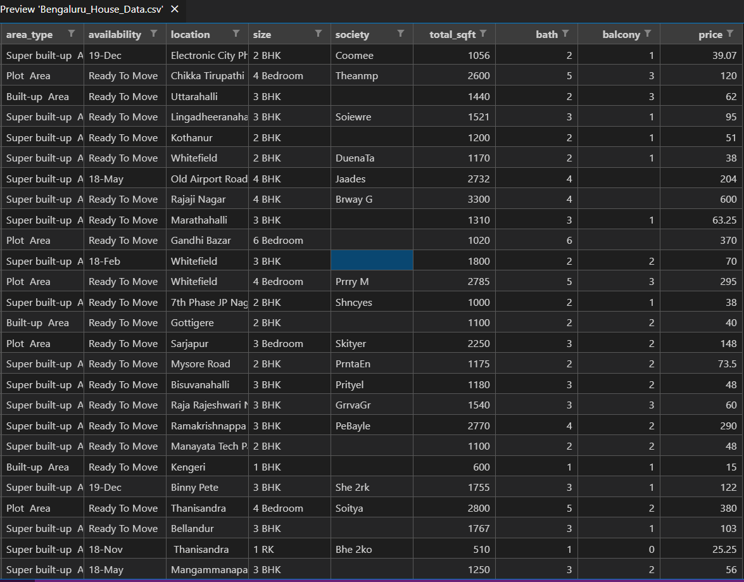
Dataset:

Slide 4
Flow:
Data Cleaning
Outlier Removal
Model Building
Flask
Website-HTML,CSS

Slide 5
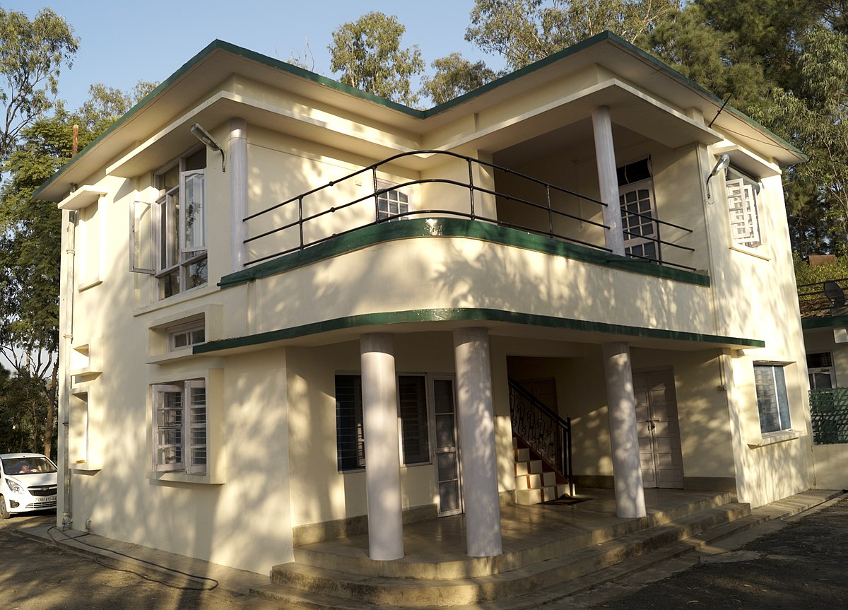
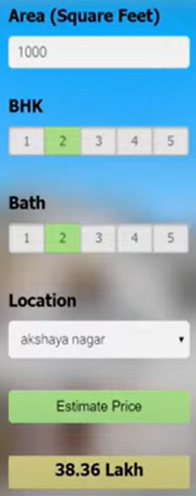
Layout:

