Slide 1
Operating System Tutorial
TOPICS
Shortest Job First(Scheduling Algorithm)
First In First Out(Page replacement Algorithm)
Team Members:
Samaresh M S ---- 4NI19CS096
Tanay Verma --- 4NI19CS112

Slide 2
Shortest Job First(SJF)
SJF scheduling algorithm, schedules the processes according to their burst time.
SJF is a non-preemptive scheduling algorithm.
In SJF scheduling, the process with the lowest burst time, among the list of available processes in the ready queue, is going to be scheduled next.
However, it is very difficult to predict the burst time needed for a process hence this algorithm is very difficult to implement in the system.

Slide 3
Characteristics of SJF Scheduling
It is associated with each job as a unit of time to complete.
This algorithm method is helpful for batch-type processing, where waiting for jobs to complete is not critical.
It can improve process throughput by making sure that shorter jobs are executed first, hence possibly have a short turnaround time.
It improves job output by offering shorter jobs, which should be executed first, which mostly have a shorter turnaround time.

Slide 4
Advantages of SJF
Used for long-term scheduling.
Reduces average waiting time.
Helpful for batch-type processing where runtimes are known in advance.
For long-term scheduling, we can obtain a burst time estimate from the job description.
It is necessary to predict the value of the next burst time for Short-Term Scheduling.
Optimal with regard to average turnaround time.

Slide 5
Disadvantages
May suffer with the problem of starvation.
It is not implementable because the exact Burst time for a process can't be known in advance.

Slide 6
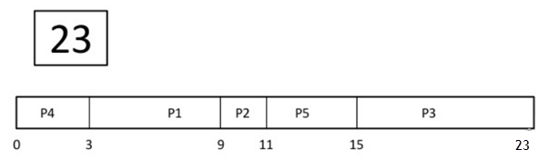
Example
Process ID | Arrival Time | Burst Time
P1 | 2 | 6
P2 | 5 | 2
P3 | 1 | 8
P4 | 0 | 3
P5 | 4 | 4
Gantt Chart

Slide 7
Process ID | Arrival Time | Burst Time | Start Time | Completion Time | Turn Around Time | Waiting Time | Response Time
P1 | 2 | 6 | 3 | 9 | 7 | 1 | 1
P2 | 5 | 2 | 9 | 11 | 6 | 4 | 4
P3 | 1 | 8 | 15 | 23 | 22 | 14 | 14
P4 | 0 | 3 | 0 | 3 | 3 | 0 | 0
P5 | 4 | 4 | 11 | 15 | 11 | 7 | 7
Average Turn Around Time=(7+6+22+3+4)/5=9.8
Average Waiting Time=(1+4+14+0+7)/5=5.2
Average Response Time=(1+4+14+0+7)/5=5.2

Slide 8
Code for SJF
#include<bits/stdc++.h>
using namespace std;
struct process {
int pid;
int arrival_time;
int burst_time;
int start_time;
int completion_time;
int turnaround_time;
int waiting_time;
int response_time;
};
int main(){
int n;
struct process p[100];
float avg_turnaround_time;
float avg_waiting_time;
float avg_response_time;
int total_turnaround_time = 0;
int total_waiting_time = 0;
int total_response_time = 0;
int total_idle_time = 0;
int is_completed[100];
memset(is_completed,0,sizeof(is_completed));

Slide 9
cout<<"Enter the number of processes: ";
cin>>n;
for(int i = 0; i < n; i++) {
cout<<"Enter arrival time of process "<<i+1<<": ";
cin>>p[i].arrival_time;
cout<<"Enter burst time of process "<<i+1<<": ";
cin>>p[i].burst_time;
p[i].pid = i+1;
cout<<endl;
}
int current_time = 0;
int completed = 0;
while(completed != n) {
int idx = -1;
int mn = 10000000;
for(int i = 0; i < n; i++) {
if(p[i].arrival_time <= current_time && is_completed[i] == 0) {
if(p[i].burst_time < mn) {
mn = p[i].burst_time;
idx = i;
}
if(p[i].burst_time == mn) {
if(p[i].arrival_time < p[idx].arrival_time) {
mn = p[i].burst_time;
idx = i;
}
}
}
}

Slide 10
if(idx != -1) {
p[idx].start_time = current_time;
p[idx].completion_time = p[idx].start_time + p[idx].burst_time;
p[idx].turnaround_time = p[idx].completion_time - p[idx].arrival_time;
p[idx].waiting_time = p[idx].turnaround_time - p[idx].burst_time;
p[idx].response_time = p[idx].start_time - p[idx].arrival_time;
total_turnaround_time += p[idx].turnaround_time;
total_waiting_time += p[idx].waiting_time;
total_response_time += p[idx].response_time;
is_completed[idx] = 1;
completed++;
current_time = p[idx].completion_time;
}
else {
current_time++;
}
}
avg_turnaround_time = (float) total_turnaround_time / n;
avg_waiting_time = (float) total_waiting_time / n;
avg_response_time = (float) total_response_time / n;

Slide 11
cout<<endl<<endl;
cout<<"Process ID\t"<<"AT\t"<<"BT\t"<<"ST\t"<<"CT\t"<<"TAT\t"<<"WT\t"<<"RT\t"<<"\n"<<endl;
for(int i = 0; i < n; i++) {
cout<<"P"<<p[i].pid<<"\t\t"<<p[i].arrival_time<<"\t"<<p[i].burst_time<<"\t"<<p[i].start_time<<"\t"<<p[i].completion_time<<"\t"<<p[i].turnaround_time<<"\t"<<p[i].waiting_time<<"\t"<<p[i].response_time<<"\t"<<"\n"<<endl;
}
cout<<"Average Turnaround Time = "<<avg_turnaround_time<<endl;
cout<<"Average Waiting Time = "<<avg_waiting_time<<endl;
cout<<"Average Response Time = "<<avg_response_time<<endl;
return 0;
}

Slide 12
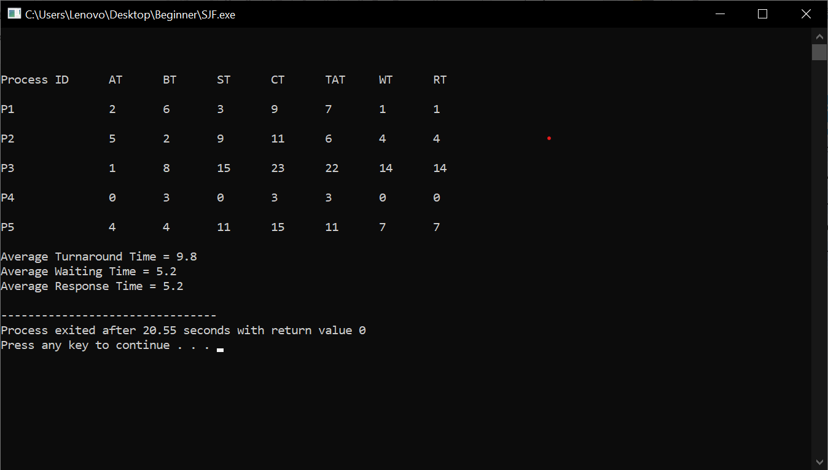
Output

Slide 13
First In First Out(Page Replacement Algorithm)
It is one of the simplest page replacement algorithm. The oldest page, which has spent the longest time in memory is chosen and replaced.
This algorithm is implemented by keeping the track of all the pages in the queue.
As new pages are requested and are swapped in, they are added to the tail of a queue and the page which is at the head becomes the victim.
This is not an effective way of page replacement but it can be used for small systems.

Slide 14
ADVANTAGES
This algorithm is simple and easy to use.
FIFO does not cause more overhead.
DISADVANTAGES
Not always good at performance. It may replace an active page to bring a new one and thus may cause a page fault of that page immediately.
Another unexpected side effect is the FIFO anomaly or Belady’s anomaly.

Slide 15
BELADY’S ANOMALY
In FIFO page replacement algorithm, the number of page faults will get increased with the increment in number of frames.
This is the strange behavior shown by FIFO algorithm in some of the cases. This is an Anomaly called as Belady'sAnomaly.

Slide 16
Example
Number of pages:12
Reference String: 1,2,3,4,1,2,5,1,2,3,4,5
Number of frames:3
Reference String | 1 | 2 | 3 | 4 | 1 | 2 | 5 | 1 | 2 | 3 | 4 | 5
Frame 1 | 1 | 1 | 1 | 4 | 4 | 4 | 5 | 5 | 5 | 5 | 5 | 5
Frame 2 |  | 2 | 2 | 2 | 1 | 1 | 1 | 1 | 1 | 3 | 3 | 3
Frame 3 |  |  | 3 | 3 | 3 | 2 | 2 | 2 | 2 | 2 | 4 | 4
 | * | * | * | * | * | * | * | H | H | * | * | H
No. of Page Fault=9
No. of Hits=3
Miss Ratio=9/12=0.75
Hit Ratio=0.25

Slide 17
CODE FOR FIFO
#include<bits/stdc++.h>
using namespace std;
int main()
{
int i,j,n,ref_str[50],frame[10],no,k,avail;
float fcount=0;
printf("\n ENTER THE NUMBER OF PAGES:\n");
scanf("%d",&n);
printf("\n ENTER THE REFERENCE STRING :\n");
for(i=1;i<=n;i++)
scanf("%d",&ref_str[i]);
printf("\n ENTER THE NUMBER OF FRAMES :");
scanf("%d",&no);
for(i=0;i<no;i++)
frame[i]= -1;
j=0;

Slide 18
printf("\n ref string \t page frames \tHit/Fault\n");
for(i=1;i<=n;i++)
{
printf("%d\t\t",ref_str[i]);
avail=0;
for(k=0;k<no;k++)
{
if(frame[k]==ref_str[i])
{
avail=1;
for(k=0;k<no;k++)
printf("%d\t",frame[k]);
printf("H");
}
}
if (avail==0)
{
frame[j]=ref_str[i];
j=(j+1)%no;
fcount++;
for(k=0;k<no;k++)
printf("%d\t",frame[k]);
printf("F");
}
printf("\n");
}
printf("Page Fault Is %.1f\n",fcount);
cout<<"Hit ratio: "<<((n-fcount)/n)<<"\n";
cout<<"Miss ratio: "<<(fcount/n);
return 0;
}

Slide 19
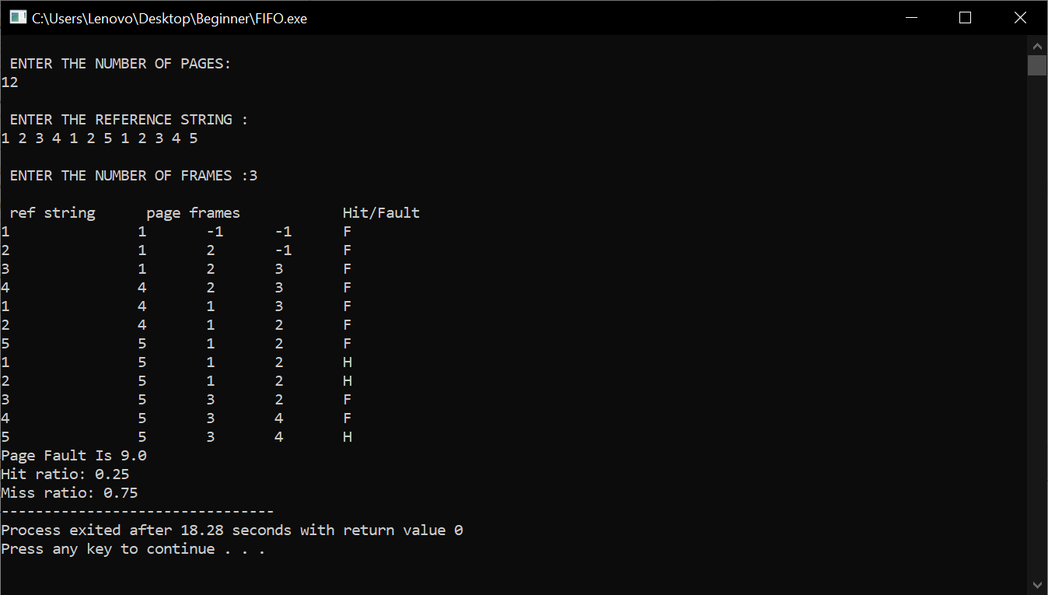
Output

Slide 20
THANK YOU

