Slide 1
Rule-based reasoning

Slide 2
Rule-based reasoning
One can often represent the expertise that someone uses to do an expert task as rules.
A rule means a structure which has an if component and a then component.

Slide 3
Rule-based reasoning: rules
examples:
if - the leaves are dry, brittle and discoloured
then - the plant has been attacked by red spider mite
if - the customer closes the account
then - delete the customer from the database

Slide 4
Rule-based reasoning: rules
The statement, or set of statements, after the word if represents some pattern which you may observe.
The statement, or set of statements, after the word then represents some conclusion that you can draw, or some action that you should take.

Slide 5
Rule-based reasoning: rules
A rule-based system, therefore, either
  identifies a pattern and draws conclusions about what it means,
  or
  identifies a pattern and advises what should be done about it,
  or
  identifies a pattern and takes appropriate action.

Slide 6
Rule-based reasoning: rules
  The essence of a rule-based reasoning system is that it goes through a series of cycles.
  In each cycle, it attempts to pick an appropriate rule from its collection of rules, depending on the present circumstances, and to use it as described above.
  Because using a rule produces new information, it's possible for each new cycle to take the reasoning process further than the cycle before. This is rather like a human following a chain of ideas in order to come to a conclusion.

Slide 7
Terminology
A rule as described above is often referred to as a production rule.
A set of production rules, together with software that can reason with them, is known as a production system.

Slide 8
Terminology
There are several different terms for the statements that come after the word if, and those that come after the word then.
  The statements after if may be called the conditions, those after then may be called the conclusions.
  The statements after if may be called the premises, those after then may be called the actions.
  The statements after if may be called the antecedents, those after then may be called the consequents.

Slide 9
Terminology
  Some writers just talk about the if-part and the then-part.

Slide 10
Terminology
If a production system chooses a particular rule, because the conditions match the current state of affairs, and puts the conclusions into effect, this is known as firing the rule.

Slide 11
Terminology
In a production system, the rules are stored together, in an area called the rulebase.

Slide 12
Reasoning with production rules
For example (assuming words beginning with capital letters are variables, and other words are constants):
if [Person, age, Number] &
[Person, employment, none] &
[Number, greater_than, 18] &
[Number, less_than, 65]
then [Person, can_claim,
unemployment_benefit].

Slide 13
Reasoning with production rules
Architecture of a typical production system:
observed data
working memory
select
modify
rule memory
Inference
engine
fire
output

Slide 14
Reasoning with production rules
Architecture of a typical production system:
New information
working memory
select
modify
rule memory
interpreter
fire
output

Slide 15
Reasoning with production rules
Architecture of a typical production system:
New information
select
working memory
modify
rule memory
interpreter
fire
output

Slide 16
Reasoning with production rules
Architecture of a typical production system:
New information
working memory
select
modify
Inference
engine
executes
actions
rule memory
output
fire

Slide 17
Reasoning with production rules
Architecture of a typical production system:
New information
working memory
select
modify
Inference
engine
executes
actions
rule memory
fire
output

Slide 18
Reasoning with production rules
Architecture of a typical production system:
New information
select
working memory
modify
rule memory
interpreter
fire
output

Slide 19
Reasoning with production rules
Architecture of a typical production system:
New information
working memory
select
modify
Inference engine
executes
actions
rule memory
output
fire

Slide 20
Reasoning with production rules
Architecture of a typical production system:
New information
working memory
select
modify
Inference engine
executes
actions
rule memory
fire
output

Slide 21
Architecture of a typical production system
Has a working memory.
  Holds items of data. Their presence, or their absence, causes the inference engine to trigger certain rules.
  e.g. W.M. contains [john, age, 29] & [john, employment, none]
  The system decides: does this match any rules in the rulebase? If so, choose the rule.

Slide 22
Architecture of a typical production system
has an inference engine. Behaviour of the inference engine :
  the system is started by putting a suitable data item into working memory.
  recognise-act cycle: when data in the working memory matches the conditions of one of the rules in the system, the rule fires (i.e.is brought into action).

Slide 23
Advantages of production systems ... at first glance
The principle advantage of production rules is notational convenience - it’s easy to express suitable pieces of knowledge in this way.
The principle disadvantage of production rules is their restricted power of expression - many useful pieces of knowledge don’t fit this pattern.

Slide 24
Advantages of production systems ... at first glance
This would seem to be a purely declarative form of knowledge representation. One gathers pieces of knowledge about a particular subject, and puts them into a rulebase. One doesn't bother about when or how or in which sequence the rules are used; the production system can deal with that.
When one wishes to expand the knowledge, one just adds more rules at the end of the rulebase.

Slide 25
Advantages of production systems ... at first glance
The rules themselves are very easy to understand, and for someone (who is expert in the specific subject the system is concerned with) to criticise and improve.

Slide 26
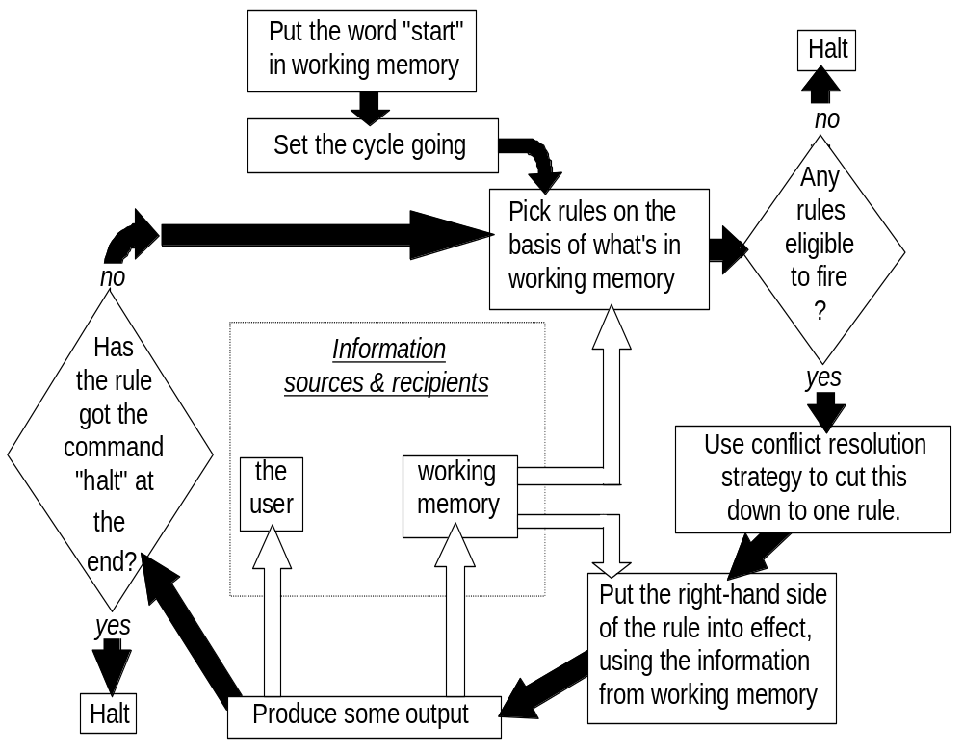
Operation of a production system in more detail
The recognise-act cycle (forward-chaining):

Slide 27

Operation of a production system in more detail
  The recognise-act cycle (forward-chaining):

Slide 28
Operation of a production system in more detail
  The recognise-act cycle (forward-chaining):

Slide 29
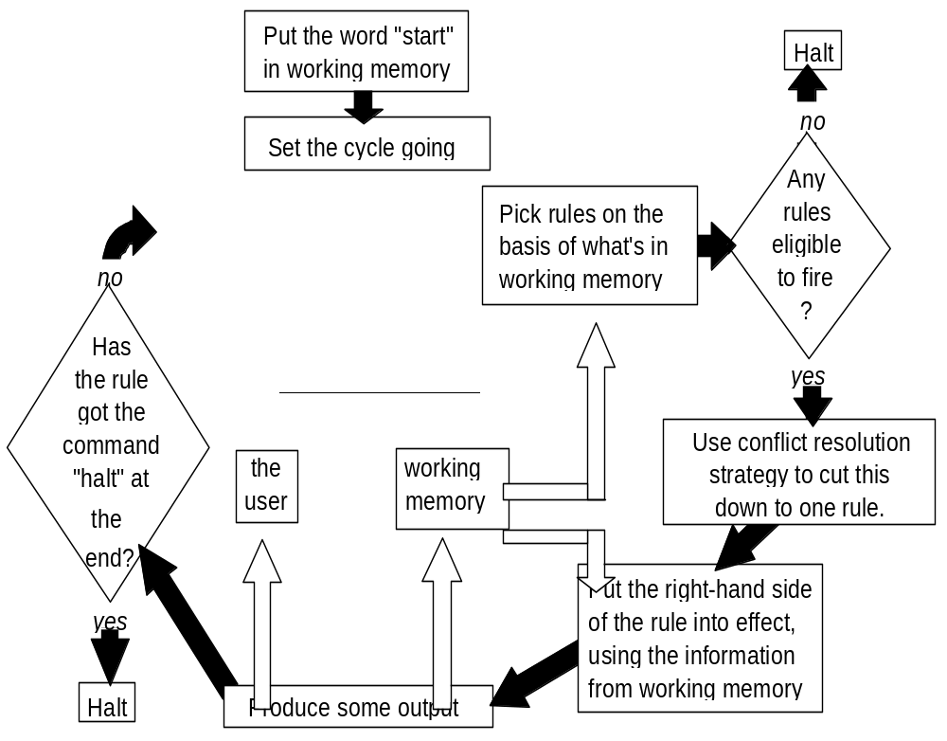
Operation of a production system in more detail
  The recognise-act cycle (forward-chaining):

Slide 30
Operation of a production system in more detail
  The recognise-act cycle (forward-chaining):

Slide 31
Operation of a production system in more detail
  The recognise-act cycle (forward-chaining):

Slide 32
Operation of a production system in more detail
  The recognise-act cycle (forward-chaining):

Slide 33
Operation of a production system in more detail
  The recognise-act cycle (forward-chaining):

Slide 34
The recognise-act cycle
N.B. "right-hand side of the rule" means the part after the word then.

Slide 35
The recognise-act cycle
conflict resolution strategy: if more than one rule matches working memory contents, this decides which one is to fire. Alternatively, the rule base could be designed so there's never any conflict (but usually isn't).

Slide 36
The recognise-act cycle
Applying the rule will probably modify the contents of working memory. Then the system continues with the recognise-act cycle.
The system stops when
  the rules stop firing, or
  a rule fires which specifically tells the system to halt.

Slide 37
Conflict resolution strategies
Choice of c.r.s. can make a big difference to system performance.
Three favourite strategies:
  Refractoriness: don't allow a rule to fire twice on same data.
  Recency: take the data which arrived in working memory most recently, and find a rule that uses this data.
  Specificity: use the most specific rule (the one with the most conditions attached).

Slide 38
Conflict resolution strategies
However, in recent years the fashion (in expert system shells) has been for very simple CRSs, coupled with a reluctance to mention the problem to the potential system builder.
Simple strategies:
  Give each rule a priority number. If a choice has to be made, choose the rule with the highest number.
  If a choice has to be made, choose the rule that comes first in the rule base.

Slide 39
Production System
A production system consists of four basic components:
1. A set of rules of the form Ci Ai where Ci is the condition part and Ai is the action part. The condition determines when a given rule is applied, and the action determines what happens when it is applied.
2. One or more knowledge databases that contain whatever information is relevant for the given problem. Some parts of the database may be permanent, while others may temporary and only exist during the solution of the current problem. The information in the databases may be structured in any appropriate manner.
3. A control strategy that determines the order in which the rules are applied to the database, and provides a way of resolving any conflicts that can arise when several rules match at once.
4. A rule applier which is the computational system that implements the control strategy and applies the rules.

Slide 40
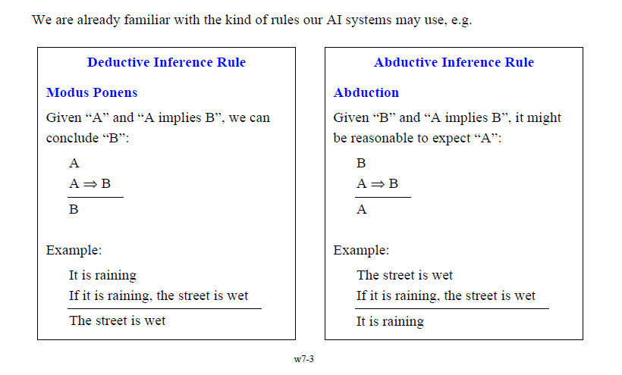
Inference Rules

Slide 41
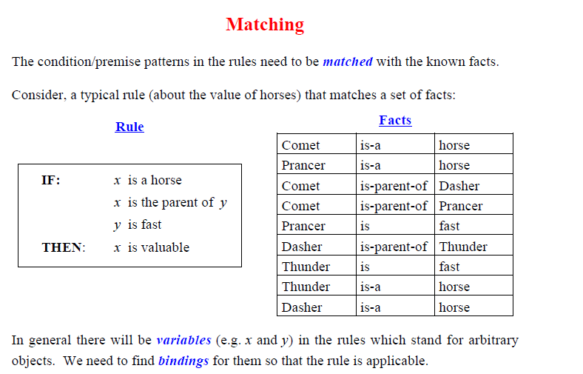

Slide 42
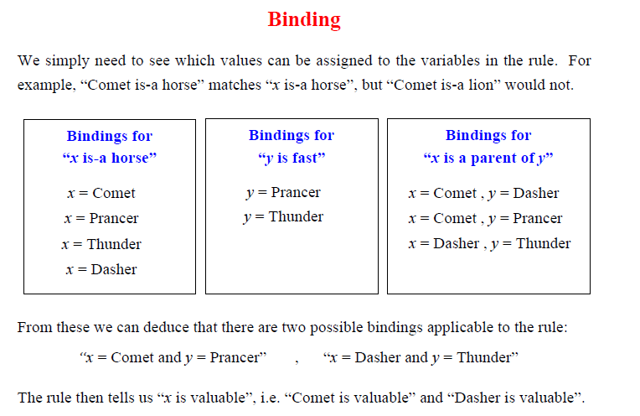

Slide 43
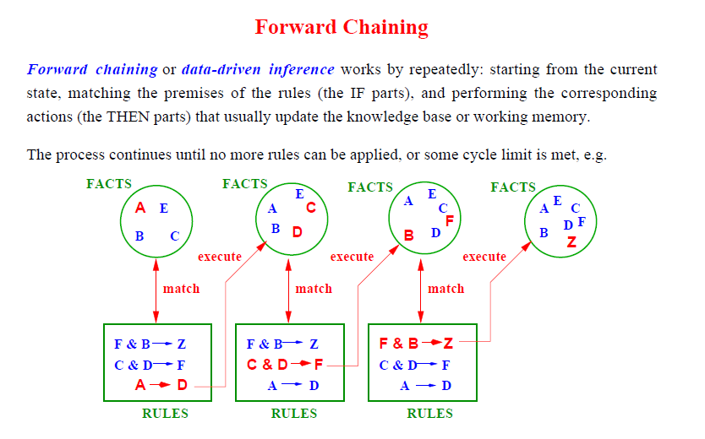

Slide 44
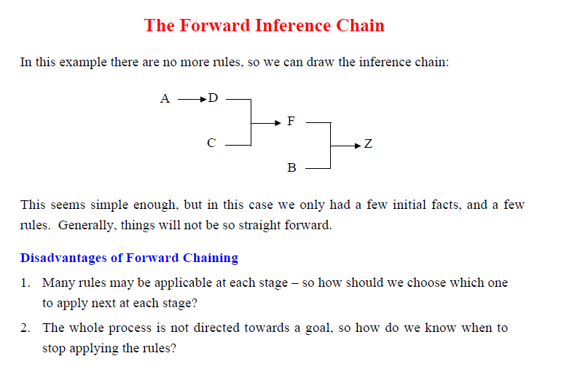

Slide 45
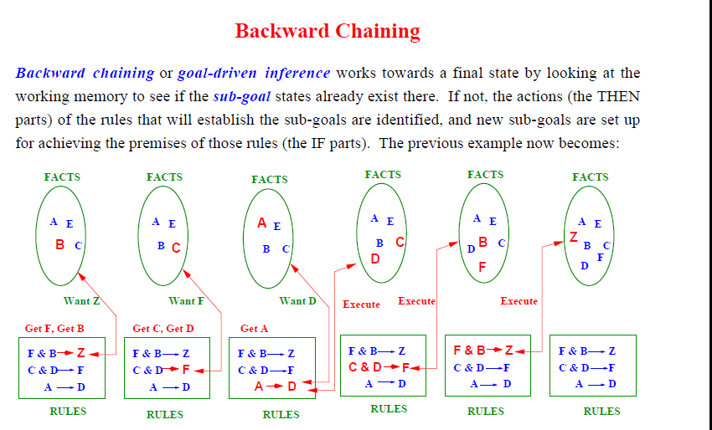

Slide 46
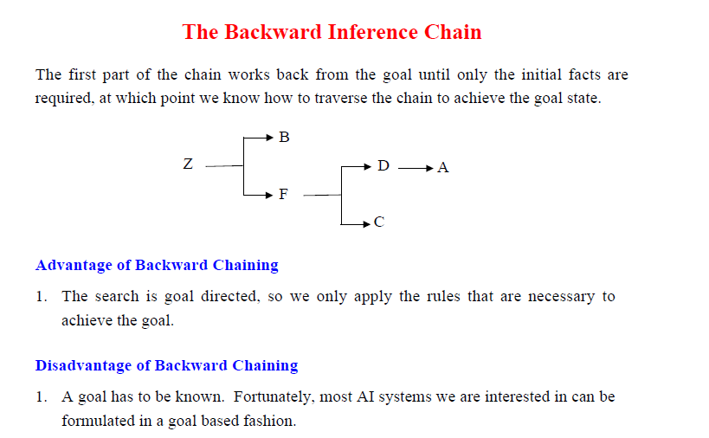

Slide 47
Thank you

