Slide 1
QAZAQ REPUBLIC
Theme: website about the brand that’s design based/linked with our country.
Style: advertisement website
Additional
information: pages with clothes and accessories and with information about the brand

Slide 2
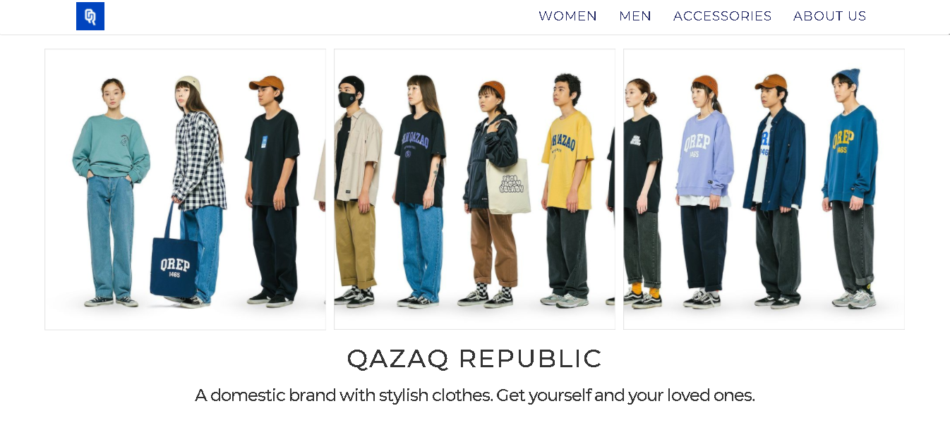
1) Number of web pages must be at least 5 pages: home, women, men, accessories, about us

Slide 3
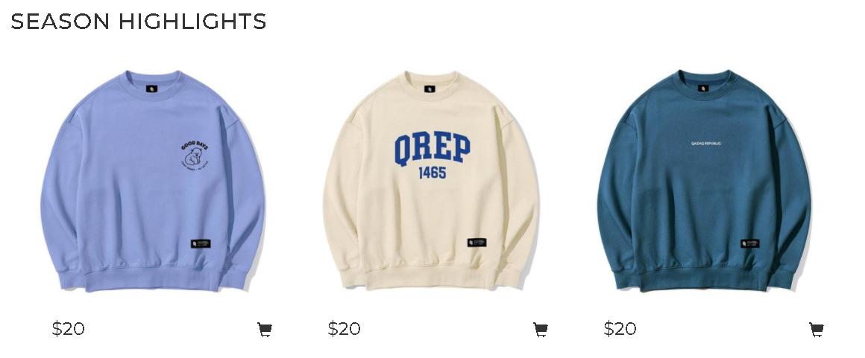
2)The project must contain at least two flexbox containers with elements. first flexbox

Slide 4
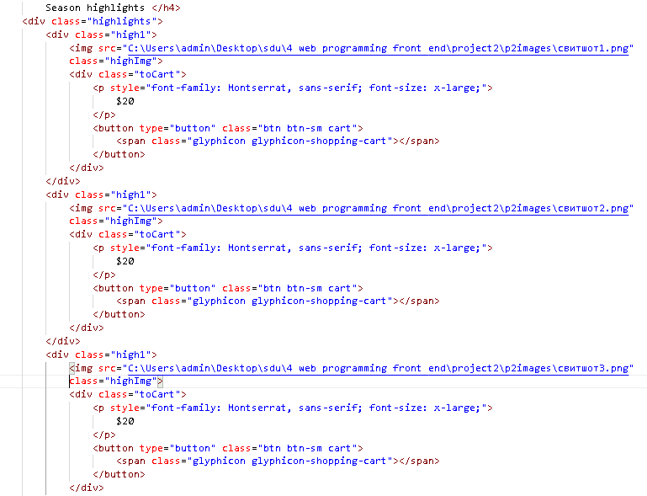
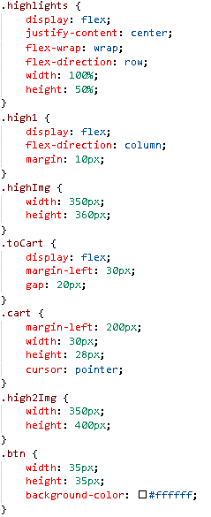
first flexbox: html and css codes

Slide 5
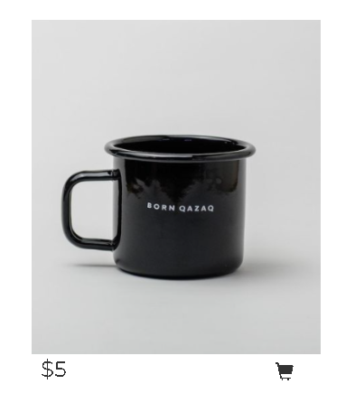
second flexbox

Slide 6
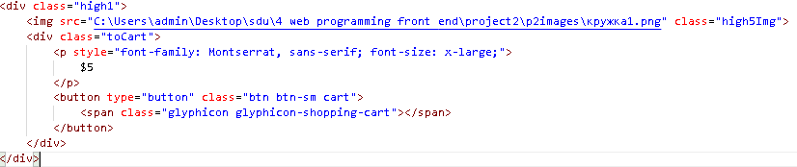
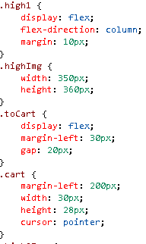
second flexbox: html and css codes

Slide 7
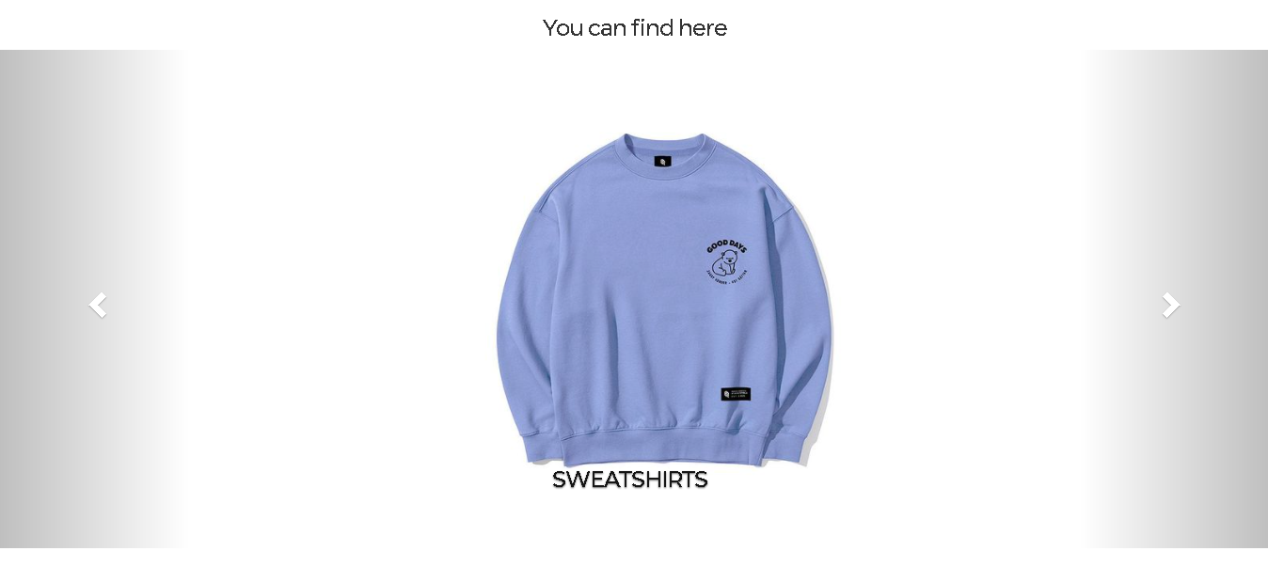
3)Some HTML elements in project must be aligned by bootstrap grid system. Carousel slides

Slide 8
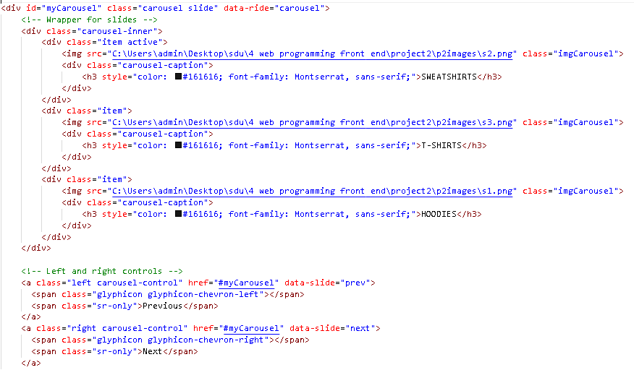
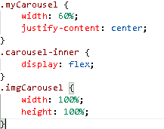
Carousel slides: html and css code.

Slide 9
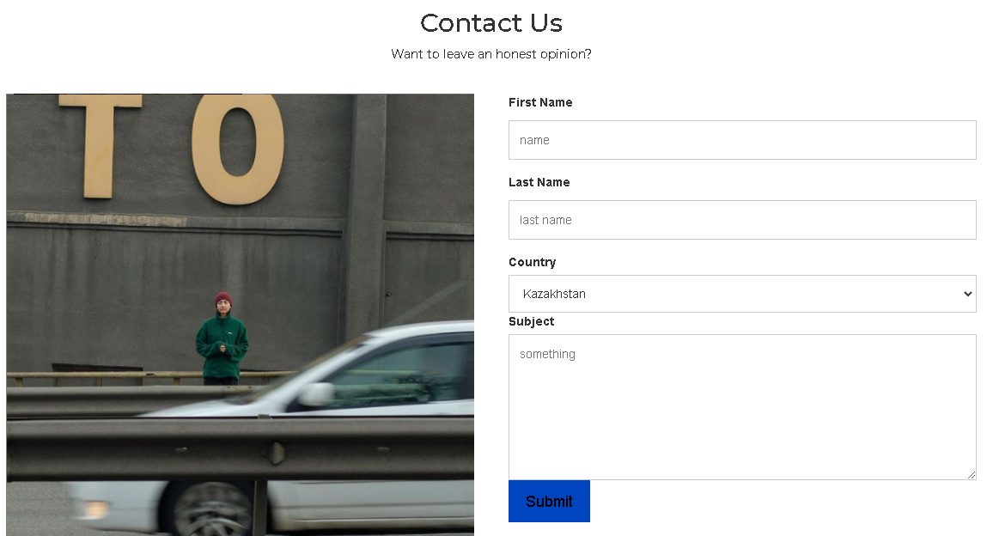
Contact us made by bootstrap grid system

Slide 10
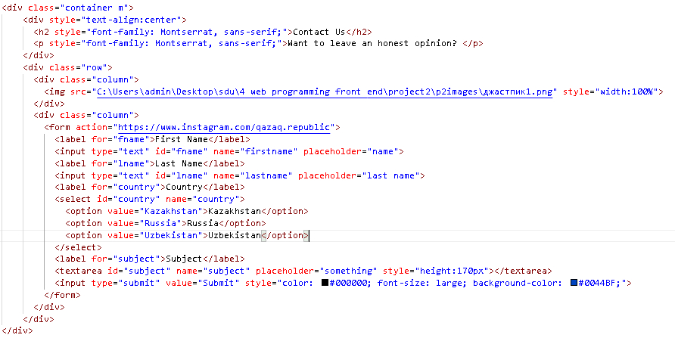
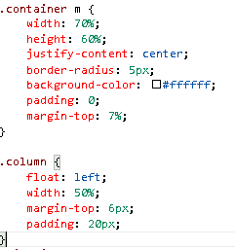
Contact us: html and css code

Slide 11
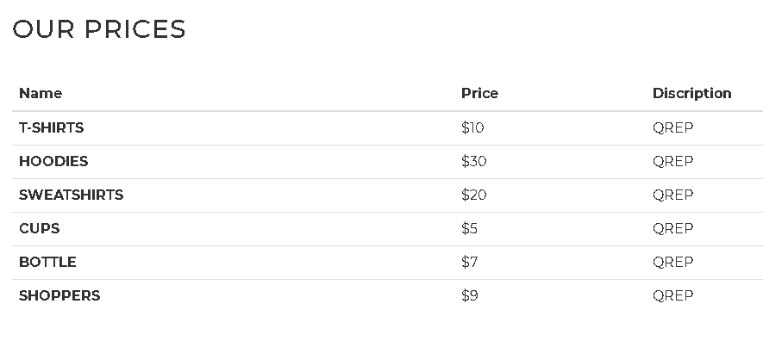
Tables

Slide 12
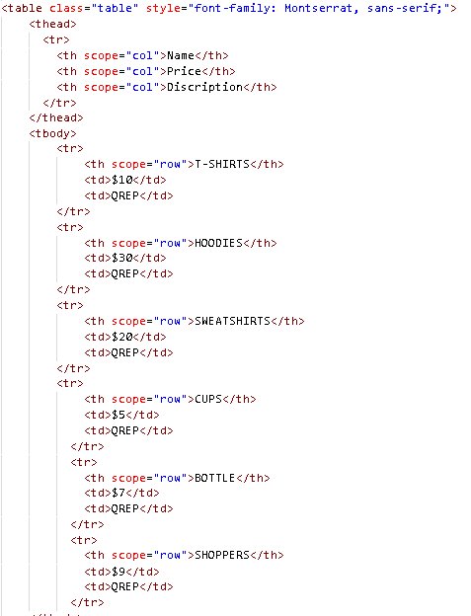

tables html and css code

Slide 13
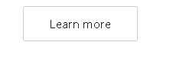
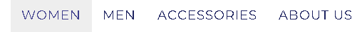
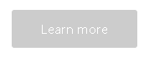
4)In your project you should have at least five buttons and two tables. They should have bootstrap classes. buttons

Slide 14

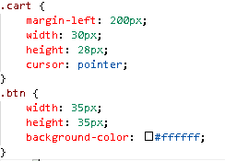
Cart buttons html and css code

Slide 15
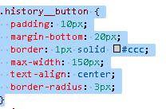
Learn more buttons html and css codes

Slide 16
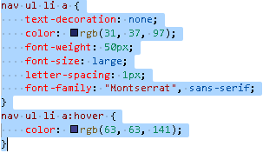
Pages link-buttons

Slide 17
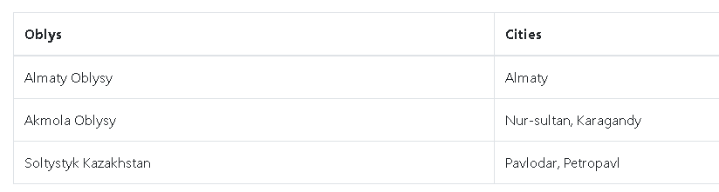
tables

Slide 18
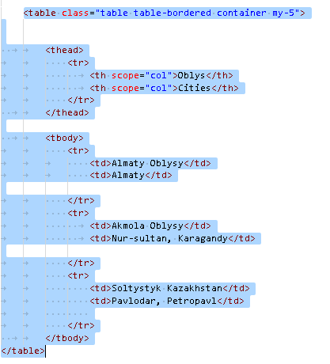
Table with places made with bootstrap grid system

Slide 19
5)Colors should be defined by rgb, rgba, hsl, hsla functions and by hexadecimal numbers.
In our project we used:

Slide 20
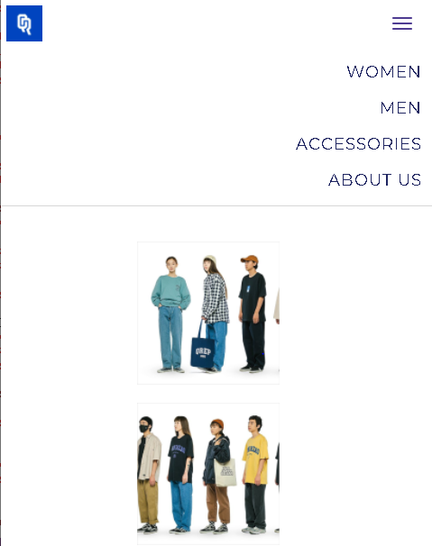
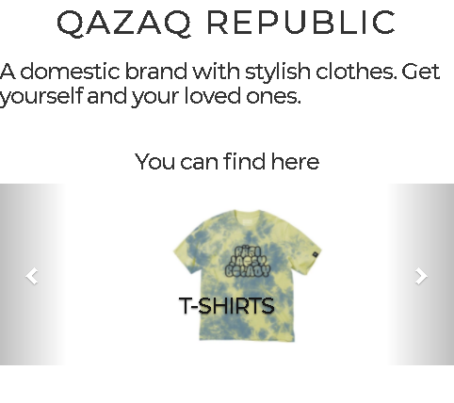
6)Web pages must be mobile adaptable. Home page’s mobile adaptable version

Slide 21
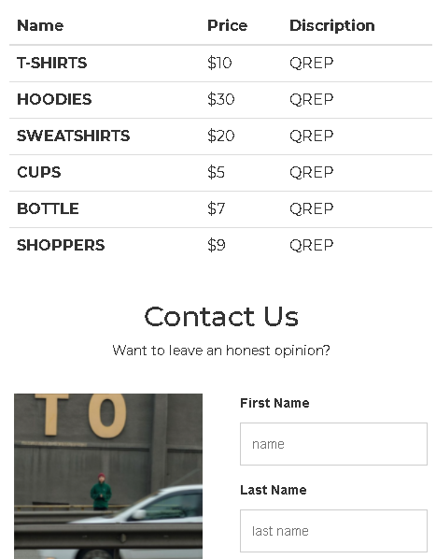
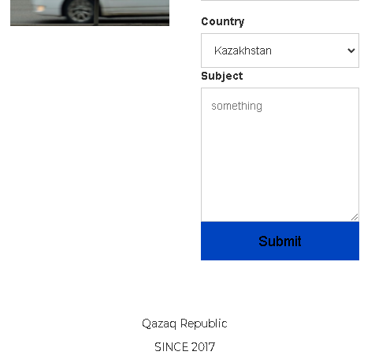
when the width of the devices changes, the elements’s width changes too.

Slide 22
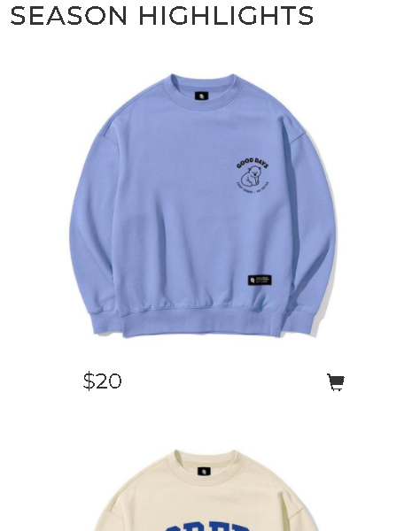
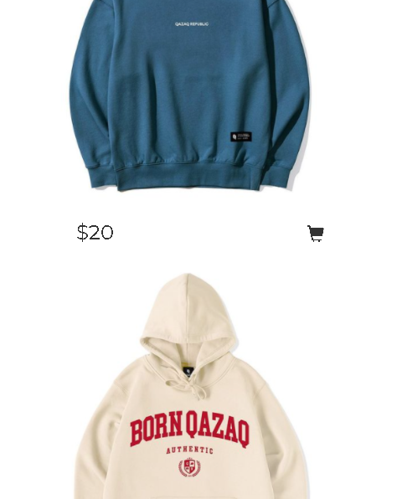
The second pages mobile adaptable version. Here the direction of clothes‘ changes from row to column.

Slide 23
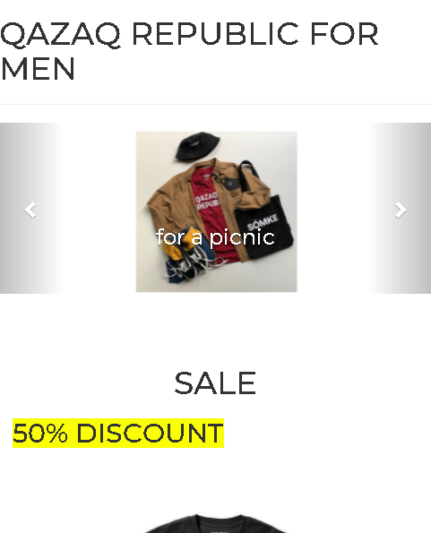
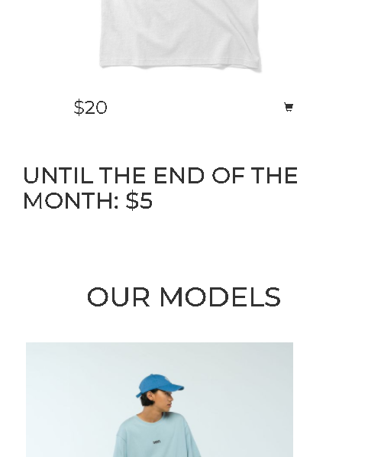
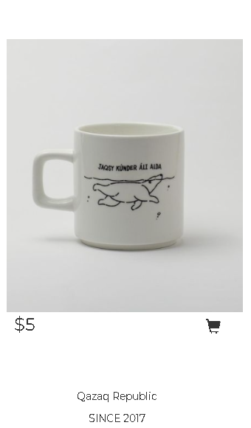
Mobile adaptable version of the men's and accessories' page

Slide 24
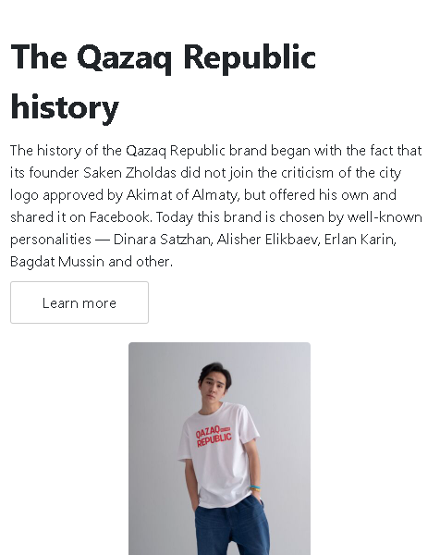
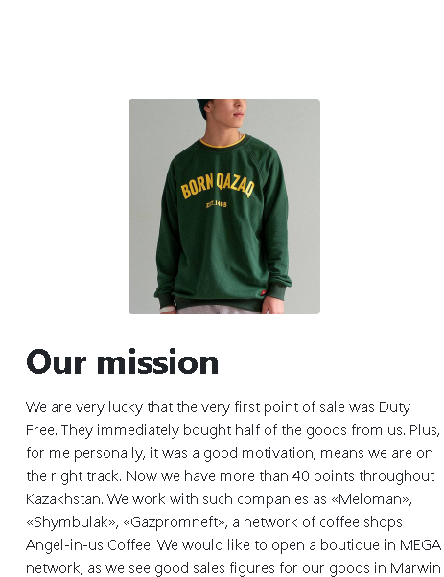
Mobile adaptable version of the page ABOUT US.

Slide 25
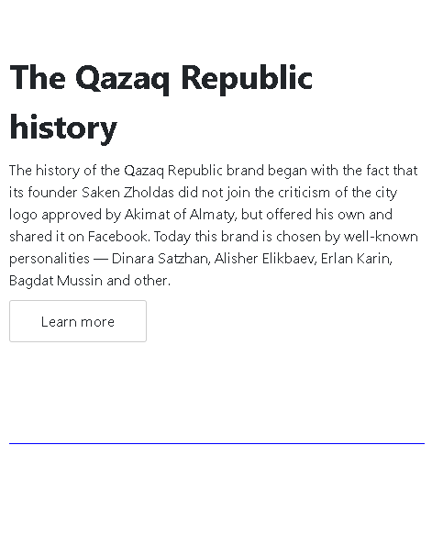
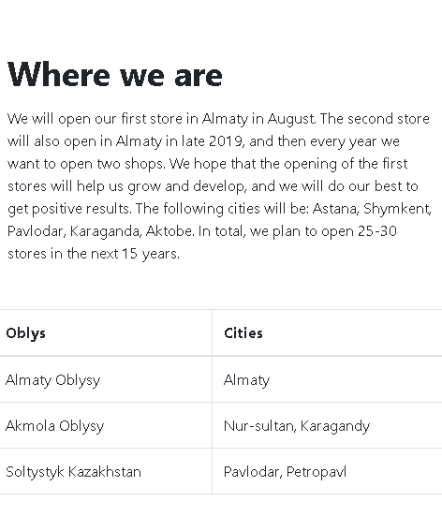
The button and the table when the width is changed

Slide 26
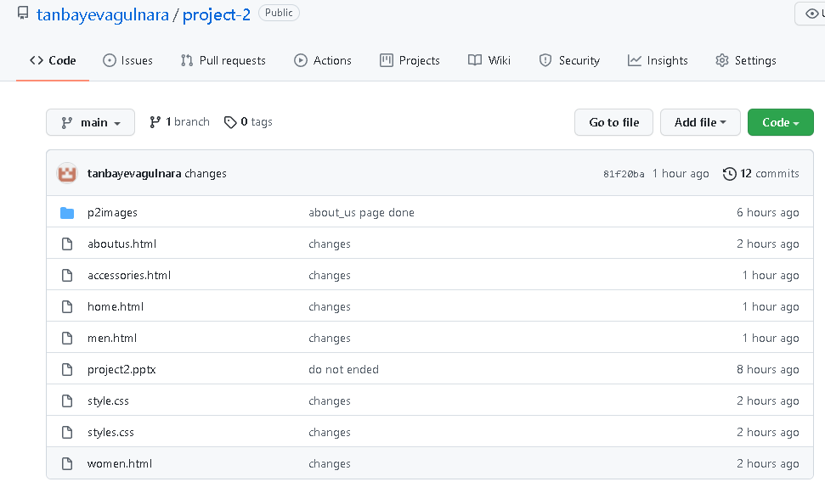
7)Push your work in github repository. Tanbayeva Gulnara’s repository link: https://github.com/tanbayevagulnara/project-2

Slide 27
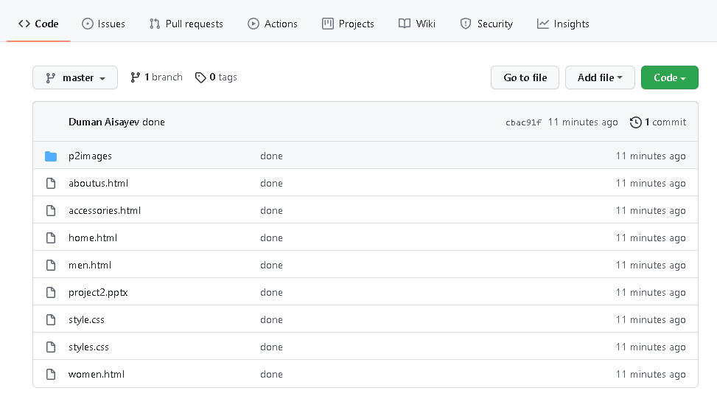
Duman Aisaev’s repository link: https://github.com/KiritoKunTi/full_project_2

