Slide 1
QAZAQ REPUBLIC
Theme: website about the brand that’s design based/linked with our country.
Style: advertisement website
Additional
information: pages with clothes and accessories and with information about the brand

Slide 2
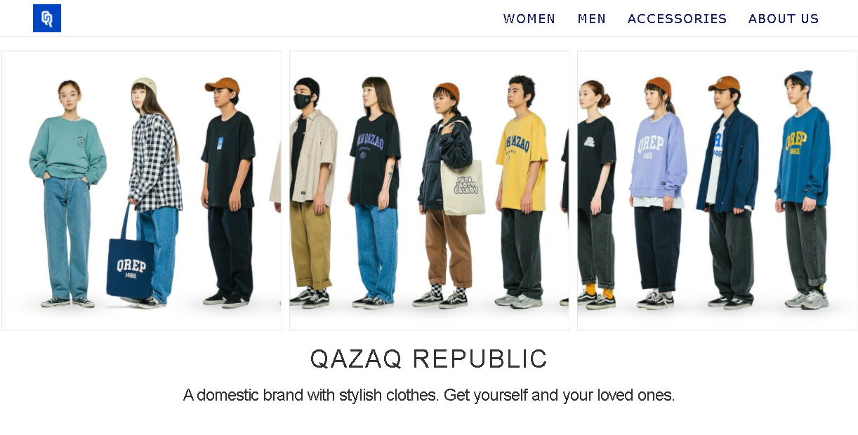

Slide 3
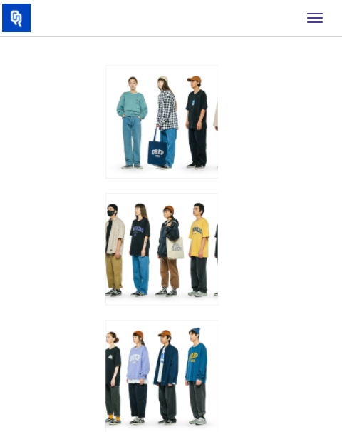
picture’s size changes with width. The links to other pages, with changing width

