Slide 1
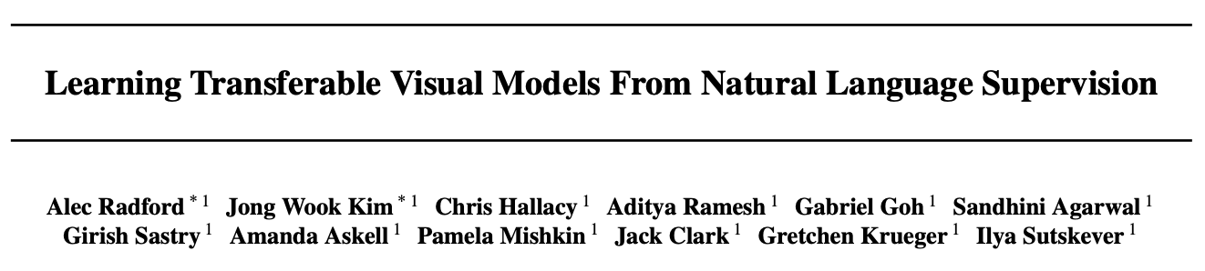
CLIP Embeddings Contrastive Language–Image Pre-training
Presented by:
John Tan Chong Min

Slide 2
Demo of CLIP Embeddings

Slide 3
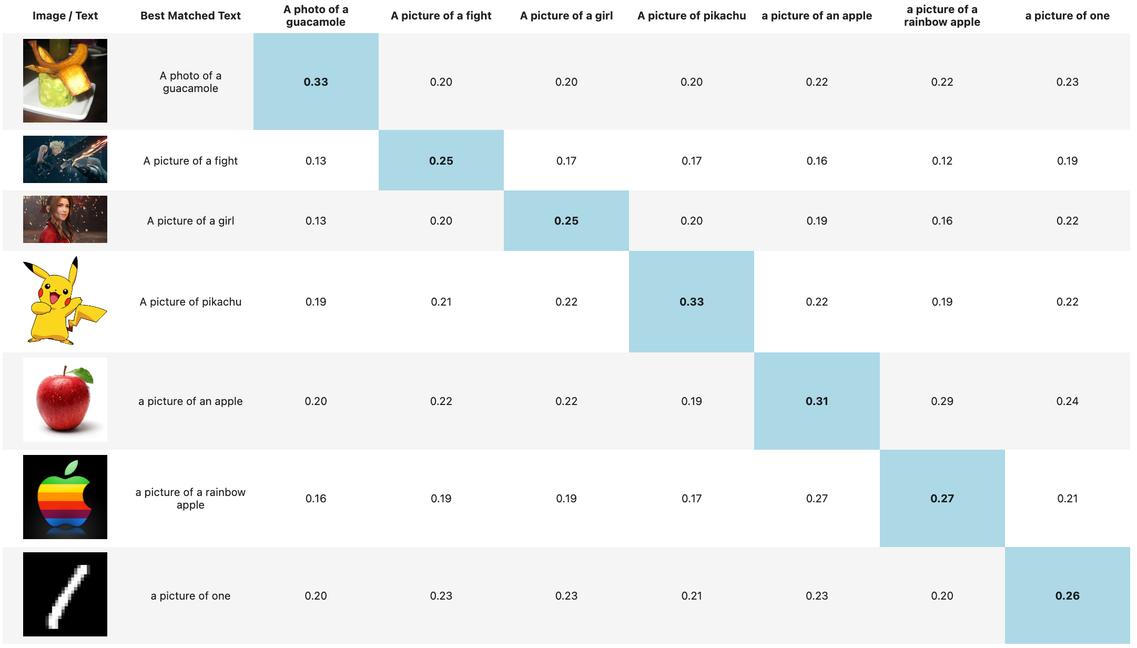
Pros: Broad Category of Image

Slide 4
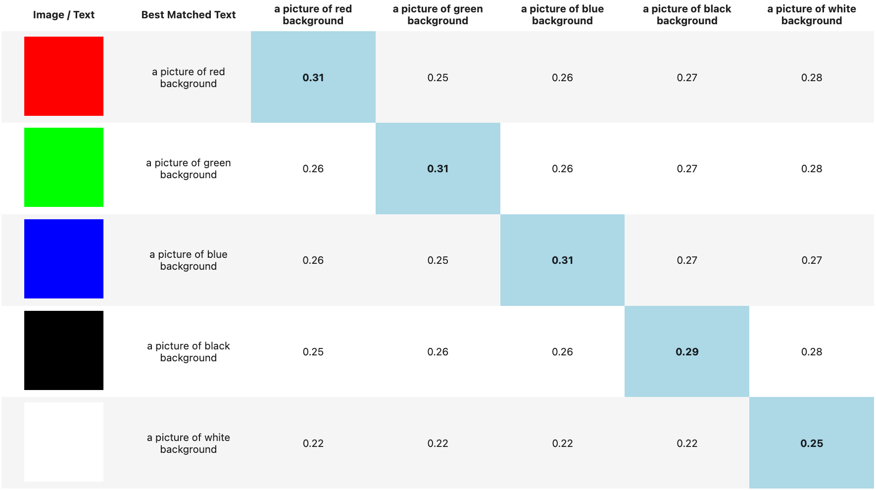
Pros: Color

Slide 5
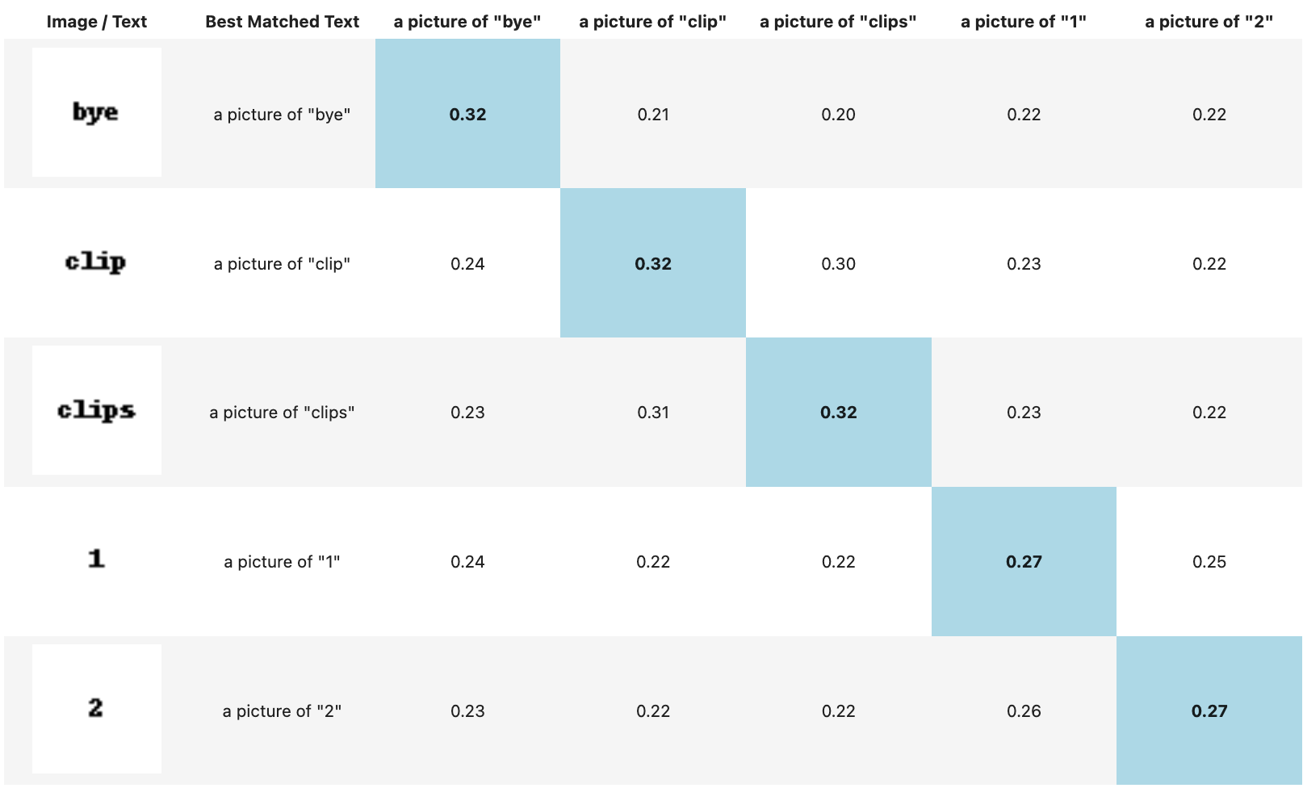
Pros: Text Detection

Slide 6
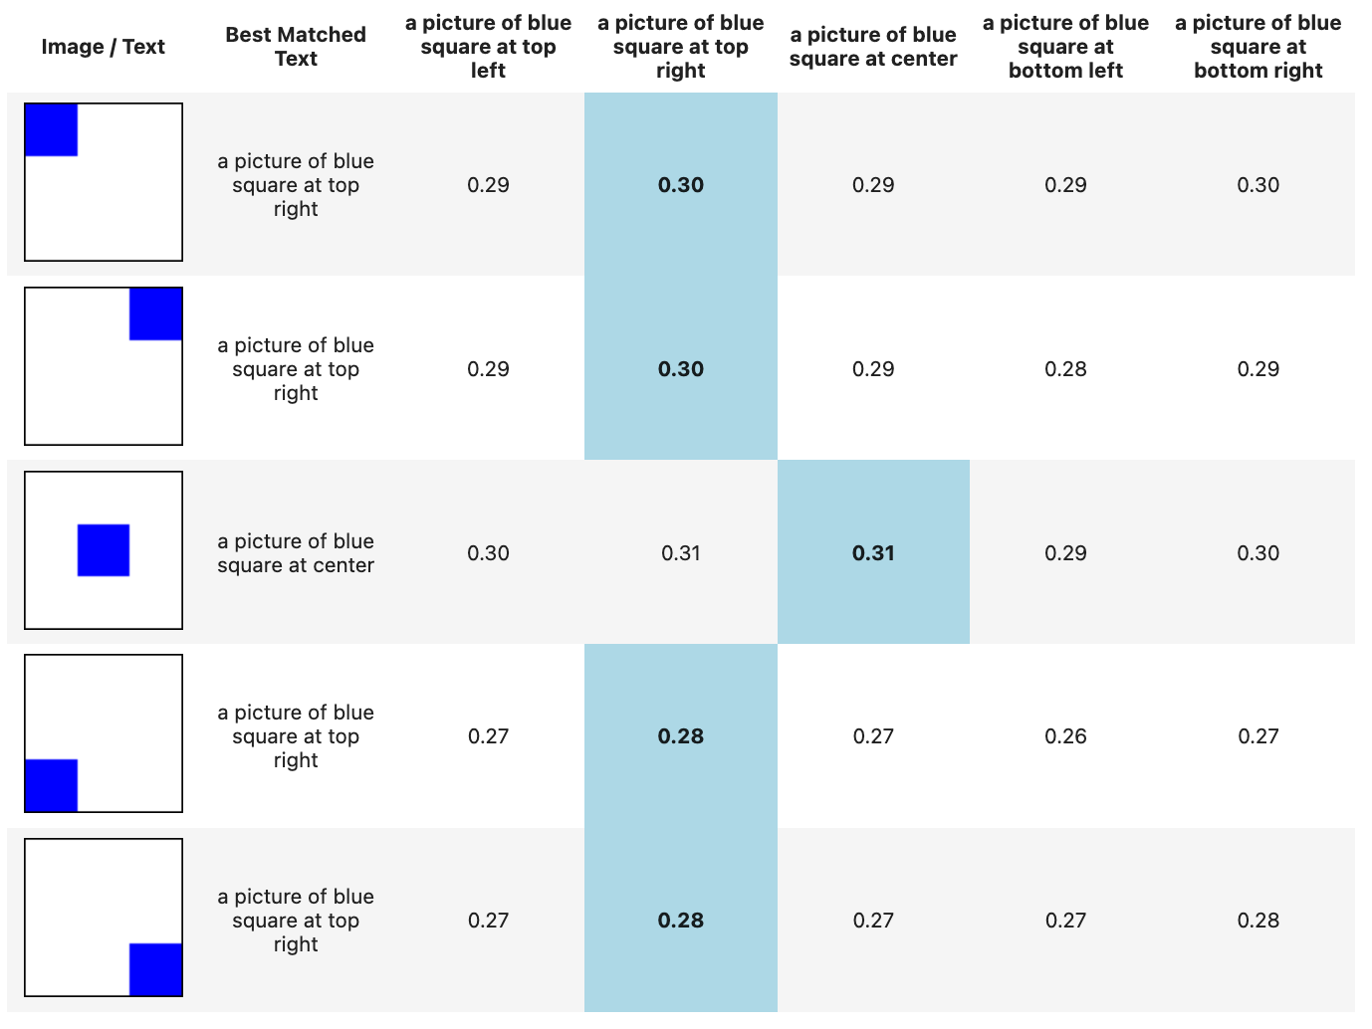
Cons: Position

Slide 7
Key takeaways
Large-scale web-scale learning is better than dataset-specific training
Text: LLM systems using unsupervised next-token prediction and can scale without labels
Multimodal: Text-image systems require Caption-Image pairs, but are easily obtainable with internet data

Slide 8
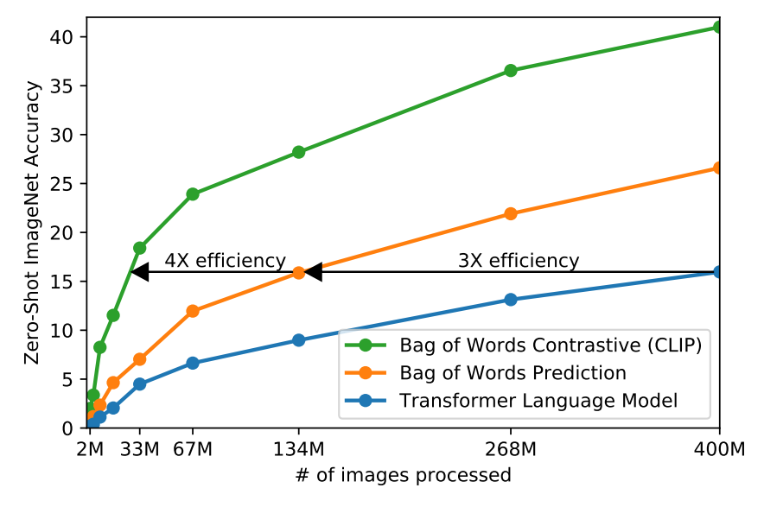
Key insight: Comparing in latent/abstraction space better than predicting in self-supervised manner for cross-domain mapping
Image domain is of high-dimensionality
Can be hard to predict image-based caption tokens exactly
Bag of words / Contrastive learning may help reduce demands on prediction by abstracting in latent space

Slide 9
Dataset
400 million text-image pairs
Text must contain one of 500,000 query words
Query words are those occurring at least 100 times in English version of Wikipedia
My Opinion: May mean cross-language support and rare domain-specific words may not be covered
Class-balance results by including up to 20000 (image, text) pairs per query
Able to perform wide set of tasks during pre-training including OCR, geo-localization, action recognition, classification

Slide 10
Final Architecture
Text Encoder: BoW / GPT-2
Image Encoder: ResNet / ViT
Embedding dimension: 512
**Impt: Max sequence length capped at 76 tokens
Training Time: The largest ResNet model, RN50x64, took 18 days to train on 592 V100 GPUs while the largest Vision Transformer took 12 days on 256 V100 GPUs

Slide 11
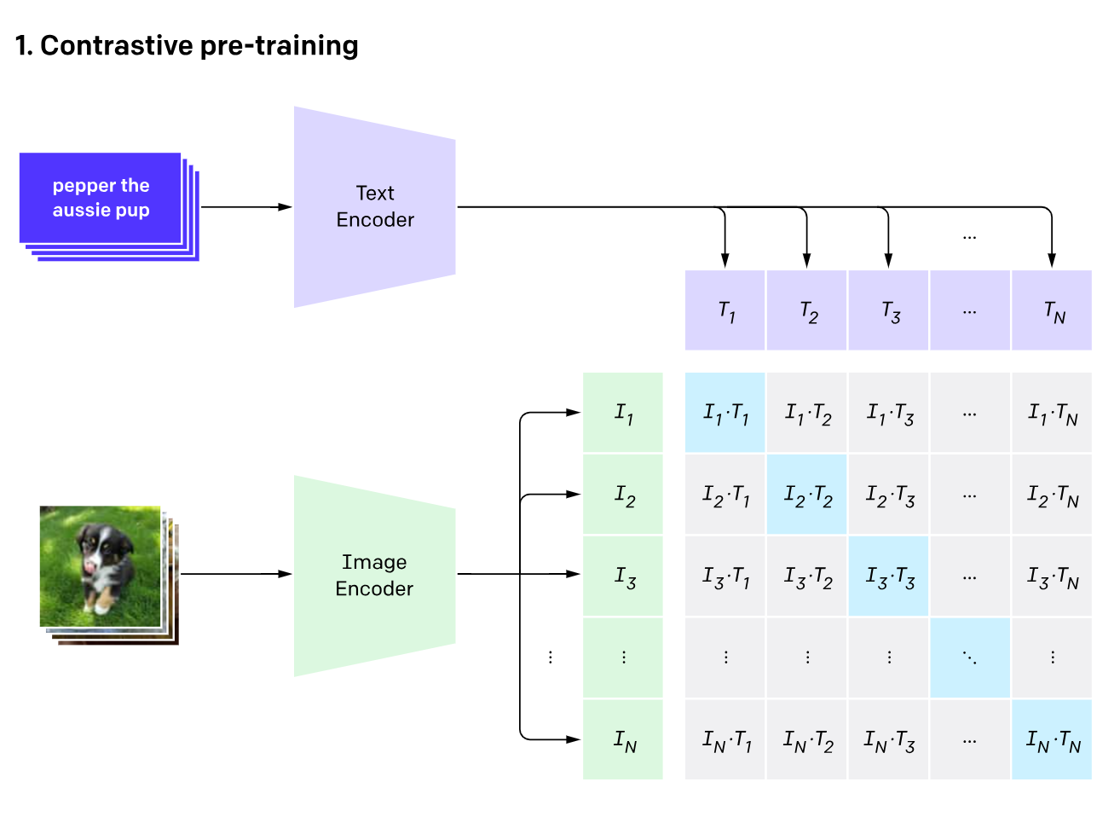
Use cosine similarity of embeddings as gauge of similarity
Predict only those image-text mappings given in N samples
Objective: Maximise cosine similarity of those in blue (true pairs), and minimize the rest
N text samples
N image samples

Slide 12
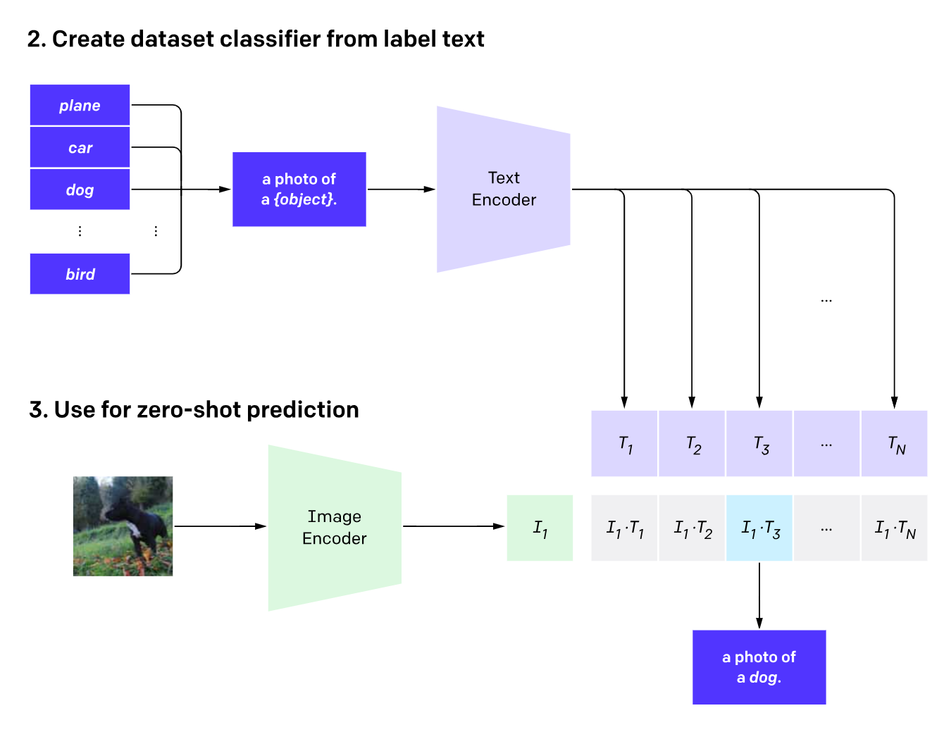
Classification by CLIP can be done by having a list of text embeddings corresponding to each class, and mapping it to image embeddings
Note: Prediction is done in latent/abstraction space
My thoughts: Coiuld performance be better with multiple abstraction spaces?

Slide 13
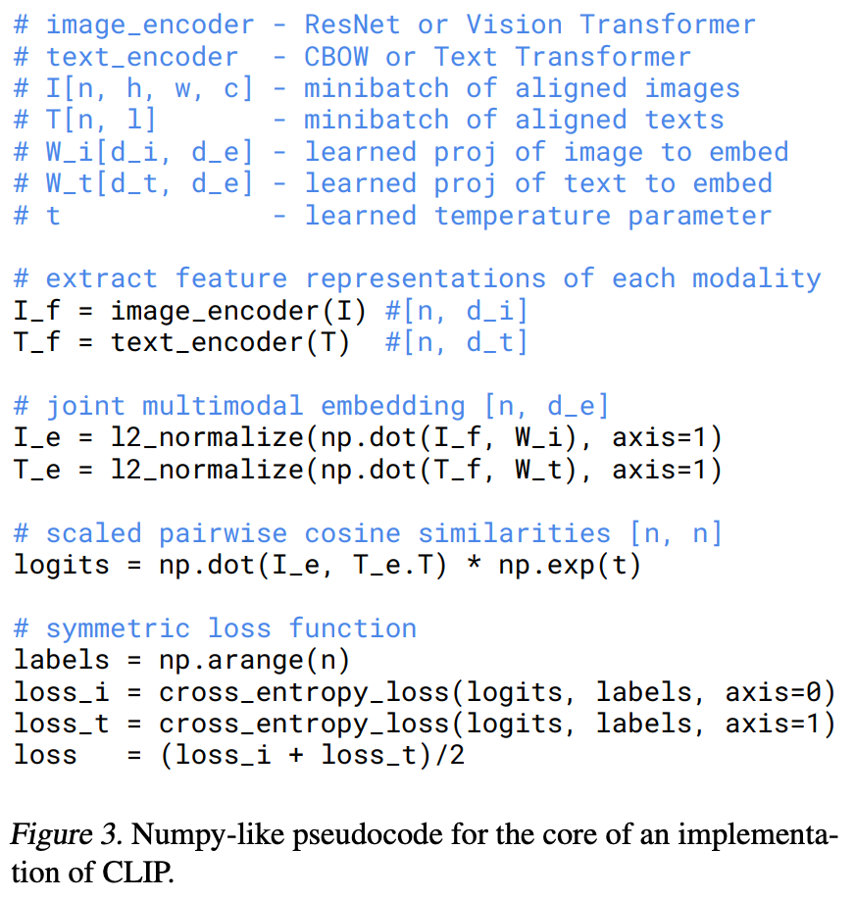
Details for the brave
Image and text encoder can be replaced with anything that takes in image/text respectively and outputs embeddings
Uses cross-entropy loss
For each image, ensure corresponding text is predicted highly
For each text, ensure corresponding image is predicted highly

Slide 14
CLIP
Train on many diverse datasets Effective across many tasks

Slide 15
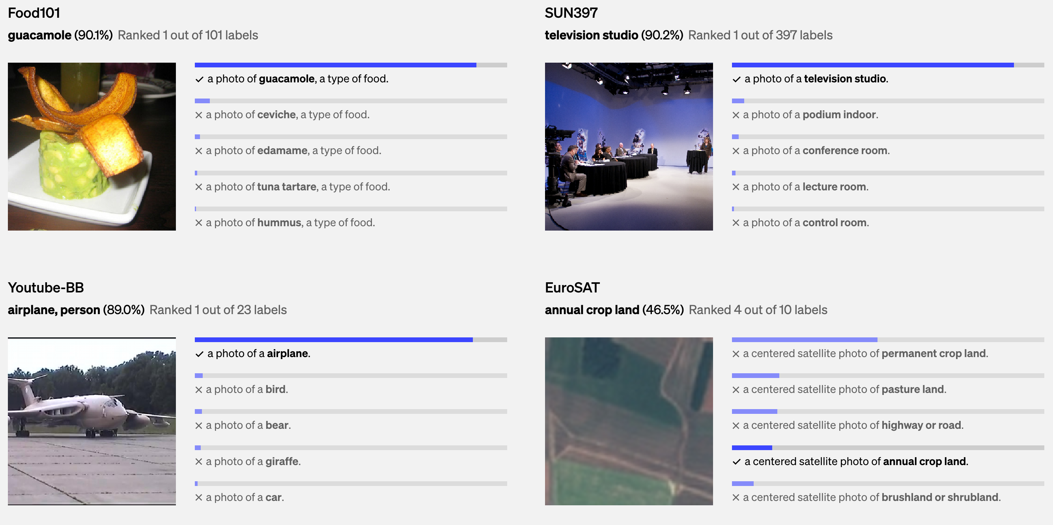
Good performance across 30 datasets

Slide 16
Issues of Text Captioning for Classification
Polysemy: Class Names may not have full context
E.g. ImageNet classes uses same word “Crane” for both construction cranes and cranes that fly.
What this means: If you are using it for classification, try to provide more context for the classes, e.g. specify location, context of the class
Single word classes not common in pre-training captions:
To help bridge this distribution gap, we found that using the prompt template “A photo of a {label}.” to be a good default
What this means: When you are using it for your tasks, try to match it to image captions in the wild

Slide 17
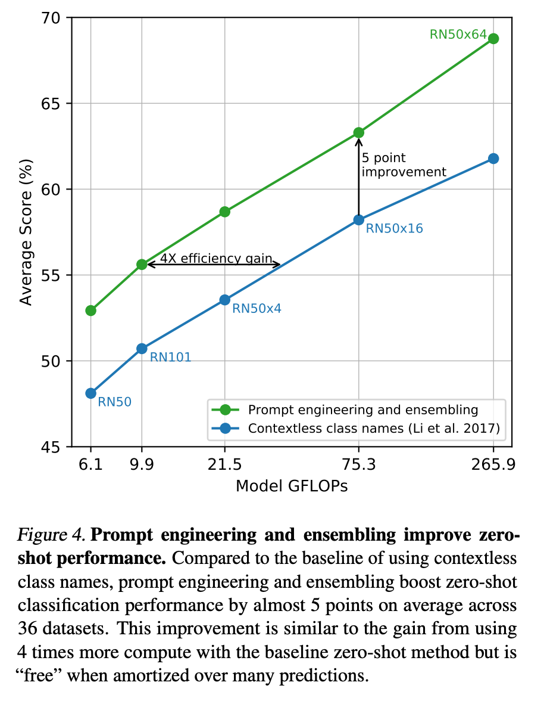
Using more diverse and context-dependent text captioning helps

Slide 18
Prompt-Engineering for Datasets
Specifying the type of dataset in text captions helps
Oxford-IIIT Pets: “A photo of a {label}, a type of pet.”
Food101: “A photo of a {label}, a type of food.”
FGVC Aircraft: “A photo of a {label}, a type of aircraft.”
OCR datasets: Put a quote around text or number to recognise
Satellite: “A satellite photo of a {label}”

Slide 19
Ensembling Text Embeddings
Average embedding over multiple similar prompts:
“A photo of a big {label}”
”A photo of a small {label}”
ImageNet ensembled over 80 context prompts
My thoughts: Don’t use text embeddings for specific image features – it probably is lost over ensembling

Slide 20
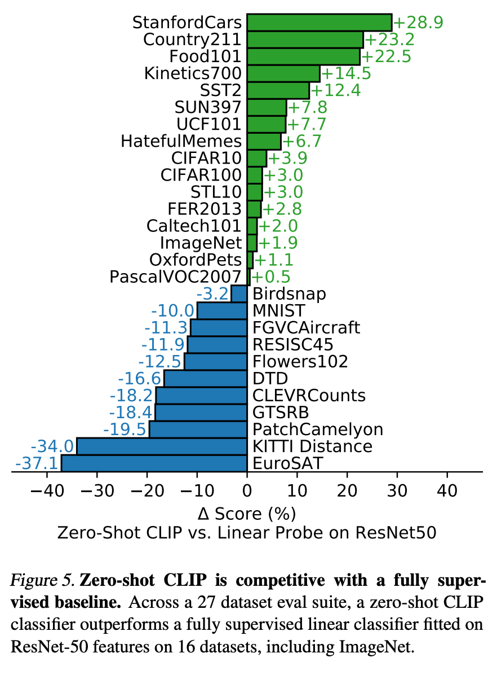
For natural image-type datasets without specialised knowledge, zero-shot CLIP is competitive
My thoughts: Web-scale data may be able to augment a limited training set
Using natural text meaning for class labels can help with transfer learning

Slide 21
For natural image-type datasets without specialised knowledge, zero-shot CLIP is competitive
CLIP is weak at specialised tasks:
Satellite image classification (EuroSAT and RESISC45)
Lymph node tumor detection (PatchCamelyon)
Counting objects in synthetic scenes (CLEVRCounts)
German traffic sign recognition (GTSRB)
Recognizing distance to the nearest car (KITTI Distance)
My thoughts: LLMs are not great for such tasks either – rule-based tasks or specialized tasks may perform better without interference from web-scale data

Slide 22
Food for thought: Multiple Abstraction Spaces?
Problem: Many potential objectives for similarity
Text prompts for objective 1
Text prompts for objective 2
Objective 1
e.g. background
Objective 2
e.g. objects
Choose the right objectives for your use cases

Slide 23
Questions to Ponder
What does it mean to be similar in image space?
Why would someone use image embeddings to find an image, as compared to using matching text embeddings to text abstracted from an image?
CLIP is trained with text and image encoder from scratch. Why not start the training with pre-trained text embeddings, and then try to base the image embeddings off these?
Will better text and image encoders help with better latent/abstraction spaces? What about dimension of latent/abstraction space?

