Slide 1
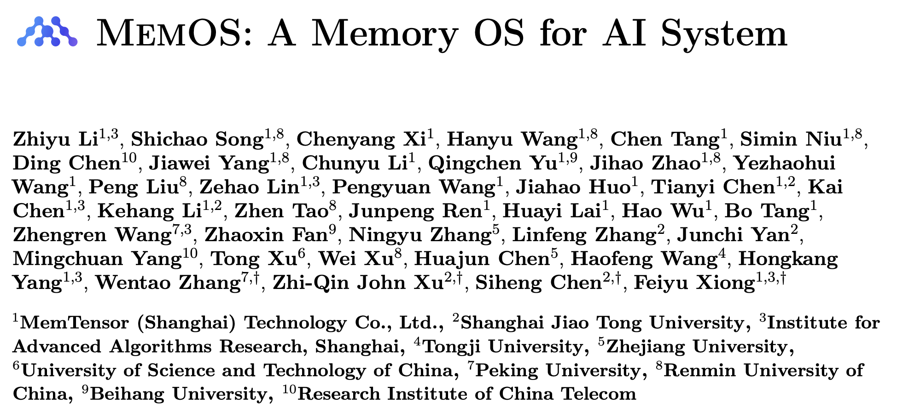
Presented by:
John Tan Chong Min

Slide 2

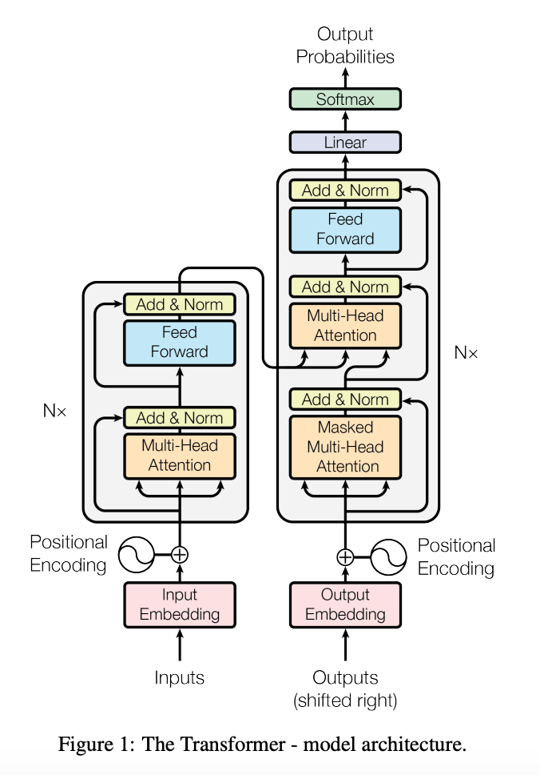
Conventional Memory in LLMs: Retrieval Augmented Generation
System Prompt
User Query
External Database
(for augmented context)
top k chunks
LLM
(Internal memory
as parameters)
Pre-training memory is in LLM model parameters
Inference time memory is in database
Response to User

Slide 3
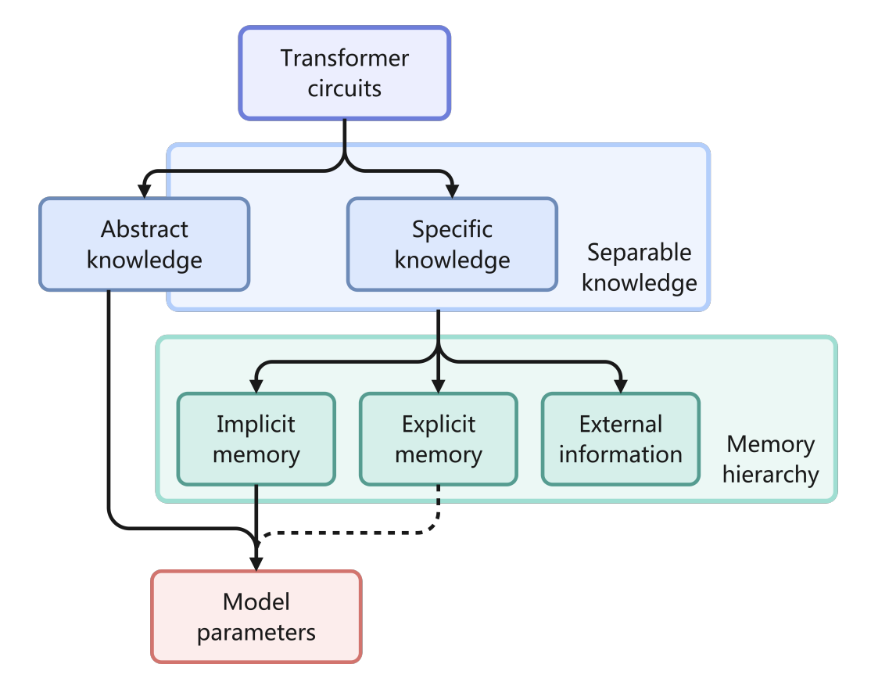
LLM Knowledge Structure
Most memory are already ”hard-coded” into parameters of LLM
Little or no learning of external memory information
Note: Explicit Memory is Activation Memory in MemOS
Memory³ : Language modeling with explicit memory. Yang et al. 2024.

Slide 4
Explicit Memory and how humans learn
Plain LLMs to patients with impaired explicit memory, e.g. due to injury to the medial temporal lobe. These patients are largely unable to learn semantic knowledge (usually stored as explicit memory), but can acquire sensorimotor skills through repetitive priming (stored as implicit memories)
Thus, one may hypothesize that due to the lack of explicit memory, the training of plain LLMs is as inefficient as repetitive priming, and thus has ample room for improvement.
Memory³ : Language modeling with explicit memory. Yang et al. 2024.

Slide 5
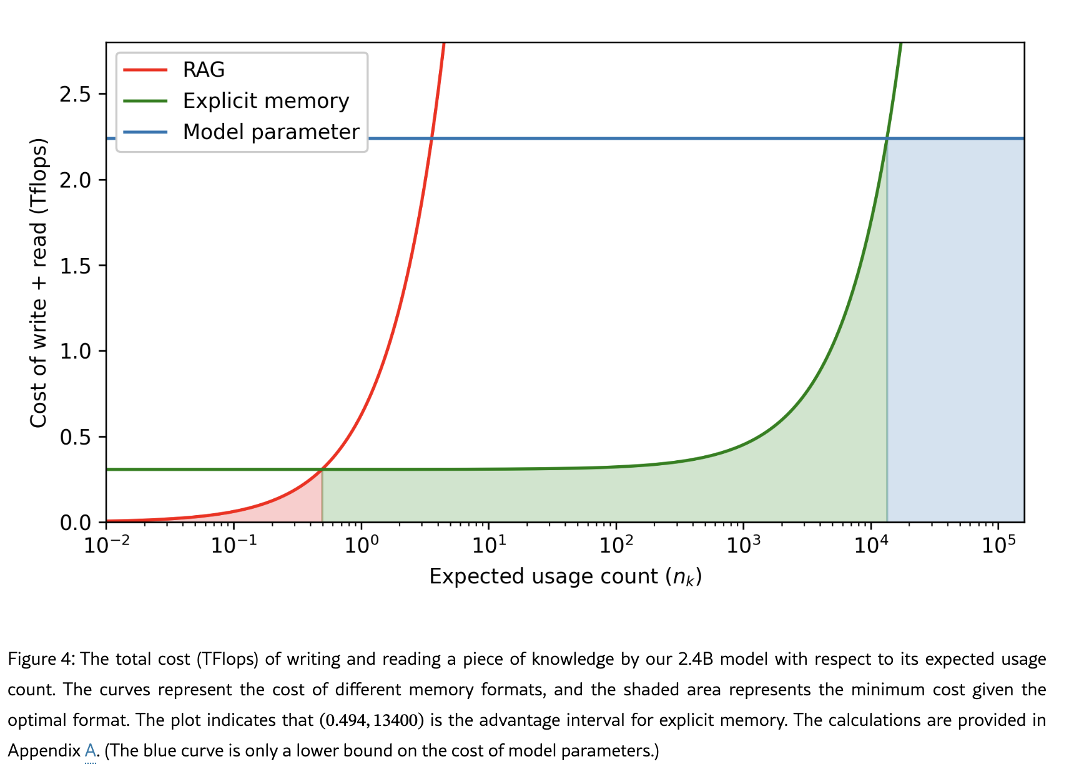
Explicit Memory and how humans learn
Here, explicit memory is stored as a KV cache generated from each reference prior to inference, but made sparse
This means there is no need to recompute the KV representation from the base tokens of the reference again
Memory encoded across all layers of transformer
Memory³ : Language modeling with explicit memory. Yang et al. 2024.

Slide 6
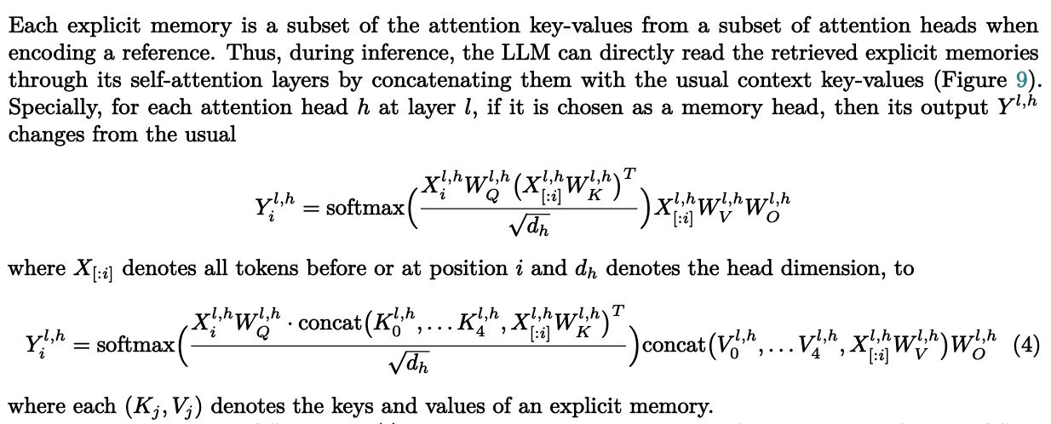
Explicit Memory Math
Memory³ : Language modeling with explicit memory. Yang et al. 2024.

Slide 7
Why memory as an OS?
Existing memory is static
Static parameters in the neural network
Static external memory chunks
Memory needs to be updated dynamically for fast adaptation
Retain, Compress, Discard, Prioritise what is needed
Memory to be stored and created within the model processing pipeline rather than an external one

Slide 8
Overview of MemOS
MemOS: a memory operating system that treats memory as a manageable system resource
Unifies the representation, scheduling, and evolution of plaintext, activation-based, and parameter-level memories, enabling cost-efficient storage and retrieval
Basic unit, MemCube, encapsulates both memory content and metadata such as provenance and versioning
Can be composed, migrated, and fused over time, enabling flexible transitions between memory types and bridging retrieval with parameter-based learning

Slide 9
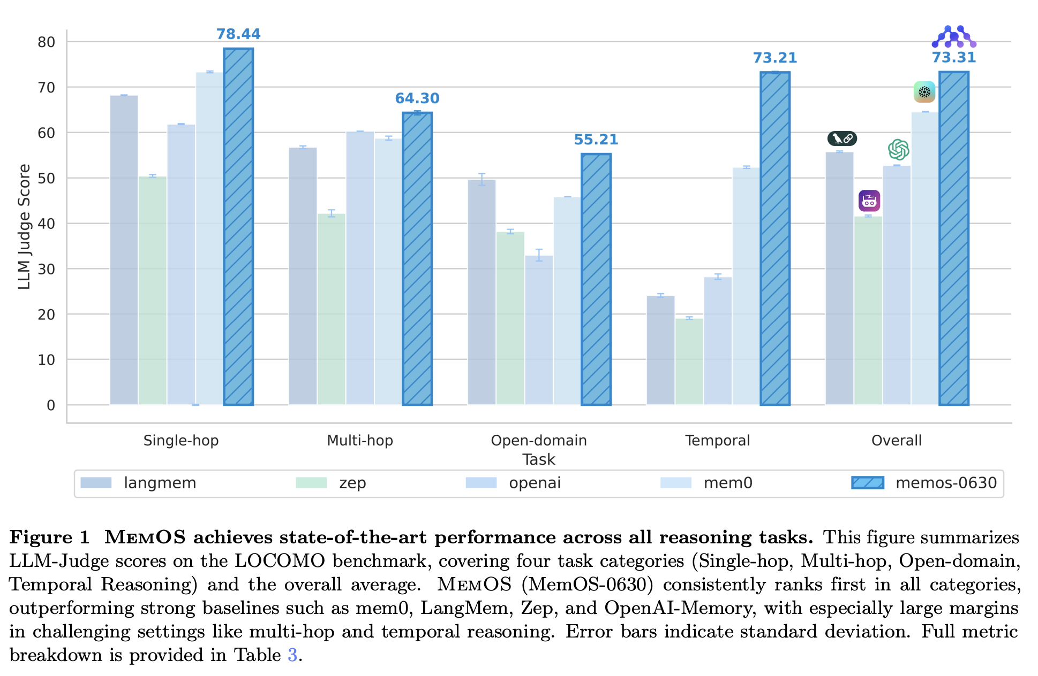
Good benchmark results on LOCOMO
LoCoMo, a dataset of very long-term conversations, each encompassing 300 turns and 9K tokens on avg., over up to 35 sessions

Slide 10
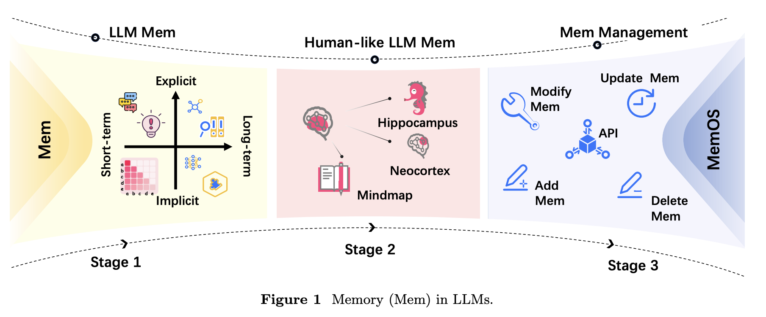
Memory Development: From static to dynamic

Slide 11
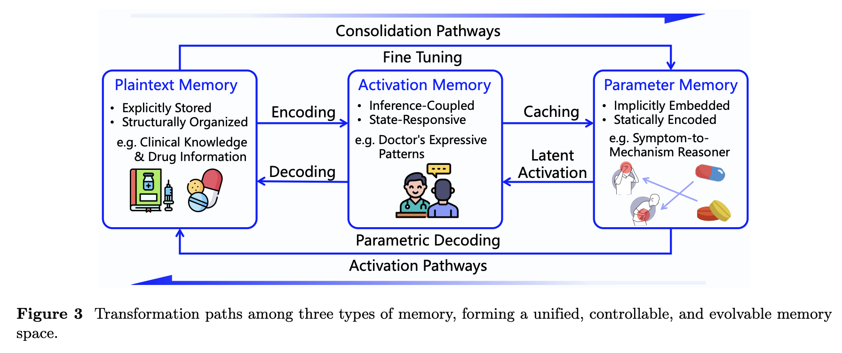
Memory consolidation along abstraction spaces
KV cache
Text, Images, etc.
Weights and biases

Slide 12
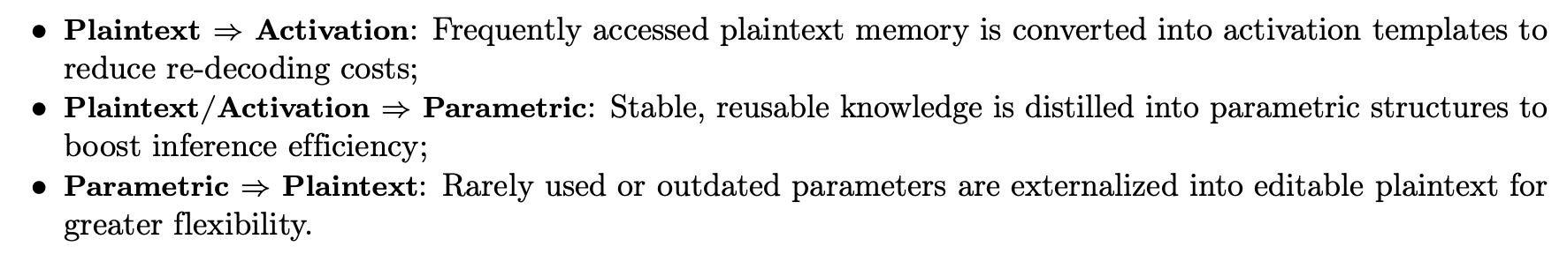
Conversion between abstraction spaces

Slide 13
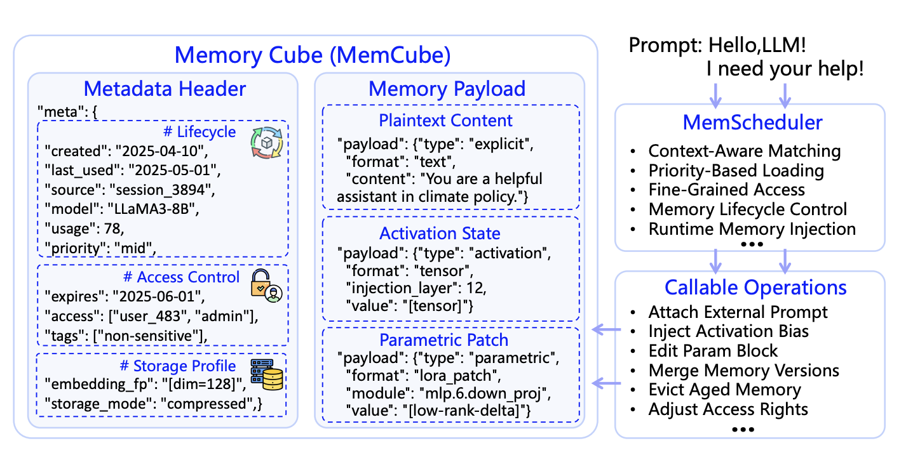
MemCube – Unified Abstraction for Heterogeneous Memory

Slide 14
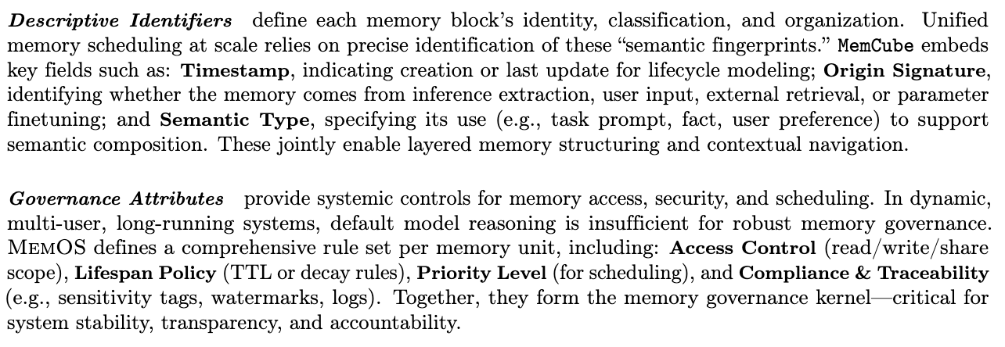
MemCube Contents

Slide 15
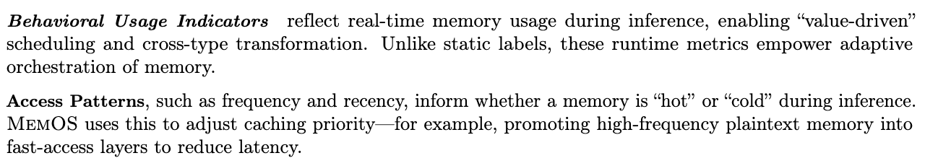
MemCube Contents

Slide 16
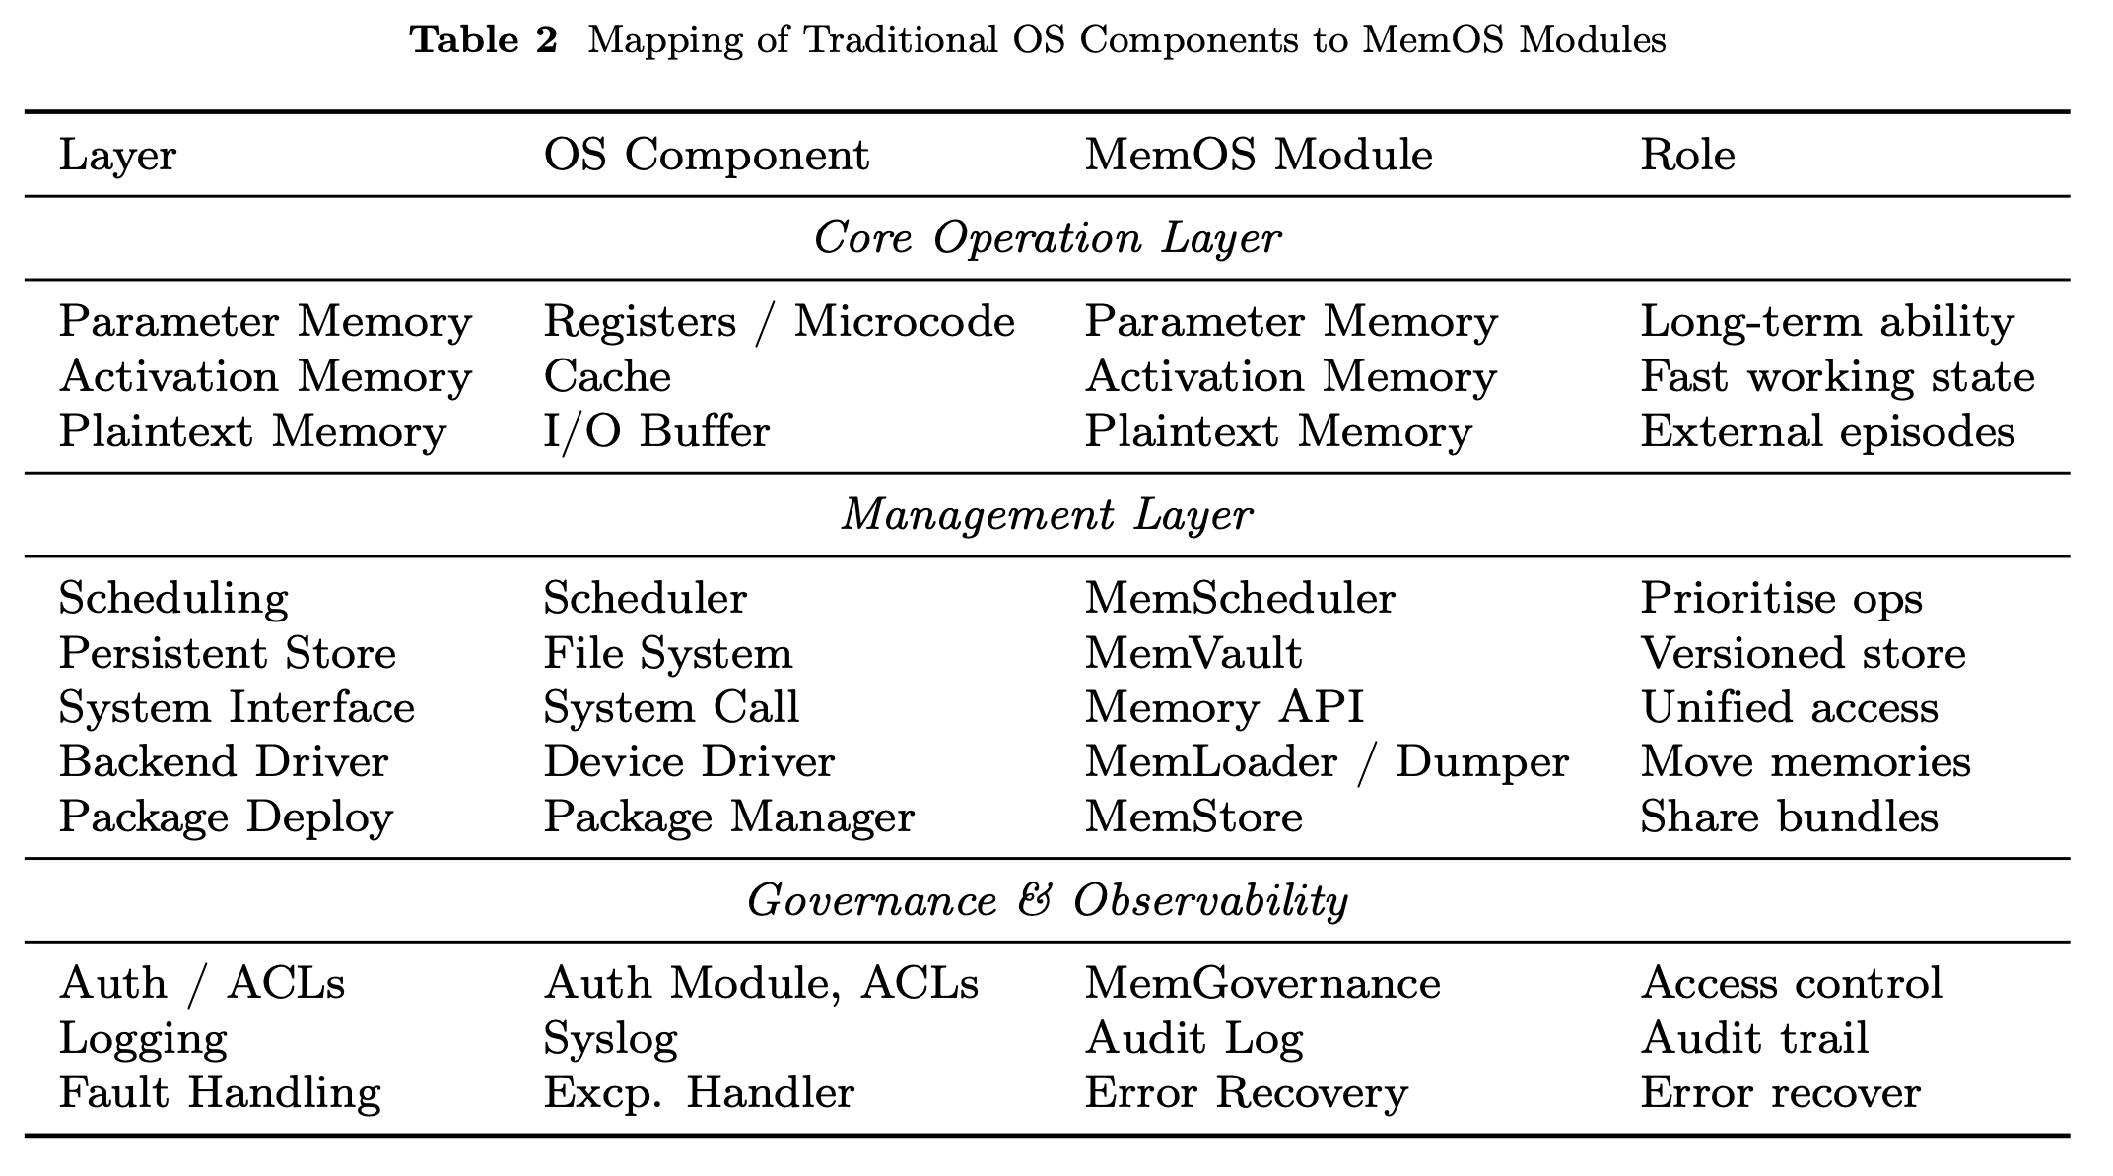
Various Processing Components across Memory Layers

Slide 17
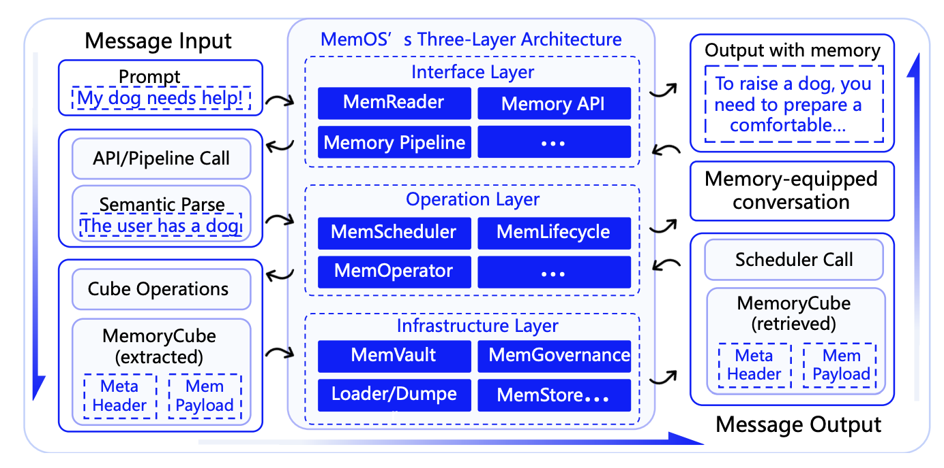
3-layer architecture and memory I/O path for MemOS
Different Memory Layers have different operations available for memory manipulation

Slide 18
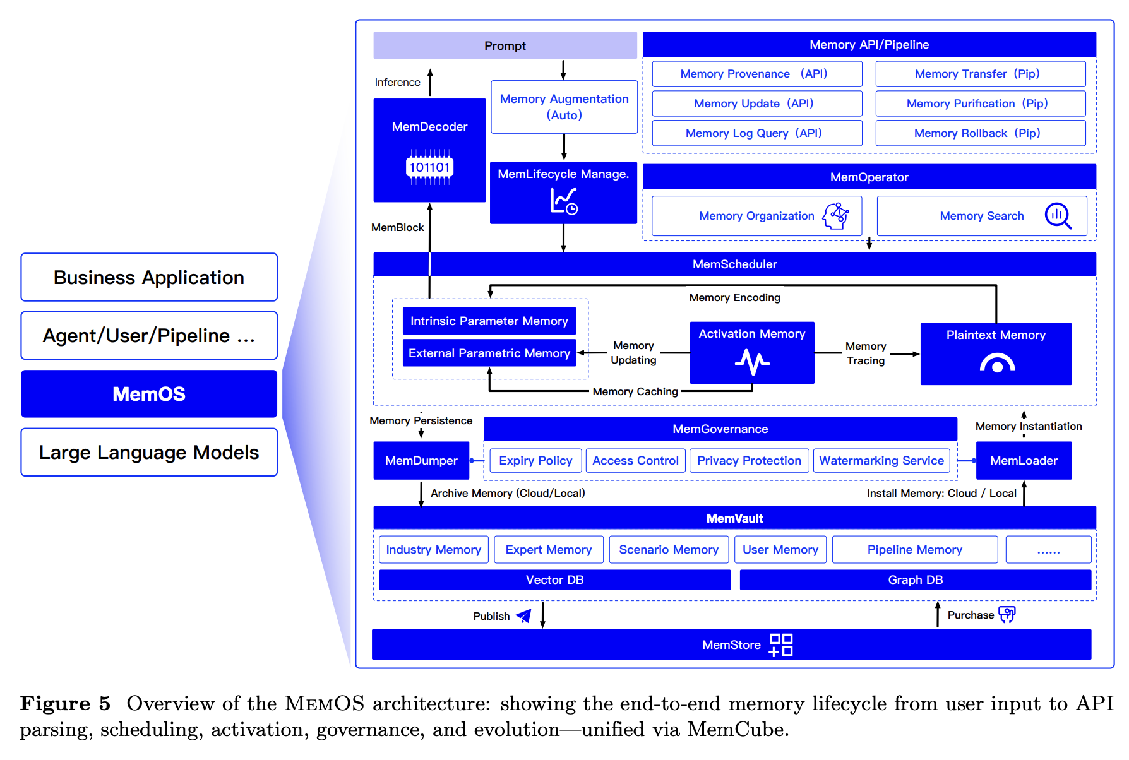
Memory Lifecycle

Slide 19
Future Plans
Cross-LLM Memory Sharing: Enable interoperability and module reuse across different foundation models by sharing parametric and activation memories. Standard formats and protocols will be needed.
Self-Evolving MemBlocks: Develop memory units capable of self-optimization, reconstruction, and evolution based on usage feedback, reducing the need for manual maintenance and supervision.
Scalable Memory Marketplace: Establish decentralized mechanisms for memory exchange, supporting asset-level transactions, collaborative updates, and distributed evolution to foster a sustainable AI ecosystem.

Slide 20
My thoughts: Curse of Memory
Using prior memory can cause agents to keep selecting previous actions, which may not be ideal if the environment has changed
There should be a way to break out of a negative cycle via future simulation or expert knowledge from others
Blindly relying on memory alone to make decisions may not be ideal

Slide 21
Question to Ponder
Can we do the same as what MemOS is proposing using memory tools given to an agent to selectively forget, compress, and store important memory?
Could a unifying OS framework for memory be too bloated for most basic use cases? Would a task-specific memory be better and more efficient?
How can we implement MemOS with any LLM, including closed-sourced LLMs?
How can memory be shared across agents/models with different pre-training parameters?

Slide 22
Test Table
Example Content | Example Value
Good day | Good night

Slide 23
How it fits with Universal Filter

Slide 24
Increasing knowledge via Query with Filter
Experienced Events
(through individual
filters)
Knowledge / Memory
Reflection
+ Consolidation
Expanded filters
https://www.youtube.com/watch?v=dW3Ic6QbkjA

Slide 25
Universal Filter
MemOS can be the database in which the query is sent to return an answer
The reflection/consolidation portion of Universal Filter can be stored inside MemOS architecture

