Slide 1
JavaScript Lesson 4
The basics of automation

Slide 2
What is automation?
Repeating a process automatically
Until a certain condition is me
(An automated process cannot go on forever!)

Slide 3
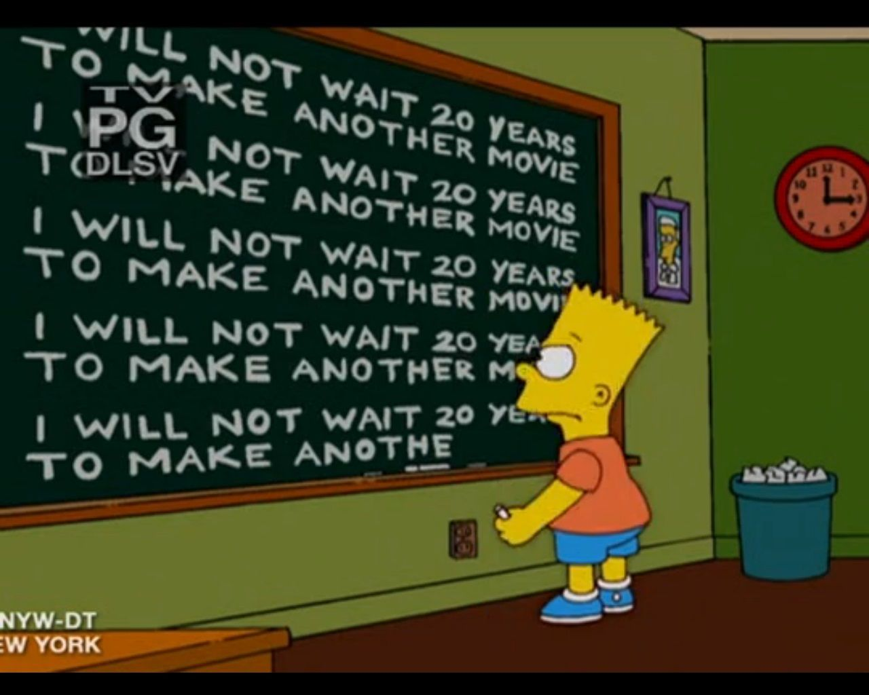
Imagine that you have to print out one hundred lines in JavaScript. "I will not wait 20 years to make another movie".
Is there a better way than just manually typing it out?

Slide 4
While Loops

Slide 5
Using While to Automate
While is also one of the flow control statements
It changes the sequence of program execution
while (condition is true) {
do something;
}

Slide 6
Real Life Example
While there is still pages to be printed, print the next page
While there is still food on the table, eat the next spoonful
While there is still work to do, do the next piece of work
While it is raining, hold up the umbrella

Slide 7
WHILE Loop to print 0 to 9
Initialise the sentinel variable
Loop sentinel
let x = 0;
while (x < 10) {
console.log(x);
x = x + 1;
}
What to repeat
Change the sentinel variable so that the loop will eventually end

Slide 8
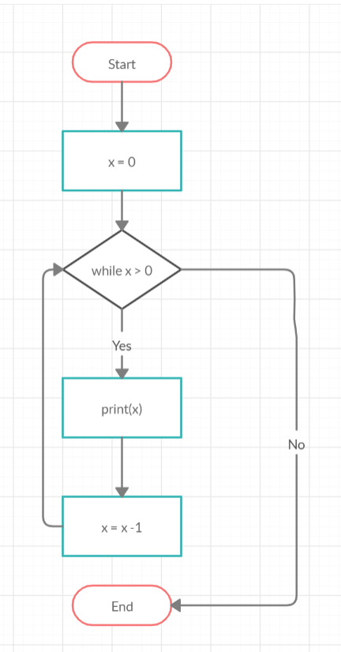
Visualizing the While Loop
let x = 0;
while (x < 10) {
console.log(x);
x = x + 1;
}
let x = 10;
while x < 0
console.log(x);

Slide 9
The Sentinel
The sentinel variable and the sentinel condition controls whether the loop runs for one more round (aka, iteration)

Slide 10
Hands On 1
How to write a loop that starts by printing 5 and all the way to 10, like below?
5 6 7 8 9 10

Slide 11
Answer
Or (x <= 10)
let x = 5;
while (x < 11) {
console.log(x);
x = x + 1;
}

Slide 12
Non-deterministic sentinel condition 1
Look at the while loop below. Just by looking the code, do we know how many iterations (i.e, rounds) the loop will run?
let x = 3;
while (x < 9) {
console.log(x);
x = x + 1;
}

Slide 13
Non-deterministic sentinel condition 2
Look at the loop below. Can we determine how many iterations the loop will run?
Always examine the sentinel condition to determine what the loop does!
let x = parseInt(prompt("Enter a number: "));
while (x < 0) {
x = prompt("Enter a number");
console.log("You have not entered a positive number");
}

Slide 14
Hands On
Ask the user to enter a 3 digit numbers. Keep asking the user if he/she doesn't enter a three digit number.
Hint: If I say someone's salary is 4 figure (or 4 digits long), what is the possible range of the person's salary?

Slide 15
Solving Complex Equations
There is a way to simulate using what is known as the monte-carlo simulation.
For instance, to calculate compound interest, we can simulate how much additional interest is incurred each month.
let loan = 20000;
let monthlyInterestRate = 0.001;
let numberOfMonthsLeft = 12;
while (numberOfMonthsLeft > 0) {
interest = monthlyInterestRate * loan;
loan = loan + interest;
numberOfMonthsLeft = numberOfMonthsLeft – 1;
}
console.log("Total owed=",loan);
If there months left to calculate
Manually add the interest (simulate the bank charging interest)
Indicate one month less to pay for

Slide 16
Hands-On 3:
Taxi fares are calculated as such:
The first 10km is charged at $3.50 per 500m
After the first 10km, the charge is $3.50 per 400m
Using a while loop, calculate how far a person can travel with $35.00

Slide 17
For Loops

Slide 18
What's the FOR loop for?
It is a simplified version of the while loop.
Used when you just need the
sentinel variable to be a range of numbers OR
Some code to repeated a fixed number of time

Slide 19
WHILE loop vs. FOR loop
let x = 0;
while (x < 10) {
console.log(x);
x = x + 1;
}
for (let x=0; x < 10; x++){
console.log(x);
}
Those two will have the same output!!

Slide 20
The FOR loop examined
for (let x=0; x < 10; x++){
console.log(x);
}
Value that the sentinel variable will end before. (In this case, it's 9)
Sets a variable before the loop starts
Increases a value (i++) each time the code block in the loop has been executed.

Slide 21
Example
The following for loop will show only 5, 7, 9 11 and 13. (Remember, the sentinel variable will never reach the max value):
for (x = 5; x < 15; x+=2) {
console.log(x);
}

Slide 22
Hands On
Write a for loop that displays the following:
10 8 6 4 2

Slide 23
Loop Control

Slide 24
Loop Control
Those loop control statements can be used in both WHILE and FOR loops:
break - exit out of the loop completely
continue - skip the rest of the loop, and start a new iteration
Those are usually use together with a IF statement.

Slide 25
BREAK
This will just break out of the loop. We can rewrite the while loop that keep asking the user to key in a positive number till they enter one like this:
VERSION 1
VERSION 2 (USING BREAK)
let x = parseInt(prompt("Enter a number: "));
while (x < 0) {
x = prompt("Enter a number");
console.log("You have entered a positive number");
}
let x = parseInt(prompt("Enter a number: "));
while (true) {
x = prompt("Enter a number");
if (x > 0) {
break;
}
}
console.log("You have entered a positive number");

Slide 26
CONTINUE
The continue statement will skip the rest of the loop and start a new iteration. (For a WHILE loop, the sentinel condition will be checked again). The following code asks the user to key in two positive numbers:
let x = 0;
let y = 0;
while (x <= 0 || y <= 0) {
x = prompt("Enter the first number: ");
if (x < 0) {
continue;
}
y = prompt("Enter the second number: ");
}
console.log("You have entered two positive numbers");
If x is lesser than 0, don't bother asking for the second number

Slide 27
Nested Loops

Slide 28

Loops within Loops
We can have a loop within a loop.

Slide 29
Nested While Loop
OUTPUT
let i = 0; while (i < 3) {
i = i+1; let j = 0; while (j < 3) { console.log ("Count ", i, j);
j = j + 1;
}
}
Count 1 0
Count 1 1
Count 1 2
Count 2 0
Count 2 1
Count 2 2
Count 3 0
Count 3 1
Count 3 2

Slide 30
Seeing the two separate loops
let i = 0; while (i < 3) {
i = i+1; let j = 0; while (j < 3) { console.log ("Count ", i, j);
j = j + 1;
}
}
Outer loop ( the "i" loop)
Inner loop (the "j" loop)

Slide 31
Hands-On
Rewrite the following using a for loop
let i = 0; while (i < 3) {
i = i+1; let j = 0; while (j < 3) { console.log ("Count ", i, j);
j = j + 1;
}
}

Slide 32
Hands-On
Rewrite the following using a for loop
let i = 0; while (i < 3) {
i = i+1; let j = 0; while (j < 3) { console.log ("Count ", i, j);
j = j + 1;
}
}
ANSWER:
for (let i=1; i<=3; i++) {
for (let j=0;j<3; j++) {
console.log ("Count ", i, j);
}
}

Slide 33
Putting it all together

Slide 34
The 7 Basic Processes of Programming
Assign to variables, variables manipulation
Input, getting users to provide the data for a variable
Operator, process and updating variables
Branching, with if, if-else
Looping, with while or for
Output, with console.log or other means (which we'll learn)
Functions, to group statements that do #1 to #5 together in a reusable unit.

Slide 35
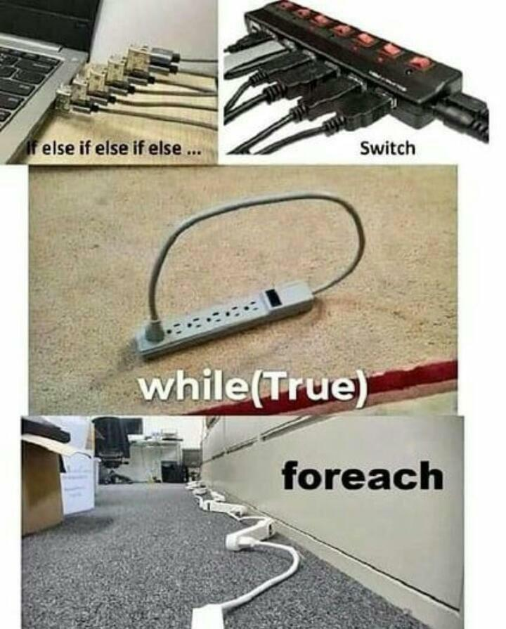

Slide 36
Hands On
Write a GST calculator, which asks the user for the total bill and the GST percentage and returns the net bill inclusive of GST. The following rules must be followed:
The total bill must be greater than 0
The GST percentage must be between 0.0 to 1.0
If the user enters an invalid gst percentage or bill, keep asking till a valid value is given.

Slide 37
Hands On
Write a BMI calculator that asks the user for his height in metres and weight in KG, and then return the BMI. Follow the rules below:
Weight must greater than 0 and below 300
Height must be greater than 0 and lesser than 3.0
If the user enters an invalid weight or height, keep asking till a valid value is given.

Slide 38
Hands On
Write a function getNumberWithinRange() that asks the user for a float, and ensure that it is greater than 0 and lesser than 100.
Change the function such that it can take in two arguments -- upper and lower, which defines the upper and lower limit of the number that the user can enter (eg, if upper is 30 and lower is 10, then the user can enter numbers from 10 to 30).
Change the previous two hands-on to use the getNumberWithinRange() function

