Slide 1

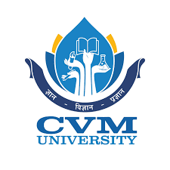
A.D. Patel Institute of technology Department of information technology 102040404(seminar) Title: web minning
Prepare by: parth tandel(12002080601078)

Slide 2
Web minning
Web mining is the application of data mining techniques to discover patterns from the World Wide Web.
It uses automated methods to extract both structured and unstructured data from web pages, server logs and link structures.
There are three main sub-categories of web mining.
Web content mining
Web structure mining
Web usage mining

Slide 3
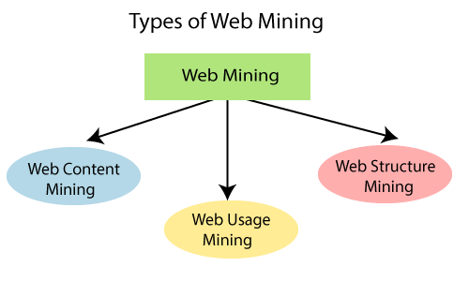

Slide 4
Web content mining
Web content mining is the mining, extraction and integration of useful data, information and knowledge from Web page content.
Web content consist of several types of data – text, image, audio, video etc.
Content data is the group of facts that a web page is designed. It can provide effective and interesting patterns about user needs.
Text documents are related to text mining, machine learning and natural language processing. This mining is also known as text mining.
This type of mining performs scanning and mining of the text, images and groups of web pages according to the content of the input.

Slide 5
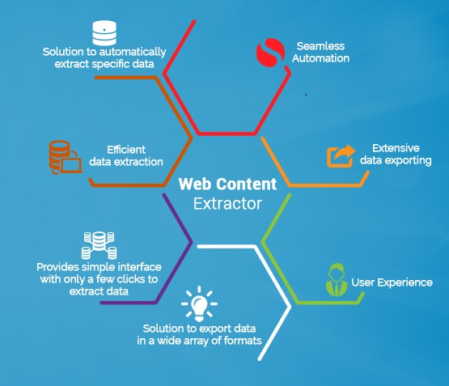

Slide 6
Web structure mining
Web structure mining is the application of discovering structure information from the web.
The structure of the web graph consists of web pages as nodes, and hyperlinks as edges connecting related pages.
Structure mining basically shows the structured summary of a particular website.
It identifies relationship between web pages linked by information or direct link connection. To determine the connection between two commercial websites, Web structure mining can be very useful.

Slide 7
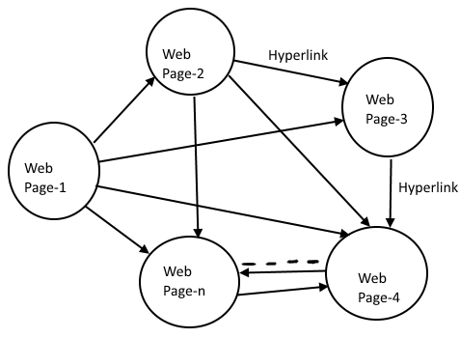

Slide 8
Web usage mining
Web usage mining is the application of identifying or discovering interesting usage patterns from large data sets.
And these patterns enable you to understand the user behaviors or something like that.
And these patterns enable you to understand the user behaviors or something like that.

Slide 9
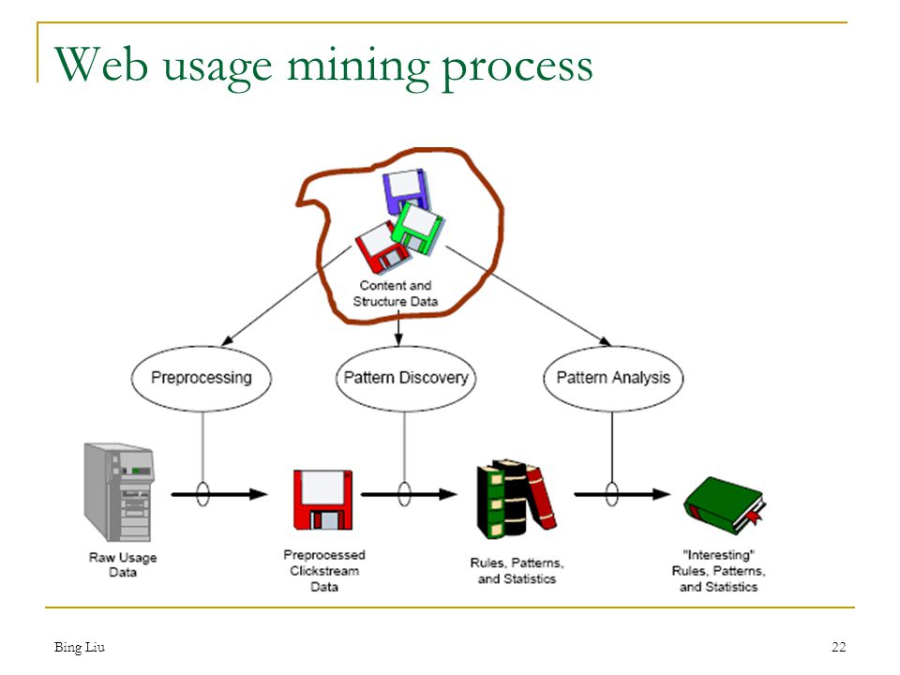

Slide 10
Thank you

