Slide 1
DRONE SWARM DELIVERY SYSTEM
A DSA-Based Mini Project
Presented by:
Swayam Tandel - 70022500659
Palak Sharama- 70022500120
Vansh Mandhan – 70022500545
Subject: Data Structures & Algorithms
Course: B.Tech Computer Engineering

Slide 2
Why Did We Choose This Project?
The Idea Behind Our Project
Delivering items inside a campus looks simple, but a drone delivery system must internally decide:
Which task should be served first (emergency or normal)?
Which drone is best suited for a task?
Does the drone have enough battery for the whole trip?
What is the shortest route between two campus locations?
How do we keep a record of completed deliveries?

Slide 3
Problem Statement
A campus drone delivery system should allow users to:
1. View all drones with battery, status and location
2. Add a delivery task with a priority level
3. View pending tasks
4. Assign the most suitable drone to a task
5. Find the shortest route between two locations
6. Maintain a history of completed deliveries
The DSA Challenge
How can we efficiently schedule tasks by priority, choose a drone and find the shortest path using appropriate data structures and algorithms?

Slide 4
Objectives of Our Project
To create a simple menu-driven drone delivery system
To apply Arrays, Structures, Queues, Linked Lists and Graphs
To serve tasks by priority: Emergency > High > Normal
To use circular queues for FIFO handling inside each priority
To find the shortest route using Dijkstra’s algorithm
To choose the nearest drone that has enough battery
To store completed deliveries in a linked list
To understand the practical application of DSA

Slide 5
Data Structures Used
Data Structures Used are :-
Data Structure | Used For
Array | Drones (drones[]), location names, visited / distance arrays
Structure | Drone, Task and History records
Circular Queue (x3) | Emergency, High and Normal priority pending tasks
Linked List | Delivery history (new node inserted at head)
Graph (Adjacency Matrix) | Campus map: 6 locations with edge distances in km
Dijkstra’s Algorithm | Shortest distance and route between two locations

Slide 6
Priority Task Queues
Three Circular Queues → FIFO inside each priority
Emergency
T7
T12
T3
FRONT ↑
REAR ↑
High
T5
T9
FRONT ↑
REAR ↑
Normal
T1
T2
T4
T6
FRONT ↑
REAR ↑
How the next task is selected (getNextTask)
Emergency queue first → if empty, High queue → if empty, Normal queue. Rear wraps to index 0 when MAX_TASKS (50) is reached (circular).

Slide 7
Campus Map as a Graph
Girl Hostel
0.1
Staff Quarter
0.7
Main Gate
0.2
0.6
Boys Hostel
0.5
0.5
0.1
College Campus
0.1
Sports Ground
Weights are distances in km. Stored in graph[6][6]; INF (9999) means no direct edge. Graph is undirected, so both graph[i][j] and graph[j][i] are set.

Slide 8
Drone Assignment Logic
For every available drone (status = 0) the system calculates:
Quantity | How it is computed
droneToSource | Dijkstra(drone location → task source)
sourceToDestination | Dijkstra(task source → task destination)
returnDistance | Dijkstra(task destination → drone location)
requiredBattery | (droneToSource + sourceToDestination + returnDistance) × 10 (%)
Selection rule
Drone is eligible only if battery ≥ requiredBattery
Among eligible drones, the one with the smallest droneToSource is chosen
If no drone is eligible, the task is put back in its priority queue
After delivery: battery is reduced, drone location = destination, record added to history

Slide 9
Delivery History – Linked List
Why Linked List?
Every completed delivery is stored as a node. The history can grow dynamically (malloc), and each new node is inserted at the head in O(1).
Each node (struct History) contains:
Task ID
Drone ID
Destination
Distance (km)
Pointer to next node
historyHead ↓
Task 3
Drone 105
| next |
Task 2
Drone 102
| next |
Task 1
Drone 101
| next |
NULL
Latest delivery is shown first (insertion at head).

Slide 10
Algorithm 1: Add Delivery Task
addTask()
1. START
2. Read Task ID, source location and destination location
3. If source or destination is outside 0 … 5 → print “Invalid location” and STOP
4. Read priority (1 = Emergency, 2 = High, 3 = Normal)
5. If priority is outside 1 … 3 → print “Invalid priority” and STOP
6. distance ← calculateShortestDistance(source, destination) (Dijkstra)
7. Set droneID ← -1 (not yet assigned)
8. If priority = 1 → enqueueEmergency(task)
else if priority = 2 → enqueueHigh(task), else enqueueNormal(task)
9. Display “Task added successfully” with shortest distance
10. STOP

Slide 11
Algorithm 2: Assign Drone to Task
assignDrone()
1. If total pending tasks = 0 → print message and STOP
2. task ← getNextTask() (Emergency → High → Normal)
3. selected ← -1, minimumDistance ← INF
4. For each drone i with status = Available:
droneToSource, sourceToDest, returnDist ← Dijkstra distances
requiredBattery ← (sum of three distances) × 10
If battery ≥ requiredBattery and droneToSource < minimumDistance → selected ← i
5. If selected = -1 → re-enqueue task into its queue and STOP
6. Mark drone busy, store droneID in task
7. Update drone: location ← destination, battery ← battery − requiredBattery
8. addHistory(task); drone status ← Available; update statistics
9. STOP

Slide 12
Algorithm 3: Dijkstra’s Shortest Path
dijkstra(source, destination) – array-based, V = 6
1. For every vertex: distance ← INF, visited ← 0, parent ← -1
2. distance[source] ← 0
3. Repeat V times:
Pick unvisited vertex u with minimum distance
If no such vertex exists (u = -1) → break
Mark u as visited
For each vertex v: if edge u–v exists, v not visited and distance[u] + w(u,v) < distance[v]:
set distance[v] ← distance[u] + w(u,v) and parent[v] ← u
4. If distance[destination] = INF → print “No route available” and STOP
5. Follow parent[] from destination back to source to build the path
6. Print the path in reverse order and total distance
7. STOP

Slide 13
Flowchart 1: Assign Drone
START
Any pending
tasks?
NO
No pending task → END
Re-enqueue task into
its queue → END
YES
task ← getNextTask()
selected ← -1, i ← 0
YES
i < droneCount?
NO
selected = -1?
YES
NO
Drone i Available? 3 × Dijkstra
required = total × 10
Drone busy; location ← dest
battery −= required
NO
battery ≥ required
& nearest so far?
addHistory(); drone free;
deliveries++
Next drone: i ← i + 1
YES
selected ← i
END

Slide 14
Flowchart 2: Dijkstra’s Algorithm
START
“No route available”
→ END
dist[all] ← INF
visited ← 0, parent ← -1
dist[src] ← 0, i ← 0
YES
i < V ?
dist[dest] = INF ?
NO
YES
NO
u ← unvisited vertex
with minimum dist
Trace parent[] from dest
to src; print path
and total distance
u = -1 ?
YES
END
NO
visited[u] ← 1; relax all v
update dist, parent; i++

Slide 15
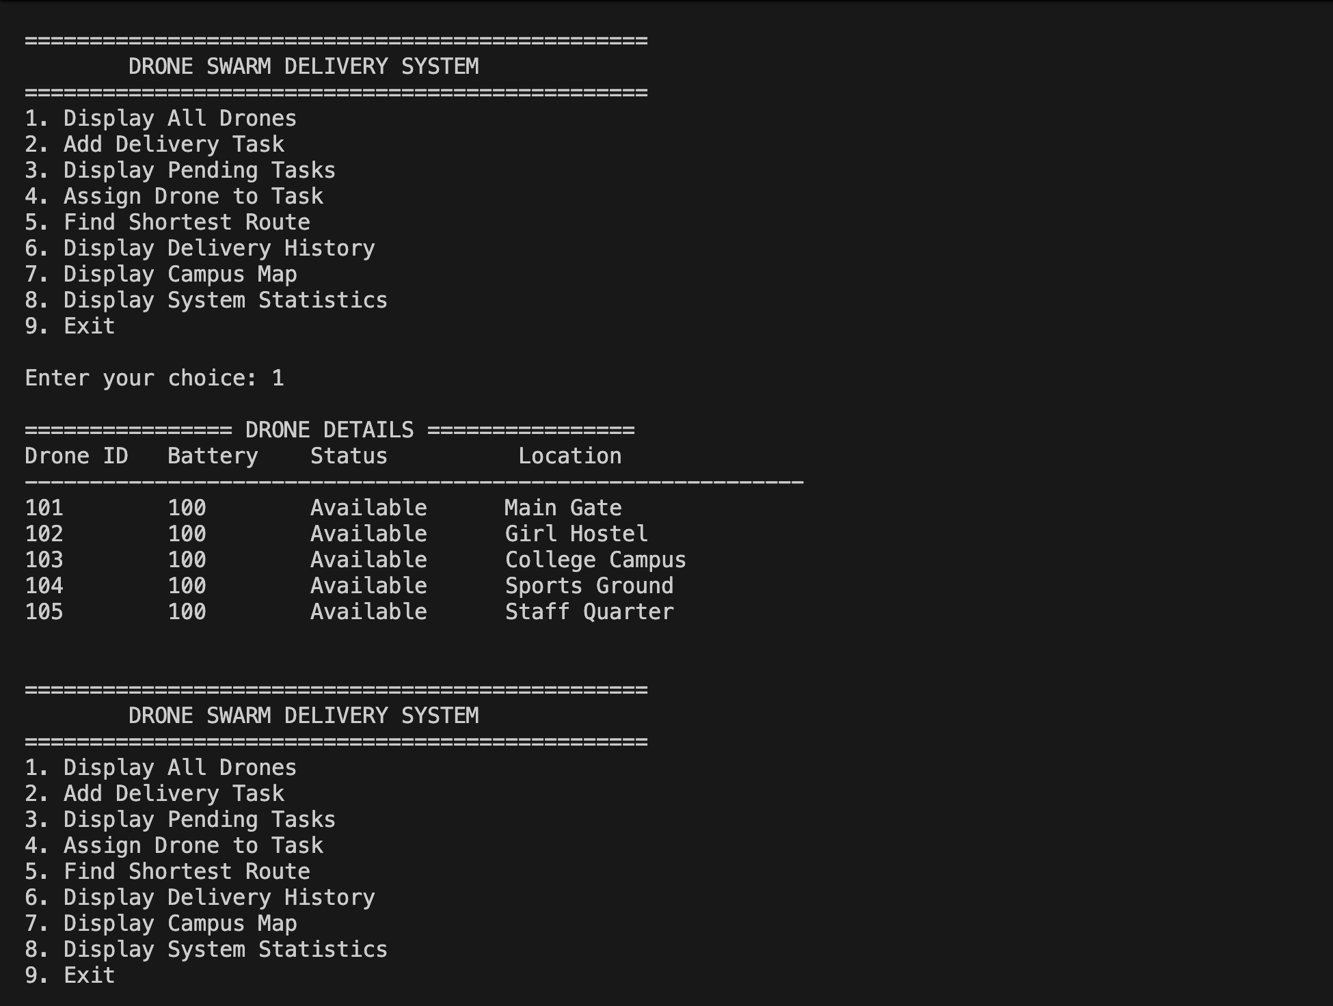
Output

Slide 16
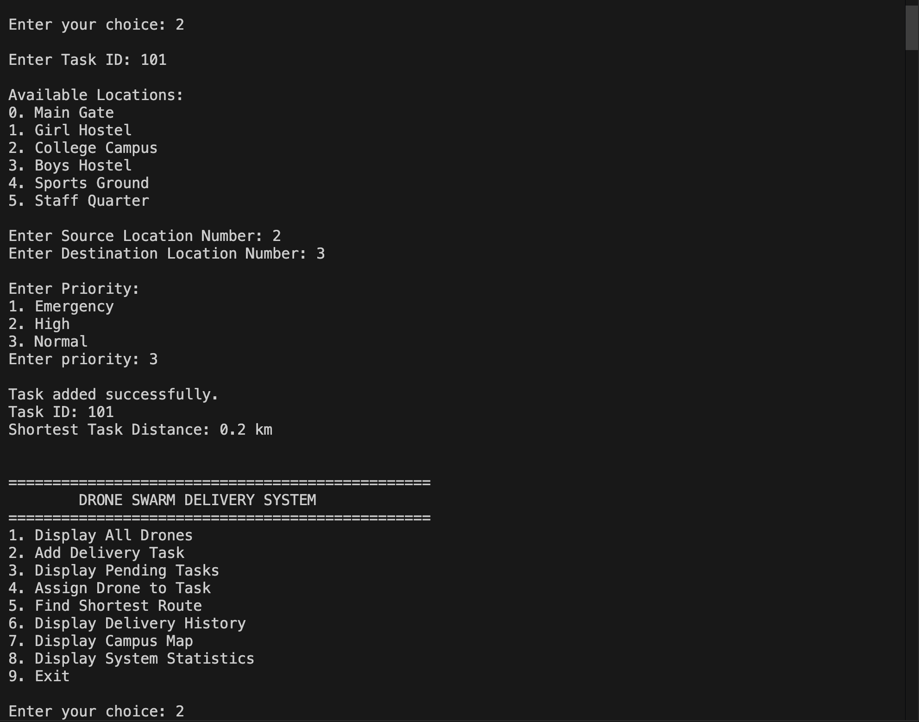

Slide 17
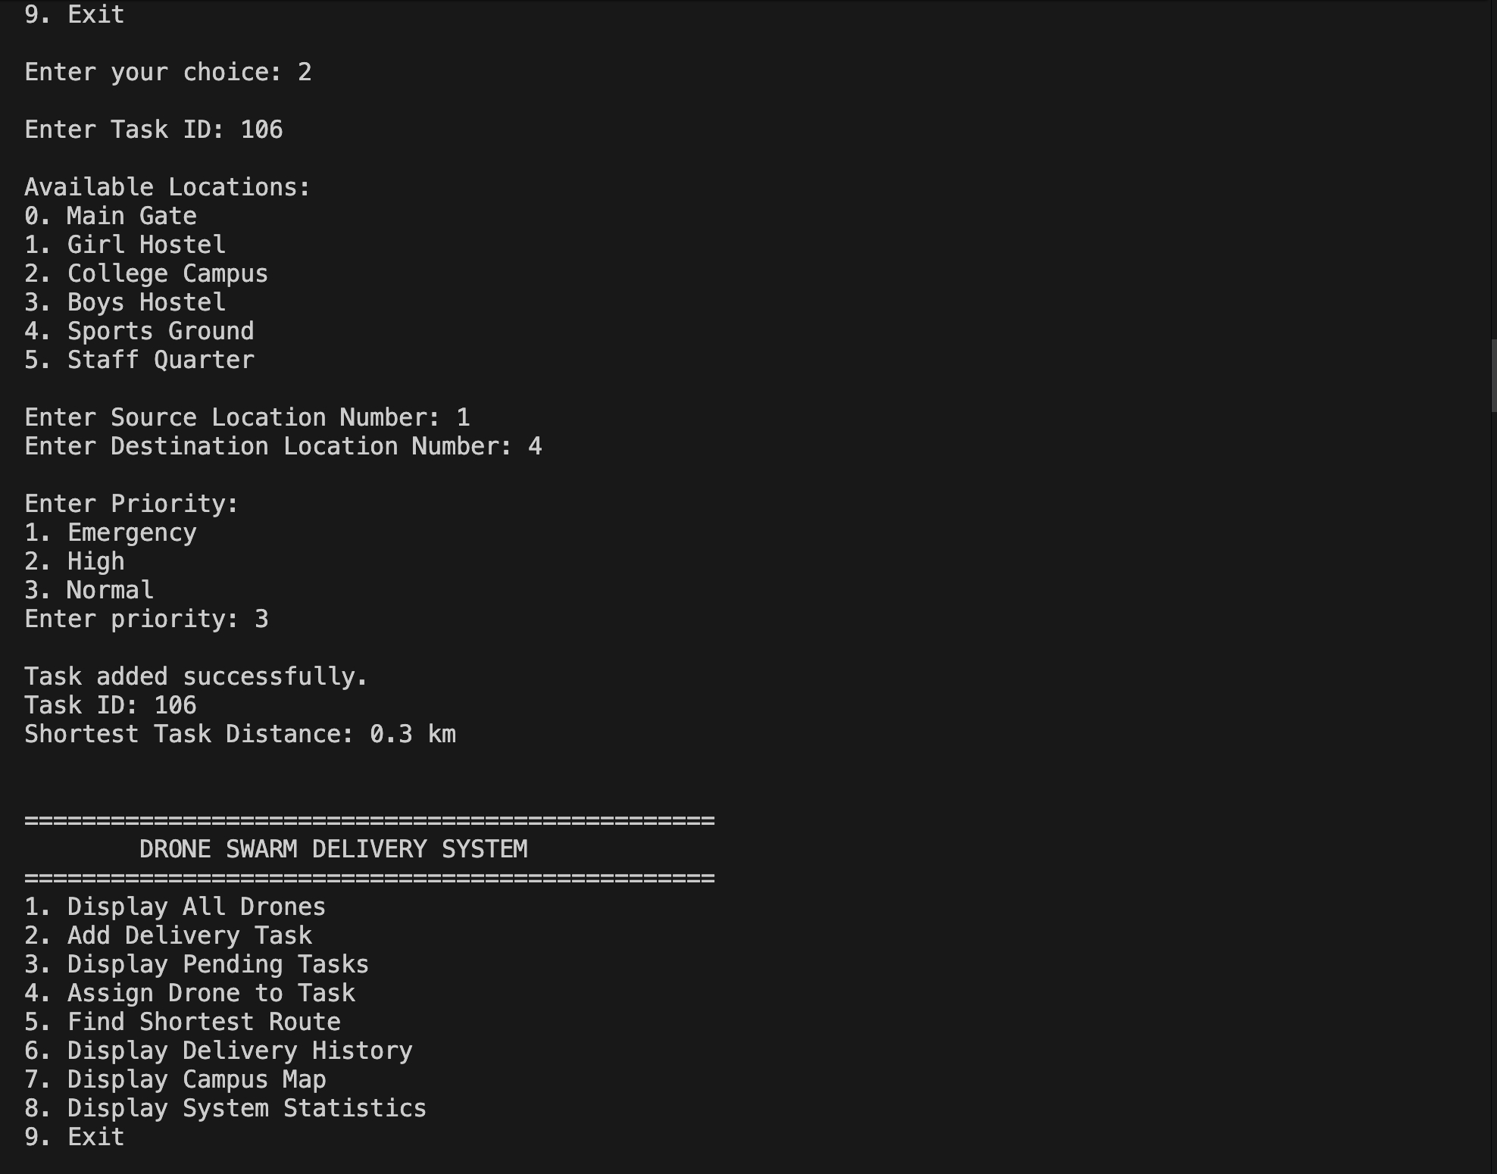

Slide 18
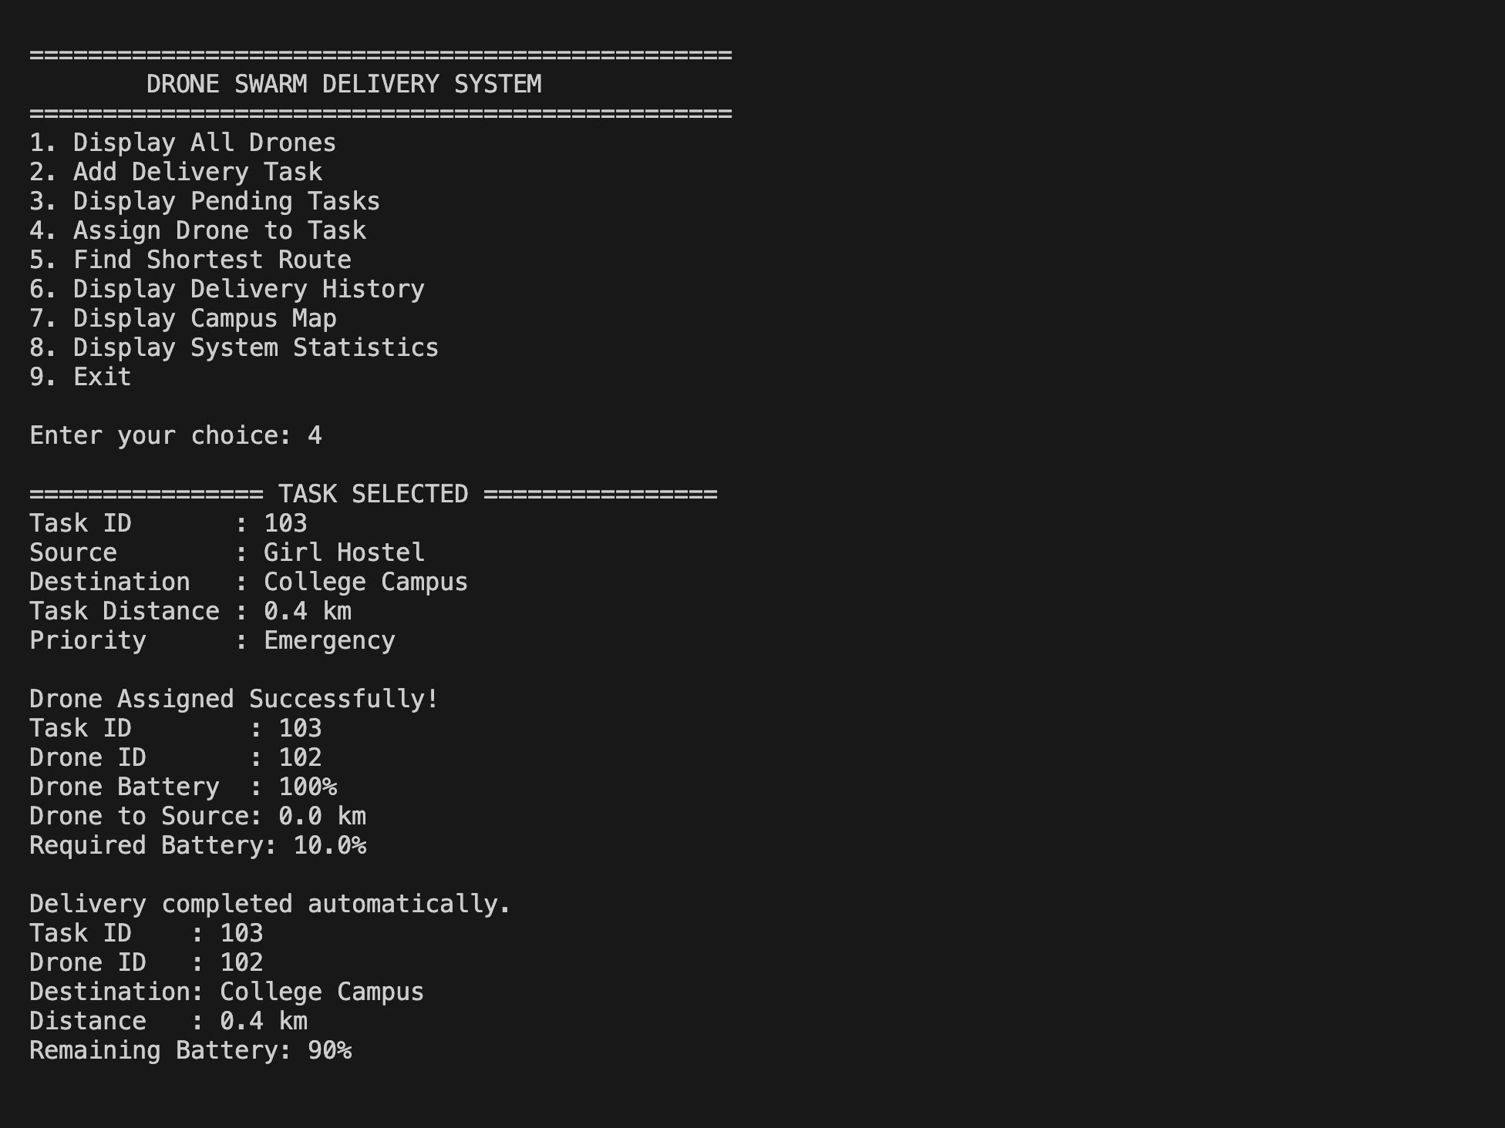

Slide 19
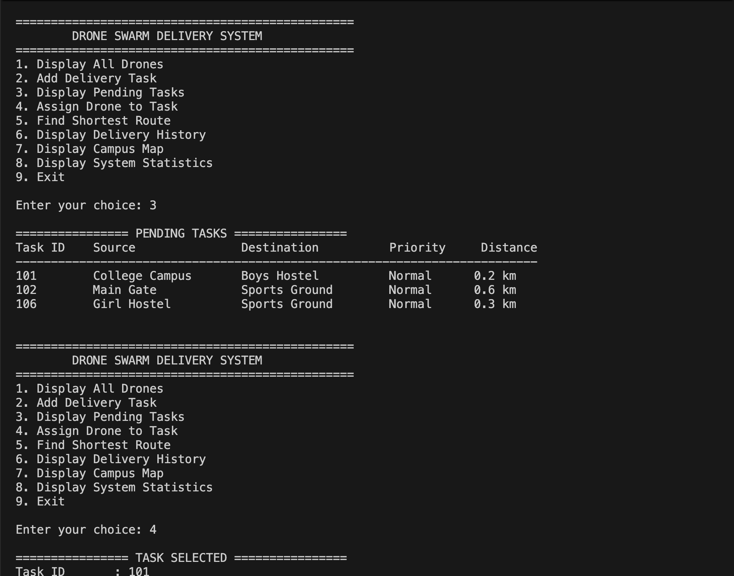

Slide 20
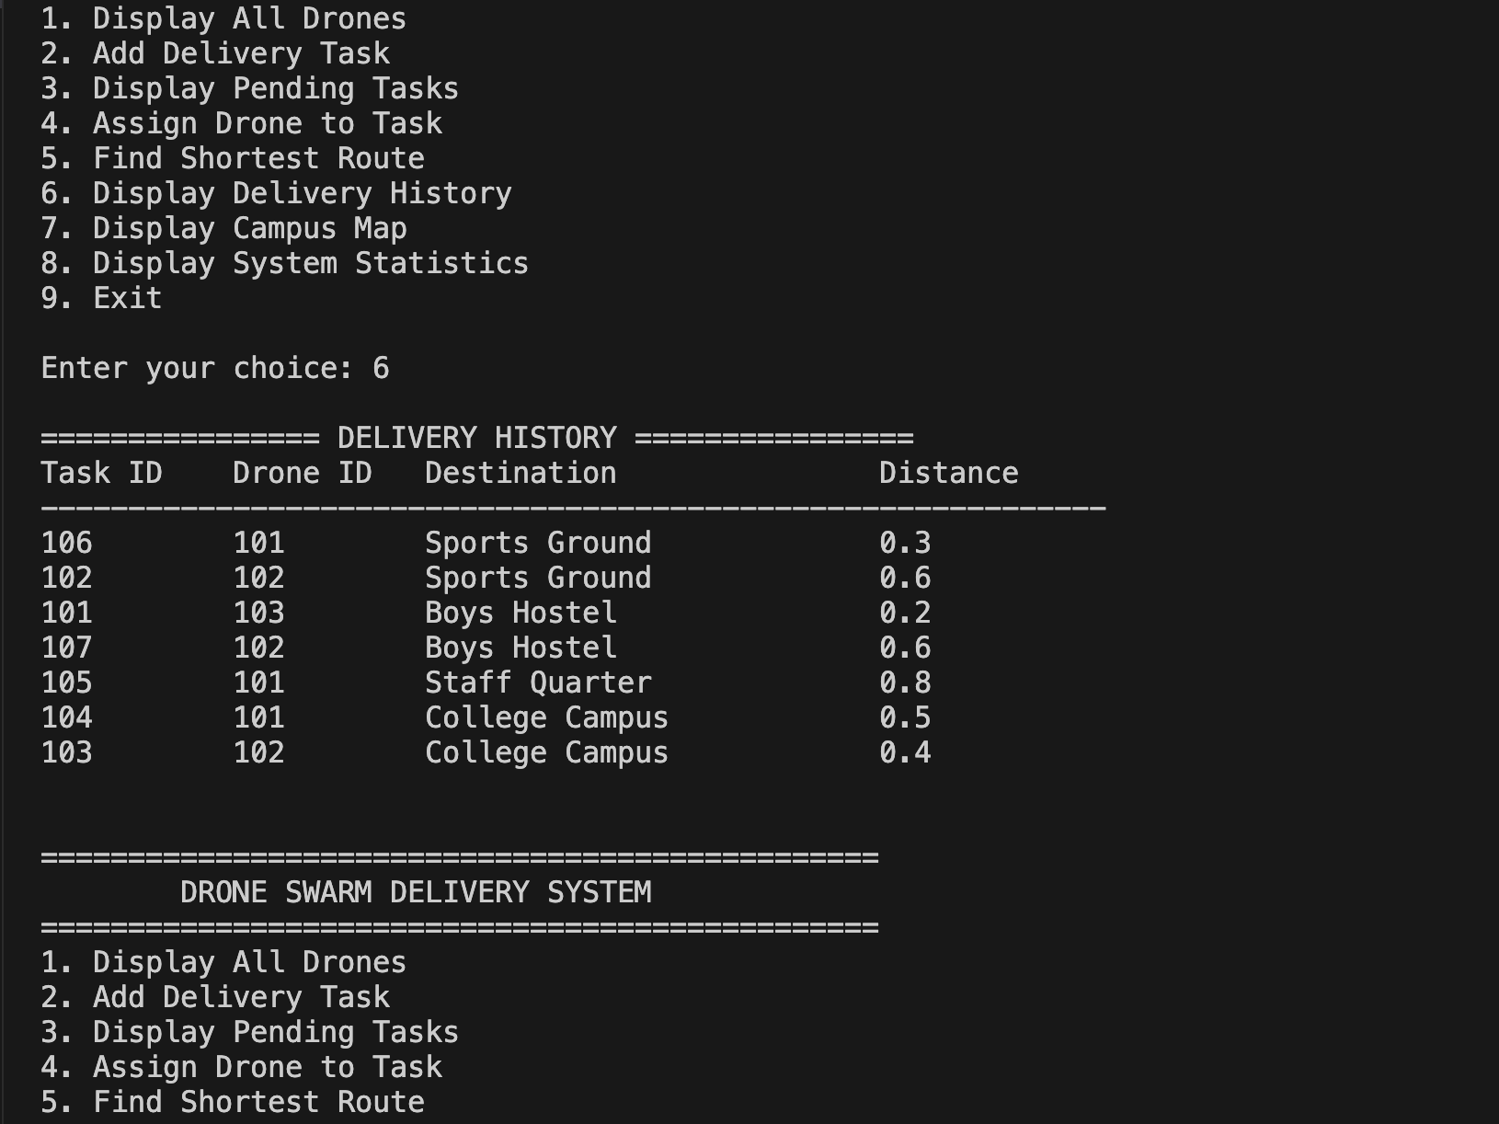

Slide 21
Time & Space Complexity
V = locations (6), D = drones (5), N = pending tasks, H = completed deliveries
Operation / Function | Data Structure | Time Complexity | Reason
enqueue / dequeue (any priority) | Circular queue | O(1) | Front / rear index update
getNextTask() | 3 queues | O(1) | Checks 3 counters only
calculateShortestDistance / dijkstra | Graph (matrix) | O(V²) | V × V scan, array-based
addTask() | Queue + Graph | O(V²) | One Dijkstra call
assignDrone() | Array + Graph | O(D · V²) | 3 Dijkstra per drone
addHistory() | Linked list | O(1) | Insert at head
displayHistory() | Linked list | O(H) | Traverse all nodes
displayTasks() | Queues | O(N) | Traverse 3 queues
displayDrones() / Statistics | Array | O(D) | Single loop
initializeGraph() | Matrix | O(V²) | Fill V × V matrix
Space: queues O(3·MAX_TASKS), graph O(V²), history list O(H). Since V and D are small constants, all operations run almost instantly.

Slide 22
Advantages
Simple menu-driven and easy to use
Demonstrates Queue, Linked List, Graph, Array and Structure together
Emergency tasks are always served first
Shortest route found using Dijkstra’s algorithm
Battery check prevents unsafe assignments
Dynamic delivery history using a linked list
Can be extended into a larger real-world application

Slide 23
Limitations & Future Scope
Current Limitations
Future Scope
Console-based system
Fixed 6 locations and 5 drones
No charging logic (status 2 unused)
Unassigned task goes back to the rear of its queue
Delivery is simulated, not real-time
Map text differs slightly from graph distances
Automatic charging scheduling
Multiple drones per delivery
Real-time tracking and GUI
Dynamic map (add / remove locations)
Priority queue using heap
Database and GPS integration

Slide 24
Conclusion
Our project demonstrates how basic Data Structures and algorithms can be combined to solve a real-world delivery problem.
We successfully implemented:
Array → Drone management
Structure → Data organization
Circular Queue → Priority task scheduling
Linked List → Delivery history
Graph + Dijkstra → Shortest route

