Slide 1

Lecture 1A: Syllabus & Logistics ECE 696B Trustworthy Machine Learning Spring 2025
Instructor: Dr Ravi Tandon
Department of ECE

Slide 2
Today’s Agenda
Introduction
Logistics, Syllabus, Course Overview
Pre-requisites on Probability and Machine Learning
Introduction to LLMs and Plan for the next 3 lectures.

Slide 3
ECE 696B: Logistics-I
Class Timings: Tues, Thurs, 11:00-12:15 pm
Location: Modern Languages, Room 504
Class Meeting Zoom Link:
https://arizona.zoom.us/j/87997122418
E-mail: tandonr@arizona.edu
(quickest way to reach me)
Office Hours: By appointment
D2L: we will be using D2L for lecture slides, videos, assignments and projects.

Slide 4
ECE 696B: Books & Reference Material
Textbook: None
Reference books (also see the syllabus)
Christopher Bishop, Pattern Recognition and Machine Learning, Springer, 2006
Shai Shalev-Shwartz and Shai Ben-David, Understanding Machine Learning from Theory to Algorithms, Cambridge University Press, 2014.
S. Bubeck, Convex Optimization: Algorithms and Complexity, NOW Publishers, 2015.
T. Hastie, R. Tibshirani, and J. Friedman, The Elements of Statistical Learning, 2nd Edition, 2017
I. Goodfellow, Y. Bengio and A. Courville, Deep Learning, Cambridge Uni. Press
HWs, lecture notes + any other additional material will be posted on D2L. Please check D2L regularly.

Slide 5
ECE 696B: Programming/Software
PyTorch (preferred) or Tensorflow
Proficiency in Python (encourage posting coding related questions on Discussion Forum)
Ability to implement & validate ML algorithms on commonly encountered datasets
Pytorch Tutorial:
https://www.youtube.com/playlist?list=PLqnslRFeH2UrcDBWF5mfPGpqQDSta6VK4

Slide 6
ECE 696B: Grading
In-class Presentations (60%)- each student will present a total of 4-5 papers
Final Project Presentation (15%)
Final Project Report (15%)
Attendance & Class Participation (10%)

Slide 7
Probability Pre-requisites
Random variables (PDF, PMF, CDF)
Basic distributions (Binomial, Normal, Laplace, Poisson, Chi-squared)
Conditional Probability, Bayes’ rule, Total Probability Theorem
Independence
Expectation, Variance, Moment Generating Functions (MGF)
Markov, Chebychev’s inequalities
Weak Law of Large Numbers (WLLN)
Central Limit Theorem (CLT)
KL Divergence, Total-variation Distance, Cross-Entropy

Slide 8
Machine Learning Pre-requisites
Exposure to basic concepts in Machine Learning
Distinction between various “types” of learning
Supervised (Linear reg, Logistic regression, SVM, MLP, CNNs)
Unsupervised (KNN, Decision Trees, PCA)
Exposure to optimization methods for training ML models (e.g., gradient descent, SGD, ADAM etc)
Prior exposure/ability to implement & validate basic learning algorithms

Slide 9
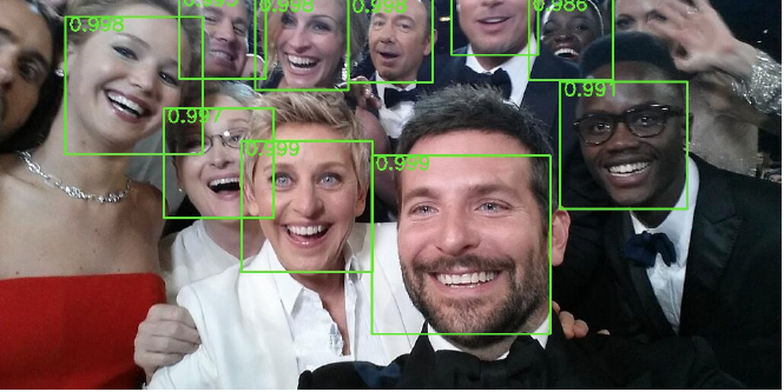
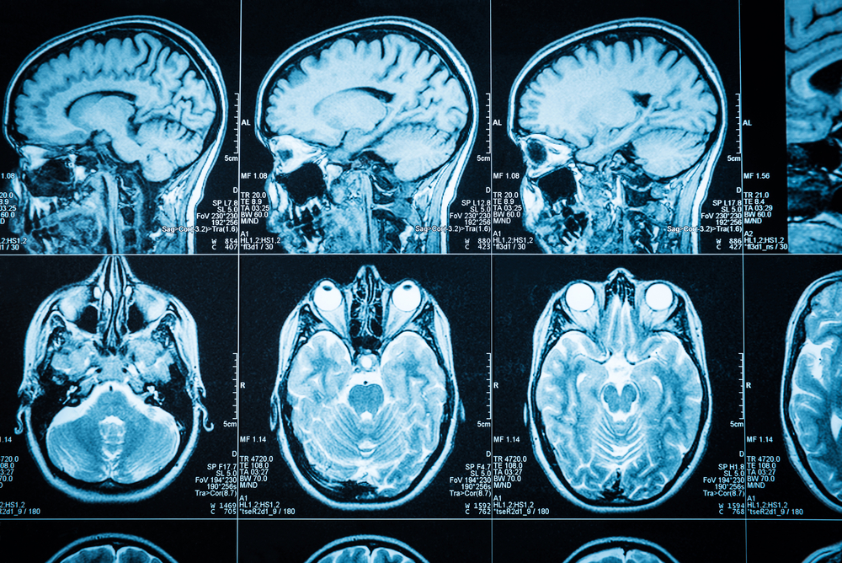

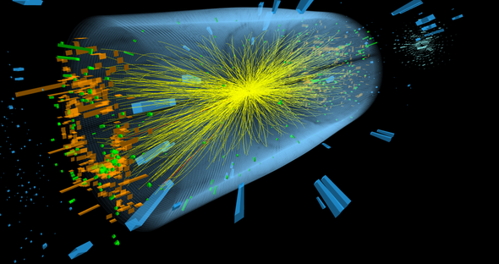

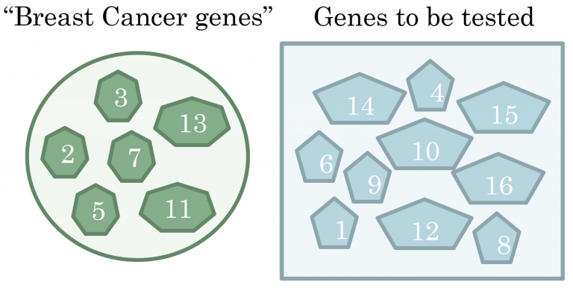
Big Data & ML
Image detection
Medical Imaging
Behavioral Analysis
Scientific Applications
Cybersecurity
Bioinformatics

Slide 10


The Classical Learning “Pipeline”
Learning Problem
(e.g., classification,
regression, ranking)
Deployment
Optimize model
on “Training data”
Learning Model
(e.g., Linear, SVM,
DNN, CNN..)
Test Data
(unseen)
Goal of conventional Data Science:
Allow useful inference from Data
i.e., optimize predictive performance on unseen data
Training
Data

Slide 11
What is this course about ? Modern Trustworthy ML
Architectural & algorithmic features
Transformers
Multi-modality
In-context
Test-time Compute
“Modern”
Deep Learning
Privacy
Robustness
Fairness
Explainability
Desirable Features &
Constraints

Slide 12
ECE 696B— Tentative Topics & Timeline
**Module 1 (Introduction to LLMs) (3 weeks)
Overview of Attention, Transformers
Foundational papers on LLMs
Module 2 (Privacy Preserving Learning) (2 weeks)
Basics of Differential Privacy
Privacy Preserving ML
Module 3 (Robust & Adversarial ML) (2 weeks)
Adversarial Machine Learning
Techniques for Attacks & Defenses
Module 4 (Fairness in Machine Learning) (2 weeks)
Notions of Fairness
Algorithmic Techniques for learning fair classifiers
Module 4 (Student Project Presentations) (3 weeks)

Slide 13
ECE 696B: Spring 2025 Trustworthy Machine Learning Lecture 1B: Introduction to Large Language Models (LLMs)
Instructor: Dr Ravi Tandon
Department of ECE

Slide 14
Lecture Outline
What are Large Language Models?
Evolution of Natural Language Processing (NLP)
Key Components of LLMs
Applications of LLMs
Challenges and Limitations
Plan for the next few lectures

Slide 15
What are LLMs ?
Definition: Neural network models designed to understand, generate, and manipulate human language.
Key Characteristics:
Large number of parameters (e.g., GPT-3 with 175 billion parameters).
Trained on massive datasets spanning diverse topics.
Contextual understanding of text inputs.
Examples:
GPT (OpenAI): Autoregressive model excelling in text generation.
BERT (Google): Bidirectional encoder for understanding sentence context.
T5 (Google): Unified text-to-text framework for multiple NLP tasks.
LLaMA (Meta): Lightweight language model for efficient inference.

Slide 16

How LLMs work ?
Response
The capital of France is Paris.
Prompt
What is the capital of France?
How LLMs Work (key steps):
Input Text: Users provide input text (e.g., a prompt or query).
Tokenization: Text is split into smaller units (tokens) for processing.
Neural Network Processing: Tokens are fed into a Transformer-based architecture.
Output Generation: The model predicts the next tokens or generates the desired output.

Slide 17
Evolution of NLP Models & Architectures
Pre-Neural Era:
Rule-Based Systems: Early systems relied on handcrafted rules for language processing.
Statistical Models: n-Grams and Hidden Markov Models (HMMs)
Neural Networks Era:
Recurrent Neural Networks (RNNs):
Process sequences of data with memory of previous inputs.
Struggled with long-term dependencies due to vanishing gradients.
Long Short-Term Memory Networks (LSTMs):
Improvement over RNNs with gates to handle long-term dependencies.
Widely used for machine translation and text generation.
Transformer Era:
Introduction of Transformers:
Key paper: Vaswani et al. (2017) "Attention Is All You Need".
Self-attention mechanism replaced recurrent structures, enabling parallel processing.
BERT and GPT Families etc.
Key Innovations Across Eras:
Shift from handcrafted rules to data-driven models.
Increased computational power and dataset sizes.

Slide 18
Key Components of LLMs
Neural Networks:
Backbone of LLMs.
Layers of interconnected nodes to process data.
Attention Mechanism:
Focuses on important parts of the input.
Key innovation in the Transformer architecture.
Tokenization:
Splitting text into smaller units (tokens) for processing.
Common methods: Byte Pair Encoding (BPE), WordPiece.
Positional Encoding:
Provides information about the order of tokens in the input sequence.
Uses mathematical functions (e.g., sinusoidal) to encode position information.
Essential for Transformers to capture sequence structure without recurrence.

Slide 19
Applications of LLMs
Text Generation: creative writing and content generation.
Summarization: Condensing information into concise formats.
Machine Translation: Translating text between different languages accurately.
Question Answering: Assisting in retrieving precise answers from large datasets.
Sentiment Analysis: Understanding public opinion from text.
Reasoning and Planning:
Solving complex problems by simulating logical reasoning.
Applications in step-by-step problem-solving (e.g., mathematics, programming).
Strategic decision-making in games or simulations.
Coding Assistance: AI coding tools (e.g., GitHub Copilot) to enhance productivity.
and many more…

Slide 20
Challenges & Limitations
Computational Costs:
High energy consumption during training & increasingly inference/deployment.
Large infrastructure requirements.
Bias in Outputs:
Reflects biases in training data.
Ethical Concerns:
Potential misuse (misinformation, deepfakes).
Context Limitations:
Struggles with very long documents or nuanced reasoning.
Privacy Issues:
Risks of exposing sensitive information during training or inference.
Challenges in ensuring secure handling of user data.
Hallucinations:
Generation of false or fabricated information that appears plausible.
Issues in reliability for critical applications like healthcare or law.

Slide 21
Next 4 lectures: LLM Foundational Papers
“Attention paper”
Attention is all you need (2017) – Presented by Ravi
“GPT-1 paper”
Improving Language understanding by Generative Pre-Traning (2018) – Presented by Ravi
“BERT paper”
BERT: Pre-training of Deep Bidirectional Transformers for Language Understanding (2019) – Presented by ?
“GPT-2 paper”
Language Models are Unsupervised Multitask Learners (2019) – Presented by ?

Slide 22
Next few lectures: LLM Foundational Papers (1)
5. “Scaling Laws paper”
Scaling Laws for Neural Language Models (2020) – Presented by ?
6. “GPT-3 paper”
Language Models are Few Shot Learners (2020) – Presented by ?
7. “Instruction Tuning paper”
Fine Tuned Language Models are Zero Shot Learners (2022) – Presented by ?
8. “Codex paper”
Evaluating Large Language Models Trained on Code (2021) – Presented by ?
9. “Chain of Thought (COT) Paper”
Chain of thought prompting elicits reasoning in Large Language Models (2022) – Presented by ?

