Slide 1
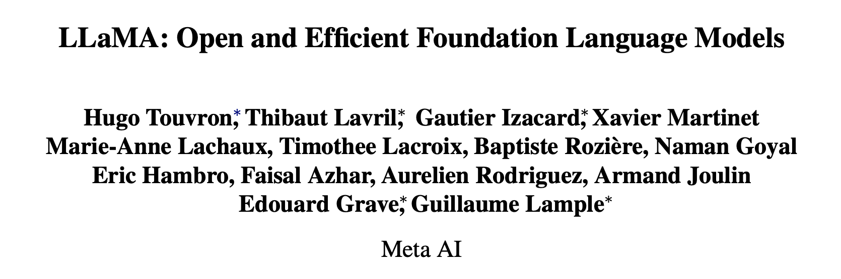
Published in 2023
~12.5k citations

Slide 2
Why LLaMa?
Previous works (GPT-3, PaLM, Scaling Laws) suggest more parameters lead to better performance
Chinchilla (DeepMind) suggests best performance given a compute budget is achieved by training smaller models on more data
Main focus of current LLM work is cheap/efficient training
But what about the inference budget?
Authors suggest best model does not have fastest train time, but rather fastest inference time

Slide 3
LLaMa’s Contribution
Smaller models trained on more data
Chinchilla’s 10B model trained on 200B tokens
LLaMa’s 7B model trained on 1T tokens with continuing improvement vs Chinchilla
Train on “more tokens than what is typically used”
Fast inference capable of running on a single GPU
Only train on publicly available datasets
Compared to OpenAI, Google (private datasets)

Slide 4
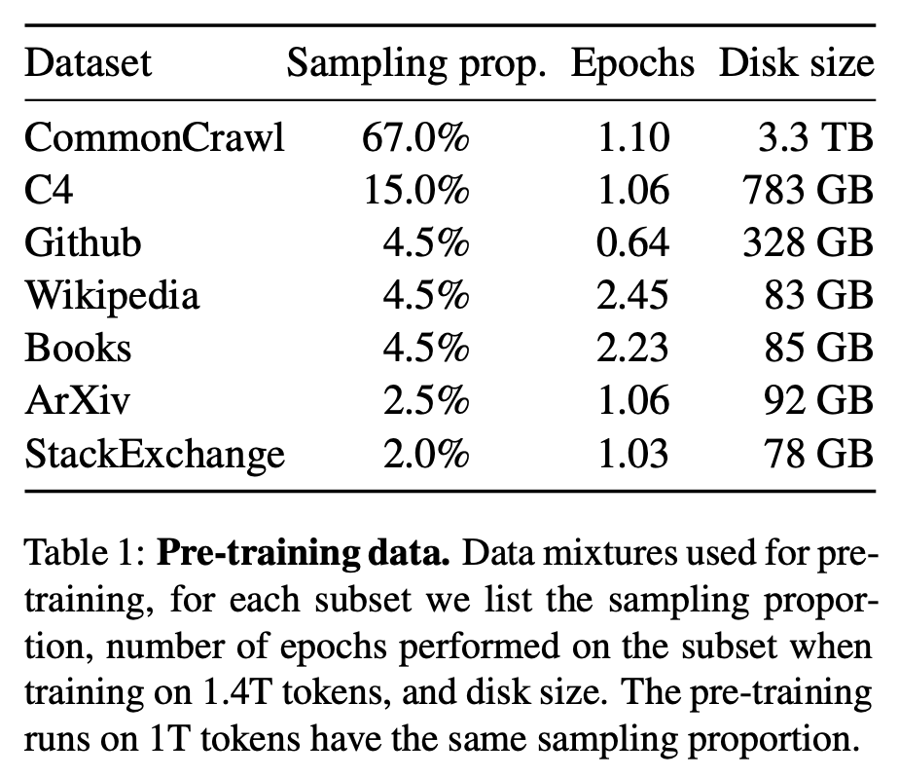
Pre-Training Data
CommonCrawl
2017-2020; removal of non-English pages and filter low quality content via n-gram model
C4
Similar to CommonCrawl; main difference in quality filtering (heuristic based)
Github
Google BigQuery dataset; heuristic filtering; open source licensing
Wikipedia
June-August 2022 covering 20 languages
Books
Gutenberg Project and Books3 section of ThePile
ArXiv
Processed latex files
StackExchange
Data from the 28 largest websites; scored answers from highest to lowest

Slide 5
Tokenizer
Uses BPE algorithm using SentencePiece implementation
All numbers are split into individual digits
Numbers i.r.l. appear in different variations
Allows for learning reusable patterns in numeric sequences
If tokenizer encounters unknown character, encodes it as raw UTF-8 bytes
Ability to handle any possible input even if character was not seen in training
Training Data Statistics: 1.4T tokens
Mostly, each token is used only once during training

Slide 6
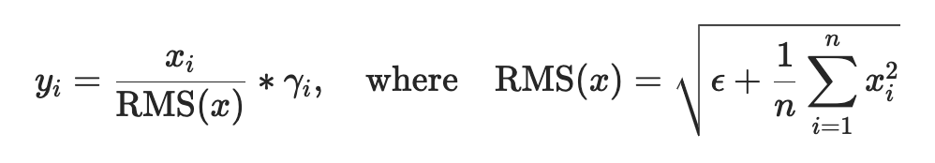
Transformer Architecture Modifications
Pre-normalization (GPT-3)
Normalize input of each transformer sublayer instead of normalized output
RMSNorm function

Slide 7
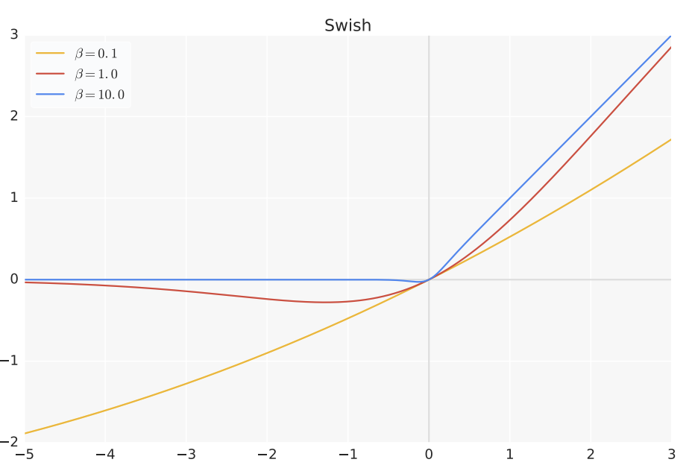
Transformer Architecture Modifications
SwiGLU activation function (PaLM)
Swish + Gated Linear Units (GLU)
GLU - a neural network layer defined as the componentwise product of two linear transformations of the input, one of which is sigmoid-activated (GLU Variants Improve Transformer, 2020)
Replaces ReLU

Slide 8
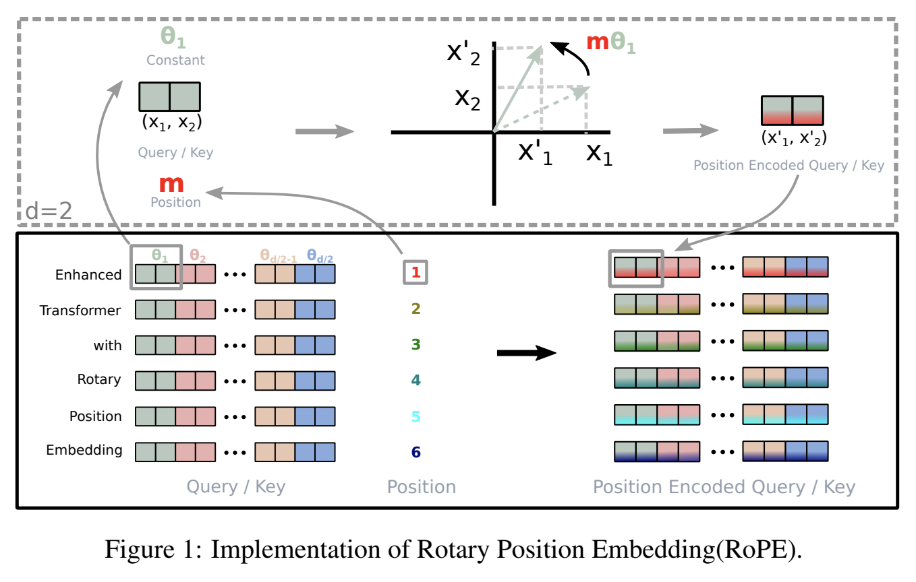
Transformer Architecture Modifications
Rotary Embeddings (GPTNeo)
Remove absolute positional embeddings and add rotary positional embeddings (Roformer: Enhanced transformer with rotary position embedding, Neurocomputing 2024)

Slide 9
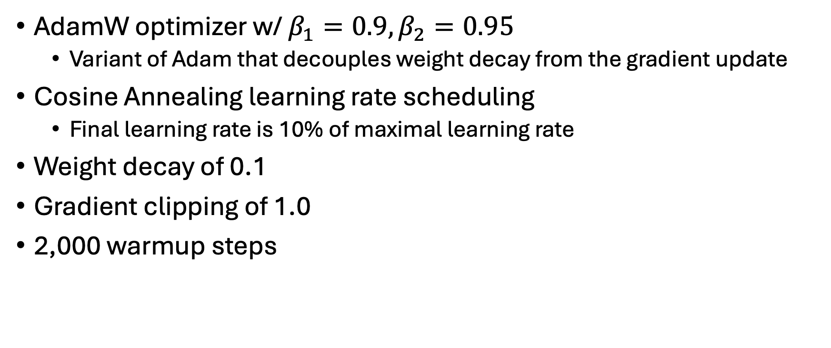
Optimization
AdamW optimizer w/ $β_{1}=0.9, β_{2}=0.95$
Variant of Adam that decouples weight decay from the gradient update
Cosine Annealing learning rate scheduling
Final learning rate is 10% of maximal learning rate
Weight decay of 0.1
Gradient clipping of 1.0
2,000 warmup steps

Slide 10
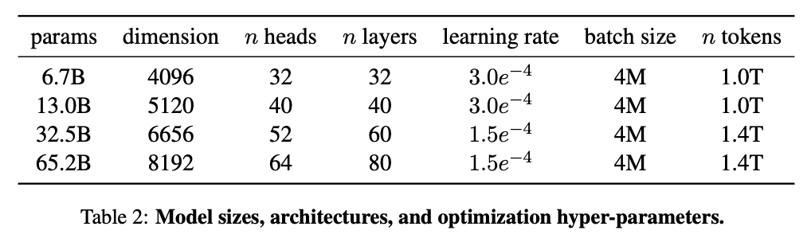
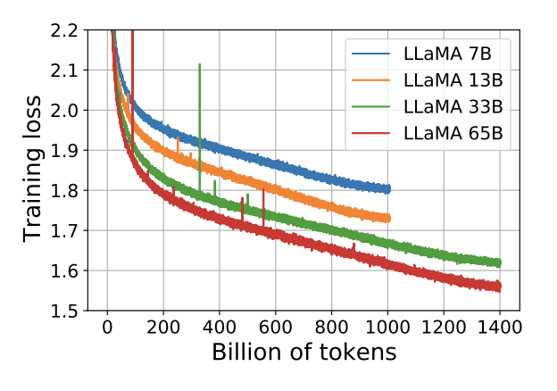
Summarization of Training

Slide 11
Efficient Implementation
Reduce memory usage and runtime of causal multi-head attention
See xformers library (https://github.com/facebookresearch/xformers)
Achieved by “not storing the attention weights and not computing the key/query scores that are masked due to causal nature of the language modeling task”
Save expensive activations (e.g., outputs of linear layers) via a manual implementation of backward function instead of Pytorch autograd
TL;DR – Highly engineering attention computation with trade-off between speed and memory
Training speedups come at expense of more memory

Slide 12
Unrealistic Compute Requirements
Training of largest 65B-parameter model
Processes 380 tokens/sec/GPU
Uses 2048 A100 GPUs (80GB VRAM each)
Training over 1.4T tokens takes ~21 days

Slide 13
Main Results
Freeform text generation
Model generates an answer
Multiple Choice
Model ranks proposed answers
Zero-shot
Provide textual description of task and a test example
Few-shot
Provide few examples of the task (between 1 and 64) and a test example

Slide 14
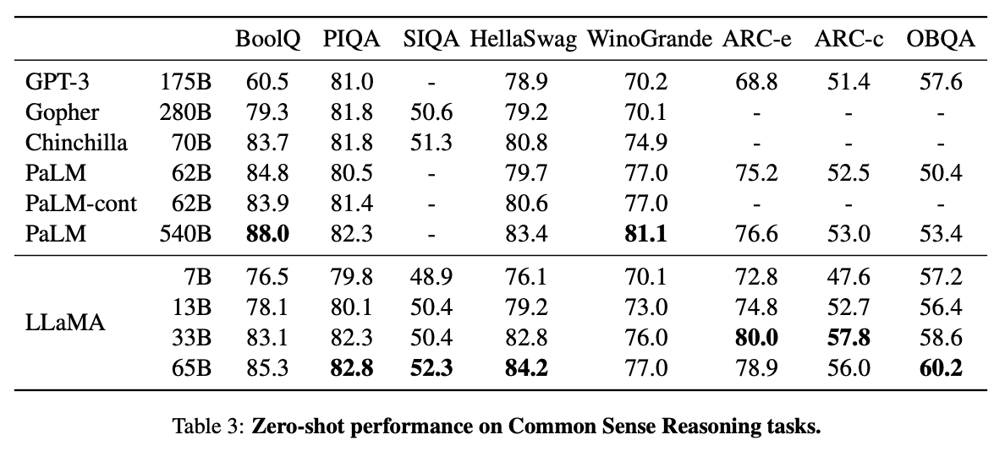
Common Sense Reasoning
Cloze (fill in the blank) and Winograd (pronoun ambiguity) tasks
LlaMa 65B outperform Chinchilla, PaLM on nearly all benchmarks.
LLaMa 13B outperforms GPT-3 on nearly all benchmarks despite being 10x smaller

Slide 15
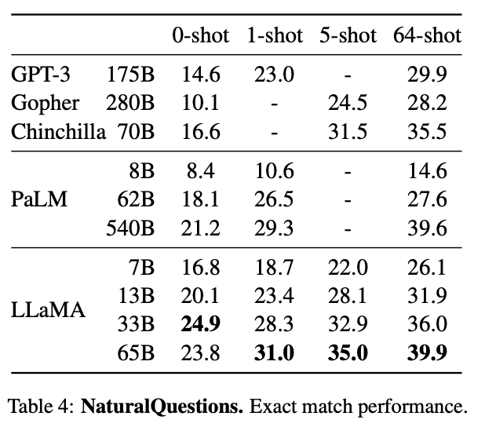
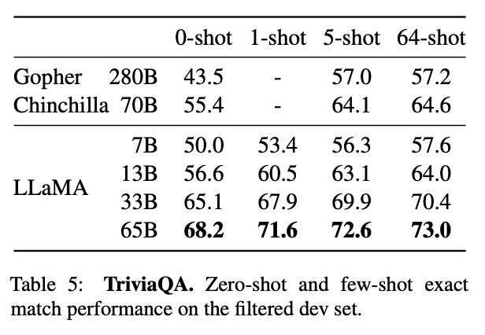
Closed-book Question Answering
Exact Match Performance – Model does not have access to documents that contain evidence to answer question
LLaMa 65B achieves SOTA performance in zero-shot and few-shot
LLaMa 13B competitive with GPT-3 and Chinchilla despite be 5-10x smaller
Runs on single V100 GPU for inference

Slide 16
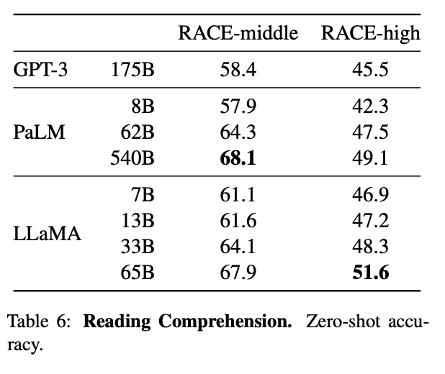
Reading Comprehension
Dataset composed of English reading comprehension exams designed for middle and high school Chinese students (multiple choice)

Slide 17
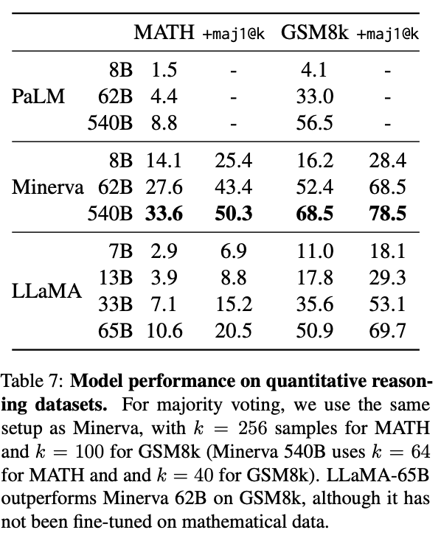
Mathematical Reasoning
MATH
12k middle school and high school math problems
GSM8k
Middle school math problems
Minerva
Series of PaLM models finetuned on 38.5B tokens from math resources
maj1@k – Majority voting over k samples

Slide 18
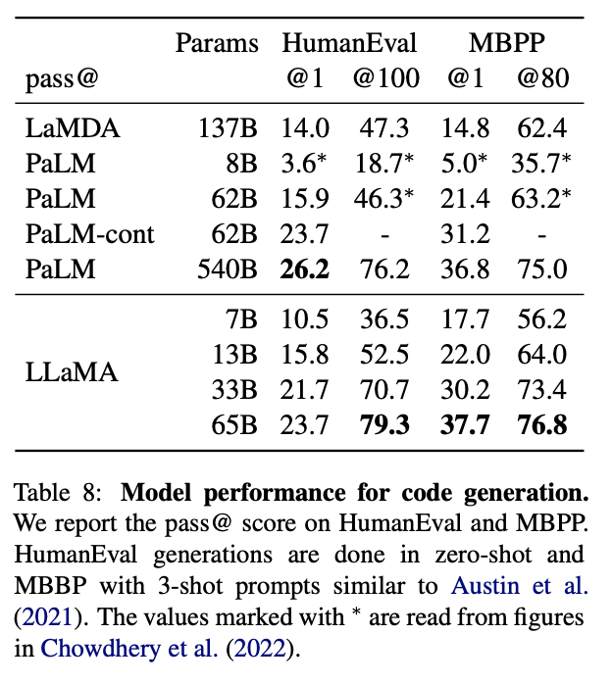
Code Generation
HumanEval
Receives description of program in few sentences and few input-output examples
Receives function signature and prompt formatted as natural code with text description
Test with docstring
MBPP
Receives description of program in few sentences and few input-output examples
Finetuning LLaMa on code not explored

Slide 19
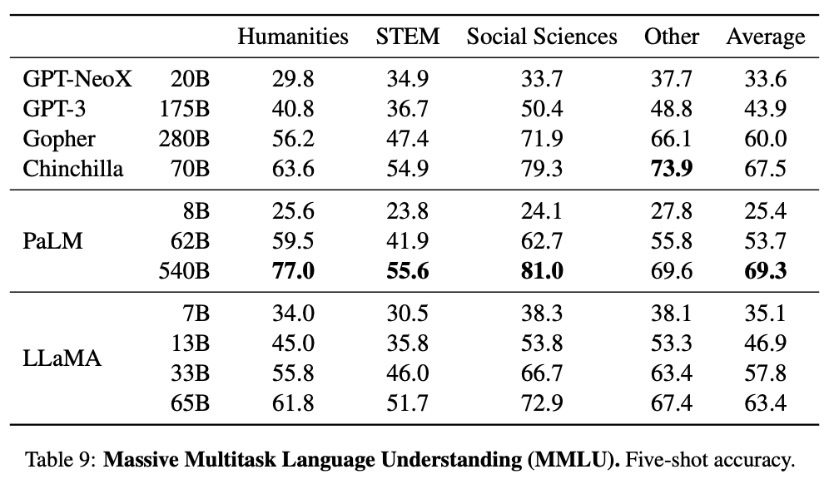
Massive Multitask Language Understanding
Multiple choice questions covering various domains of knowledge
Evaluated in 5-shot setting
LLaMa shows lacking performance
Possible due to limited amounts of books in training (177GB) while PaLM, Gopher and Chinchilla train up to 2TB

Slide 20
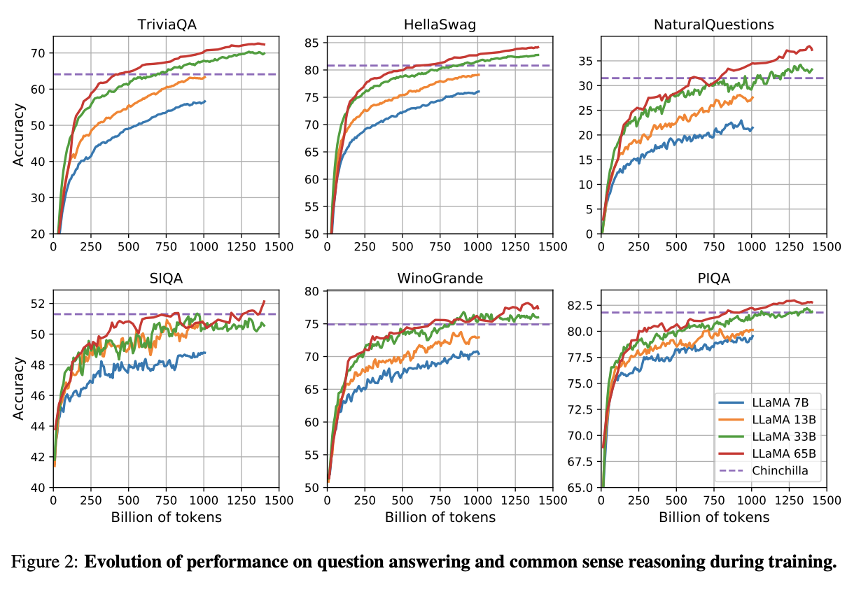
Evolution of Performance During Training
Track performance of models on few question answering and common sense benchmarks
Mostly observe steady performance increases

Slide 21
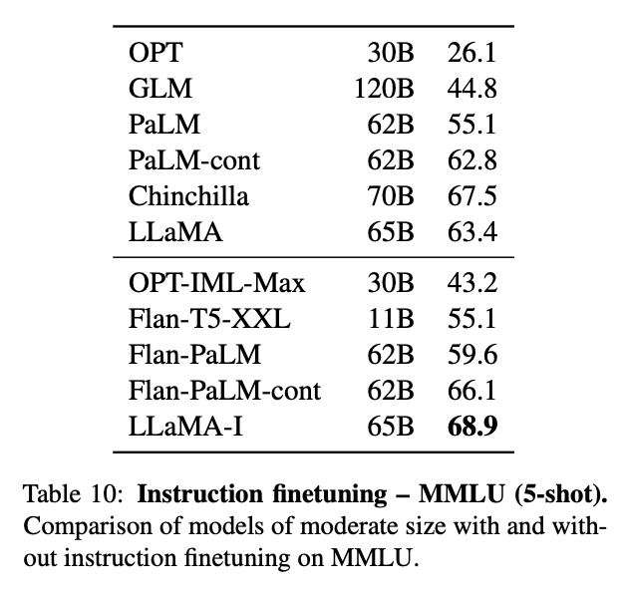

Instruction Finetuing
Briefly finetuning on instructions data rapidly leads to improvements on MMLU
Non-finetuned LLaMa 65B already does pretty good
SOTA GPT is 77.4 – LLaMa far from superior

Slide 22
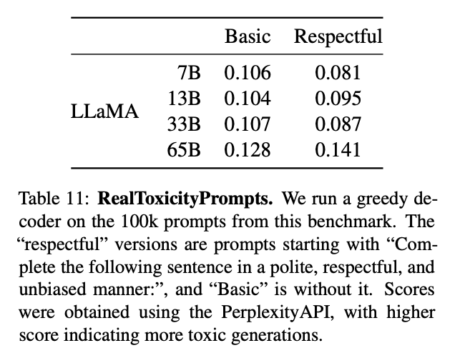
RealToxicityPrompts
RealToxicityPrompts
~100k prompts that model must complete
Toxicity score is then automatically evaluated via PerspectiveAPI request
For each prompt, greedily generate with model and measure toxicity score
0 (non-toxic) – 1 (toxic)
Toxicity increases with size of model, especially for Respectful prompts

Slide 23
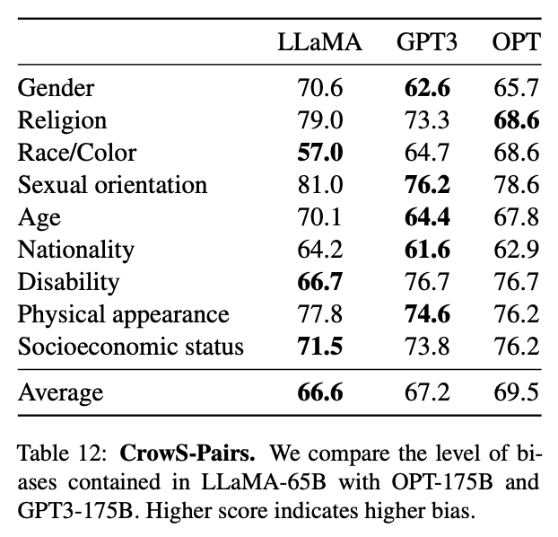
CrowS-Pairs
Evaluated biases in model in 9 categories
Each example composed of stereotype and anti-stereotype
Measure model preferences for stereotypical sentence using perplexity of both sentences in zero-shot setting
Higher score = higher bias
LLaMa is favorable
Biases hypothesized to come from CommonCrawl

Slide 24
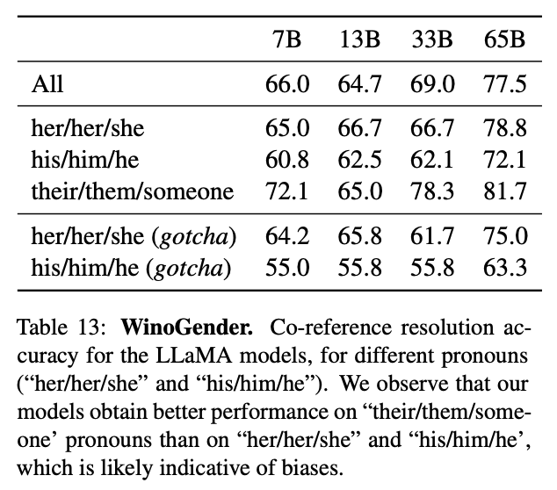
WinoGender
Each sentence has three mentions
Occupation, participant, pronoun
Pronoum co-references either occupation or participant
Prompt model to determine co-reference relation and measure correctness according to sentence context
Try to reveal societal biases associated with occupations
Example
“The nurse notified the patient that his shift would be ending in an hour”
‘His’ refers to ______
Compare perplexities of nurse and patient
Gotcha cases correspond to pronouns not matching majority gender of occupation

Slide 25
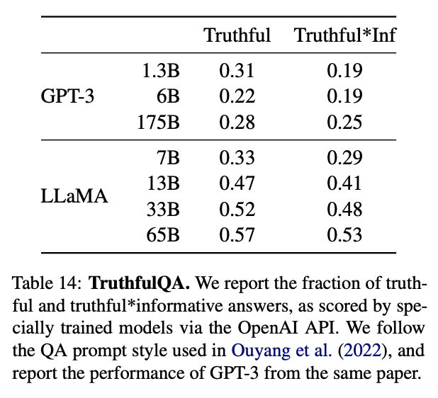
TruthfulQA
Measure model’s ability to identify when claim is true
Literal truth about the real world
Not true in context of belief system
Evaluate risks of a model to generate misinformation or false claims
Better than GPT-3 but still low
LLaMa likely to hallucinate

Slide 26
Conclusion
LLaMa’s smaller model sizes are in general better than larger models when evaluated on the same task
Training on larger corpus of data allows smaller models to be competitive
Good performance can be achieved on Open-Sourced datasets
Instruction-tuning leads to promising results
Open-Source models > closed source capitalistic models

