Slide 1
Retrieval-Augmented Generation for Knowledge-Intensive NLP Tasks
Patrick Lewis, Ethan Perez, Aleksandra Piktus, Fabio Petroni, Vladimir Karpukhin,
Naman Goyal, Heinrich Küttler, Mike Lewis, Wen-tau Yih,
Tim Rocktäschel, Sebastian Riedel, Douwe Kiela
Notes:
conducted by researchers at Facebook AI Research, University College London, and New York University.

Slide 2

Knowledge-Intensive NLP Tasks
Parametric?
Yes
No
Pretrained LM
IR + Heuristics
Fixed parameters capture knowledge
Prone to hallucination
Accurate document reference
Lacks flexibility
Coherent generation
Dynamic knowledge access
Notes:
Parametric Models (e.g., GPT-3): Knowledge stored in fixed weights → static, prone to hallucination.
Non-Parametric Systems (e.g., IR + heuristics): Retrieve documents but lack generative fluency.
Key Limitation: Trade-off between dynamic knowledge access and coherent generation.
Modern language models have shown remarkable ability to store knowledge in their parameters through pre-training.
Static knowledge base - costly to expand
- Specialized architectures for specific tasks like question answering
Larger parametric models like T5
Some have explored memory networks and other architectures that separate computation from memory
However, until RAG, we lacked a general-purpose solution that could effectively combine the benefits of parametric and non-parametric approaches"

Slide 3
Previous Approaches
Gap: Joint retrieval and generation
Coherent generation
GPT-2/3
LSTM/RNN
Dynamic knowledge access
TF-IDF
BM25
Hybrid Systems
REALM
ORQA
Notes:
1. Pure Retrieval Systems: Relied on curated databases (e.g., BM25) but lacked generative capability.
2. Pure Generative Models: GPT-2/3: Generated text fluently but with static, unupdatable knowledge.
3. Hybrid Systems (Pre-2020): Pipeline approaches (retrieve → generate) with no end-to-end training.
BM25 – word overlap based retriever

Slide 4
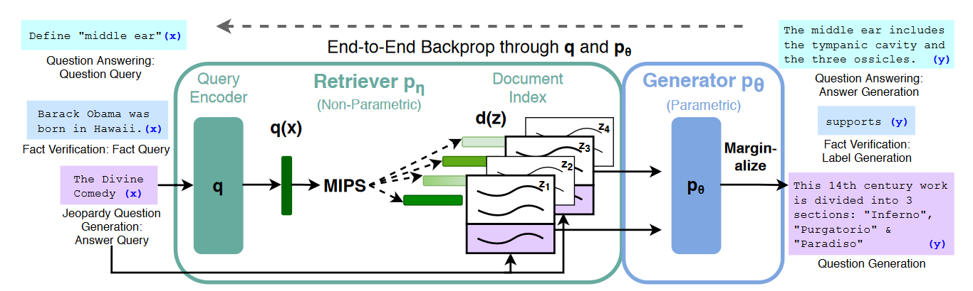
Retrieval-Augmented Generation (RAG)

Slide 5
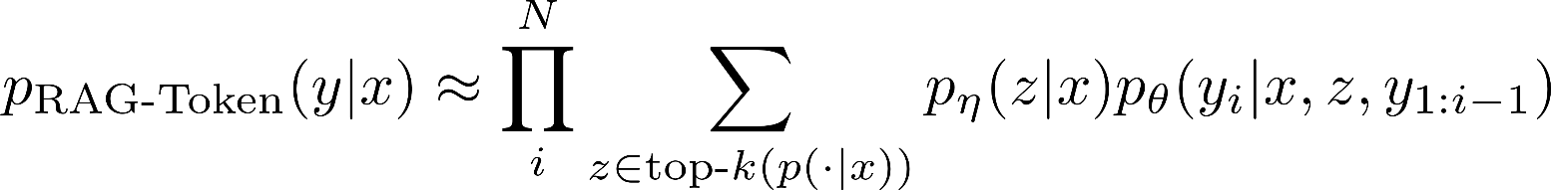



RAG Variants
Input sequence
Output sequence
Latent document
Sequence-level marginalization
Token-level marginalization
Retriever
Generator
Training: minimization of negative marginal log likelihood
Karpukhin, V. et al. (2020). Dense Passage Retrieval for Open-Domain Question Answering. EMNLP 2020, Online. ACL.
Notes:
Estimate probability of generating an output sequence given an input sequence
Y – answer , X – question
Sequence-level marginalization – marginalize over entire y sequences

Slide 6
Retrieval-Augmented Generation (RAG)

Slide 7




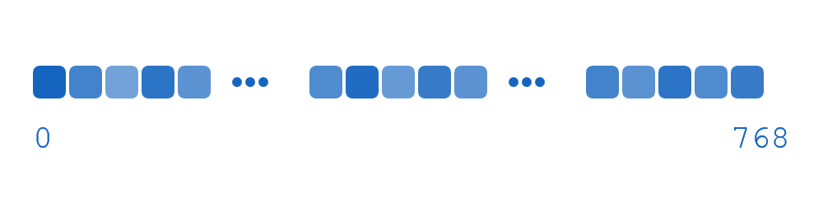
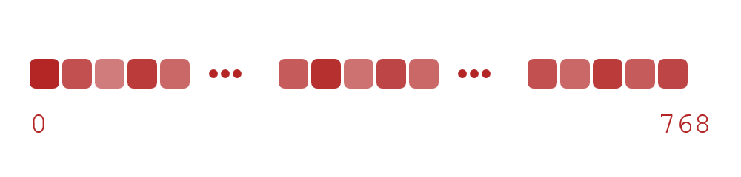




Dense Passage Retrieval (DPR)
Question
Passages
Backprop
Encoded once
Facebook AI Similarity Search (FAISS)
Maximum Inner Product Search (MIPS)
Karpukhin, V. et al. (2020). Dense Passage Retrieval for Open-Domain Question Answering. EMNLP 2020, Online. ACL.
Notes:
Encode Wikipedia documents once with document encoder (21M Wikipedia pages – 100 word chunks)
Optimizes distance between question and relevant passage vectors compared to irrelevant ones
FAISS builds index -> ~ sublinear time
Efficient retrieval is critical for RAG’s performance, enabling real-time access to external knowledge.
Finetune query encoder end-to-end with RAG

Slide 8
Retrieval-Augmented Generation (RAG)
Query concatenated to documents
Pretrained Seq2seq (BART-Large)
Notes:
Bidirectional encoder -> autoregressive decoder
BART – Similar to T5, slightly different training
400M parameters
Denoising objective, noising functions as opposed to masking -> outperforms T5 of similar size

Slide 9
RAG Variants
Input sequence
Output sequence
Latent document
Sequence-level marginalization
Token-level marginalization
Retriever
Generator
Training: minimization of negative marginal log likelihood
Karpukhin, V. et al. (2020). Dense Passage Retrieval for Open-Domain Question Answering. EMNLP 2020, Online. ACL.
Notes:
Estimate probability of generating an output sequence given an input sequence
Y – answer , X – question
Sequence-level marginalization – marginalize over entire y sequences

Slide 10
Experiments
Can be applied to any task with input/output sequence
Focus is on tasks with need for precise knowledge access
Open-domain QA
Question Generation
Abstractive open-domain QA
Fact Verification
Notes:
BART and T5 work well in many of these tasks
TriviaQA, Natural Questions, WebQuestions, CuratedTREC
“Open” MS MARCO
Given NLQ -> return 1-5 word answer to this question
Abstractive – full sentence outputs
Question Generation – jeopardy question/answer entity
Fact verification – NL claims, support/reject/not enough info

Slide 11
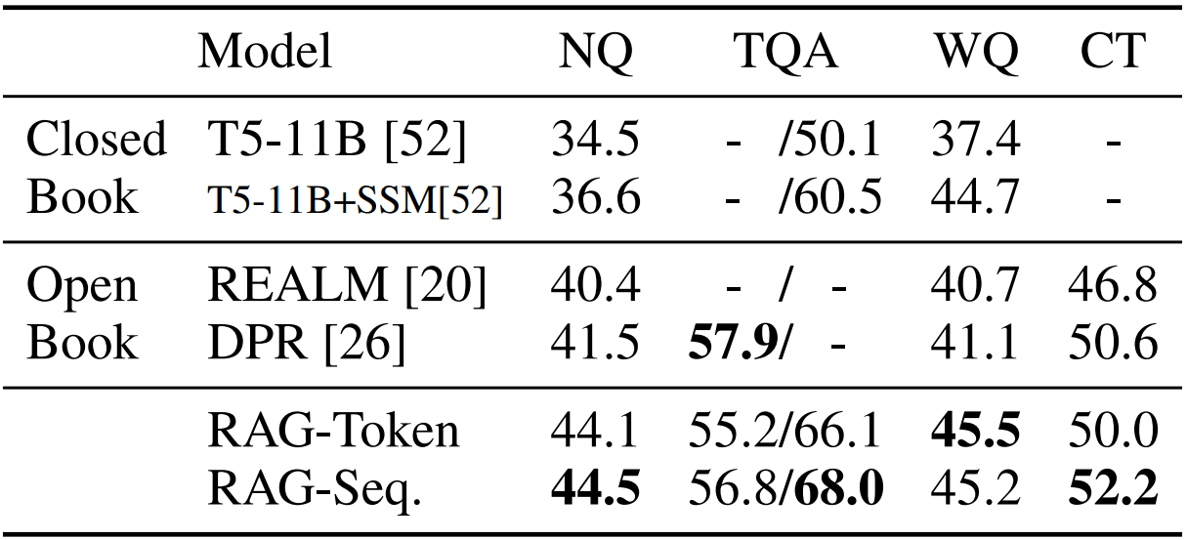
Results – Open-Domain QA
Standard test set
TQA-Wiki test set
Notes:
Be prepared to explain models and metrics
TriviaQA, Natural Questions, WebQuestions, CuratedTREC
Salient Span Masking – pretraining objective -> improves ability to answer questions
REALM
DPR Pipeline -> ranking (cross-encoder)
Strongly outperform closed-book
No re-ranking, span extraction
Documents without exact answer still help
Answer questions correct when answer is not in retrieved docs (~10%)

Slide 12
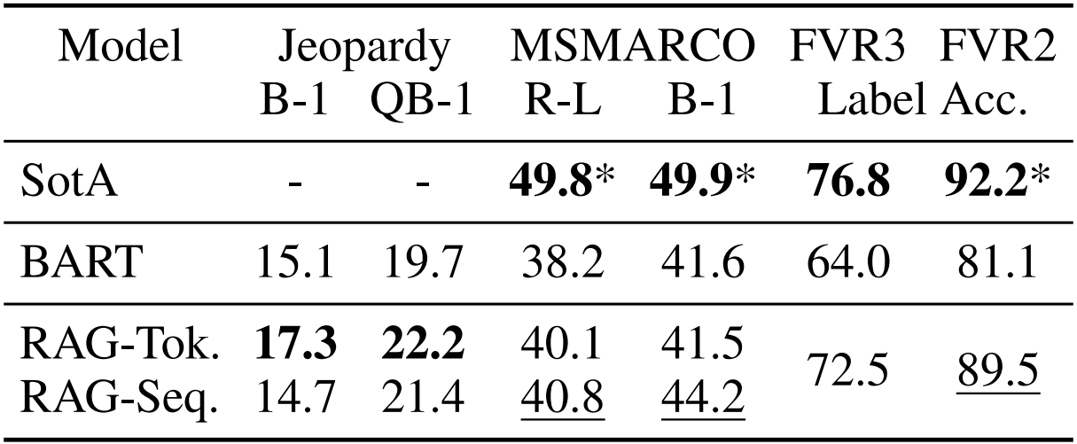
Results – Abstractive QA
Input: how many calories in average apple
GOLD: an average apple has 80 calories
BART: The average apple contains 1,000 calories in an average apple and 1,200 calories in a medium apple
RAG: There are 126 calories in an average apple, while an extra large size apple has 172 calories
Top Retrieved doc: A typical apple serving weighs 242 grams and provides 126 calories with a moderate content of dietary fiber (table). Otherwise, there is ... is usually not eaten and is discarded.
*Uses gold context/evidence. Best model without gold access underlined.
Notes:
Q-BLEU is a variant of BLEU with a higher weight for matching entities and has higher correlation with human judgment for question generation than standard metrics
MSMARCO has some questions that cannot be answered in a way that matches the reference answer without access to the gold passages, such as “What is the weather in Volcano, CA?” so performance will be lower without using gold passages. We also note that some MSMARCO questions cannot be answered using Wikipedia alone.
Rouge-L, Bleu1

Slide 13
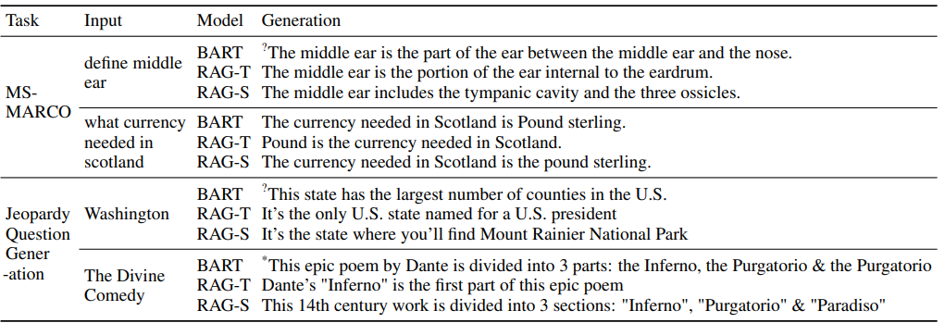
Results – Abstractive QA
Notes:
MSMARCO has some questions that cannot be answered in a way that matches the reference answer without access to the gold passages, such as “What is the weather in Volcano, CA?” so performance will be lower without using gold passages. We also note that some MSMARCO questions cannot be answered using Wikipedia alone.
Rouge-L, Bleu1

Slide 14
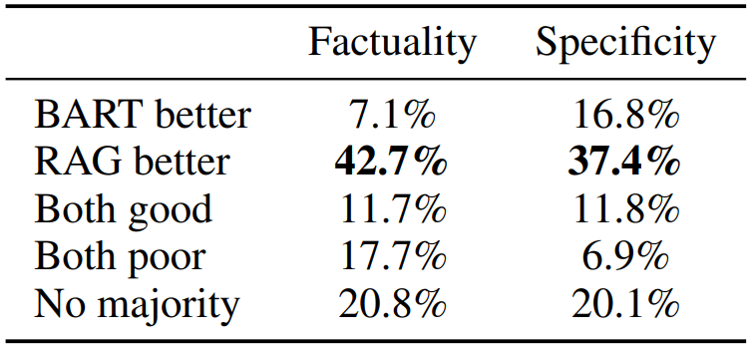
Results – Jeopardy Question Generation
Notes:
Rouge-L, Bleu1
Human assessment
RAG token better performance because of nmultiple documents
We also perform two human evaluations, one to assess generation factuality, and one for specificity. We define factuality as whether a statement can be corroborated by trusted external sources
specificity as high mutual dependence between the input and output

Slide 15
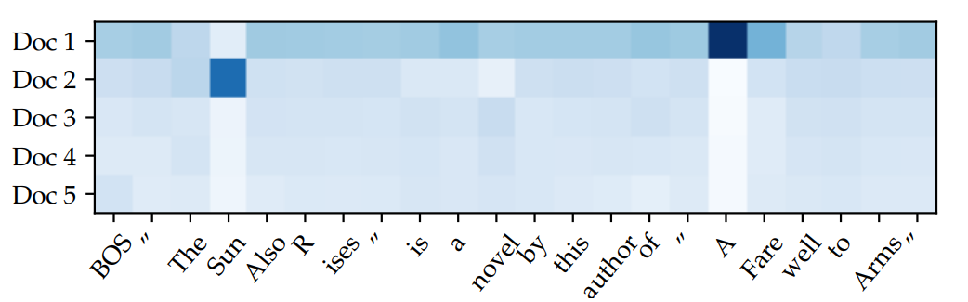
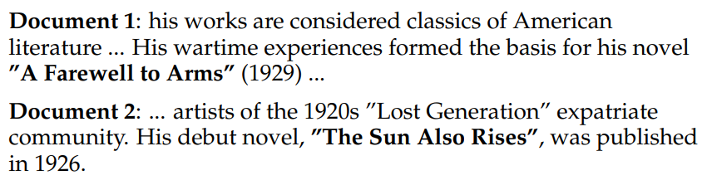
Results – Jeopardy Question Generation
Notes:
Parametric/non-parametric memory interaction
RAG-Token document posterior p(zi |x, yi , y−i) for each generated token for input “Hemingway"

Slide 16
Results – Fact checking
FVR3: supports/refutes/not enough info
FVR2: supports/refutes
SotA: complex pipeline, retrieval supervision
RAG: No supervision on retrieved evidence
*Uses gold context/evidence. Best model without gold access underlined.
Notes:
SotA3 – complex pipeline – strong retrieval supervision
SotA2 – RoBERTA
supports, refutes, or not enough info
Crucially, unlike most other approaches to FEVER, we do not use supervision on retrieved evidence

Slide 17
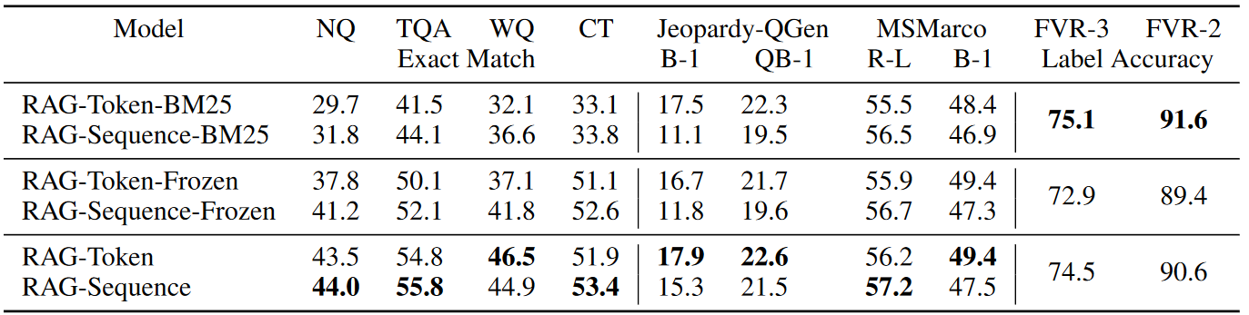
Results – Ablation
Notes:
BM25 replaces retriever
Fever – equivalent rag models

Slide 18
Conclusion
Hybrid generation: Access to parametric/non-parametric memory
Learned retrieval: Ablations support trainable retriever
Index hot-Swapping: Update model memory on the fly
Fewer hallucinations
Knowledge source bias
Notes:
The key insight is making this entire system end-to-end differentiable, allowing it to learn which information to retrieve and how to use it during fine-tuning.

Slide 19
Questions?

Slide 20
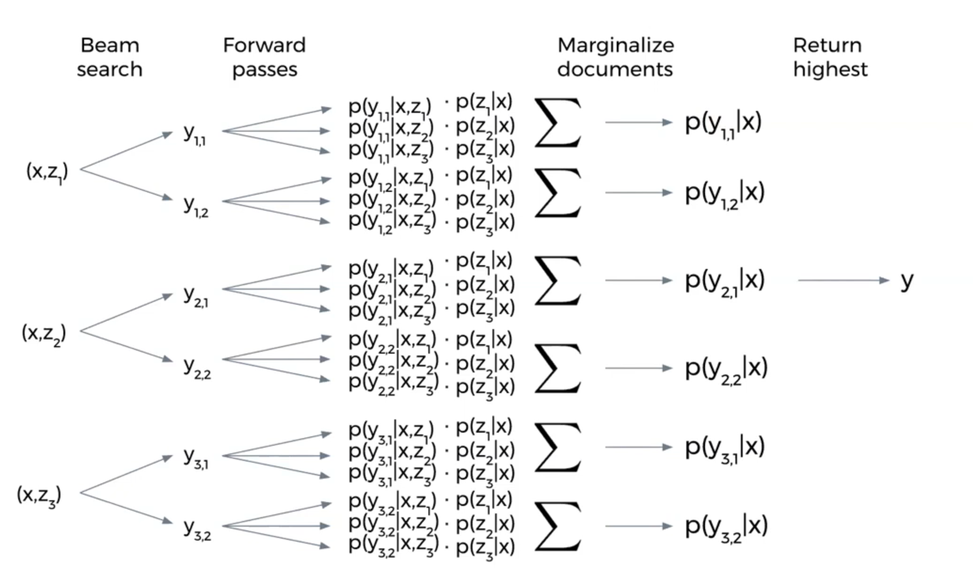
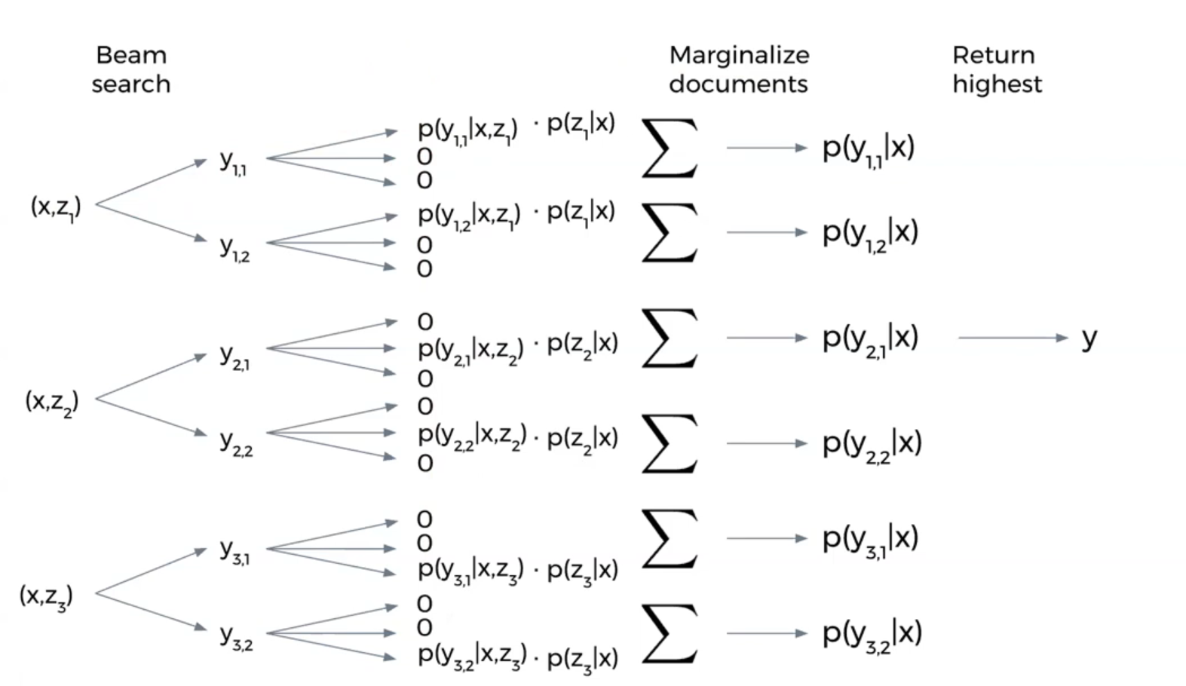
Notes:
Optimizes distance between question and relevant passage vectors compared to irrelevant ones
Requires surprisingly few training examples (as few as 1000) to outperform traditional retrieval

Slide 21
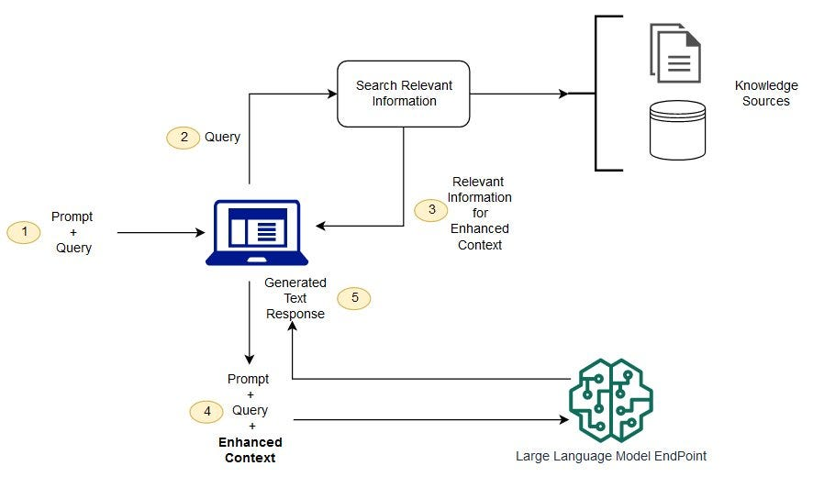
https://docs.aws.amazon.com/sagemaker/latest/dg/jumpstart-foundation-models-customize-rag.html

Slide 22
NOTES
Notes:
# Retrieval-Augmented Generation (RAG) for Knowledge-Intensive NLP Tasks
## Background & Motivation
### The Problem
- Pre-trained language models store knowledge in their parameters
- But they have limitations:
- Cannot easily expand or revise their knowledge
- Lack transparency in predictions
- May produce "hallucinations"
- Knowledge is frozen at training time
### Previous Approaches
- Task-specific architectures with retrieval for individual tasks
- Pure parametric models like T5 and BART
- Memory networks and other specialized architectures
- But no general solution combining parametric and non-parametric memory
## The RAG Approach
### Key Innovation
- Combines pre-trained parametric memory (BART) with non-parametric memory (Wikipedia index)
- End-to-end differentiable architecture for both retrieval and generation
- Can be fine-tuned for any sequence-to-sequence task
### Architecture Components
1. Retriever (DPR):
- BERT-based bi-encoder architecture
- Learns to retrieve relevant documents given input
- Returns top-k documents using Maximum Inner Product Search
2. Generator (BART):
- Pre-trained seq2seq transformer
- Generates output conditioned on input and retrieved documents
- 400M parameters
### Two Model Variants
1. RAG-Sequence:
- Uses same retrieved document for entire output sequence
- Marginalizes over documents for final prediction
2. RAG-Token:
- Can use different documents for each output token
- More flexible but potentially less coherent
## Methods & Implementation
### Training Process
- Joint end-to-end training of retriever and generator
- No direct supervision on which documents to retrieve
- Minimize negative log-likelihood of targets
- Document encoder kept frozen, only fine-tune query encoder and generator
### Key Implementation Details
- Uses December 2018 Wikipedia dump split into 21M passages
- FAISS index for efficient document retrieval
- Mixed precision training across 8 GPUs
- Flexible number of retrieved documents (typically 5-50)
## Experimental Results
### Tasks Evaluated
1. Open-domain QA (Natural Questions, TriviaQA, WebQuestions, CuratedTrec)
2. Abstractive QA (MS-MARCO)
3. Jeopardy Question Generation
4. Fact Verification (FEVER)
### Key Findings
#### Open-domain QA
- State-of-the-art results on all datasets
- Outperforms both pure parametric and pure retrieval approaches
- Can generate correct answers even when not in retrieved documents
#### Generation Tasks
- More factual and specific outputs than BART baseline
- Higher diversity in generated text
- Better human evaluation scores for factuality and specificity
#### Fact Verification
- Competitive results without requiring retrieval supervision
- Within 4.3% of state-of-the-art pipeline systems
### Ablation Studies
- Learned retrieval improves performance vs. frozen
- Dense retrieval better than BM25 except for FEVER
- More retrieved documents generally helps RAG-Sequence
- RAG-Token peaks around 10 documents
## Key Advantages
1. Flexibility
- Single architecture for multiple tasks
- Can be fine-tuned like any seq2seq model
2. Updateability
- Knowledge can be revised by updating document index
- No retraining required
3. Interpretability
- Retrieved documents provide insight into model decisions
- Transparent knowledge source
4. Performance
- State-of-the-art results with fewer parameters
- More factual and specific generations
## Limitations & Future Work
### Current Limitations
- Retrieval can "collapse" for some tasks
- Computationally intensive
- Requires significant CPU memory for document index
- May not be ideal for tasks not requiring external knowledge
### Future Directions
- Joint pre-training of retriever and generator
- More efficient document indexing
- Better handling of tasks with long outputs
- Integration with other knowledge sources
## Conclusion
RAG represents a significant advance in combining parametric and non-parametric approaches for NLP:
- Strong performance across diverse tasks
- More factual and controllable than pure parametric models
- Practical advantages in updateability and interpretability
- Promising direction for future research in knowledge-intensive NLP

Slide 23
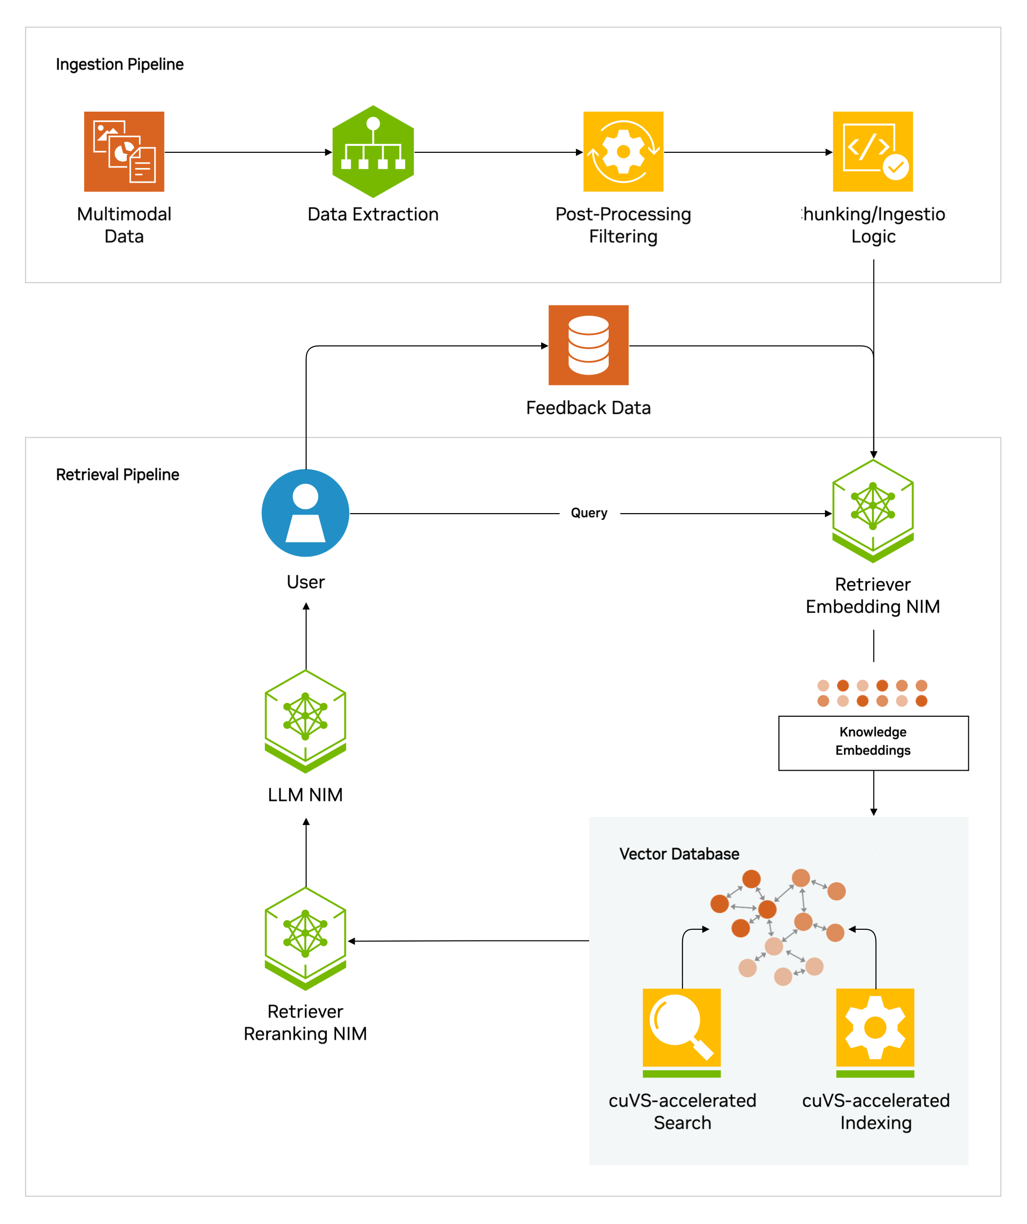
https://developer.nvidia.com/topics/ai/retrieval-augmented-generation

Slide 26
https://blog.langchain.dev/tutorial-chatgpt-over-your-data/
https://developer.nvidia.com/topics/ai/retrieval-augmented-generation

Slide 27
https://github.com/aishwaryanr/awesome-generative-ai-guide/blob/main/research_updates/rag_research_table.md
https://developer.nvidia.com/topics/ai/retrieval-augmented-generation

Slide 28


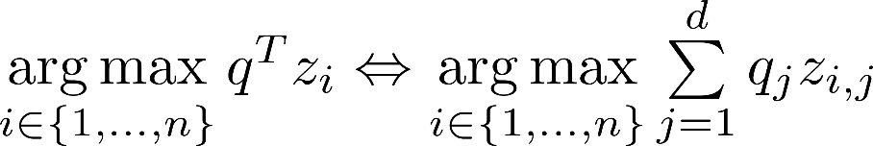

Dense Passage Retrieval
FAISS READING
Question vector
Bi-Encoder Architecture
Database of passage vectors
Maximum Inner Product Search (MIPS)
Facebook AI Similarity Search (FAISS)
Karpukhin, V. et al. (2020). Dense Passage Retrieval for Open-Domain Question Answering. EMNLP 2020, Online. ACL.
Notes:
Optimizes distance between question and relevant passage vectors compared to irrelevant ones
Requires surprisingly few training examples (as few as 1000) to outperform traditional retrieval

Slide 29
https://arxiv.org/abs/2408.13533
https://developer.nvidia.com/topics/ai/retrieval-augmented-generation

Slide 30
Knowledge-Intensive NLP Tasks
Parametric?
Yes
No
Pretrained Language Model
Retrieval
Parameters capture knowledge
Costly updates
Precise and accurate
Costly labeling
Strong results for several tasks
Hallucinations
Easy to update
Heuristics lack flexibility
Diverse application space
Limited depth
Dense Retrieval
Challenging integration
Notes:
Parametric Models (e.g., GPT-3): Knowledge stored in fixed weights → static, prone to hallucination.
Non-Parametric Systems (e.g., IR + heuristics): Retrieve documents but lack generative fluency.
Key Limitation: Trade-off between dynamic knowledge access and coherent generation.
Modern language models have shown remarkable ability to store knowledge in their parameters through pre-training.
Static knowledge base - costly to expand
- Specialized architectures for specific tasks like question answering
Larger parametric models like T5
Some have explored memory networks and other architectures that separate computation from memory
However, until RAG, we lacked a general-purpose solution that could effectively combine the benefits of parametric and non-parametric approaches"

Slide 31
Knowledge-Intensive NLP Tasks
Parametric Memory (BART)
Non-parametric Memory (Wikipedia)
Notes:
"RAG's core innovation is to combine two types of memory:
Parametric memory through the BART language model, which provides general language understanding and generation capabilities
Non-parametric memory through a Wikipedia knowledge base that can be easily updated
The key insight is making this entire system end-to-end differentiable, allowing it to learn which information to retrieve and how to use it during fine-tuning.

Slide 32
Significance
Parametric Memory (BART)
Non-parametric Memory (Wikipedia)
Notes:
Slide 5: RAG vs. Previous Models
Feature
RAG
Previous Models
Knowledge
Dynamic (external corpus)
Static (parametric) or heuristic
Training
Joint retriever-generator
Isolated components
Hallucination
Reduced via grounding
High in generative models
Adaptability
Update corpus → new knowledge
Requires retraining
Slide 6: Significance of RAG
Key Innovations
Unified Framework: Seamless integration of retrieval and generation.
Dynamic Knowledge: Avoids knowledge cutoff via updatable corpus.
Reduced Hallucination: Generations grounded in retrieved evidence.
Versatility: Applicable to QA, dialogue, summarization.
Theoretical Impact: Introduced non-parametric memory as a first-class citizen in generative models.

Slide 33
Developments
Parametric Memory (BART)
Non-parametric Memory (Wikipedia)
Notes:
Slide 7: Evolution Since 2020
1. Enhanced Retrieval
Shift from sparse (BM25) to dense retrievers (ANCE, DPR).
Efficiency via FAISS for billion-scale similarity search.
2. Scaling & Integration
Larger generators (T5, GPT-3 + retrieval).
REALM, FiD: Alternate architectures for retrieval-augmentation.
3. Applications
Enterprise search, medical QA, legal document analysis.
4. Training Advances
Contrastive learning for retrievers; multi-task fine-tuning.

Slide 34
Conclusion & Future Directions
Parametric Memory (BART)
Non-parametric Memory (Wikipedia)
Notes:
Slide 9: Conclusion & Future Directions
Why RAG Matters
Resolves the knowledge-lag problem in generative AI.
Balances fluency and factual accuracy.
Future Work
Real-time retrieval optimization.
Cross-lingual/multimodal retrieval.
Ethical safeguards for retrieved content.
Final Takeaway: RAG redefined generative NLP by unifying retrieval and generation, setting the stage for knowledge-aware AI systems.

Slide 35
https://arxiv.org/pdf/2404.10981
https://developer.nvidia.com/topics/ai/retrieval-augmented-generation

