Slide 1

ECE 696B: Spring 2025 Trustworthy Machine Learning Tree of Thoughts: Deliberate Problem Solving with Large Language Models
Presented by: Zhenyu Jin

Slide 2
Questions Raised
The inference process of LLMs is still at the token level, proceeding from left to right.
Previously, Chain-of-Thought (CoT) has allowed LLMs to reason through problems step by step. However, CoT has an obvious drawback: it neither expands on intermediate steps nor incorporates foresight or backtracking.

Slide 3
Inspiration
Humans have two modes of decision-making: one that is fast, automatic, and unconscious, and another that is slow, deliberate, and conscious. The former is known as System 1, while the latter is referred to as System 2.
Which one does simple token-level associative decisions resemble?

Slide 4
Background
1. Input-Output (IO) Prompting
The most commonly used method—input a question and get an answer.
2. Chain-of-Thought (CoT)
When the relationship between the input question and the output answer is not immediately obvious or intuitive (such as in mathematical derivations), CoT enables the model to generate intermediate reasoning steps.
Under CoT, the transition from each step to the next is clear and logical, linking an otherwise disconnected input and output through a structured reasoning process.
3. Self-Consistency with CoT (CoT-SC)
This method involves running CoT multiple times and then making a final decision by voting on the generated outputs. CoT-SC improves the performance of CoT because LLMs can prove the same theoretical question in different ways. Additionally, by sufficiently expanding the reasoning process, the final conclusion becomes more reliable.
However, each reasoning chain in CoT-SC does not involve "local expansions" (branching into different paths). Furthermore, the voting mechanism is only effective in cases where the output space is limited (e.g., multiple-choice questions).

Slide 5
Theory Generated
This paper proposes extending the reasoning capabilities of LMs into a tree structure, referred to as Tree-of-Thoughts (ToT), where each "thought" corresponds to a node in the tree.
This paper introduces a self-evaluation method for LMs, which serves as a heuristic to guide ToT's search process.
Compared to the previously mentioned methods, ToT can expand into different sequential thought branches, forming the tree's structure.

Slide 6
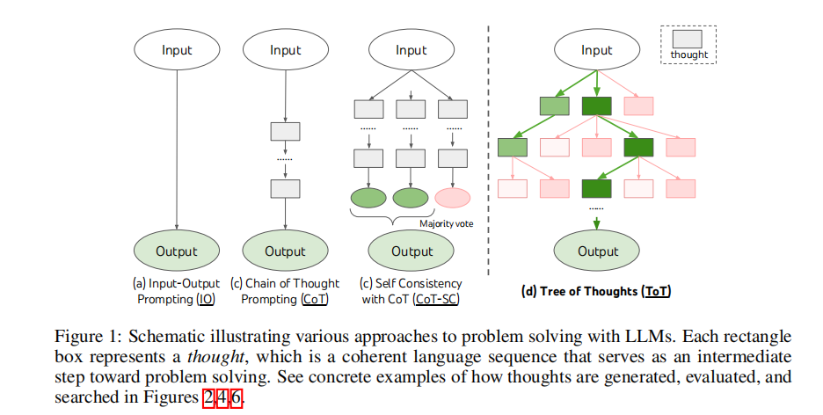
Graphically Discription
ToT abstracts the problem as a search task on a tree structure, and such a search task consists of four components: thought decomposition, thought generator, state evaluator and search algorithm

Slide 7
1. Thought Decompostion
Different problems require different decomposition methods. In the three experiments presented in this paper, a thought can be a group of words (Crossword game), an equation (24-point game), or a writing plan (creative writing).
When decomposing thoughts, the following principles should be followed:
The thought should be short enough for LMs to generate promising and distinct ideas.
The thought should also be long enough for LMs to evaluate whether it is promising.

Slide 8
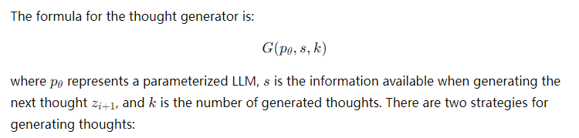

2. Thought Generator
Generating k numbers of independent distribution of thoughts from a CoT prompt
(same goal but different forms)
The formula is:
Essentially, this method applies a CoT reasoning prompt (k times) to generate k
different thought branches.
Generating (a sequence of) thought proposals from a single prompt
The formula representation is:

Slide 9
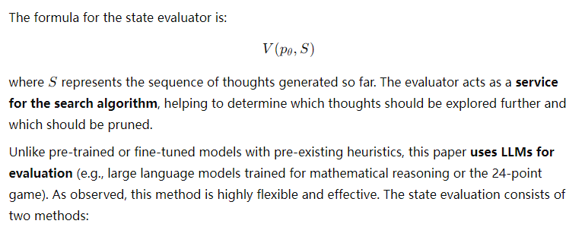

3.1 State Evaluator
Independently evaluating a thought:
A specially designed scoring prompt is used to evaluate the state s, generating either a
scalar score v or a qualitative label (such as sure/likely/impossible).

Slide 10

3.2 State Evaluator
(continue)
Vote between different states:
Good states represents that s* is determined by voting among all states in
S. When the success of a solution cannot be easily determined by scoring individual states (such as evaluating the quality or coherence of an article), comparative evaluation becomes more suitable.
In experiments, this paper inputs prompts multiple times into the evaluator to obtain either the average score or the final voting result.

Slide 11
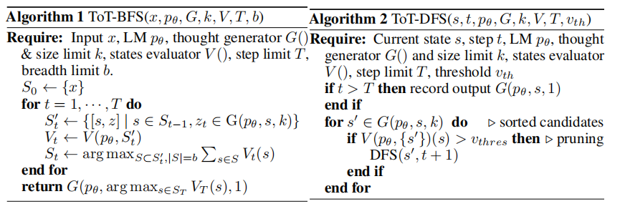
4.1 Search Algorithm
This paper adopts the most basic BFS (Breadth-First Search) and DFS (Depth-First Search) as the search algorithms.

Slide 12
4.2 Search Algorithm-BFS
Breadth-First Search (BFS) generates k thoughts S_t ‘ in each round. The state evaluator then assesses all thoughts, producing corresponding scores or classifications V_t​. Finally, the top b most promising thoughts based on V_t
​are retained to form the final thought set S_t. The ultimate goal is to find the thought with the highest evaluation score at the final step.

Slide 13
4.3 Search Algorithm-DFS
Depth-First Search (DFS) generates k thoughts per round, then ranks them using the state evaluator, prioritizing the most promising ones for expansion. If a thought's evaluation result falls below a threshold v_th, pruning occurs, and the search backtracks to the previous state - parent node, then attempts to expand the next child node.

Slide 14
TOT Advantages
In theory, ToT has the following advantages:
Generality: IO, CoT, and CoT-SC, and even self-correction methods are all special cases of ToT.
Modularity: Each step of ToT is highly modular.
Adaptability: ToT can be adjusted based on different problem types, LLM capabilities, and resource constraints by modifying specific parameters.
Convenience: No additional model training is required

Slide 15
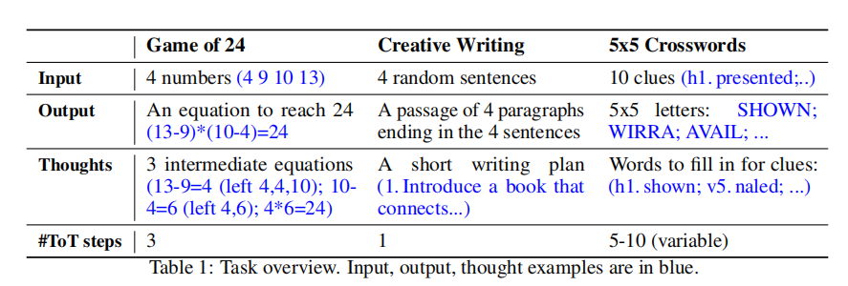
Experiments-result in one table

Slide 16
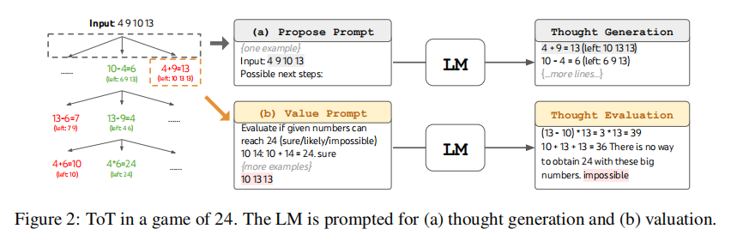
Experiment1-Game of 24
Task Setup:
Select 100 problems from http://4num.com for testing, plus five additional problems for prompt context (to guide the model on what to do).
A problem is considered successfully completed if the model provides a correct solution.

Slide 17
Experiment1-Game of 24
Baseline Methods:
IO: Use a prompt containing five context examples. For each problem, repeat the input 100 times and calculate the number of successful attempts.
CoT: Expand the five context examples from simple input-output pairs to step-by-step reasoning. Each problem is repeated 100 times, and success rate is measured.
CoT-SC: Same as CoT, but instead of counting the number of successes, CoT-SC determines whether success is more frequent than failure across the 100 attempts.
IO+Refine: Based on IO, if the model makes a mistake, it is prompted to reflect on the error and generate a revised answer—up to 10 refinements per question.
Tree-of-Thoughts (ToT) Approach:
Decomposed into three steps, where each step represents an equation. The model is explicitly informed of the remaining numbers and prompted to generate a set of possible next steps.
BFS search is used, retaining only the five most promising thoughts. The evaluator assesses each thought based on whether it is sure/maybe/impossible to reach 24.

Slide 18
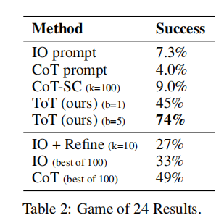
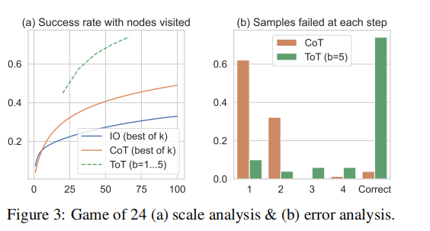
Experiment1-Game of 24-Result
Even when ToT retains only one branch per layer (denoted as ToT b=1), it still achieves a 45% success rate.
The key difference from CoT is that ToT b=1 selects the most promising thought from all generated candidates, with the involvement of an evaluator.

Slide 19
Experiment1-Game of 24-Result
Key Findings from Figure 3:
Figure 3(a): The results indicate that regardless of how many nodes are visited, IO and CoT never outperform ToT (for any b=1...5). (The dashed line represents the aggregated ToT results across different values of b).
Figure 3(b): Computes the failure rate at each step for both CoT and ToT.
In CoT, failure is defined as the step where the thought sequence breaks down.
In ToT, failure occurs when all b generated thoughts fail at a given step.
The analysis reveals that around 60% of CoT samples fail immediately after the first step.This highlights a fundamental issue with left-to-right token-level generation, as CoT lacks the ability to revise or backtrack.

Slide 20
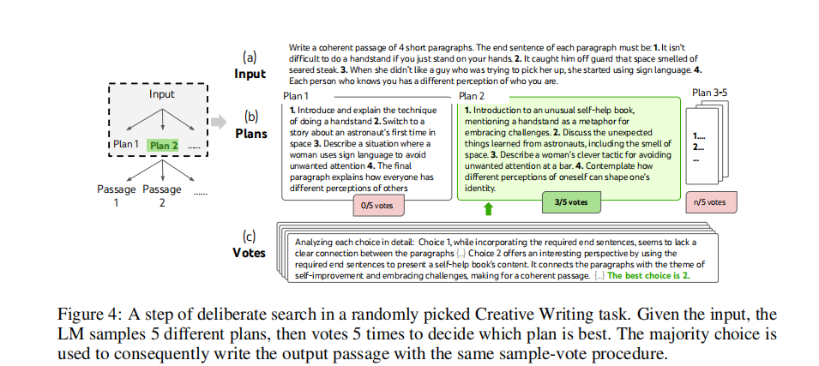
Experiment2-Creative Writing
Task Setup:
100 input prompts are randomly selected from http://randomwordgenerator.com.
Using GPT-4 to score the coherence of the generated text on a scale of 1-10.
Human evaluation, where people compare outputs from different methods (e.g., CoT vs. ToT) and judge which is more coherent for the same input.

Slide 21
Experiment2-Creative Writing
Baseline Methods:
This task is zero-shot.
IO: Directly input the prompt and let the LLM generate a constrained coherent passage. Each prompt runs 10 times.
CoT: Before generating the passage, the LLM first outputs a simple plan (intermediate step). Each prompt runs 10 times.
IO+Refine (k≤5): The LLM assesses whether the generated passage meets the initial coherence constraints. If not, it iteratively refines the passage up to 5 times.
ToT Approach:
The LLM first generates 5 plans.
A state evaluator votes on the plans and selects the one with the highest score.
Based on the selected plan, the LLM generates 5 different passages.
The evaluator votes on the best passage.

Slide 22
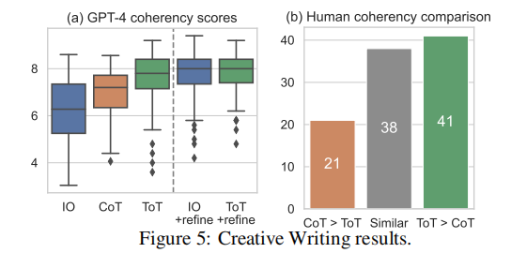
Experiment2-Creative Writing-Result
Figure 5(a) shows that ToT-generated passages are rated by GPT-4 as more coherent compared to those generated by IO and CoT.
To address concerns about the rigor of GPT-4’s scoring, Figure 5(b) presents human preferences when comparing ToT and CoT-generated passages. The results indicate that humans also favor ToT-generated passages more often.

Slide 23
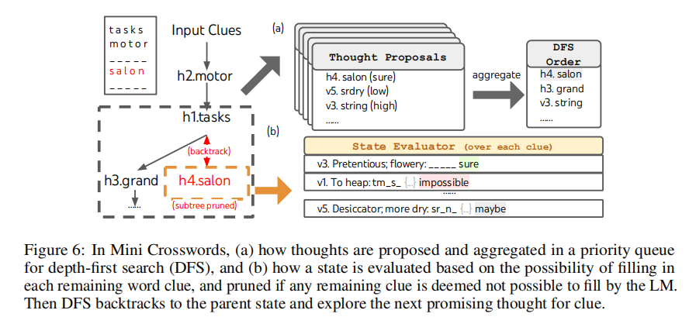
Experiment3-Crosswords
It is worth noting that the goal of this experiment is not to solve the crossword puzzle task but rather to explore the limitations of using LMs themselves as a heuristic method.

Slide 24
Experiment3-Crosswords
Task Setup:
20 crossword puzzles were selected from GooBix to evaluate ToT's guidance capability, with 5 additional puzzles used for designing prompts.
For each puzzle, the initial input consists of 5 horizontal word clues and 5 vertical word clues.
The output should be 10 words (filling all 25 letters) to complete the crossword grid.
To assess ToT’s guidance effectiveness, this paper evaluates three levels of performance:
The number of correct letters (maximum of 25 per game).
The number of correct words (maximum of 10 per game).
Whether the puzzle is fully completed.
Baseline Methods:
IO: The prompt includes 5 selected input-output examples to guide the LLM. Each prompt runs 10 times, and the average result is taken.
CoT: Builds upon the IO prompt, but includes intermediate steps where previously filled words are shown in sequence: h1, ..., h5, v1, ..., v5.

Slide 25
Experiment3-Crosswords
ToT Approach:
DFS is used to expand the most promising word clues continuously. If the current state is determined to be unsolvable, backtracking occurs to explore alternative states.
When filling a new word, ToT ensures that previously filled letters are not overwritten.
Each state in ToT completes one word, so the maximum depth of ToT’s search tree is 10.
Prompt Design for ToT:
Already filled letters are appended to their corresponding clues in the prompt (e.g., v1. To heap: tm_s_, as shown in the figure).
The designed prompt is input into the LLM 5 times to generate 5 ranked sequences of proposed words and placements (as shown in the Thought Proposals in the figure).
Each proposal is assigned a confidence level, and the results are aggregated to determine the final DFS search order.
State Evaluation (as shown in the figure):
The current filled words and remaining clues are input into the evaluator.
If any clue is determined to be unsolvable, the branch is immediately pruned, and backtracking occurs.
To improve efficiency:
The DFS maximum search depth is limited to 100 steps.
If the search reaches 100 steps without a solution, the deepest explored state is used as the final output.

Slide 26
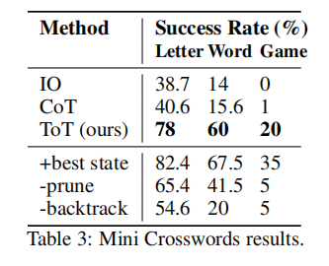
Experiment3-Crosswords-Result
The results are clear—ToT outperforms both baseline methods at every level, even successfully completing 4 full crossword puzzles.
This approach performs even better than ToT, indicating that the current heuristic (LM evaluator) still has room for improvement.
What happens without pruning?
What happens without backtracking?
"-backtrack" means no backtracking is used. Instead, at each step, the model chooses the most promising clue, overwriting previously filled letters if necessary, and limits the search depth to 20 layers.
Key Takeaways:
The results from "-prune" and "-backtrack" show that pruning and backtracking are essential for successfully solving an entire crossword puzzle.

Slide 27
Summary and Conclusion
Limitations:
This paper represents a preliminary exploration of LMs' search capabilities. When investigating LMs' ability to make decisions in real-world tasks, more complex challenges will arise, further testing their capabilities.
Additionally, using ToT to guide LMs in search requires more computational resources (e.g., increased GPT-4 API calls). However, ToT's high modularity allows for trade-offs between search performance and computational cost.
Lastly, this paper directly uses pre-trained LMs. If ToT-style counterfactual decision-making were used for fine-tuning (e.g., considering multiple potential next-paragraph choices instead of simply predicting the next token), it might further enhance LMs' ability to solve reasoning-intensive tasks.
Conclusion:
The associative capabilities of LMs (System 1) can be enhanced by complex reasoning abilities (System 2) through search-based problem-solving approaches.
ToT is a form of prompt engineering that provides a feasible method to restore LMs' reasoning ability to its core logical foundation. In essence, it represents a fusion of LMs' capabilities and traditional search problem-solving techniques.

