Slide 1

ECE 696B: Spring 2025 Trustworthy Machine Learning GPT-2
Ashley Tittelbaugh

Slide 2
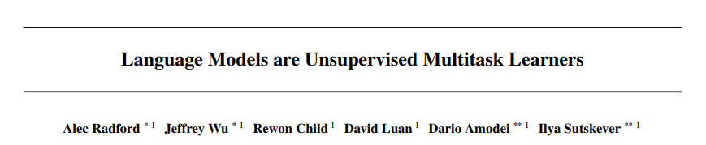
Overview
Zero-shot performance
Published by OpenAI
GPT-2
Cited 15,480 times
(as of Jan 27, 2025)

Slide 3
Previous Work and Shortcomings
GPT-1/BERT: Generalized Pre-training and Fine-tuning
Generalized Pre-training:
Large Data-set
No given task
Fine-tuning:
Modifies all parameters for a specific task
Structure inputs
What are some issues/problems with this model ?
Architectures, Algorithms and/or Training is Task Specifc
Issue 1: Requires pre-known knowledge and sufficient data
Issue 2: Diverse inputs -> low performance

Slide 4

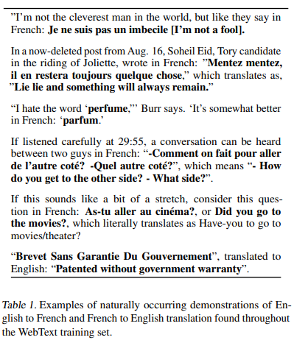
New Idea
Main Idea: Use a large dataset to perform unsupervised learning to result in competitive zero-shot results
Task interpretation from language

Slide 5
Relevant Changes and Updates
Previous
GPT-2
Dataset
Small, Task Specific
Dataset
News Articles, Wikipedia
Common Crawl
WebText – Large and quality
Large but not quality
Input Encodings
Input Encodings
Byte-Pair Unicode encodings
Large vocab
Duplicate information
Byte-Pair encodings at byte level
Restricted combinations
Dog. Dog? Dog!

Slide 6
WebText
Reddit outgoing links with 3 or more karma
“Quality Control”
45 million outgoing links
De-duplication
40GB of text
NO Wikipedia documents
Worries about recursive sourcing

Slide 7
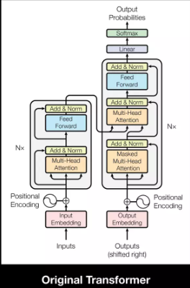
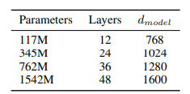

Transformer Architecture
Based on the GPT-1 transformer architecture
Layer normalization moved to the input of each block
Additional LayerNorm added after the self-attenuation block
Vocabularly 50,257

Slide 8
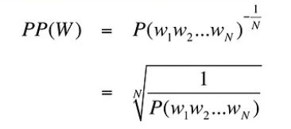
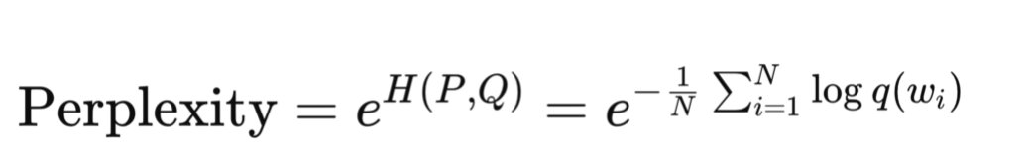

Aside: Perplexity Scores
“The best model is one that predicts an unseen test set”
Lower score => less “perplexed” the model is with unseen inputs
Inverse probability of the test set normalized by the number of words
Comes from information theory $PP\left(W\right)= 2^{ cross entropy}$

Slide 9
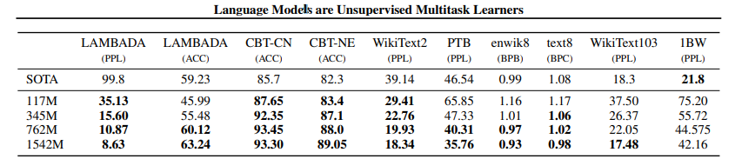
Results: Language Modeling
Language Modeling:
Primary task that they are trained for
Modify Preprocessing from normal testing parameter
De-tokenization
Remove unfamiliar characters
De-standardize text
“De preprocessing” Introduce extra error
Significant improvement in small datasets
Penn Tree Bank and Wiki Text each have 1 to 2 million tokens
Underperforms the 1 Billion Word benchmark
Largest data set
Could indicate underfitting
Most aggressive preprocessing

Slide 10
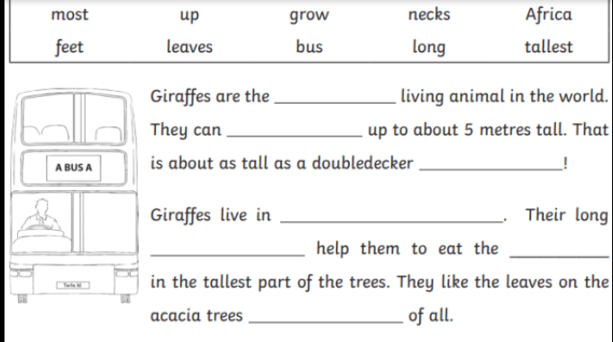
Aside: Cloze Tasks
Random parentage of words are masked
LLM are asked to “Fill in the blanks” from their vocabulary

Slide 11
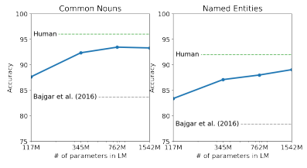
Results: Children’s Book Test
Children’s Book test:
Cloze task – random words are masked from various children's books
Performance of LLM on different categories of words
Performance increases with model size
Closes the majority of the gap between previous state of the art and human
One book – The Jungle Book – included in WebText
removed for testing

Slide 12
Results: Long Term Dependencies
LAnguage Modeling Broadened to Account for Discourse Aspects
Task is to predict final word of a sentence that requires at least 50 tokens for humans to predict correctly
GPT-2 improved on state of the art
Mistakes were often a valid continuation of the sentence but not the end of the sentence

Slide 13
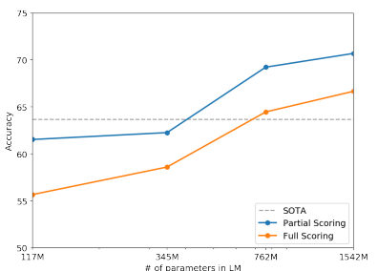
Results: Common Sense reasoning
Winograd Schema Challenges
Measures common sense reasoning by the ability to resolve ambiguities in text
Very small dataset

Slide 14
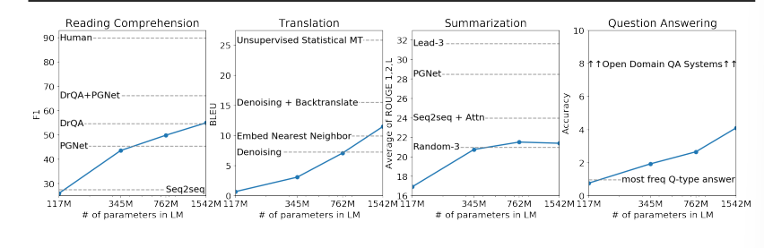
Results: Reading Comprehension
Conversation Question Answering dataset (CoQA)
7 distinct domains that contain dialogue between a question asker and a question answerer
Measures both reading comprehension ability and ability to retain context from previous conversation
GPT-2 seemed to use simple retrieval based characteristics rather than a more complex understanding

Slide 15
Results: Translation
Previously seen WMT
GPT-2 only slightly better than word by word replacement from English to French 5 BLEU
GPT-2 does much better French to English 11.5 BLEU
Due to large English database
Surprising result!
Had removed all non-English documents from WebText

Slide 16
Results: Summarization
CNN and daily mail dataset
Added TL;DR: token for task inference
Outputs resembled length and verbiage of summeries but often focused on specific details
Only slightly better than picking 3 sentences at random

Slide 17
Results: Question answering
Natural Questions dataset
Usually used with neural systems
Test what information is contained in a language model
GPT-2 is 5.3 times more accurate than smallest model
Greatly underperforms open domain question answering systems
Hybridize information retrieval with extractive document question answering

Slide 18
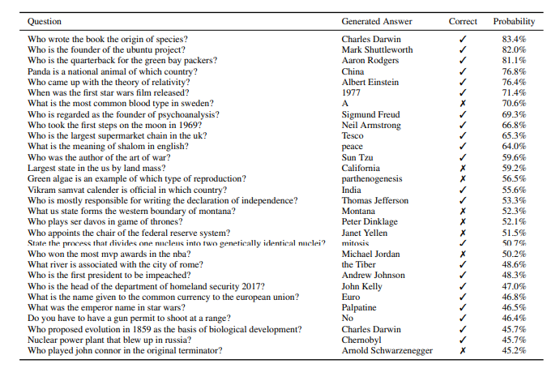

Slide 19
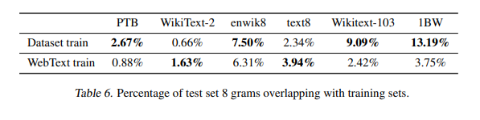
Memorization vs Generalization
Does such a large dataset just contain most of the answers?
GPT-2 contains equivalent or less overlapping data than standard training data
Can answer questions without having the answer in the dataset

Slide 20
Key Takeaways
With a large and quality dataset and model, GPT-2 Zero-shot results often preform at or above baseline
Language models can learn tasks from language
There are still some tasks where GPT-2 doesn’t preform very well

Slide 21
What’s Next?
Does not argue for complete switch to unsupervised models
Rather promotes further research into these multitask models with large unsupervised training as a first step.
Results show GPT-2 underfits WebText
There are benefits to be gained with even arger models

