Slide 1
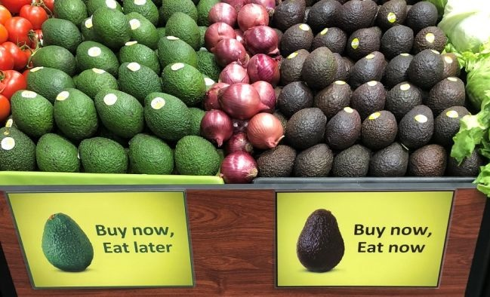
Machine Learning Project on Avacado Dataset
by Lalit Taneja
Nov 2018 Cohort

Slide 2
Story
Dataset retrieved for Avacados, with 18249 observations (rows) and 14 attributes (columns)
Dataset attributes includes the Avacado’s Date of Observation, Average Price, Total Volume, Total Bags, Type and Region
With the help of this dataset, I tried to predict the Average Price of Avacodo based on the predictor variables.

Slide 3
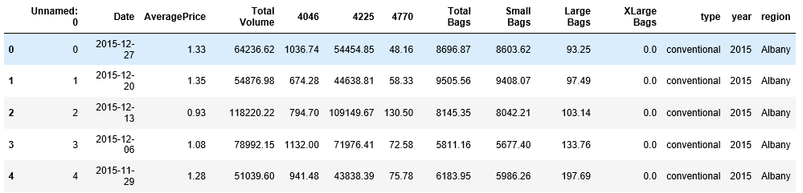
Data in depth
Total No. of records in dataset: 18,249
Total No. of columns (attributes): 14
‘Unnamed: 0’ attribute has index value, that can be ignored for analysis

Slide 4
Problem Statement
This project is to predict average price of Avacado from the given dataset for year 2015 -2018 using various regressions and arriving at the best fit model based on least RMSE

Slide 5
Data Profiling
Understood the data using the ‘info’, ‘dtypes’ and ‘describe’ methods of the dataframe into which data was loaded from the csv file.
Performed pre profiling using pandas profiling feature to understand the dataset info of each attribute and identify the values to be cleaned (refer the file Avacado_before_preprocessing.html)
Performed data cleaning:
Dropped column ‘Unnamed: 0’ since it represents index values
Split ‘Date’ column into ‘Month’ and ‘Day’
Performed post profiling using pandas profiling feature to ensure that the new dataset has clean values for the above mentioned columns (refer the file Avacado_post_profiling.html):

Slide 6
Data Analysis
Analyzed the data to understand following details and predict Average Price:
How Average Price is spread with respect to Date ?
How Average Price is spread with respect to Year ?
How Average Price is spread with respect to Month ?
How Avacado observations are spread with respect to type (Conventional or Organic)?
How Average Price is spread for Small Bags?
How Average Price is spread for Small Volume (column 4046) ?
How Average Price is spread for Large Bags?
How Average Price is spread for Large Volume (column 4225) ?
How Average Price is spread for XLarge Bags?
How Average Price is spread for XLarge Volume (column 4770)?
Correlation Matrix

Slide 7
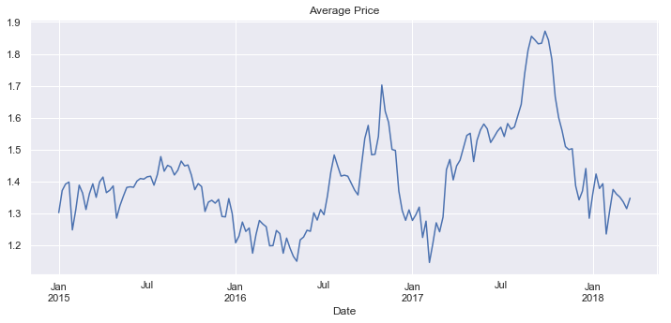
How Average Price is spread with respect to Date ?

Slide 8
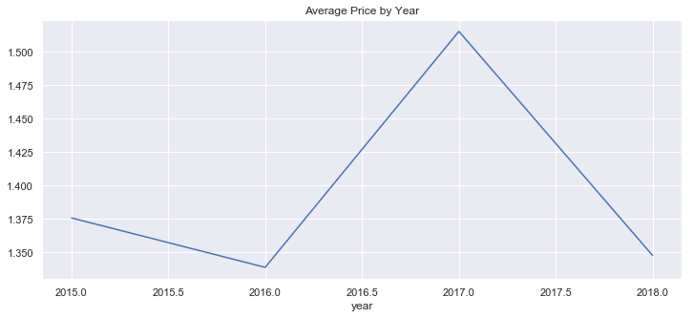
How Average Price is spread with respect to Year ?

Slide 9
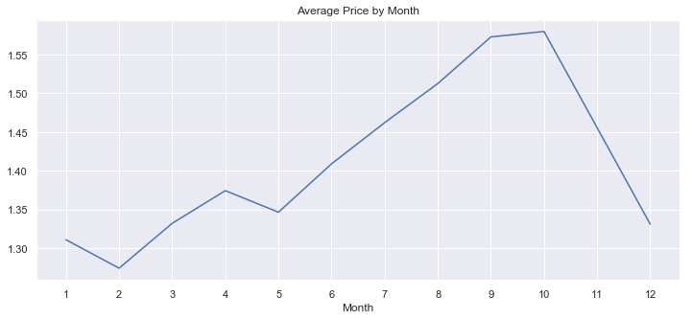
How Average Price is spread with respect to Month ?

Slide 10
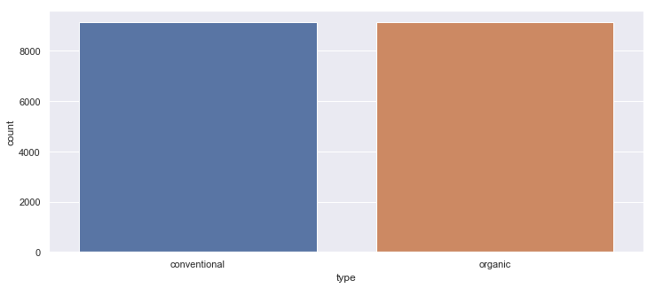
How Avacado observations are spread with respect to type (Conventional or Organic)?

Slide 11
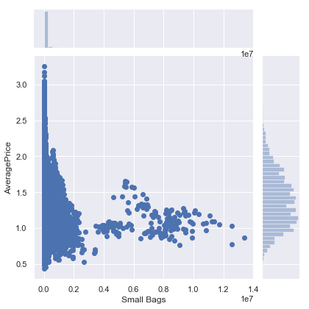
How Average Price is spread for Small Bags?

Slide 12
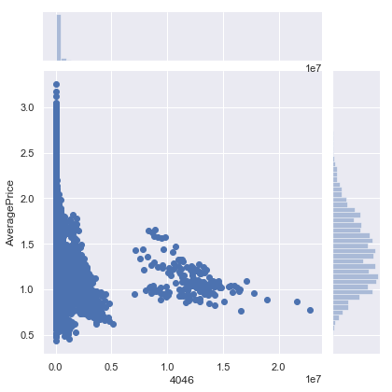
How Average Price is spread for Small Volume (column 4046) ?

Slide 13
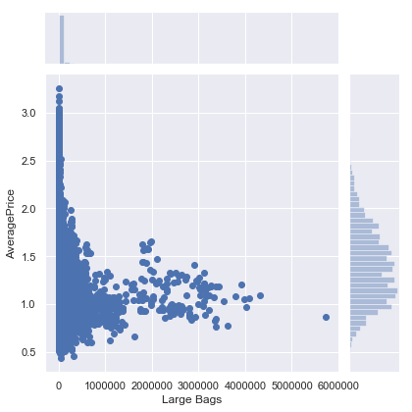
How Average Price is spread for Large Bags?

Slide 14
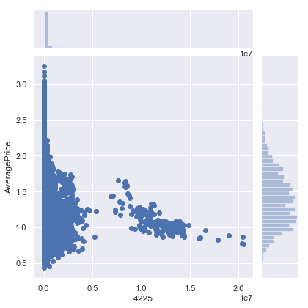
How Average Price is spread for Large Volume (column 4225) ?

Slide 15
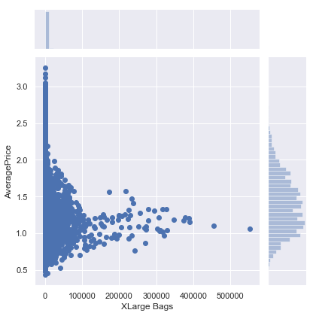
How Average Price is spread for XLarge Bags?

Slide 16
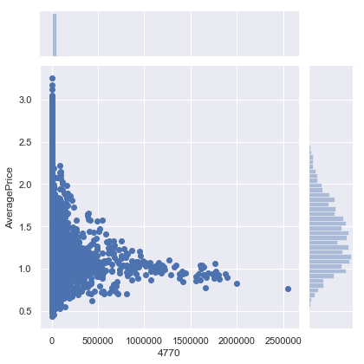
How Average Price is spread for XLarge Volume (column 4770)?

Slide 17
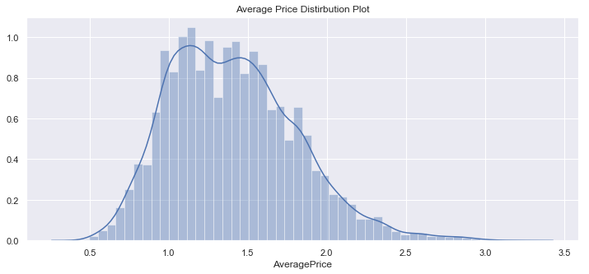
Average Price Distribution Plot

Slide 18
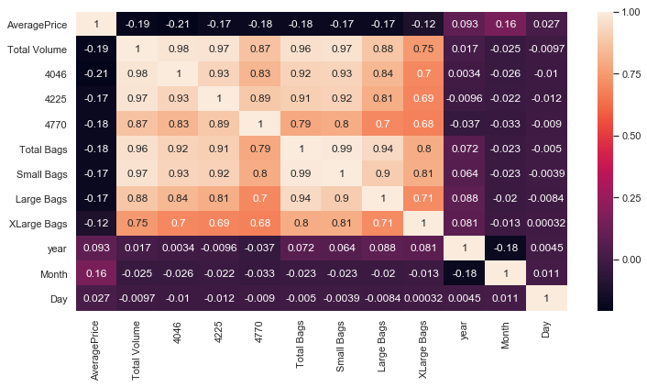
Correlation Matrix

Slide 19
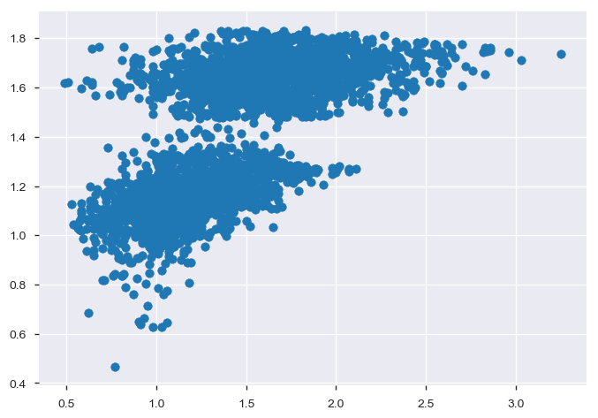
y_test vs predictions (Linear Regression)
Observation: Since the RMSE from this model is low (0.3009369374668302), so it can be said that we have created a good model. However, I checked to be more sure by plotting the y_test vs the predictions. It can be observed that there is no straight line, so it cannot be ensured that this is the best model that could be applied on our data.

Slide 20
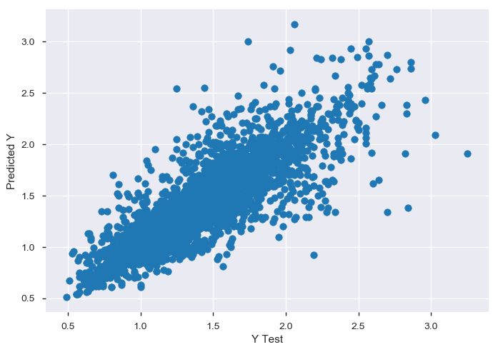
y_test vs predictions (Decision Tree Model)
Observation: Here it can be observed that we nearly have a straight line, and it seems to be better than the Linear Regression Model, and to be more sure I checked the RMSE. The RMSE from Decision Tree model is (0.2069136541506447) lower than the RMSE we got with Linear Regression model (0.3009369374668302).

Slide 21
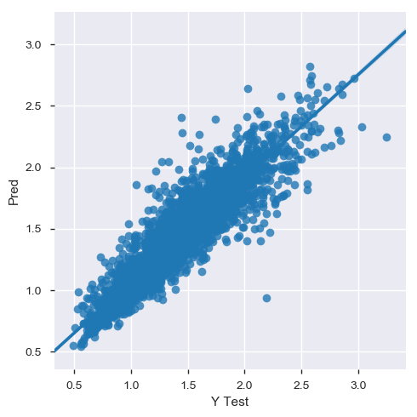
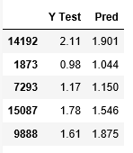
y_test vs predictions (Random Forest Model)
Observation: It can be observed that the RMSE from Random Forest model (0.14989820107303325) is lower than the Linear Regression (0.3009369374668302) and Decision Tree models (0.2069136541506447), so the Random Forest is the best model in our case.

Slide 22
Conclusion
Based on the various models applied, among Linear Regression, Decision Tree and Random Forest models, Random Forest model seems to be the best fit model in our case, considering the least RMSE among all the models

