Slide 1
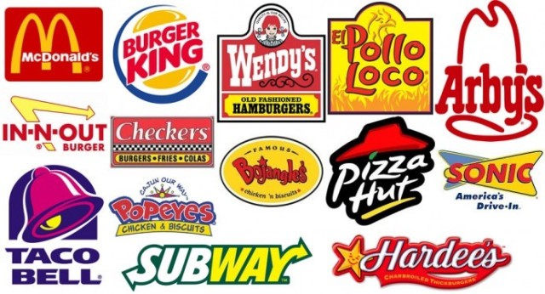
EDA on Fast Food Restaurants
by Lalit Taneja
Nov 2018 Cohort

Slide 2
Story
Dataset retrieved for Fast Food Restaurants in USA, with 10000 observations (rows) and 10 attributes (columns)
Dataset attributes includes the restaurant’s Address, City, Latitude, Longitude, Name, Postal Code, Province and Websites
With the help of this dataset, I tried to gain the following insights:
Largest and smallest fast food restaurant chains
Regions with highest and fewest concentration of fast food restaurants
Provinces with highest and fewest concentration of fast food restaurants
Cities with highest and fewest concentration of fast food restaurants

Slide 3
Data in depth
Total No. of records in dataset: 10,000
Total No. of columns (attributes): 10
Most of the data contains categorical values
‘country’ attribute has constant value ‘US’
‘name’ attribute seems to contain duplicate values that needs to be cleaned
‘province’ attribute seems to contain inconsistent value for ‘CO’ that needs to be cleaned

Slide 4
Problem Statement
This project has been executed to perform EDA using Pandas on the Fast Food Restaurants data and provide actionable insights to the stakeholders. The stakeholders can be:
existing restaurants management,
person who want to start a fast food restaurant post understanding the current business scenario
food delivery chains who accepts and deliver food at door step

Slide 5
Data Profiling
Understood the data using the ‘info’, ‘dtypes’ and ‘describe’ methods of the dataframe into which data was loaded from the csv file.
Performed pre profiling using pandas profiling feature to understand the dataset info of each attribute and identify the values to be cleaned (refer the file FastFoodRestaurants_before_preprocessing.html)
Performed data cleaning:
Dropped column ‘country’ since it has constant value ‘US’
Dropped column ‘keys’ since this being a derived column
Updated values in columns ‘name’ and ‘province’ to ensure the values are uniform and consolidated while reporting instead of being considered separately
Introduced a new feature ‘region’ to understand the restaurant distribution region-wise
Performed post profiling using pandas profiling feature to ensure that the new dataset has clean values for the above mentioned columns and also the new feature ‘region’ has been added to the dataset (refer the file FastFoodRestaurants_post_profiling.html):

Slide 6
Data Analysis
Analyzed the data to gain following details:
How the restaurants are distributed region-wise ?
What is the percentage distribution of Top 10 restaurants ?
What is the percentage distribution of Bottom 10 restaurants ?
Which are the Top 10 Provinces ?
Which are the Bottom 10 Provinces ?
Which are the Top 10 Cities ?
Which are the Bottom 10 Cities ?
What is the distribution of top 10 restaurants in California ?
How McDonald's restaurant is distributed in top 10 provinces ?
How McDonald's restaurant is distributed in top 10 cities ?
Restaurants distribution as per Region, Province and City ?
Perform Label Encoding for Categorical Variables
Correlation Matrix of Fast Food Restaurants
Donut Plot with Regions and Top 10 Provinces

Slide 7
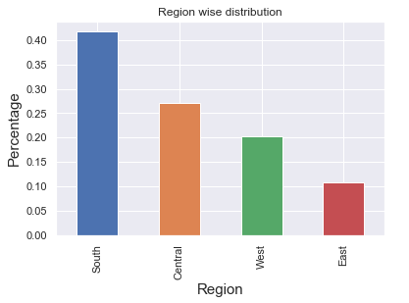
How the restaurants are distributed region-wise ?
Actionable insight: With the help of this distribution, the existing and new entrepreneurs in this field could focus to open restaurants in West and East regions in US after also understanding the population density in the cities and provinces under these regions

Slide 8
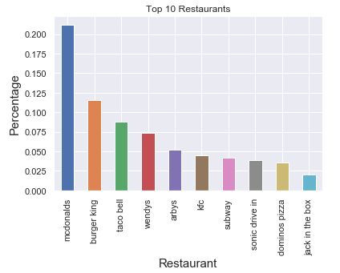
What is the percentage distribution of Top 10 restaurants ?

Slide 9
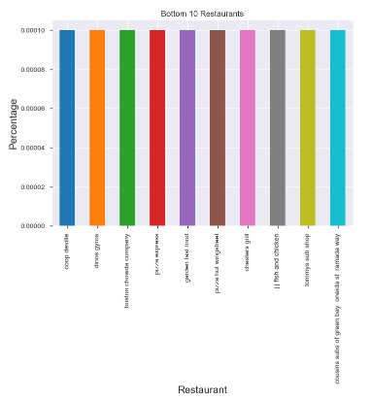
What is the percentage distribution of Bottom 10 restaurants ?

Slide 10
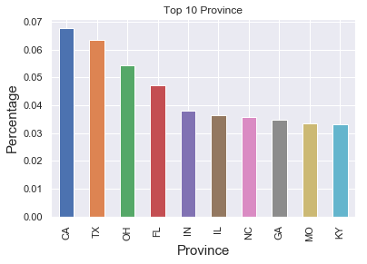
Which are the Top 10 Provinces ?
Actionable insight: With the help of this distribution, the food delivery chains can focus on CA, TX, OH and FL provinces due to presence of large number of restaurants in these provinces.

Slide 11
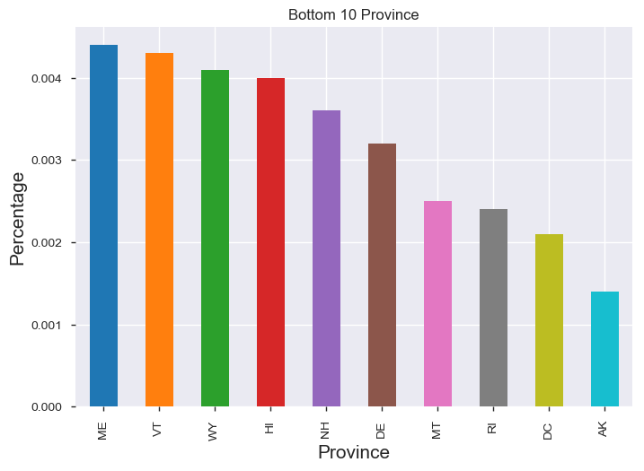
Which are the Bottom 10 Provinces ?
Actionable insight: With the help of this distribution, the existing and new entrepreneurs in this field could focus to open restaurants in these cities where limited number of restaurants seems to be present, and also less competition.

Slide 12
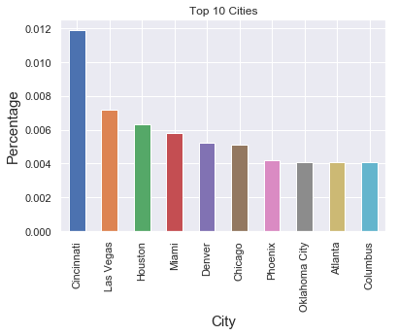
Which are the Top 10 Cities ?
Actionable insight: With the help of this distribution, the food delivery chains can focus on Cincinnati, Las Vegas, Houston and Miami cities due to presence of large number of restaurants in these cities.

Slide 13
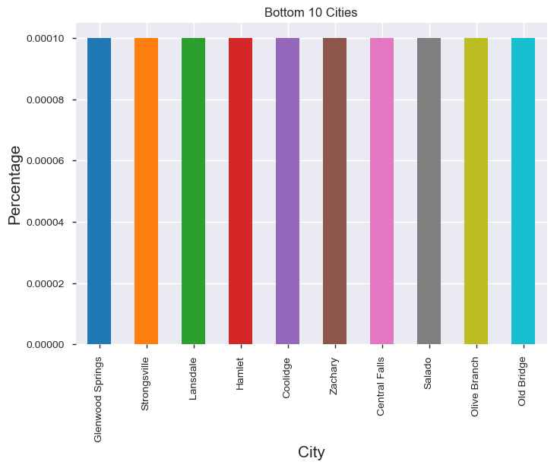
Which are the Bottom 10 Cities ?

Slide 14
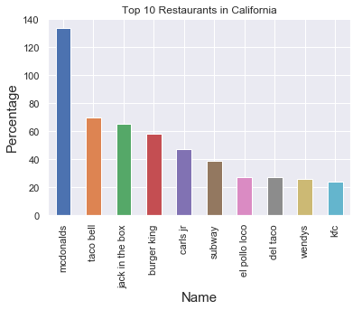
What is the distribution of top 10 restaurants in California (Topmost province)?

Slide 15
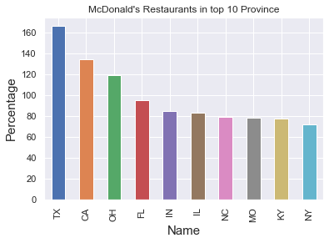
How McDonald's restaurant is distributed in top 10 provinces ?

Slide 16
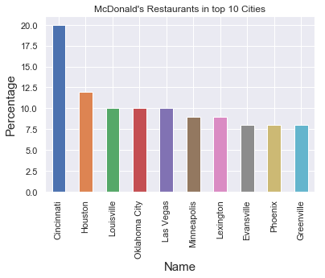
How McDonald's restaurant is distributed in top 10 cities ?

Slide 17
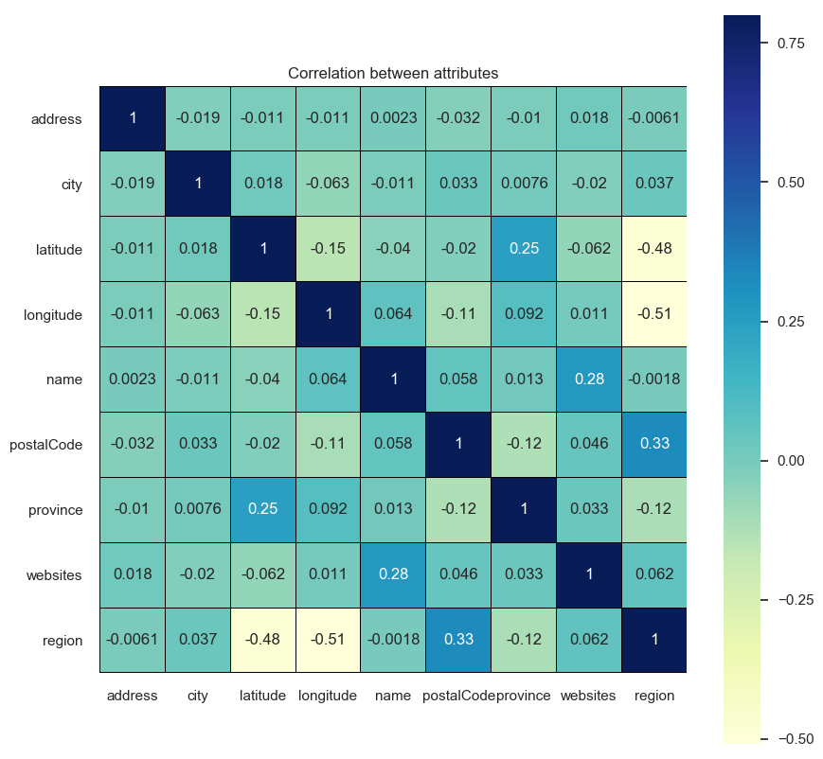
Correlation Matrix of Fast Food Restaurants

Slide 18
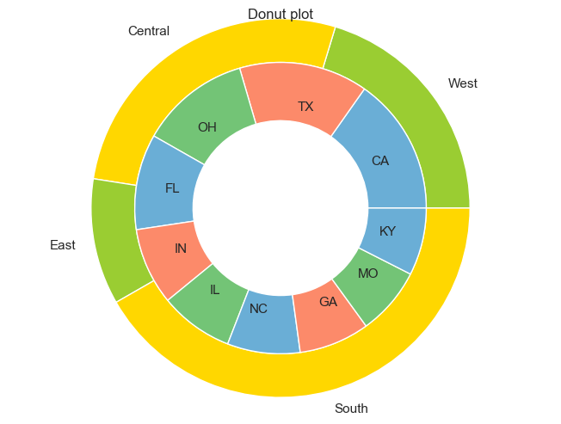
Donut Plot with Regions and Top 10 Provinces

Slide 19
Conclusion
Post cleaning the name and province features, we were able to consolidate the restaurant names and group them correctly.
We also created a new feature region that helped us to understand the distribution region wise.
We also used profiling feature to generate html reports (both pre and post cleaning) resulting in the information about the attributes present in the dataset.
This analysis will help the stakeholders (existing restaurants management, new entrepreneurs and food delivery chains) to understand the presence of top 10 and bottom 10 restaurants, provinces and cities to explore opportunities in new regions, provinces and cities

