Slide 1
About Deloitte Deloitte refers to one or more of Deloitte Touche Tohmatsu Limited, a UK private company limited by guarantee (“DTTL”), its network of member firms, and their related entities. DTTL and each of its member firms are legally separate and independent entities. DTTL (also referred to as “Deloitte Global”) does not provide services to clients. In the United States, Deloitte refers to one or more of the US member firms of DTTL, their related entities that operate using the “Deloitte” name in the United States and their respective affiliates. Certain services may not be available to attest clients under the rules and regulations of public accounting. Please see www.deloitte.com/about to learn more about our global network of member firms. Copyright © 2017 Deloitte Development LLC. All rights reserved.

Slide 2

Timesaver
Charts, tables, diagrams, icons and more

Slide 3
Contents:
Introduction
Data Structures
Strings
Object Oriented Programming
File Handling
Exceptions
Docstrings

Slide 4
Introduction
Open-sourced
Interpreted language.
Extensive support libraries
Object Oriented
Everything in Python is an object, and almost everything has attributes and methods.
According to a recent survey, in the UK in 2015, Python overtook French to be the most popular language taught in primary schools. Out of 10, 6 parents preferred their children to learn Python over French.
MyScript.py
MyScript.pyc
Python Virtual Machine
Source Code
Byte Code
Python runtime execution model

Slide 5
Data Structures
Python has four basic inbuilt data structures namely Lists, Dictionary, Tuple and Set.
List is a collection which is ordered and changeable. Allows duplicate members. Eg: [1, 2, 3, 4, 5, 6, 7, 8, 9, 10]
Dictionary is a collection which is unordered, changeable and indexed. No duplicate members. Eg: { 'Mango': 100, 'Apple': 80, 'Guava': 60, 'Grape': [10, 20] }
Tuple is a collection which is ordered and unchangeable. Allows duplicate members. Eg : (1, 2, 3, ‘Hello’)
Set is a collection which is unordered and unindexed. No duplicate members. Eg: set([1, 2, 3, 4, 5, 6, 7])
Notes:
One-liner definition

Slide 6

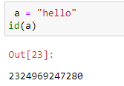
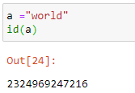
Strings
Strings in Python are arrays of bytes representing unicode characters.
String literals in python are surrounded by either single quotation marks, or double quotation marks.
Python strings are immutable in nature.

Slide 7
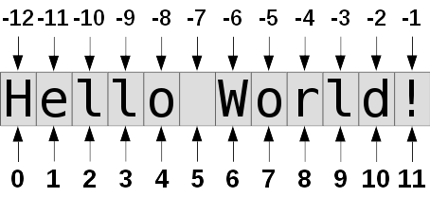
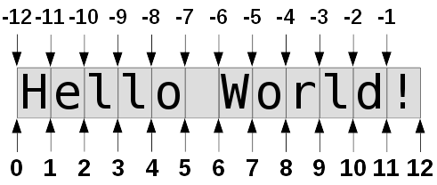
Strings
Indexing
Slicing

Slide 8
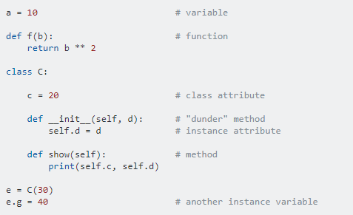
Object Oriented Programming
Object-orientated programming is programming with custom data types. In Python that means using classes and instances.
Methods and attributes
self represents the instance of the class.
__init__ is a special method, and it's ran when a new instance of a class is created. It does nothing by default.
Class.method(instance) does the same thing as instance.method(). This also works with built-in classes, for example 'hello'.lower() is same as str.lower('hello')
Notes:
A variable stored in an instance or class is called an attribute.
A function stored in an instance or class is called a method.

Slide 9
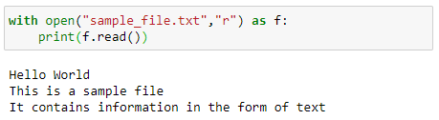
File Handling
Python supports file handling and allows users to handle files i.e., to read and write files, along with many other file handling options, to operate on files.
“r”, for reading
“w”, for writing
“a”, for appending
“r+”, for both reading and writing
Python treats file differently as text or binary.
Each line of code includes a sequence of characters and they form text file.
Each line of a file is terminated with a special character, called the EOL (End of Line). It ends the current line and tells the interpreter a new one has begun.

Slide 10
Exceptions
An error that can occur in our program. If an exception occurs, the program will stop and we get an error message. The interactive prompt will display an error message and keep going.
try
except
Exceptions are classes and they can be used just like all other classes.
The try and except keywords can be used for attempting to do something and then doing something else if we get an error. This is known as catching exceptions.
It's possible to raise exceptions with the raise keyword. This is also known as throwing exceptions.
Raise exceptions if they are meant to be displayed for programmers and use sys.stderr and sys.exit otherwise.

Slide 11
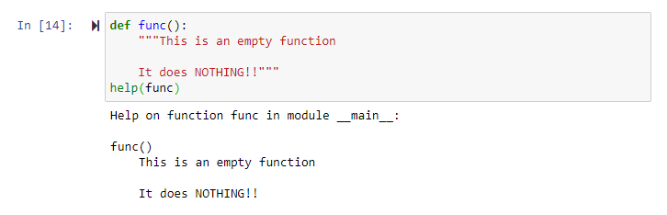
Docstrings
Python documentation strings (or docstrings) provide a convenient way of associating documentation with Python modules, functions, classes, and methods.
Docstrings are quite helpful when writing code that other people will import.
Helps other people reading your code in understanding the purpose it, without having to read through all of the code.

Slide 12
